Slide 1
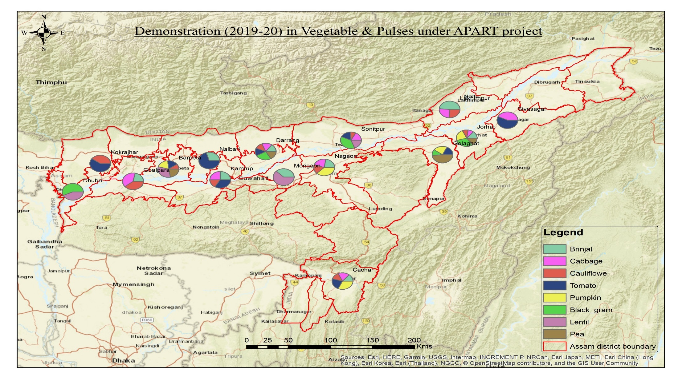
District-wise interventions of WorldVeg in APART

Slide 2
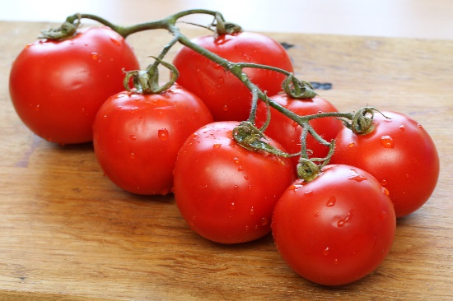
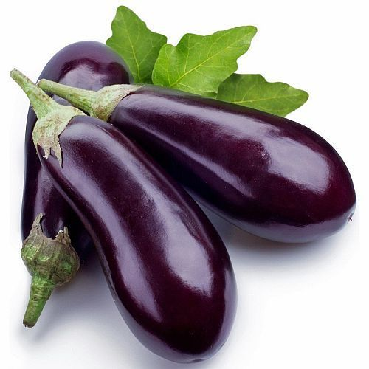
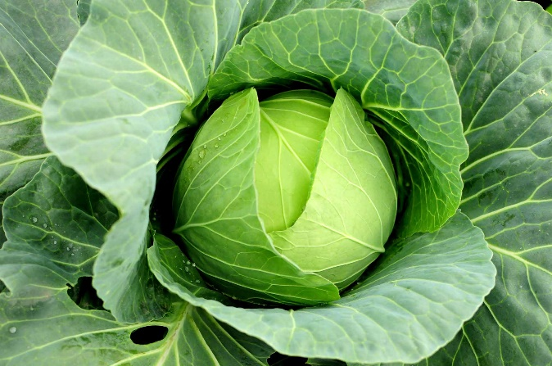
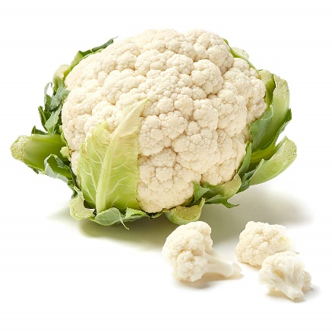
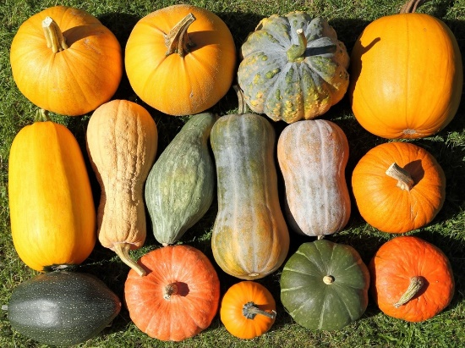
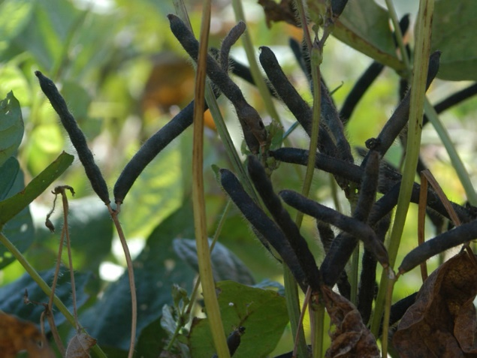
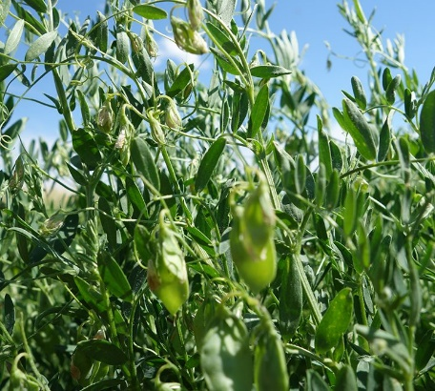
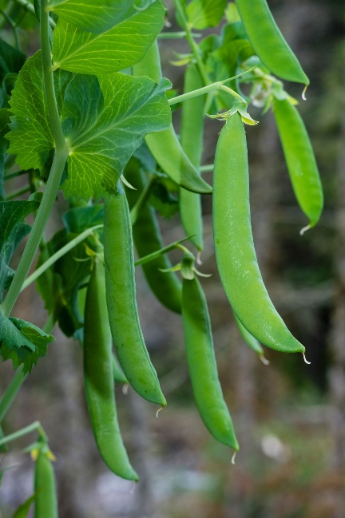
Vegetables and Pulses under WorldVeg in APART
Tomato
Brinjal
Cauliflower
Cabbage
Pumpkin
Black gram
Lentil
Pea

Slide 3
Part B: Promoting the adoption of climate resilient good agricultural practices B2: Application of integrated pest management (IPM) systems for reduced pesticide usage for all legume and non-legume crops
IPM demonstration conducted in 2019-20
Large, community-level demonstrations
One IPM community for each of the 8 crops
7-10 ha total area; of which 4 – 5 ha IPM demonstration area and 3 – 5 ha farmers’ practice. Total 80 ha of area covered
Crop production practices similar to regular climate resilient demonstrations

Slide 4
Details on the community-level IPM demonstrations
Part B: Promoting the adoption of climate resilient good agricultural practices B2: Application of integrated pest management (IPM) systems for reduced pesticide usage for all legume and non-legume crops
Crop | District | No. of farmers engaged
Brinjal | Darrang | 51
Cabbage | Kamrup | 10
Cauliflower | Barpeta | 10
Pumpkin | Jorhat (Titabor) | 25
Tomato | Golaghat | 5
Black gram | Jorhat (Majuli) | 10
Lentil | Sonitpur | 10
Pea | Golaghat (Bokakhat) | 10

Slide 5
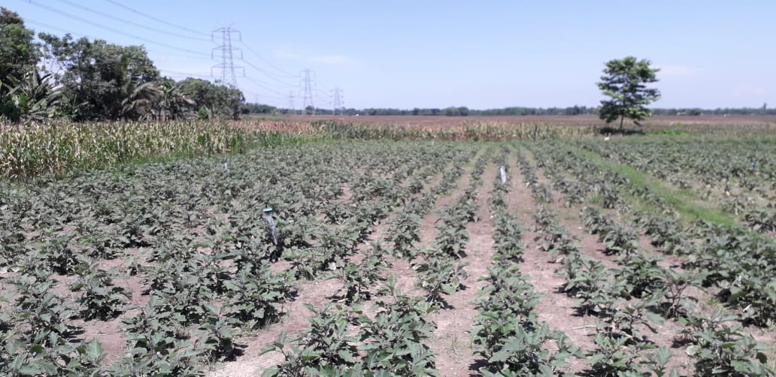
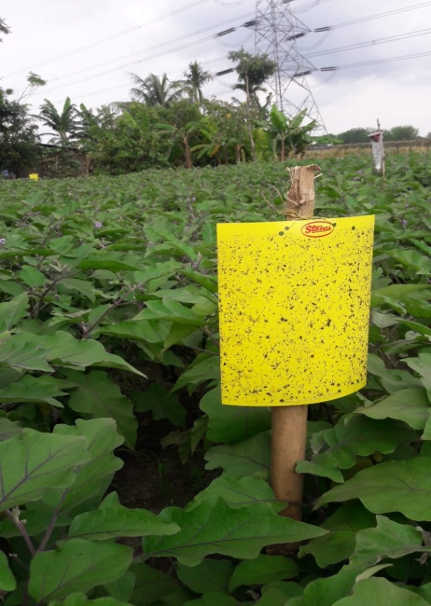
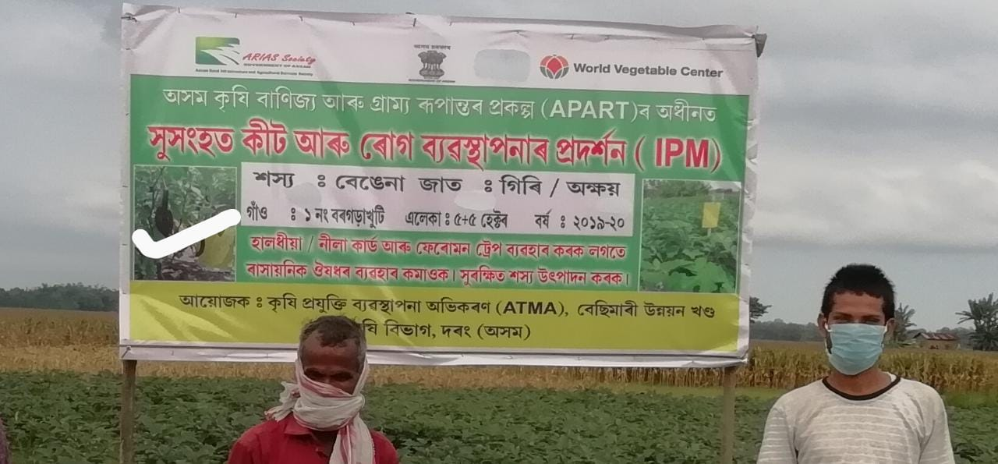
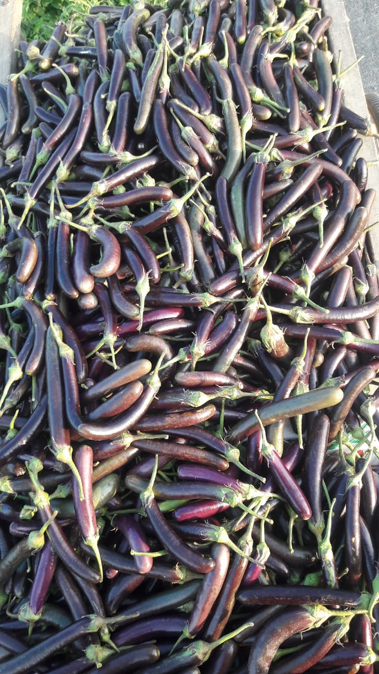
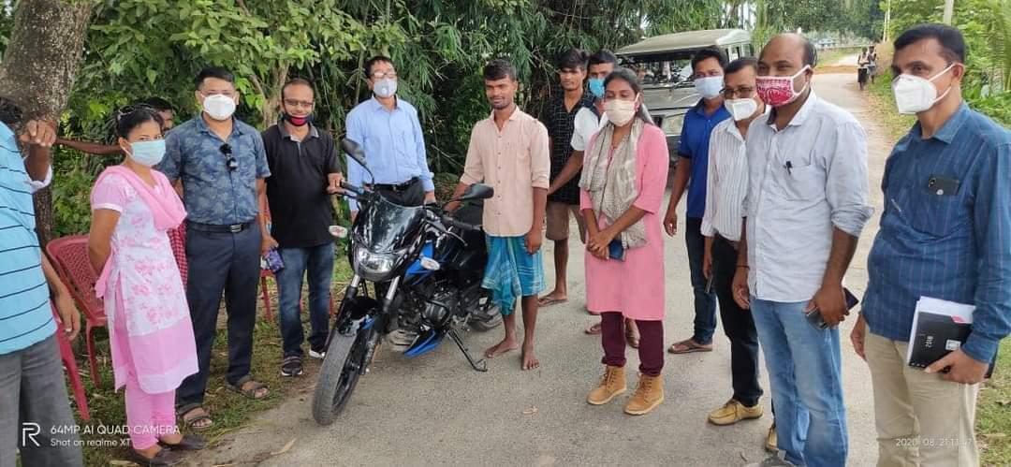
Impact of IPM-Brinjal, Darrang
The farmers have got around 15.25 % increased in production from demo plot as compared to control plot
Reduction in chemical use by 70% saving farmer’s cost of cultivation upto 60-70%, got more net income as compared to control plot
Prolonged harvesting, more than 40 pickings with an average of 1- 1.5 quintal brinjal harvested per picking.
Additional income for coriander (intercrop) and maize (border crop)
Group of 51 farmers involved have done market linkage as a group and is now in process of forming a FIG
The farmer group has taken up community cultivation and is growing early cabbage and cauliflower following cropping sequence
Md. Shadul Hoque, IPM beneficiary bought a bike from his income from brinjal cultivation. Visit of Ms. Laya Maduri, SPD, ARIASS

Slide 6
Production and Sale status of Brinjal under IPM- demonstration
Demo/ Control | Area (ha) | Total production (in quintals) | Total quantity sold (in quintals) | Minimum Rate (Rs per q) | Maximum Rate (Rs per q) | Average Rate (Rs per q)
Demo Plot | 5 ha | 1672.5 | 1650.25 | 1800.00 | 4000.00 | 2900.00
Control Plot | 5 ha | 1451.25 | 1417.87 | 1500.00 | 3500.00 | 2500.00
Total | 10 ha | 3123.75 | 3068.12 | 1500.00 | 4000.00 | 2750.00

Slide 7
Part B: Promoting the adoption of climate resilient good agricultural practices B2: Application of integrated pest management (IPM) systems for reduced pesticide usage for all legume and non-legume crops
Percentage reduction in chemical pesticides usage after WorldVeg intervention in vegetable and pulse production
Crops | Number of chemical sprays |  | Percentage reduction of chemical spray in demonstration plot
 | Demonstration | Control
Brinjal | 2 | 7 | 72
Cabbage | 2 | 4 | 50
Cauliflower | 2 | 4 | 50
Pumpkin | 1 | 3 | 66
Tomato | 3 | 5 | 40
Black gram | 2 | 3 | 33
Lentil | No chemical used
Pea | 1 | 2 | 50

Slide 8
Technologies introduced & promoted by WorldVeg
Seedling trays
Potting mixture
Enriched vermicompost
Transplanting media
Microbial bio-fertilizers
Microbial bio-control agents
Localized fertilizer application
Intercropping
Mulching
Line sowing in pulses
Rhizobia inoculation in pulses
Sticky traps
Pheromone traps
Trap crops
Border crops
Safer alternatives to conventional synthetic pesticides
Reduced rates of agro-chemicals in demonstrations
Micronutrients
Personal protection equipment (PPE) for farmers
Awareness on pesticide handling and application
Increase sustainability and climate resilience
Training to extension agents and farmers
Aim to: produce healthy, disease free seedlings with good root system; intensify cropping; reduce synthetic agro-chemical use and dependence; create safer conditions for farmers, consumers and environment.

Slide 9
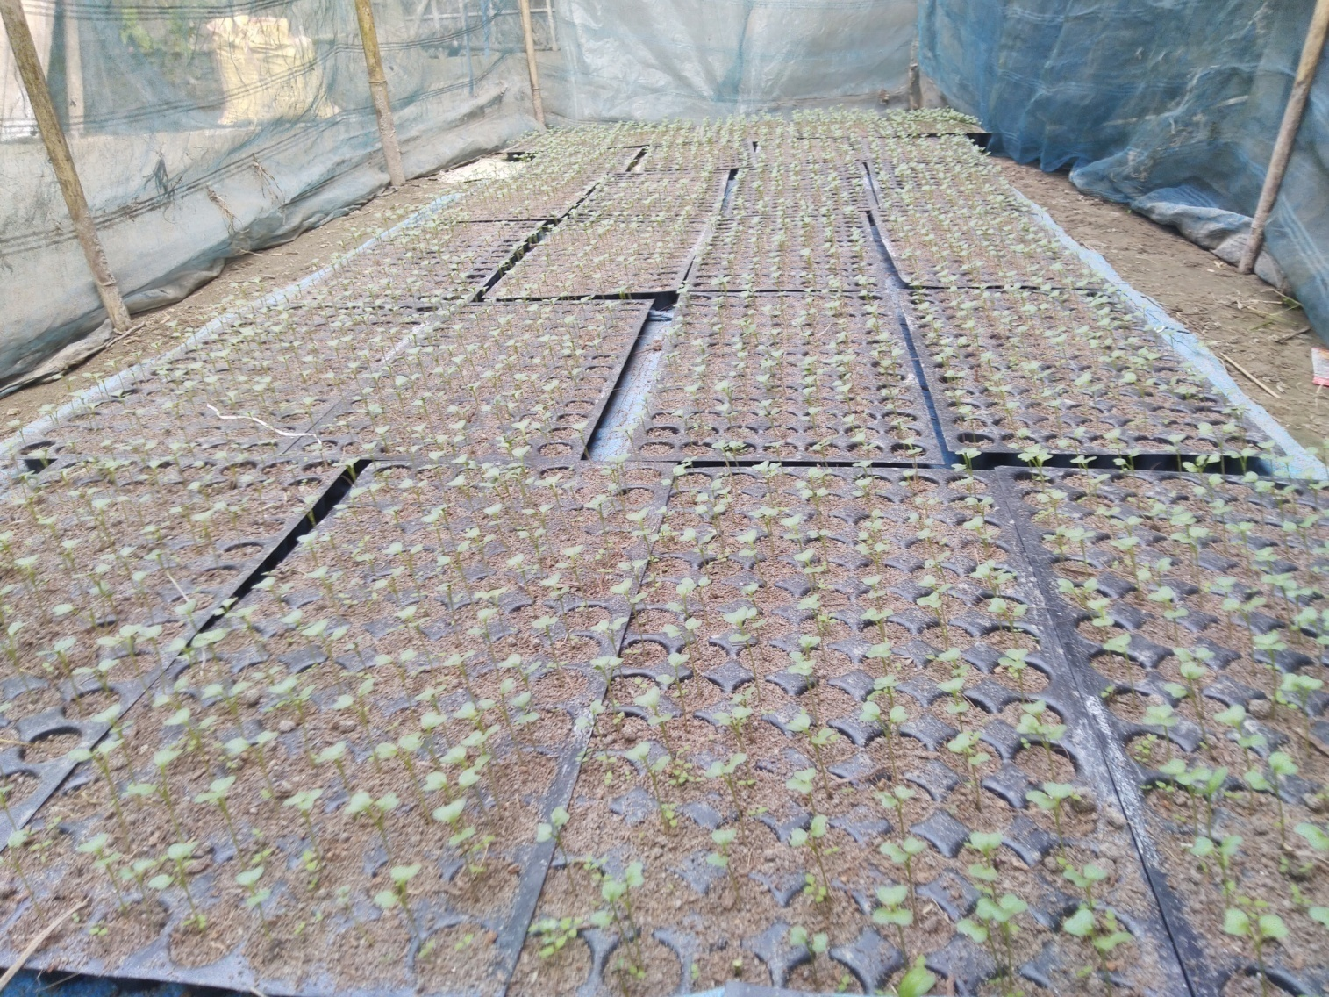
Seedling tray
Technologies introduced & promoted by WorldVeg
Healthier than seedlings from raised beds
Eliminates root damage
Minimize transplanting shock and risk of disease incidence
Cuts down on seed requirement
Easy to transport

Slide 10
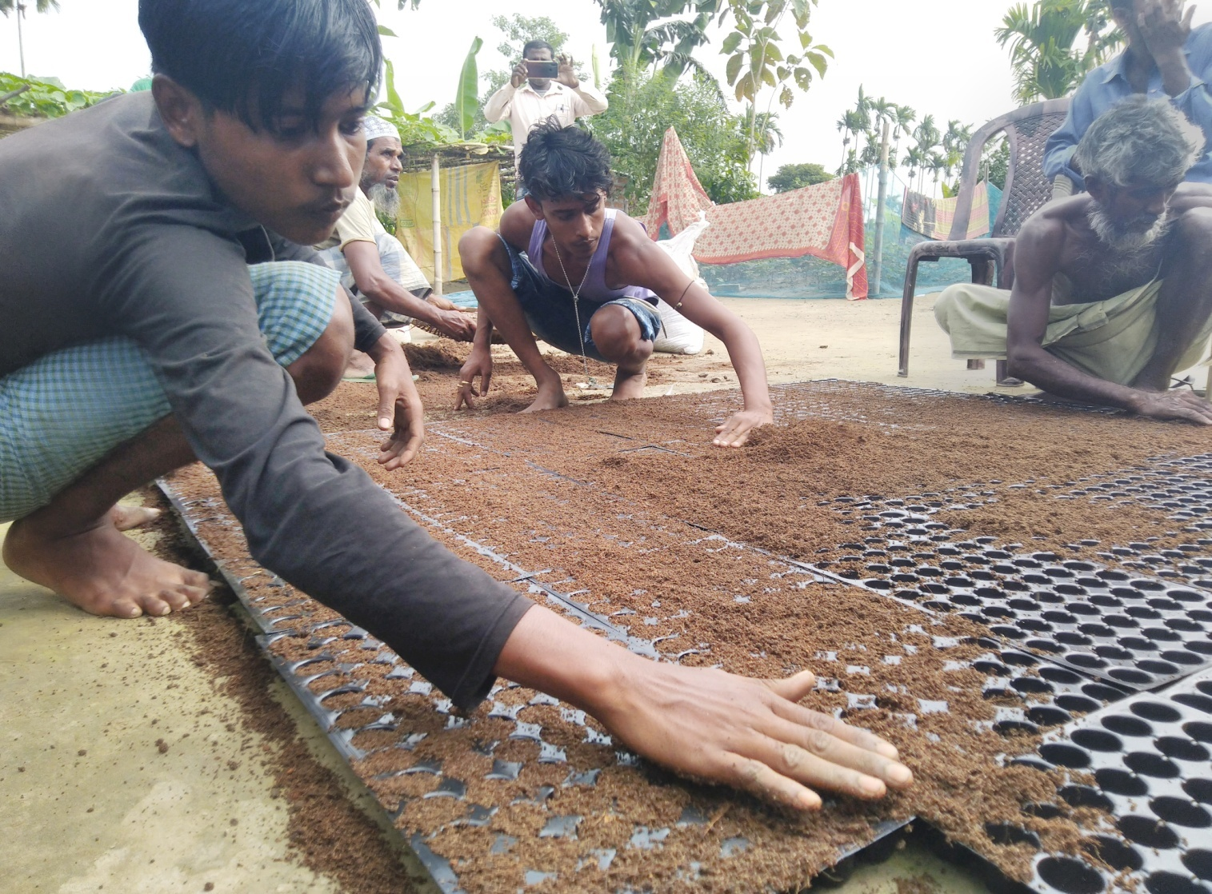
Soil-less Potting mixture
Technologies introduced & promoted by WorldVeg
3x coco-peat + 1x vermicompost + 1x charred rice husk
Plus microbial bio-fertilizers and bio-control agents
Well-matured vermicompost to be used
Soilless media
Lower risk of soil-borne diseases

Slide 11
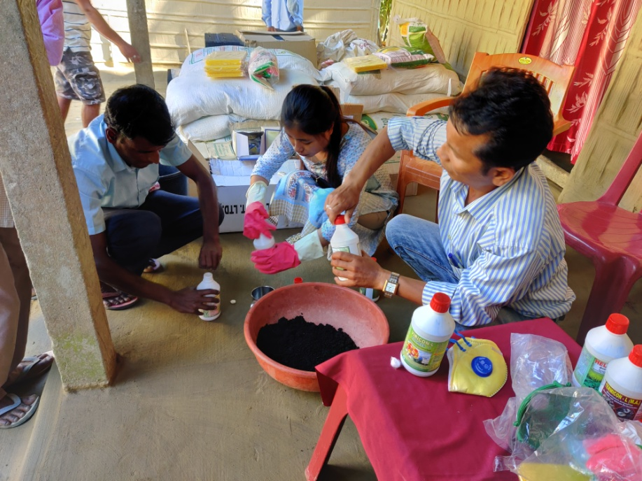
Enriched vermicompost
Technologies introduced & promoted by WorldVeg
Enriched using various microbial bio-fertilizers and bio-control agents
Incubated for 2 – 3 weeks following inoculation
Improves soil health

Slide 12
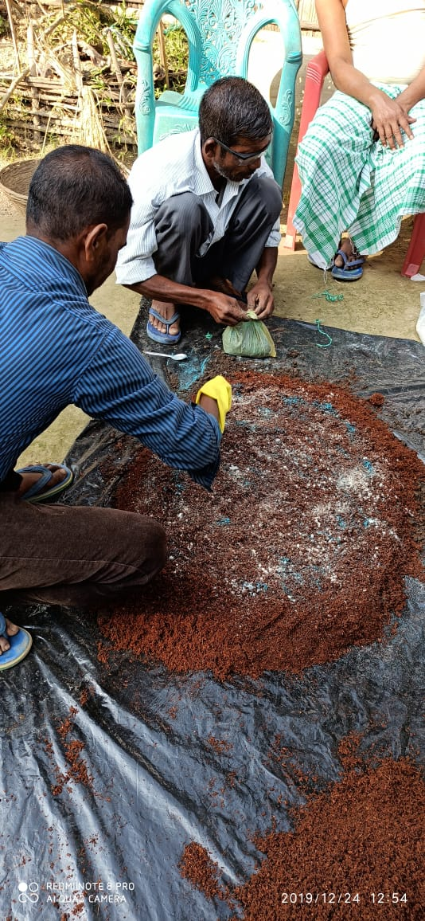
Transplanting media
Technologies introduced & promoted by WorldVeg
Promotes localized application of manure/compost/fertilizer
Enriched vermicompost + farmyard manure + reduced quantities of synthetic fertilizers
Applied into transplanting pits or planting furrows.
Increases nutrient availability and improves soil health

Slide 13
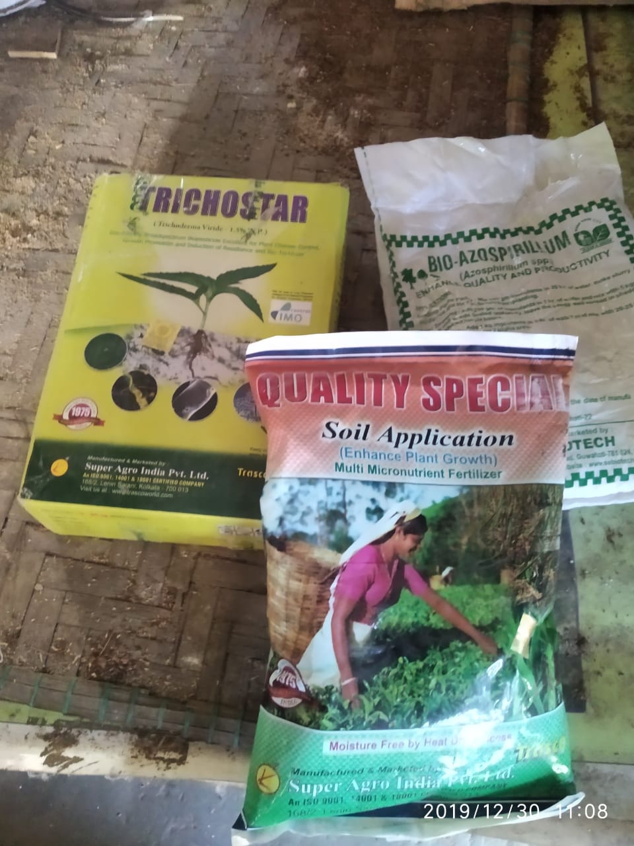
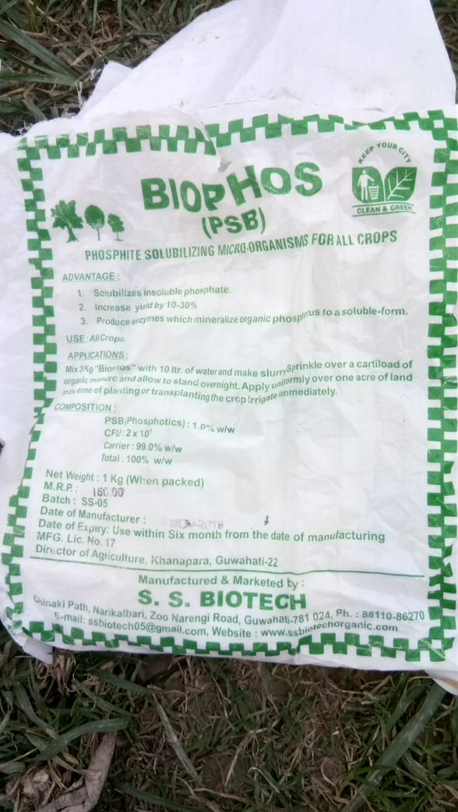
Microbial bio-fertilizers and bio-control agents
Technologies introduced & promoted by WorldVeg
Bio-fertilizers:
Azotobacter
Azospirillum
Rhizobium
Phosphorus solubilizing bacteria (PSB)
Bio-control agents:
Trichoderma
Pseudomonas
Beauveria
Metarhizium
Increases nutrient availability, soil fertility, and lowers pest damage

Slide 14
Source of procurement of bio fertilizers and bio agents
District | Vendor detail
Nagaon | Balark Biotech, B. M. Road, Amolapatty, Nagaon
Morigaon | Nazrul Islam, Krishi Vikas Kendra, Burbondha, Morigaon
Kokrajhar | National Seed Nursery, Boro Bazar Road, Kokrajhar
Kamrup | S H Enterprise, Barpeta Road, Assam 781315
Nalbari | Maa Trading, L N B Road, Nalbari
Sivasagar | Haque Beej Bhandhar, Central Market, Sivasagar
Jorhat | Surabhi Agro Service, Demow
Sonitpur | Sonitpur Nursery, Chawk Bazaar, Tezpur
Cachar | Seed House, Opp. Silchar Court, Cachar
Lakhimpur | Assam Beej Bhandar, Bazaarpati Road, North Lakhimpur
Barpeta | Kohinor Beej Bhandar, Barpeta Road, Barpeta
Golaghat | Vishal Organics and Research Centre, Jorhat
Goalpara | Goalpara Seed House, Opp. Canara Bank, Near ASTC, Goalapara
Darrang | Ahmed Agro Care, Dhula/ Rahman Agro Agency, Kkarupetia, Darrang

Slide 15
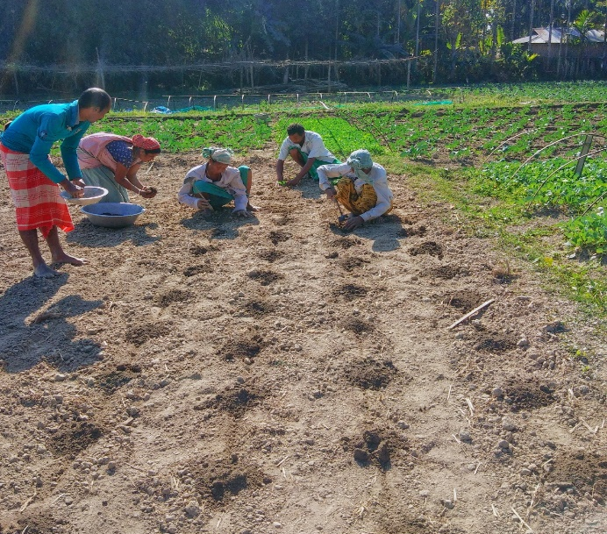
Localized fertilizer application
Technologies introduced & promoted by WorldVeg
Instead of broadcasting over entire field area
Localized application to root zone of individual plants
Through transplanting media
Increases fertilizer use efficiency and soil fertility
Reduces fertilizer requirement

Slide 16
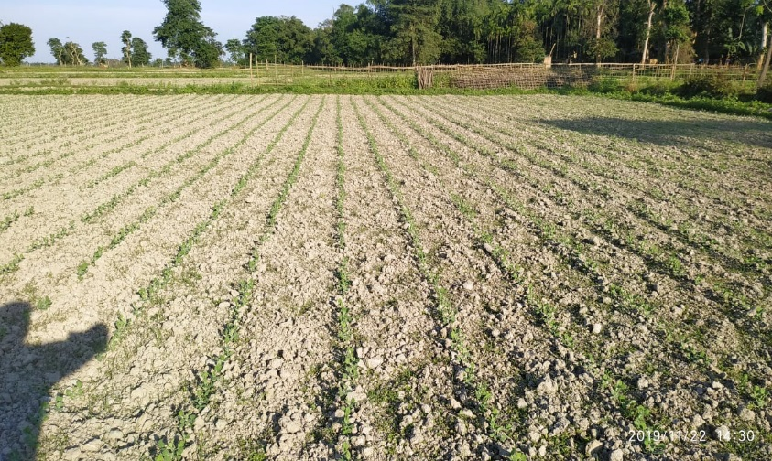
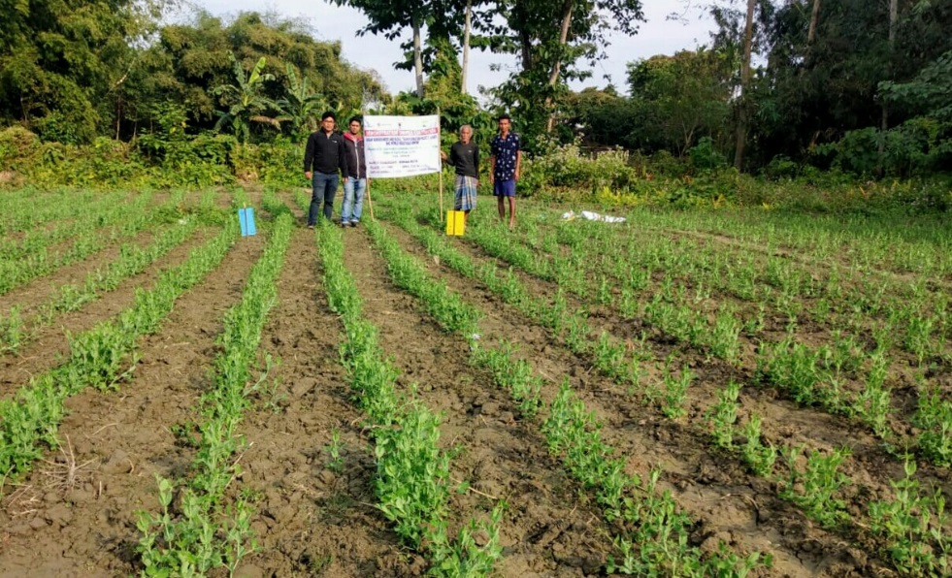
Line sowing in pulses
Technologies introduced & promoted by WorldVeg
Reduces seed requirement
Facilitates inter-cultural operations
Weeding
Balanced competition among crop plants
Less disease/ insect pest incidence
Line sowing/planting in lentil [left], compared with broadcasting [right]
Line sowing in black gram
Line sowing in pea

Slide 17
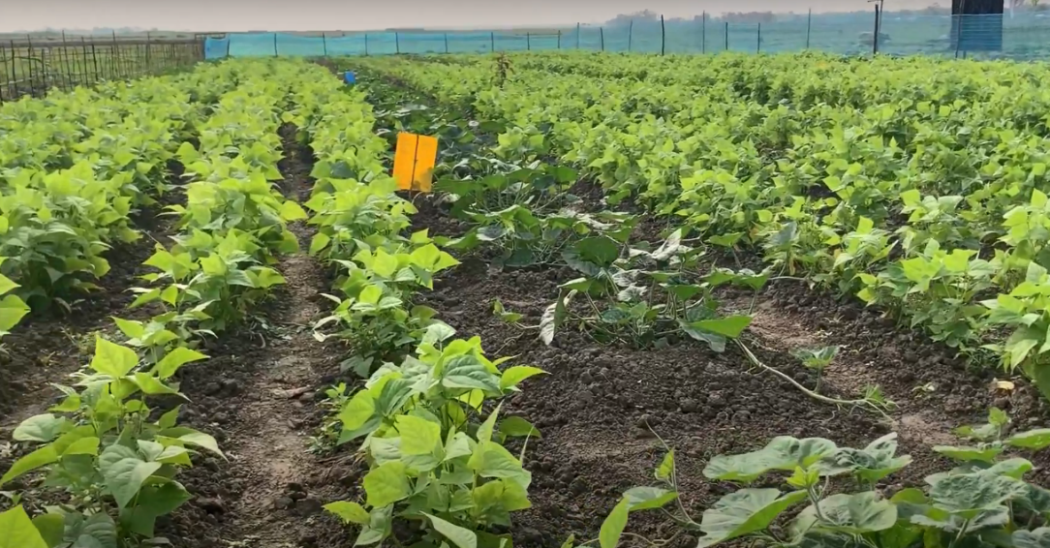
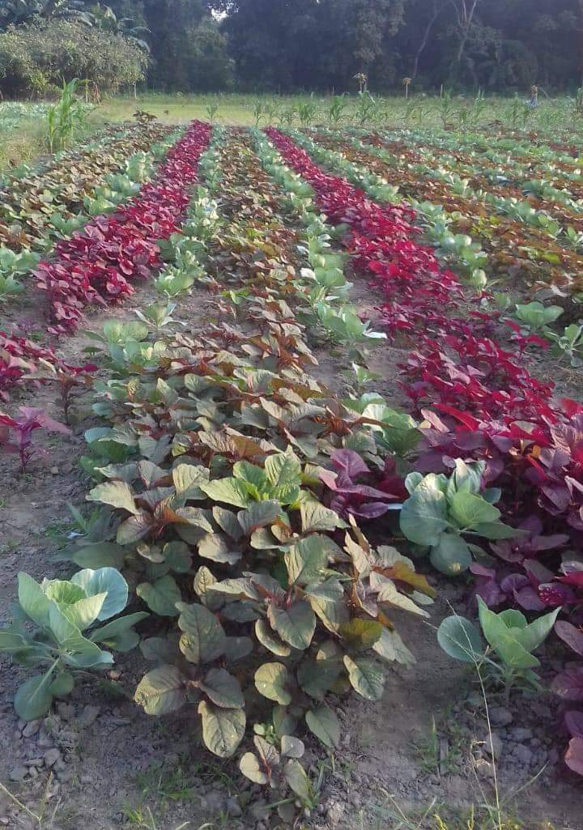
Intercropping
Technologies introduced & promoted by WorldVeg
With quick-growing, short-duration cash crop
Increases returns
Reduces risk
Intensifies cropping
Use time required for ground-cover by cash crop
Increases resource utilization/biomass production
Amaranth in brinjal, cabbage and tomato; coriander in cauliflower; beans in pumpkin
Beans as intercrop in pumpkin
Amaranth as an intercrop with cabbage

Slide 18
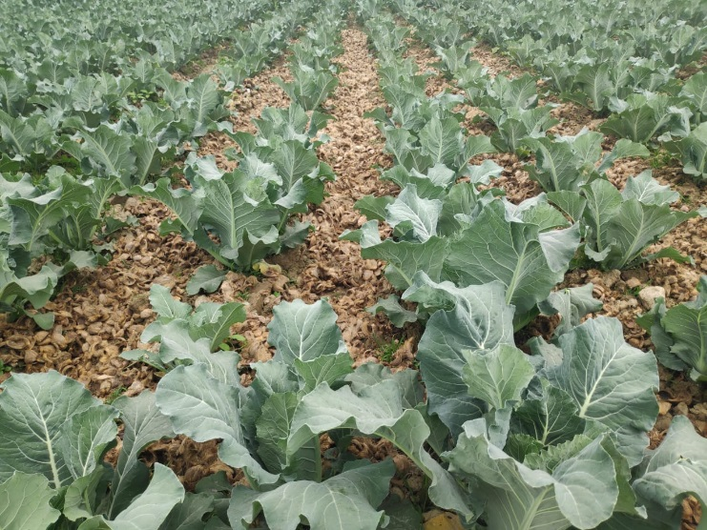
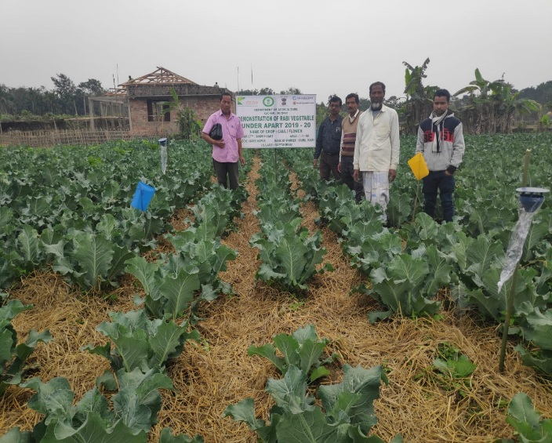
Mulching
Technologies introduced & promoted by WorldVeg
Covering soil surface with rice straw, arecanut husk, etc.
Locally available, biodegradable
Use of residue considered waste/burden in many areas
Increases soil organic matter, soil microbial populations
Conserves soil and soil moisture
Use of rice straw as mulch in tomato
Use of Arecanut husk (left) and rice straw (right) as mulch in cauliflower

Slide 19
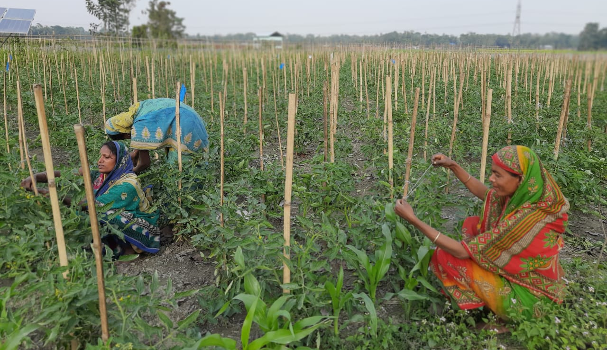
Staking in tomato
Technologies introduced & promoted by WorldVeg
Keeps plants erect
Prevents contact of fruits with soil
Increases air circulation
Reduces disease incidence
Improves fruit quality
Makes intercultural operation easier

Slide 20
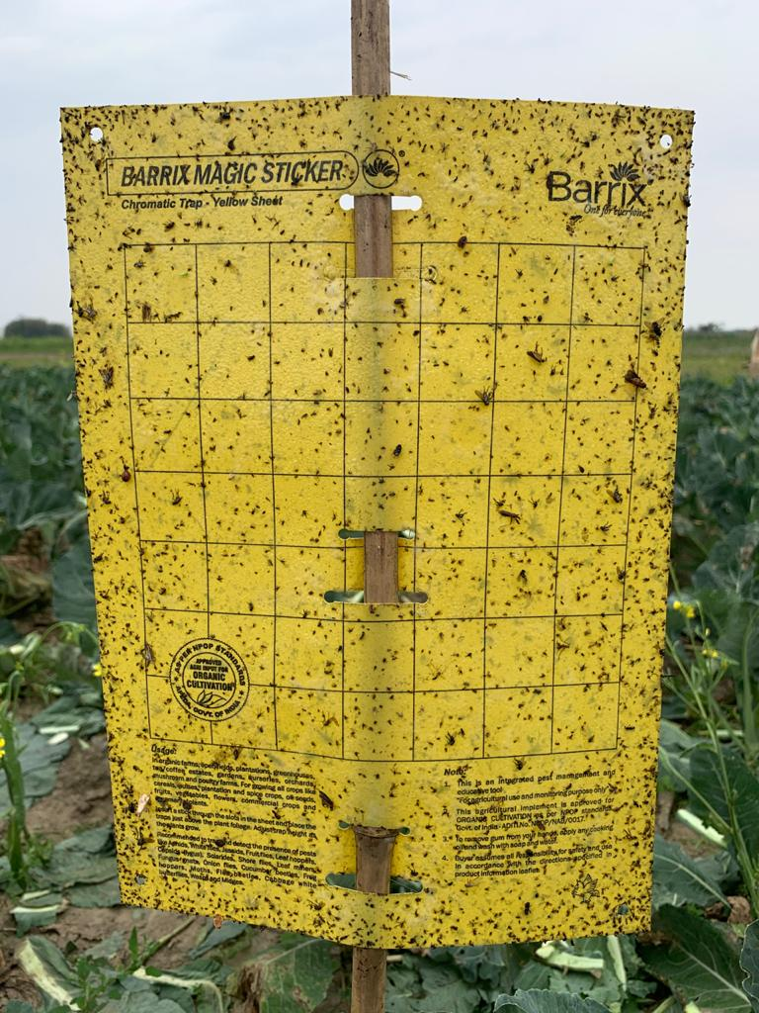
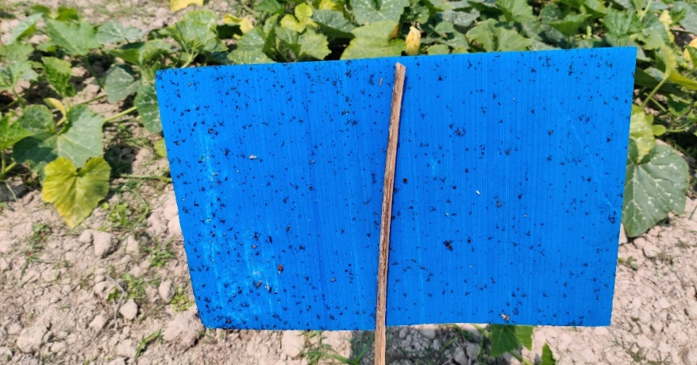
Sticky traps
Technologies introduced & promoted by WorldVeg
Yellow and blue
Different insect pests attracted to different colors
e.g., whitefly to yellow
Thrips to blue
Traps on to adhesive surface
Blue sticky trap
Yellow sticky trap

Slide 21
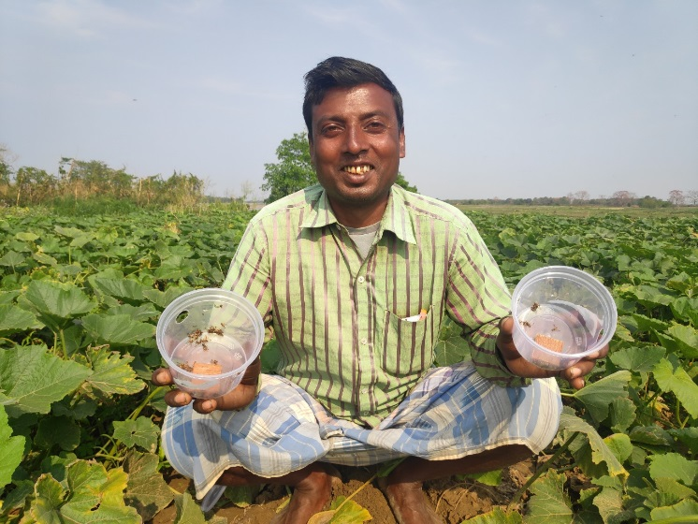
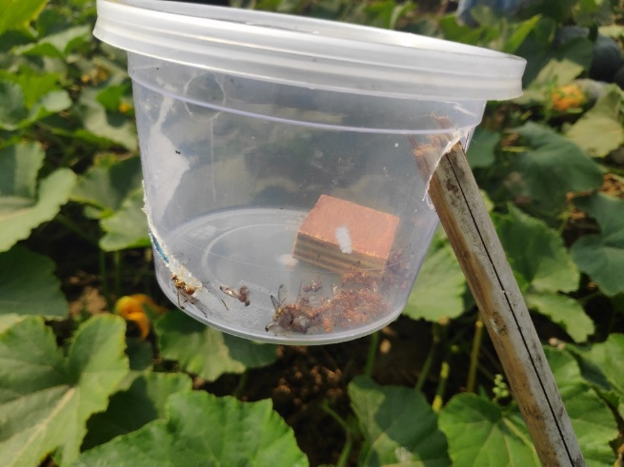
Pheromone traps
Technologies introduced & promoted by WorldVeg
Attract target insects using species-specific lures and traps them
Fruit and shoot borer lures in brinjal
Spodo lures for Spodoptera in cabbage and cauliflower
Lures for fruitfly in pumpkin
Heli lures for Helicoverpa in tomato, black gram, lentil and pea

Slide 22
Trap crops
Technologies introduced & promoted by WorldVeg
Crop-specific plant species
Attract insect pests
Keep them away from main crop
Pesticide application on trap crop if needed
Keep main crop safe from pesticide residues
Mustard in cabbage and cauliflower
African marigold in pumpkin, tomato, black gram, lentil and pea

Slide 23
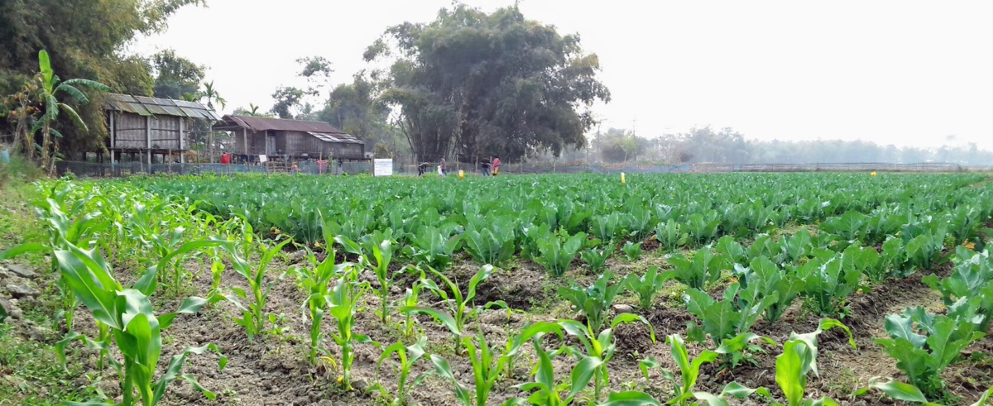
Border crops
Technologies introduced & promoted by WorldVeg
Quick-growing, tall, dense plants
Planted along field boundary
Physical deterrent to entry of insect pests
Maize for all crops
Maize as a border crop in pumpkin (top) & cauliflower (below)

Slide 24
Technologies introduced & promoted by WorldVeg
Safer alternatives to conventional pesticides
Reduced rates of agro-chemicals
Neem oil
Salts of fatty acids (e.g., Lastraw®)
Foliar applications of Beauveria and Metarhizium
In demonstrations
Reduced quantities of fertilizers
Reduced budget for conventional pesticides
To create awareness
Facilitate use of IPM components

Slide 25
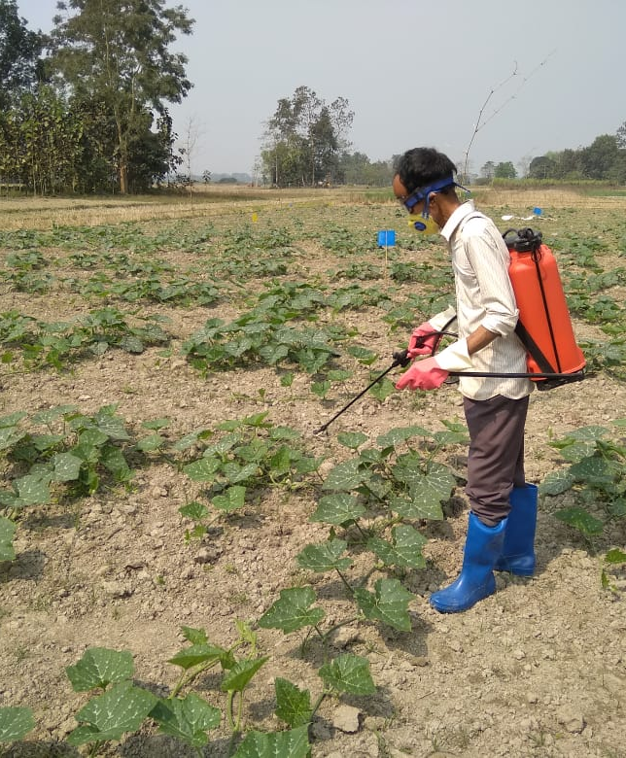
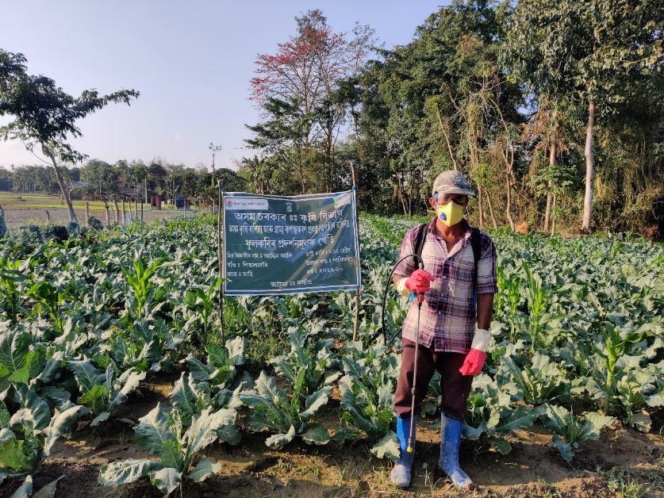
Personal protection equipment for farmers
Technologies introduced & promoted by WorldVeg
Awareness on use of safety gear
During pesticide handling and application
Reduce health risks to farmers
Gloves
Nose masks
Safety goggles [eyewear]
Gum boots

Slide 26
Economic analysis of the demonstration (Cost: Benefit)
Crops | Demonstration cost |  | Assessment on 2019-20 demos (Rs)
 | (Veg: 0.15 ha & Pulse: 0.25ha)
 | Demo (Rs.) | For 1 ha (Rs.) | Demo area (ha) | Average yield per ha (t/ha) | Market price per ton (Rs.) | Total income per ha (Rs.) | Cost: Benefit
Brinjal | 12,284 | 81,893 | 16.2 | 29 | 15,000 | 435000 | 5.3
Cabbage | 13,240 | 88,266 | 16.8 | 28 | 13,000 | 364000 | 4.1
Cauliflower | 13,080 | 87,200 | 14.4 | 25 | 15,000 | 375000 | 4.3
Pumpkin | 16,326 | 1,08,840 | 16.8 | 25 | 18,000 | 450000 | 4.1
Tomato | 12,060 | 80,400 | 18.9 | 32 | 13,000 | 416000 | 5.2
Black gram | 7,353 | 29,412 | 40 | 0.85 | 80,000 | 68,000 | 2.31
Lentil | 7,518 | 30,072 | 25 | 1.50 | 80,000 | 120,000 | 4.00
Pea | 8,360 | 33,440 | 25 | 5.00 | 55,000 | 275,000 | 8.22

Slide 27
Rapid assessment of Adoption of technologies by farmers
Technologies promoted/introduced | Adoption percentage (%)
Use of seedling trays for production of healthy seedlings | 97
Preparation and use of enriched vermicompost, bio fertilizers and bio pesticides | 100 (of which 33% consider it as excellent technology)
Maize as border crop | 86.51
Use of trap crop | 40.25
Use of intercrop | 77
Use of yellow and blue sticky traps | 100 (of which 71% consider it to be an excellent technology)
Use of pheromone trap | 95
Line sowing in pulses | 60
Use of safety PPE kits | 54
A rapid assessment on adoption of technologies was conducted in 20% of beneficiary farmers of 2019-2020 in eight districts (Jorhat, Golaghat, Sivasagar, Cachar, Kamrup, Goalpara, Nalbari and Darrang)

Slide 28
Technical training on climate resilient and IPM technologies in vegetable and pulses
Year | Target group | Training topic | No. of training | Total participants | Male | Female
2018-19 | Farmers | Package of Practices on five vegetables and pulses | 66 | 1814 | 1444 | 370
2019-20 | ATMA officials | Improved Production Guides(IPGs) of vegetables & pulses | 17 | 281 | 232 | 49
 | Farmers | 1st Phase Training on IPGs | 111 | 3244 | 2658 | 586
 | Farmers | 2nd phase traing on IPGs | 31 | 737 | 546 | 191
Total |  |  | 225 | 6076 | 4880 | 1196

Slide 29
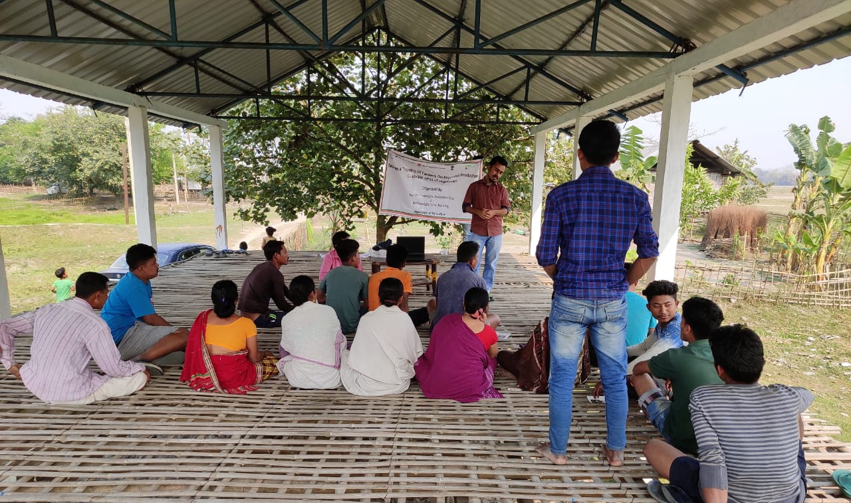
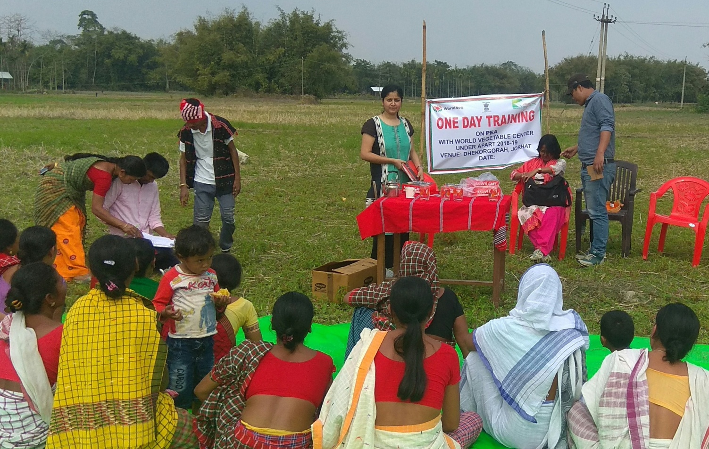
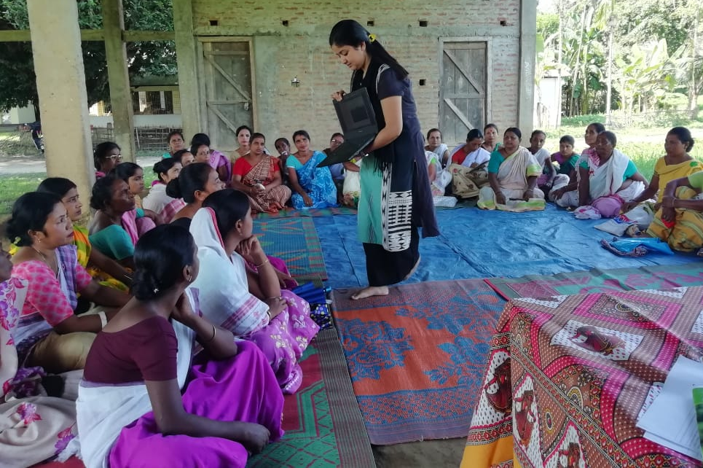
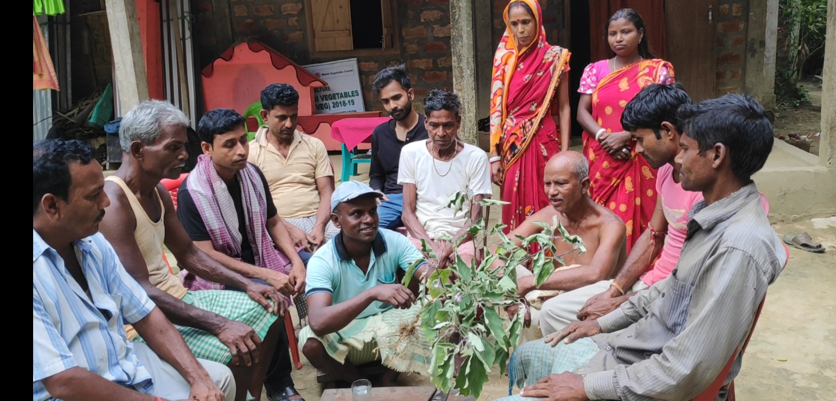
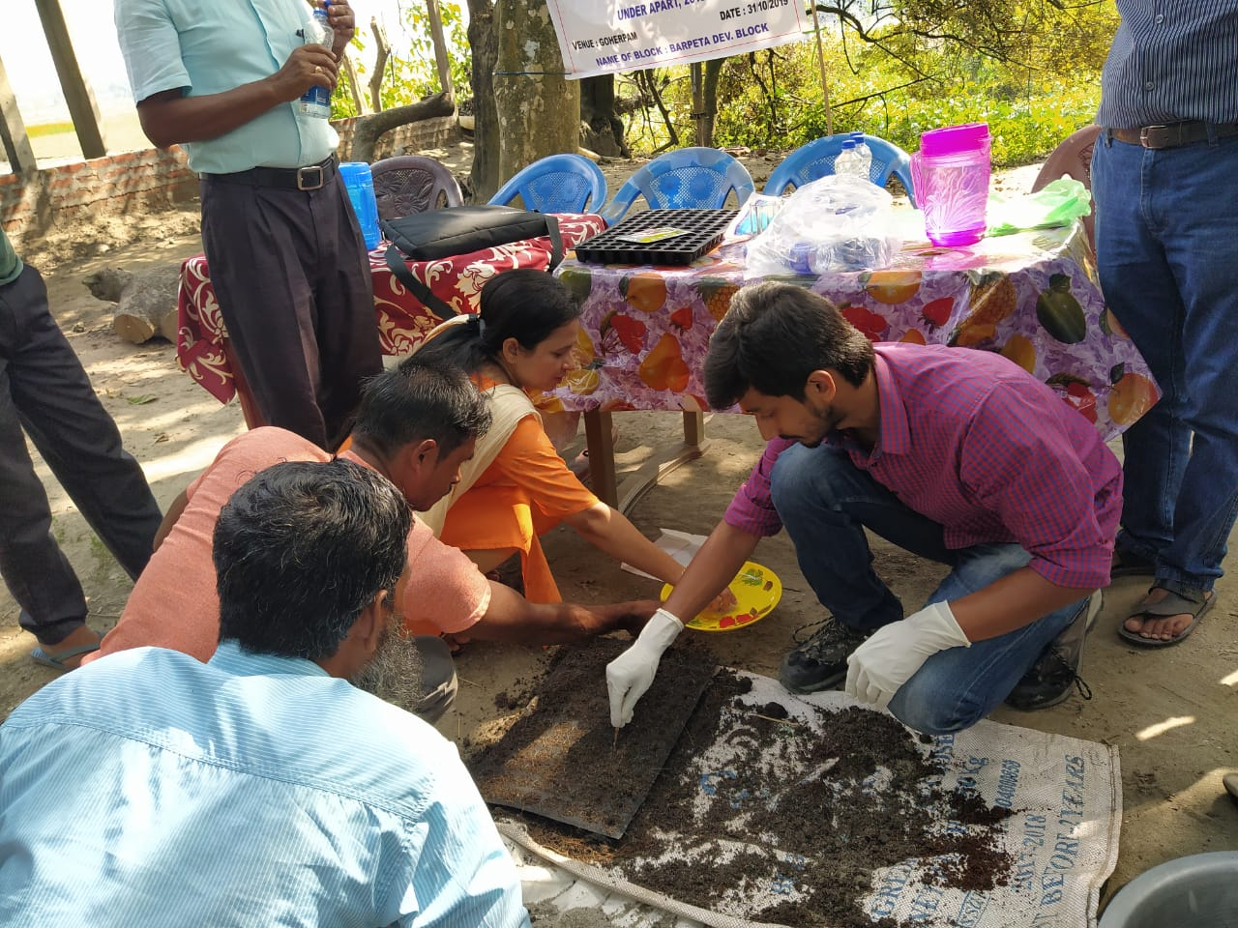
Technical training to farmers at different stages by WorldVeg team

Slide 30
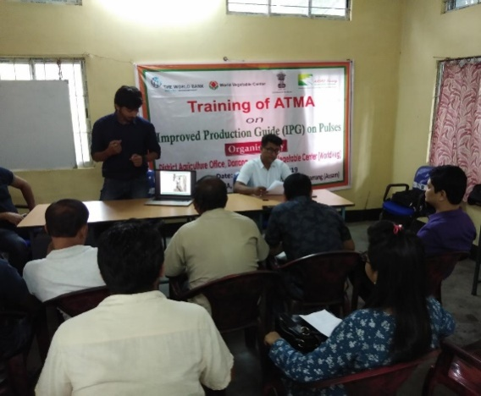
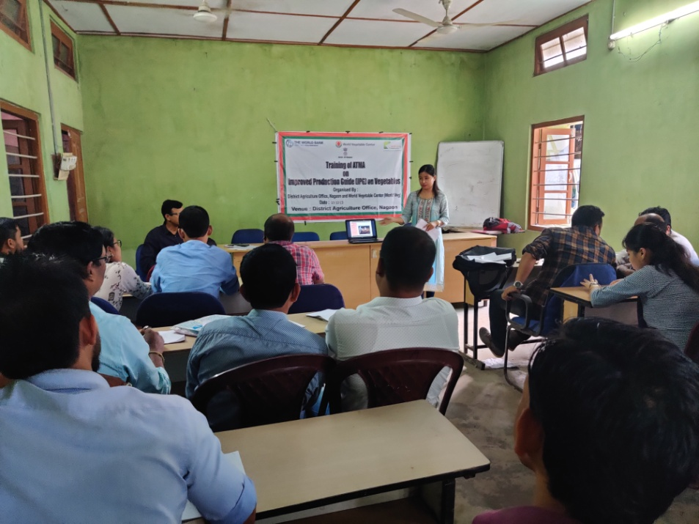
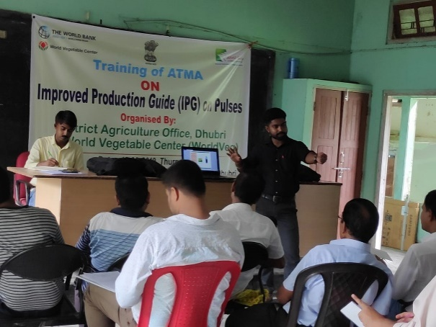
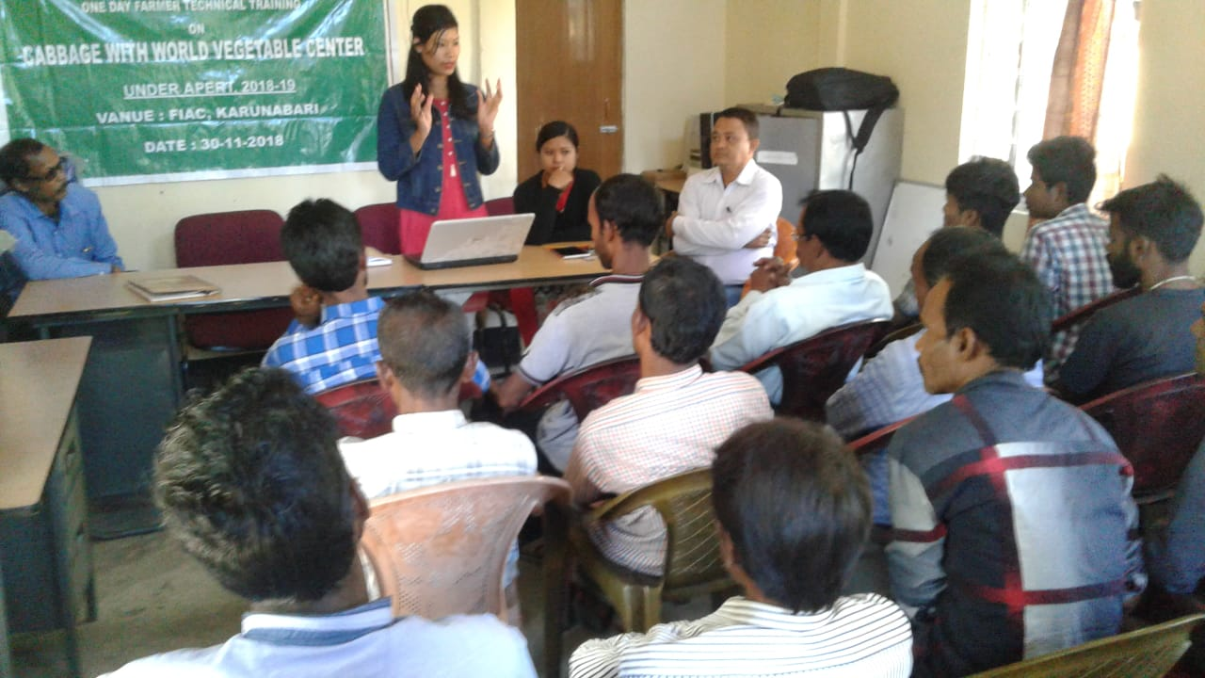
Technical training to district team by WorldVeg at different districts

Slide 31
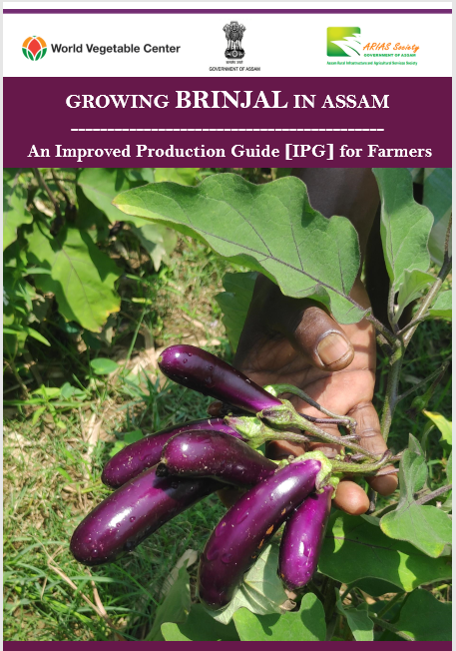
Crop manuals & Improved Production Guides (IPGs)
Training materials prepared by WorldVeg team
For 8 crops
Detailed instructions + tips
Crop production aspects + WorldVeg interventions
Nursery through harvest
Easy-to-use, comprehensive
Farmers + extension agents

Slide 32
Training materials prepared by WorldVeg team
Farmers’ friendly crop manuals and IPGs on 8 crops are shared with ARIASS and AAU and DoH&FP. WorldVeg shared the English versions of the crop manuals and IPGs to implementing partners for translation to local languages and distribution at district and farmers’ level

Slide 33
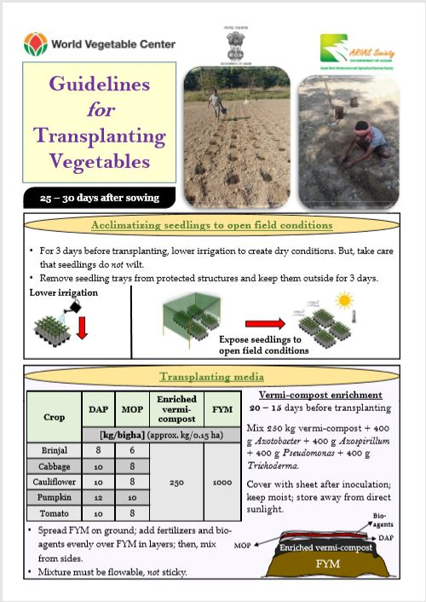
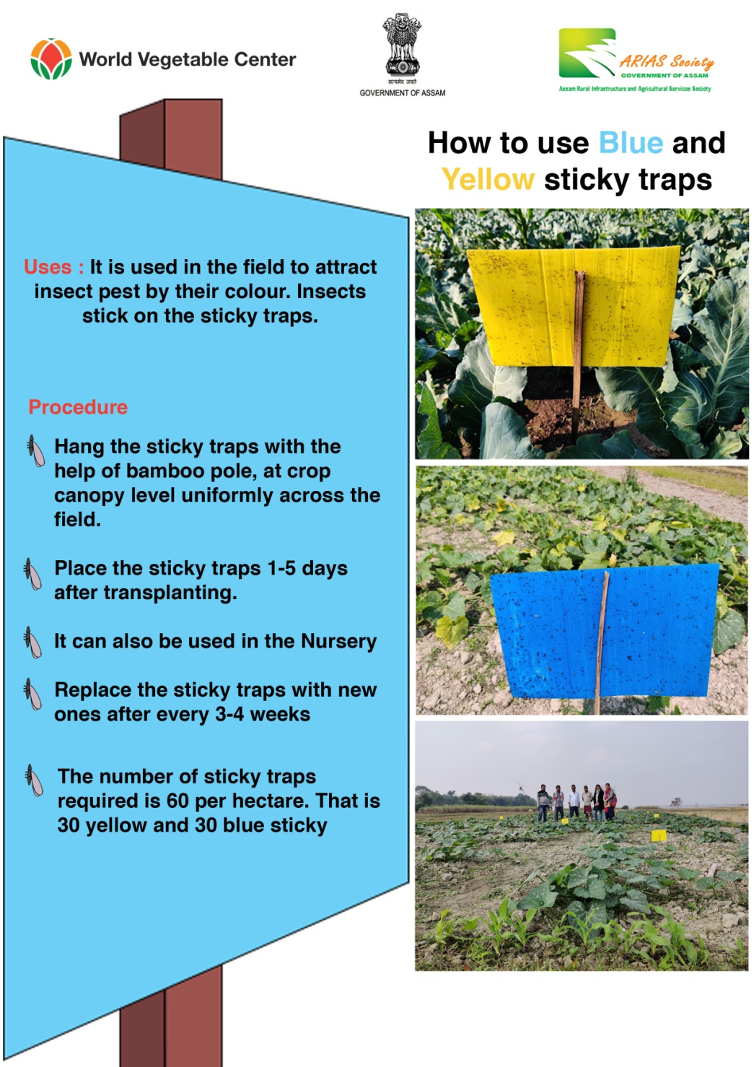
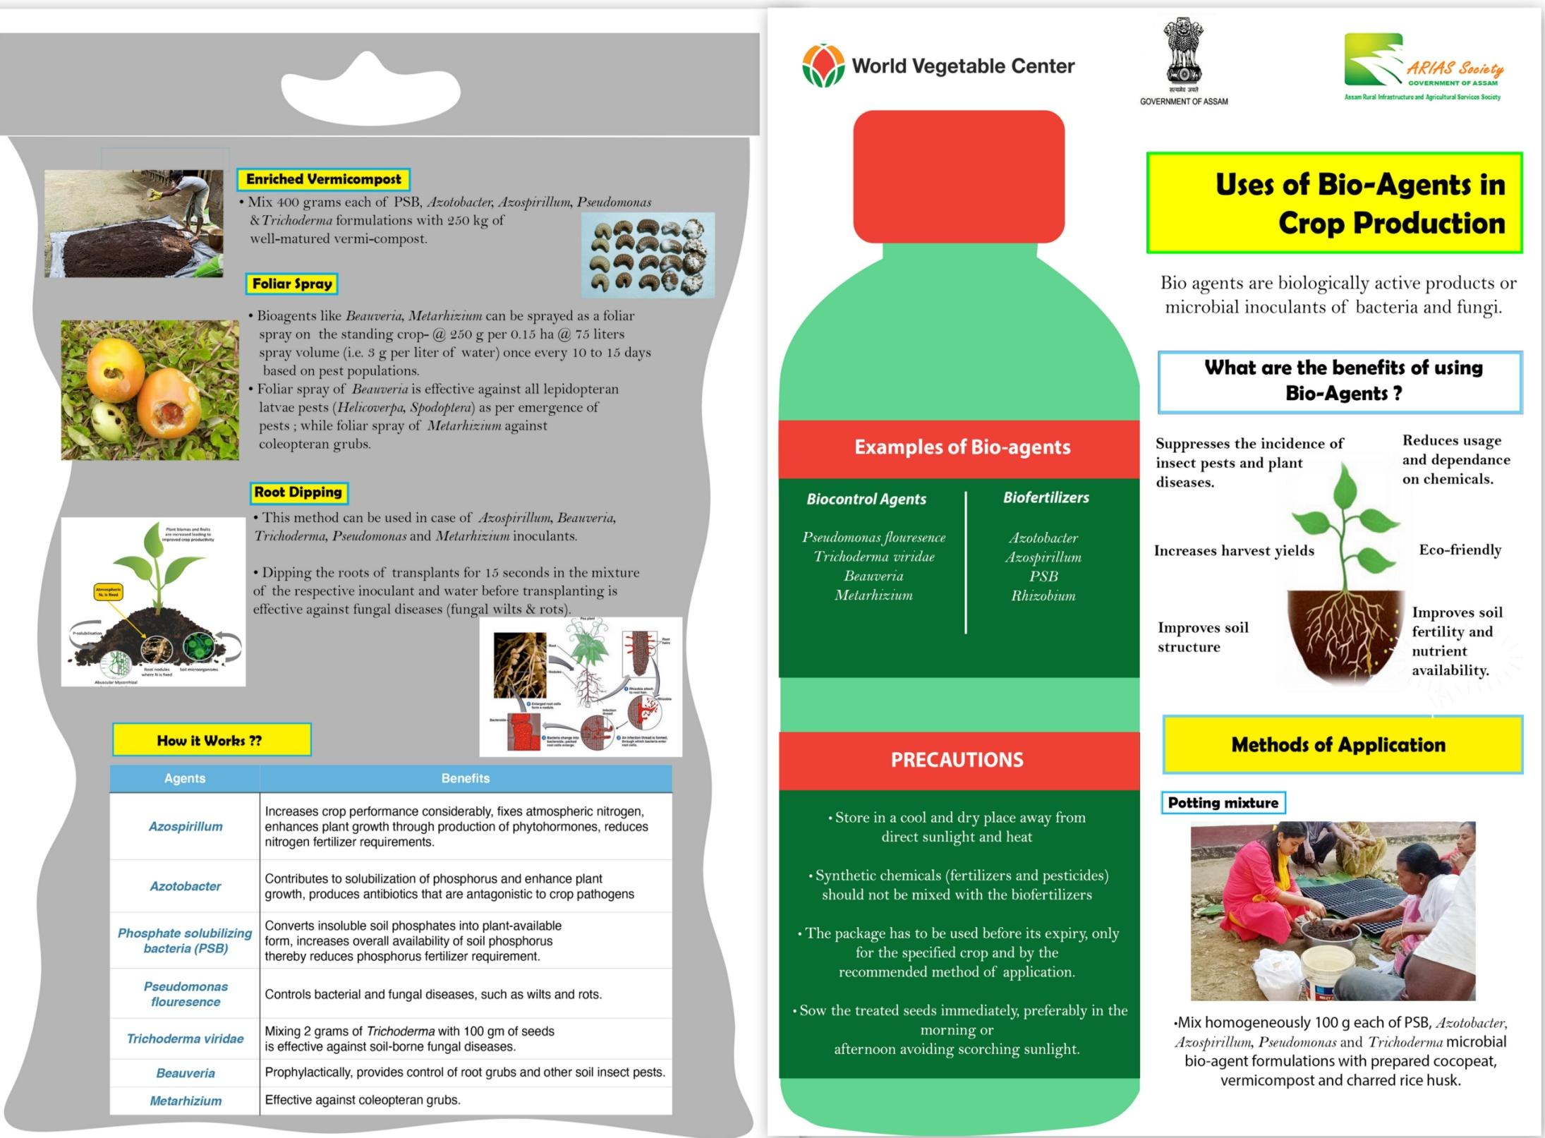
Leaflets
Training materials prepared by WorldVeg team
On specific topics
2-page hand-outs
Leaflets prepared under APART by WorldVeg are shared with implementing partners for translation and distribution.

Slide 34
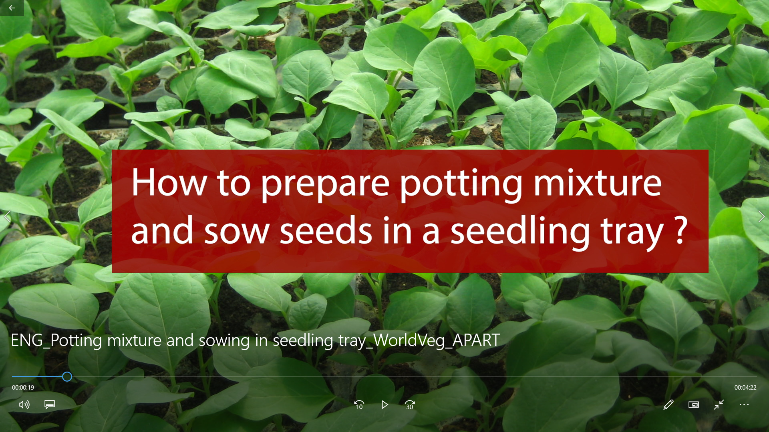
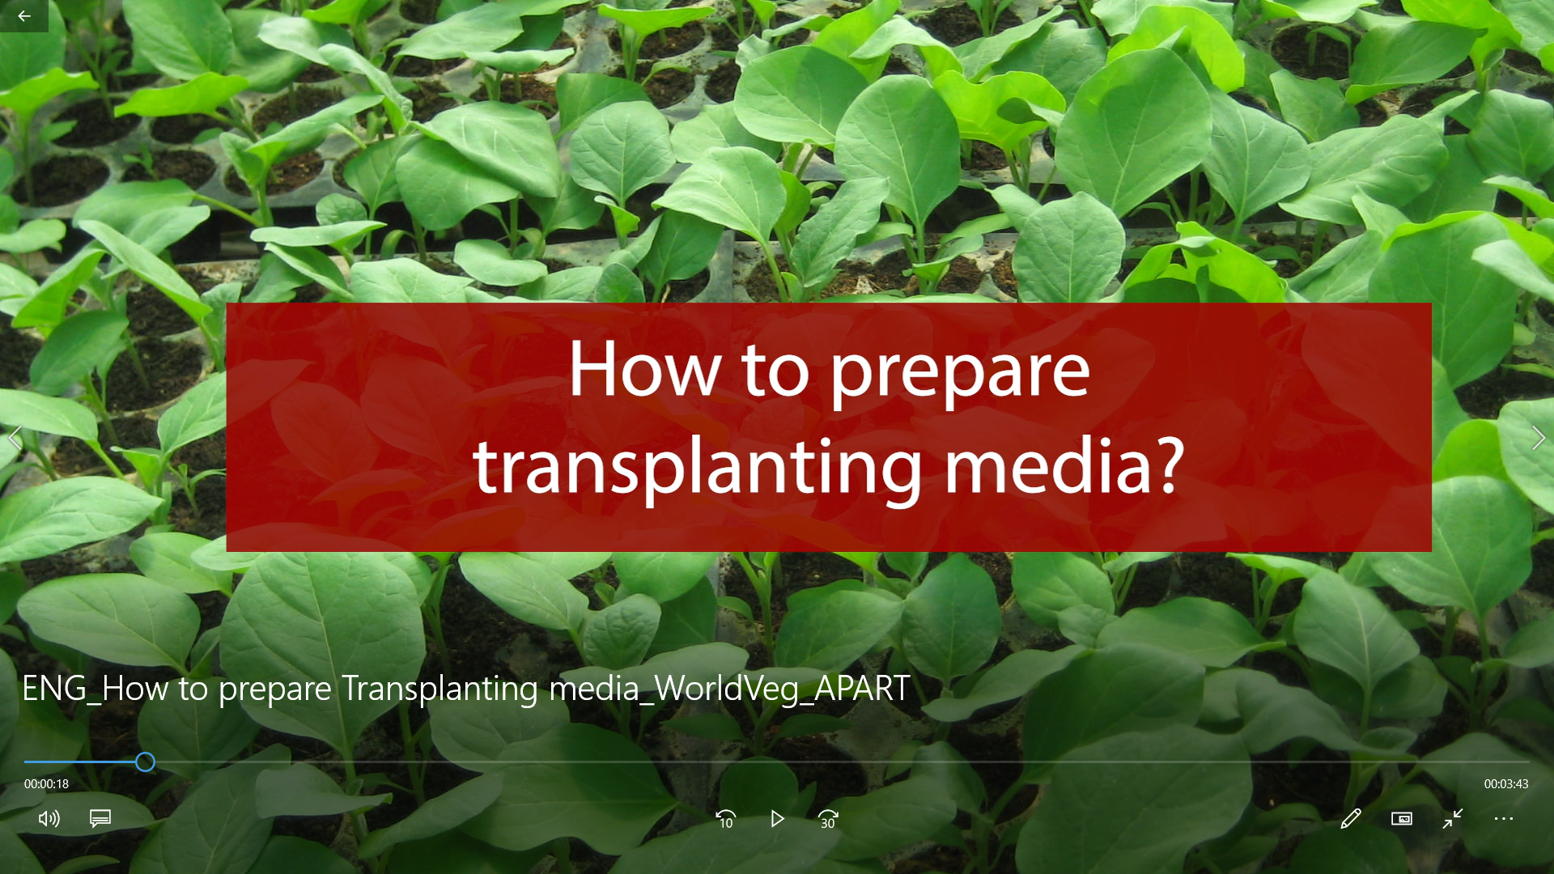
Field activity videos
Training videos prepared by WorldVeg team
Three videos for technical training both in English and Assamese prepared and shared with implementing partners
How to prepare potting mixture and sowing in seedling trays
How to prepare transplanting media
Field preparation for transplanting
Farmers testimonial video with English subtitle

Slide 35
Activities planned under AWP 2020-21

Slide 36
Part B: Promoting the adoption of climate resilient good agricultural practices B2: Application of integrated pest management (IPM) systems for reduced pesticide usage
Activities planned under AWP 2020-21: DoH&FP
Crops | District selected
Brinjal | Lakhimpur
Cabbage | Sonitpur
Cauliflower | Nagaon
Pumpkin | Barpeta
Tomato | Darrang

Slide 37
Thank you

