Slide 1
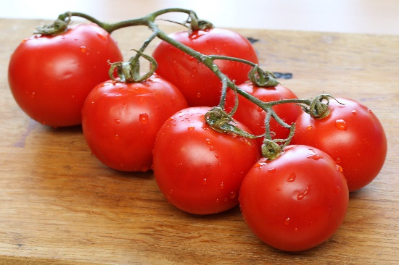
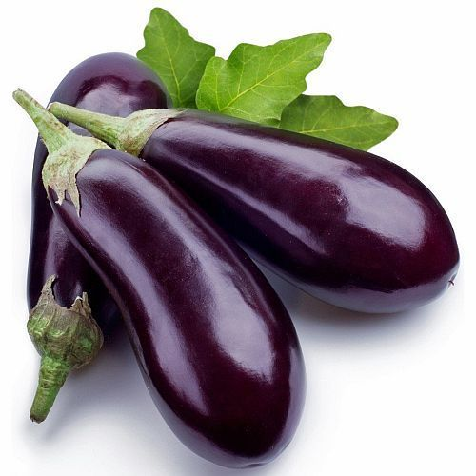
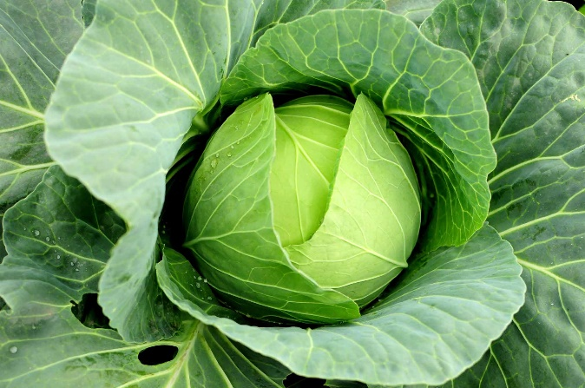
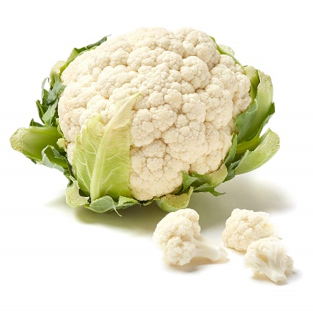
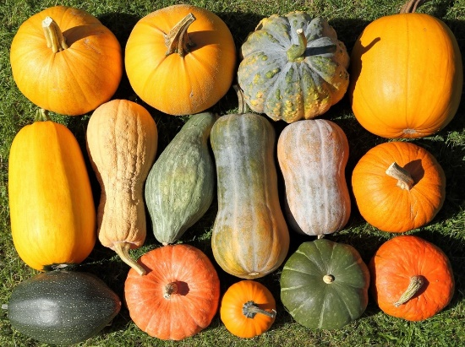
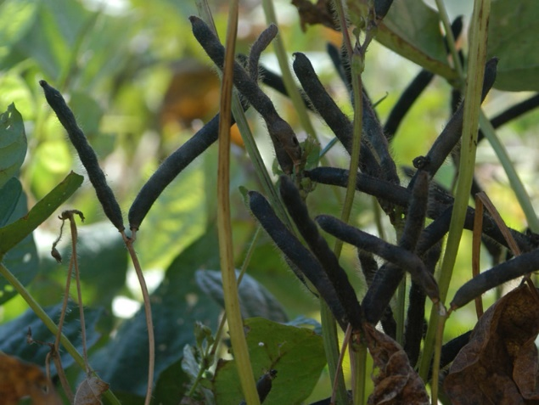
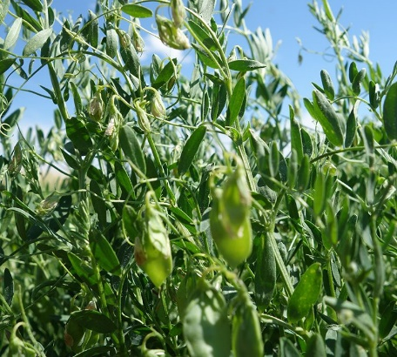
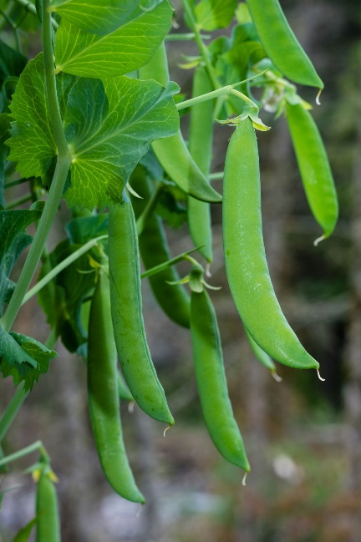
Vegetables and Pulses under WorldVeg in APART
Tomato
Brinjal
Cauliflower
Cabbage
Pumpkin
Black gram
Lentil
Pea

Slide 2
Part B: Promoting the adoption of climate resilient good agricultural practices
B1: Climate resilient production demonstrations
.

Slide 3
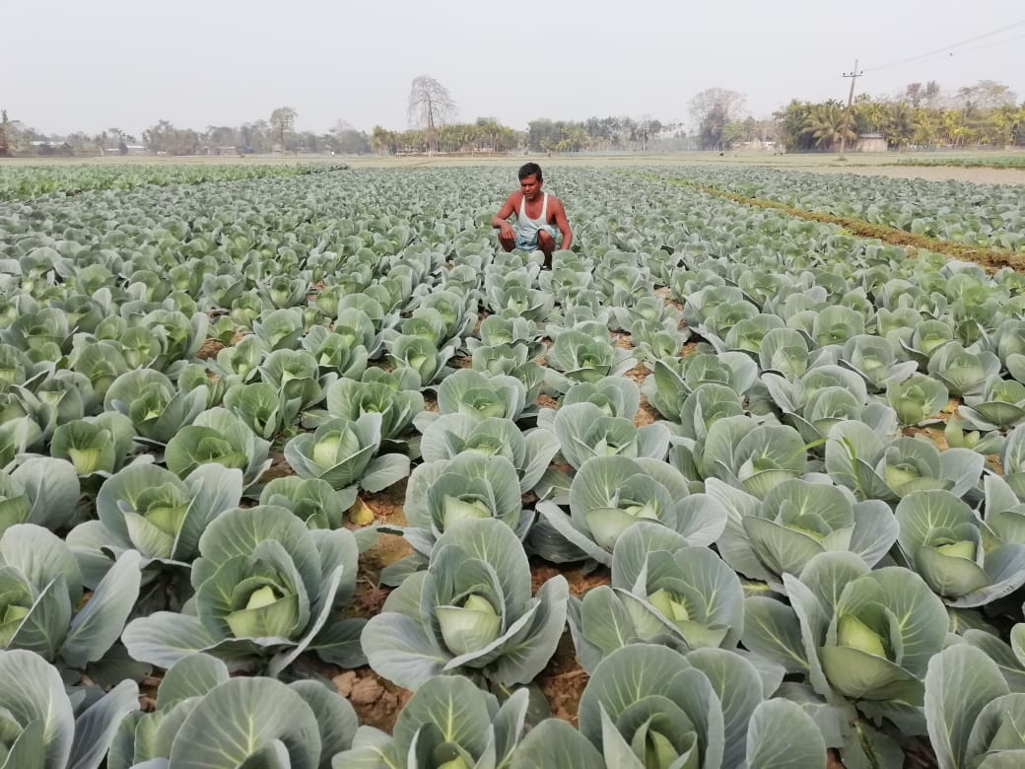
Part B: Promoting the adoption of climate resilient good agricultural practices B1: Climate resilient production demonstrations
Direct engagement in 20% demonstrations
Need-based technical support in 80% demonstrations
100% demonstrations = 451 in 2018-19 and 914 in 2019-20
All demonstrations organized by implementing partners.
Technical support by WorldVeg

Slide 4
Part B: Promoting the adoption of climate resilient good agricultural practices B1: Climate resilient production demonstrations
Physical Progress of Vegetable and Pulse Value Chain under OPIU(Horti) & OPIU(AGRI)
Demonstration on Climate Resilient Technology and Market Led | 2018-19 |  |  |  | 2019-20 |  | 2020-21 |  | Cumulative
 | Plan | Achievement |  | Total | Plan | Achieved | Plan | Achieved | Plan | Achievement
 |  | ATMA- District | WorldVeg
Tomato | 150 | 143 | 7 | 150 | 126 | 126 | 189 | 36 (early-ongoing) | 465 | 276
Cabbage | 150 | 139 | 11 | 150 | 112 | 112 | 168 | 80 (early-ongoing) | 430 | 262
Cauliflower | 150 | 140 | 10 | 150 | 96 | 96 | 144 | 57 (early-ongoing) | 390 | 246
Brinjal | 150 | 139 | 11 | 150 | 108 | 108 | 162 |  | 420 | 258
Pumpkin | 150 | 139 | 11 | 150 | 112 | 112 | 168 |  | 430 | 262
Black gram | 80 | 64 | 0 | 64 | 160 | 160 | 240 | Final decision from ARIASS is pending
Lentil | 50 | 40 | 10 | 50 | 100 | 100 | 150
Pea | 50 | 40 | 10 | 50 | 100 | 100 | 150
Pea | 50 | 40 | 10 | 50 | 100 | 100 | 150

Slide 5
Part B: Promoting the adoption of climate resilient good agricultural practices B1: Climate resilient production demonstrations
Average comparative yield of demonstration vs control plot
Climate resilient demonstrations | Average Yield (q/ha) (2018-2019) |  |  | Average Yield (q/ha) (2019- 2020)
 | Demo | Control | Percentage increase (%) | Demo | Control | Percentage increase (%)
Brinjal | 157 | 107 | 46 | 293 | 232 | 27.40
Cabbage | 616 | 566 | 9 | 283 | 224 | 26.34
Cauliflower | 422 | 403 | 5 | 255 | 210 | 21.43
Pumpkin | 178 | 166 | 7 | 248 | 192 | 29.16
Tomato | 181 | 141 | 29 | 324 | 275 | 17.81
Black gram | WorldVeg missed the black gram season since the project started in Nov. 2018 |  |  | 8.2 | 5.3 | 54.7
Lentil | 15 | 12 | 25 | 18.5 | 15.5 | 19.35
Pea | 63 | 51 | 23 | 66 | 53 | 24.5

Slide 6
Technologies introduced & promoted by WorldVeg
Seedling trays
Potting mixture
Enriched vermicompost
Transplanting media
Microbial bio-fertilizers
Microbial bio-control agents
Localized fertilizer application
Intercropping
Mulching
Line sowing in pulses
Rhizobia inoculation in pulses
Sticky traps
Pheromone traps
Trap crops
Border crops
Safer alternatives to conventional synthetic pesticides
Reduced rates of agro-chemicals in demonstrations
Micronutrients
Personal protection equipment (PPE) for farmers
Awareness on pesticide handling and application
Increase sustainability and climate resilience
Training to extension agents and farmers
Aim to: produce healthy, disease free seedlings with good root system; intensify cropping; reduce synthetic agro-chemical use and dependence; create safer conditions for farmers, consumers and environment.

Slide 7
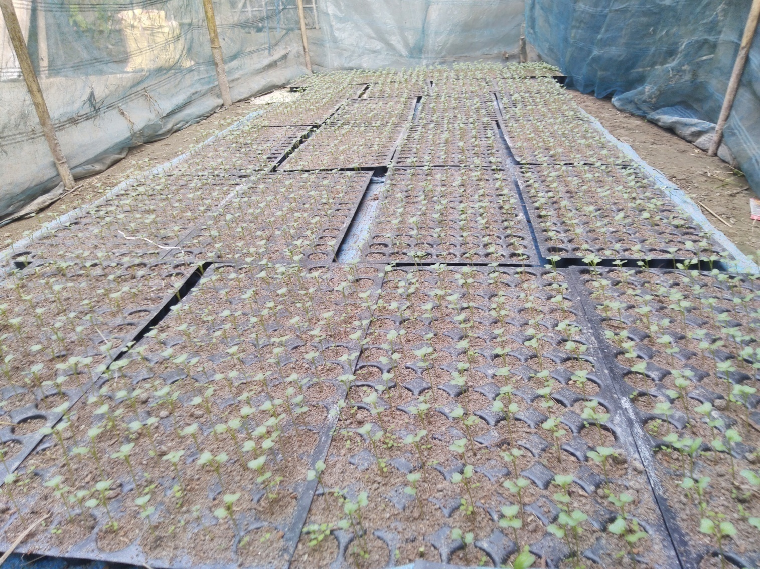
Seedling tray
Technologies introduced & promoted by WorldVeg
Healthier than seedlings from raised beds
Eliminates root damage
Minimize transplanting shock and risk of disease incidence
Cuts down on seed requirement
Easy to transport

Slide 8
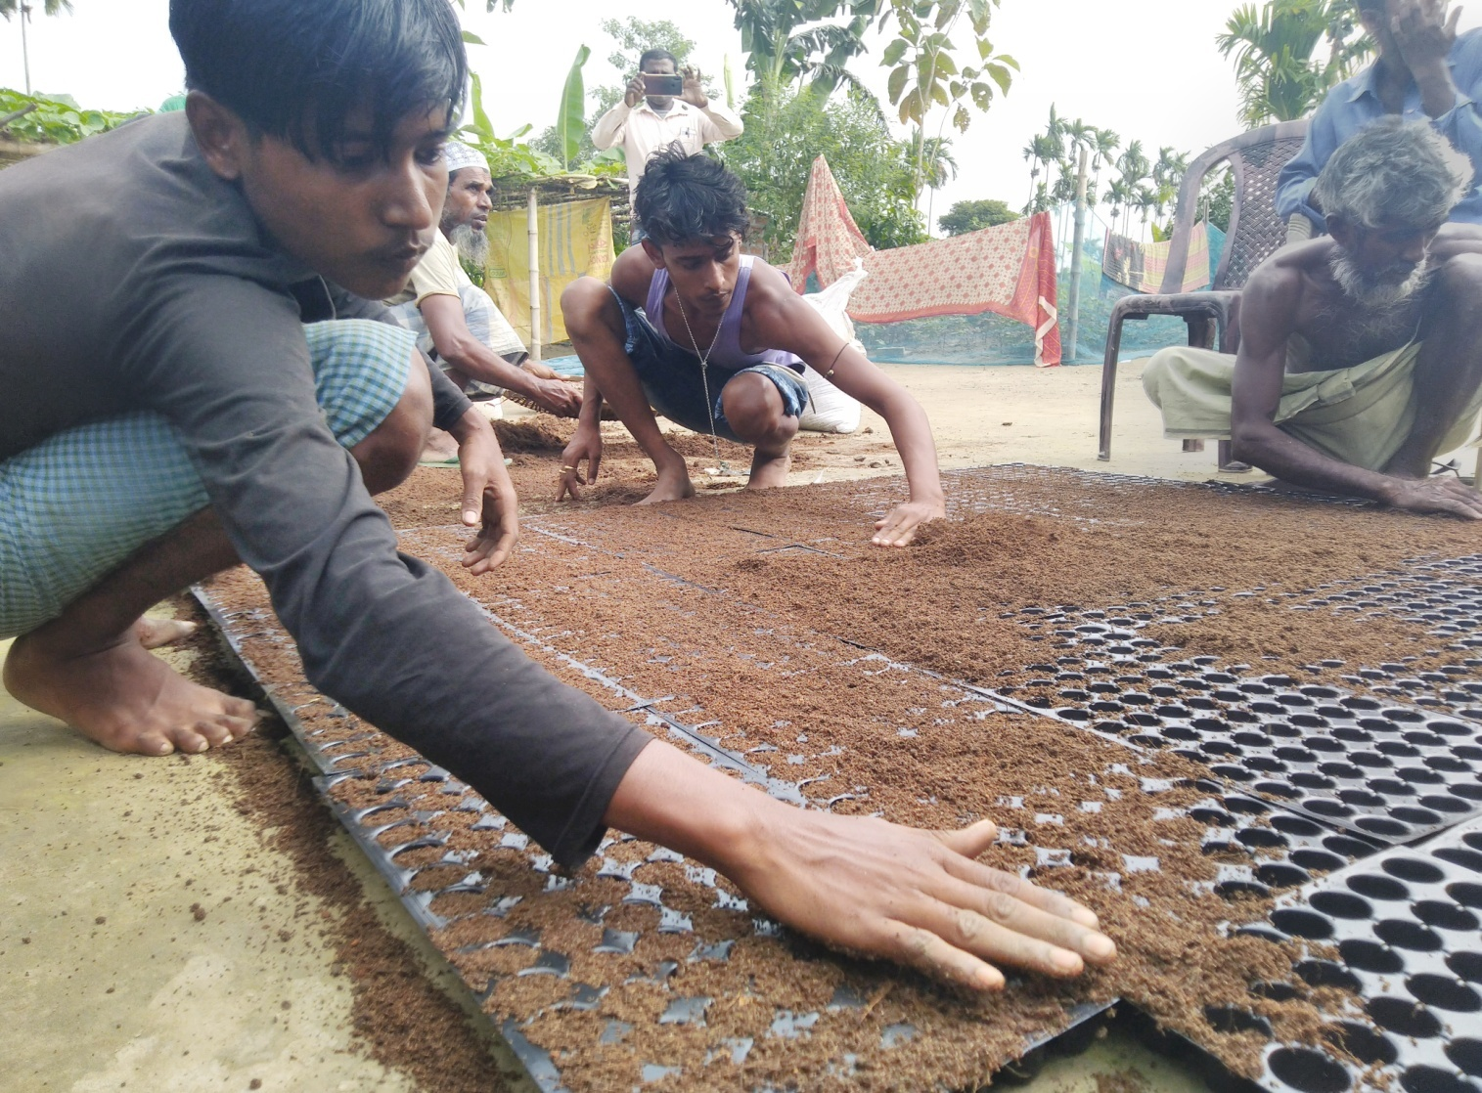
Soil-less Potting mixture
Technologies introduced & promoted by WorldVeg
3x coco-peat + 1x vermicompost + 1x charred rice husk
Plus microbial bio-fertilizers and bio-control agents
Well-matured vermicompost to be used
Soilless media
Lower risk of soil-borne diseases

Slide 9
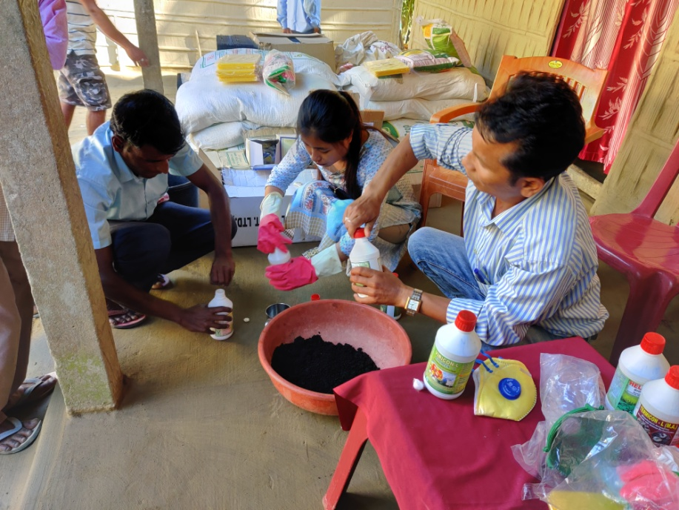
Enriched vermicompost
Technologies introduced & promoted by WorldVeg
Enriched using various microbial bio-fertilizers and bio-control agents
Incubated for 2 – 3 weeks following inoculation
Improves soil health

Slide 10
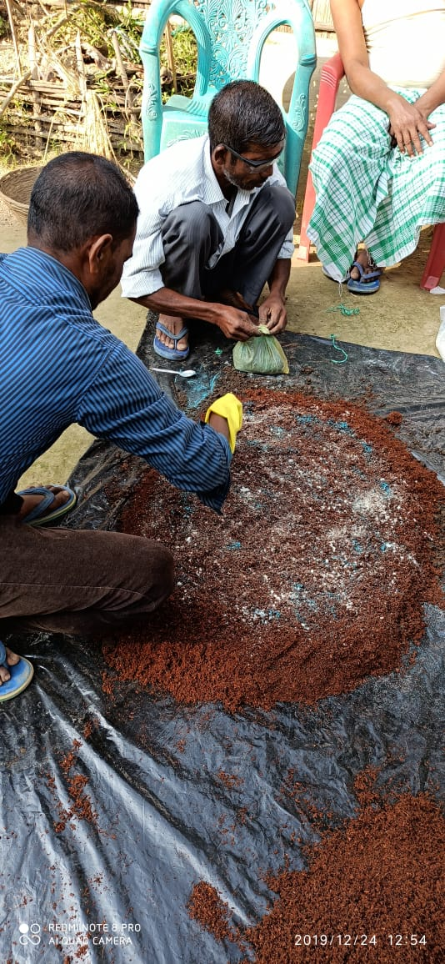
Transplanting media
Technologies introduced & promoted by WorldVeg
Promotes localized application of manure/compost/fertilizer
Enriched vermicompost + farmyard manure + reduced quantities of synthetic fertilizers
Applied into transplanting pits or planting furrows.
Increases nutrient availability and improves soil health

Slide 11
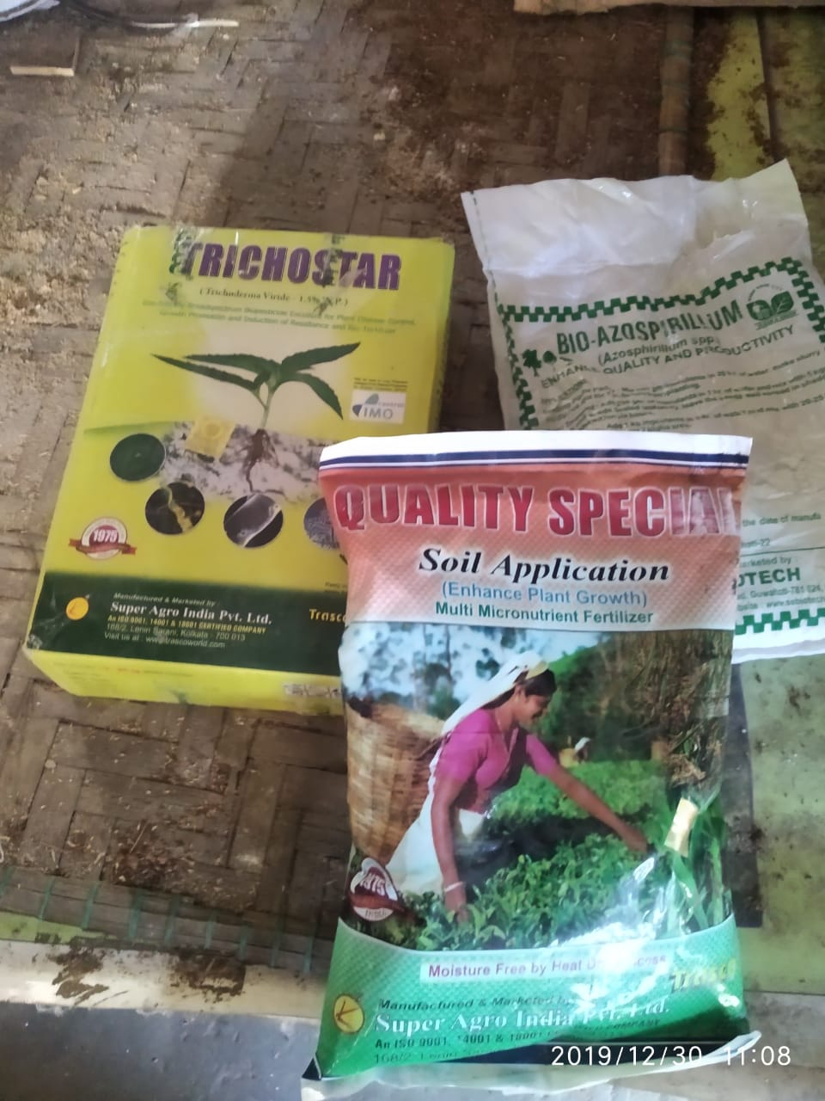
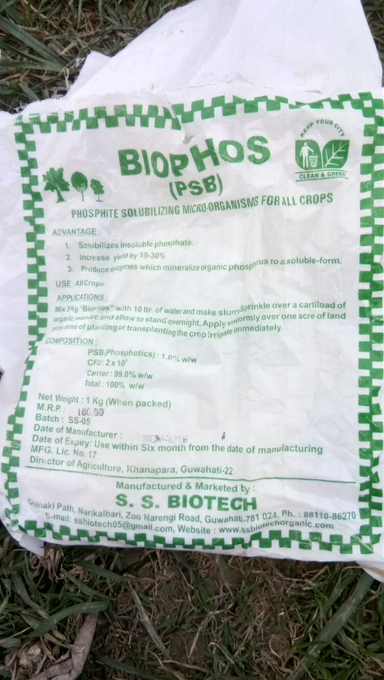
Microbial bio-fertilizers and bio-control agents
Technologies introduced & promoted by WorldVeg
Bio-fertilizers:
Azotobacter
Azospirillum
Rhizobium
Phosphorus solubilizing bacteria (PSB)
Bio-control agents:
Trichoderma
Pseudomonas
Beauveria
Metarhizium
Increases nutrient availability, soil fertility, and lowers pest damage

Slide 12
Source of procurement of bio fertilizers and bio agents
District | Vendor detail
Nagaon | Balark Biotech, B. M. Road, Amolapatty, Nagaon
Morigaon | Nazrul Islam, Krishi Vikas Kendra, Burbondha, Morigaon
Kokrajhar | National Seed Nursery, Boro Bazar Road, Kokrajhar
Kamrup | S H Enterprise, Barpeta Road, Assam 781315
Nalbari | Maa Trading, L N B Road, Nalbari
Sivasagar | Haque Beej Bhandhar, Central Market, Sivasagar
Jorhat | Surabhi Agro Service, Demow
Sonitpur | Sonitpur Nursery, Chawk Bazaar, Tezpur
Cachar | Seed House, Opp. Silchar Court, Cachar
Lakhimpur | Assam Beej Bhandar, Bazaarpati Road, North Lakhimpur
Barpeta | Kohinor Beej Bhandar, Barpeta Road, Barpeta
Golaghat | Vishal Organics and Research Centre, Jorhat
Goalpara | Goalpara Seed House, Opp. Canara Bank, Near ASTC, Goalapara
Darrang | Ahmed Agro Care, Dhula/ Rahman Agro Agency, Kkarupetia, Darrang

Slide 13
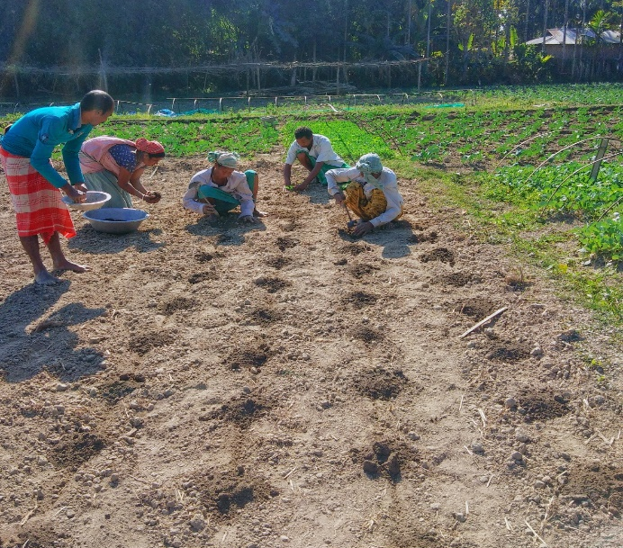
Localized fertilizer application
Technologies introduced & promoted by WorldVeg
Instead of broadcasting over entire field area
Localized application to root zone of individual plants
Through transplanting media
Increases fertilizer use efficiency and soil fertility
Reduces fertilizer requirement

Slide 14
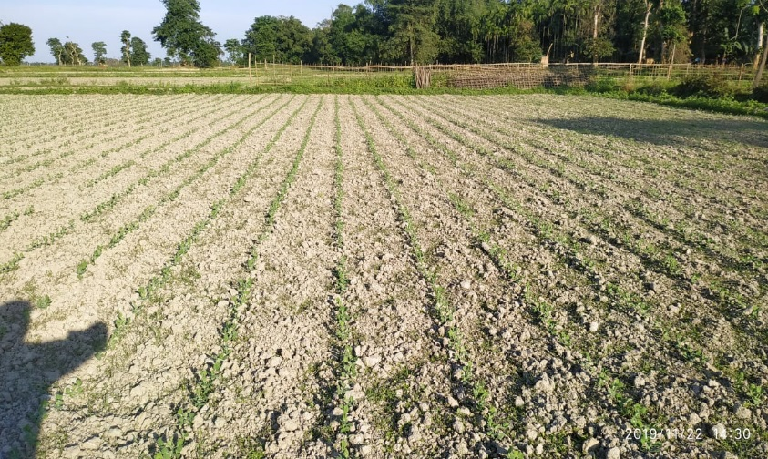
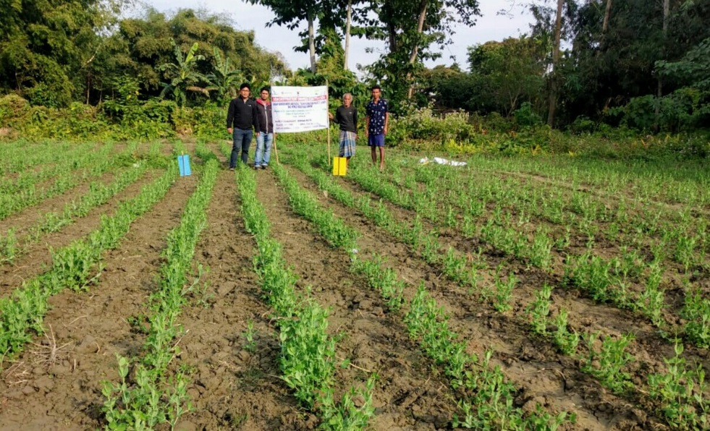
Line sowing in pulses
Technologies introduced & promoted by WorldVeg
Reduces seed requirement
Facilitates inter-cultural operations
Weeding
Balanced competition among crop plants
Less disease/ insect pest incidence
Line sowing/planting in lentil [left], compared with broadcasting [right]
Line sowing in black gram
Line sowing in pea

Slide 15
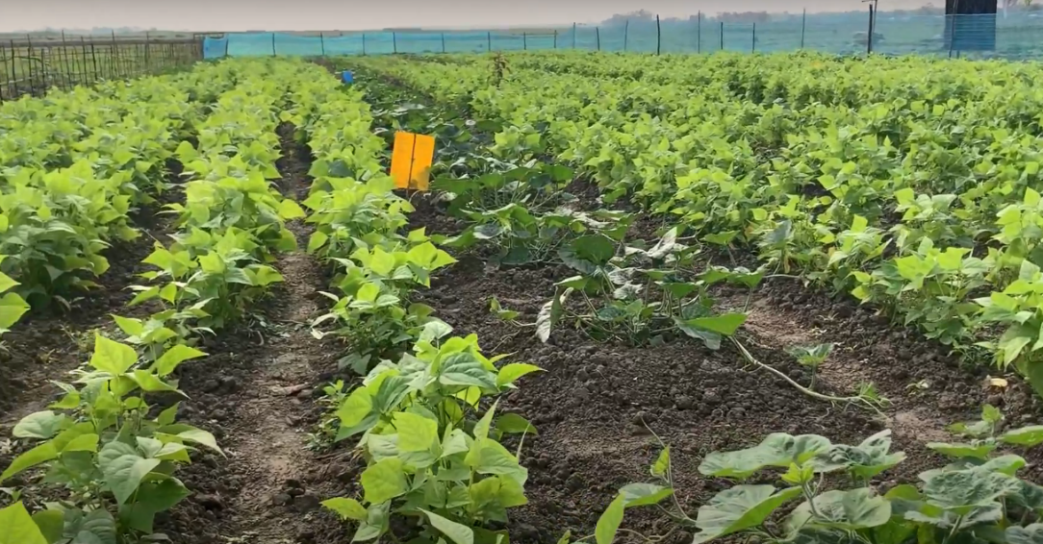
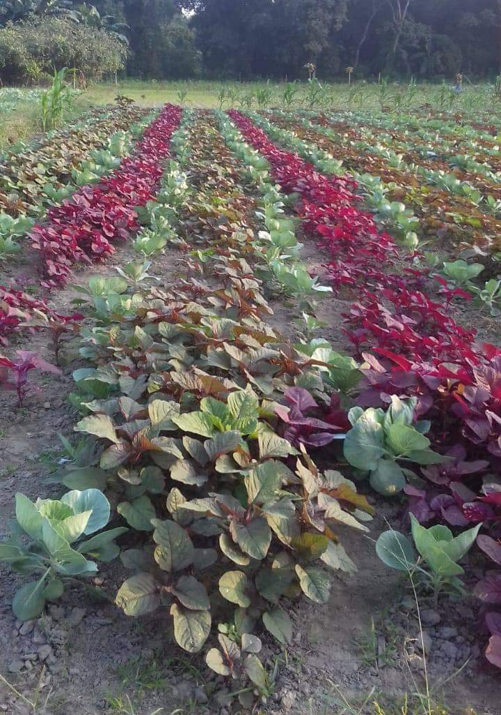
Intercropping
Technologies introduced & promoted by WorldVeg
With quick-growing, short-duration cash crop
Increases returns
Reduces risk
Intensifies cropping
Use time required for ground-cover by cash crop
Increases resource utilization/biomass production
Amaranth in brinjal, cabbage and tomato; coriander in cauliflower; beans in pumpkin
Beans as intercrop in pumpkin
Amaranth as an intercrop with cabbage

Slide 16
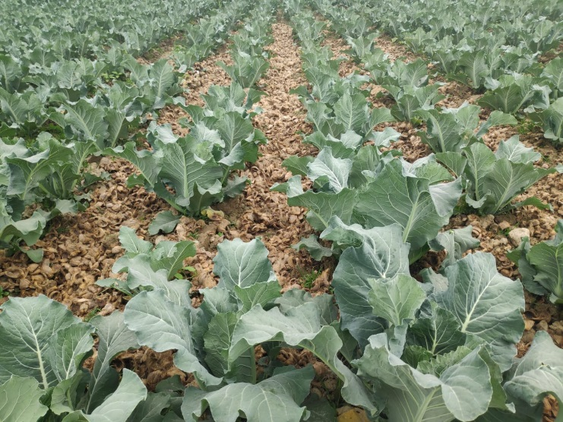
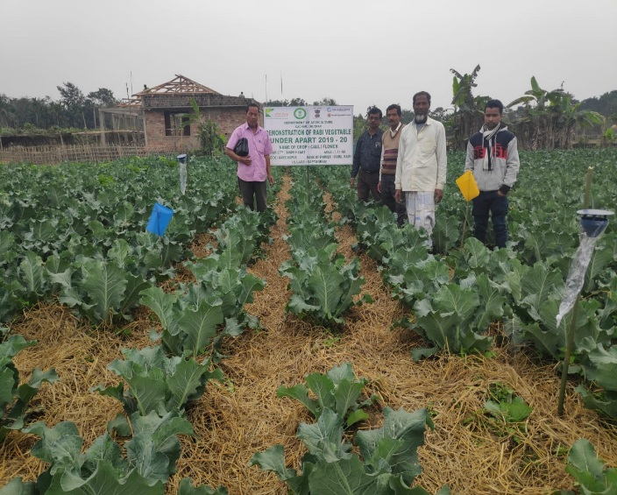
Mulching
Technologies introduced & promoted by WorldVeg
Covering soil surface with rice straw, arecanut husk, etc.
Locally available, biodegradable
Use of residue considered waste/burden in many areas
Increases soil organic matter, soil microbial populations
Conserves soil and soil moisture
Use of rice straw as mulch in tomato
Use of Arecanut husk (left) and rice straw (right) as mulch in cauliflower

Slide 17
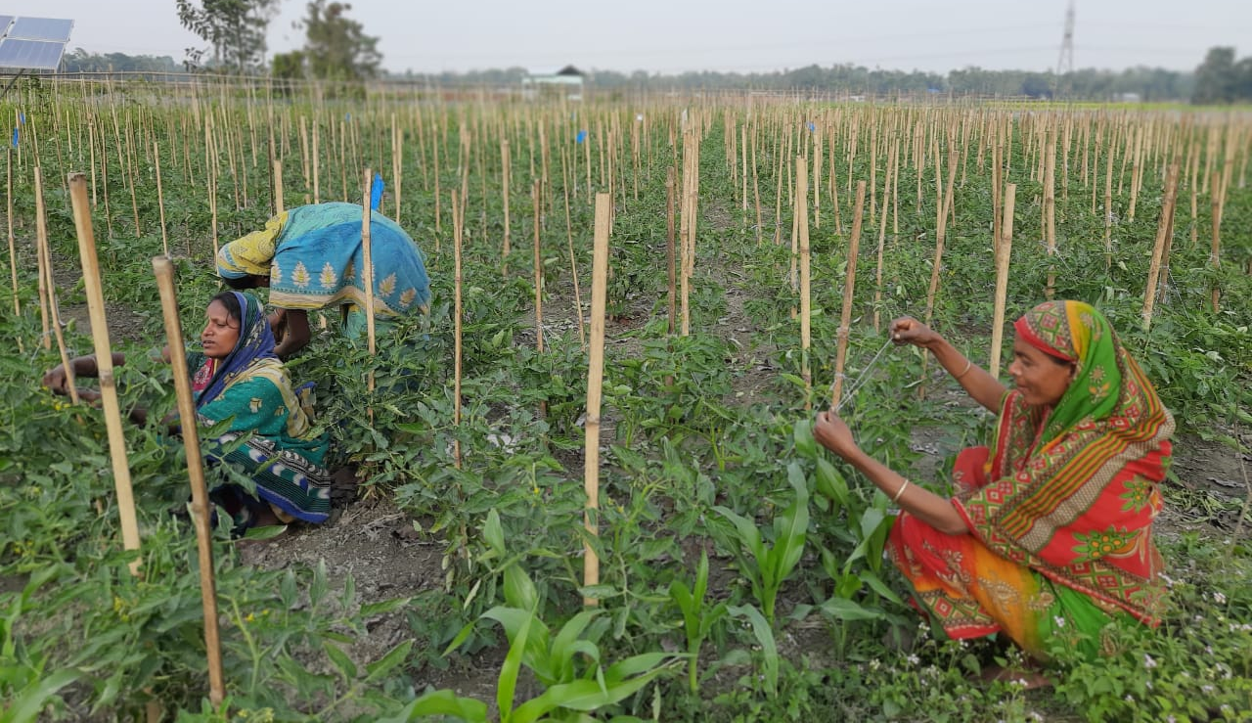
Staking in tomato
Technologies introduced & promoted by WorldVeg
Keeps plants erect
Prevents contact of fruits with soil
Increases air circulation
Reduces disease incidence
Improves fruit quality
Makes intercultural operation easier

Slide 18
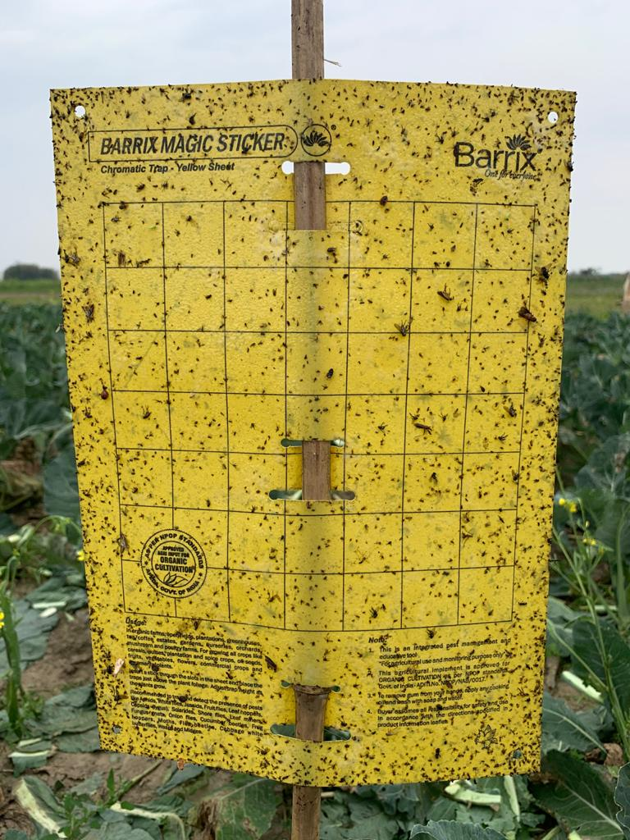
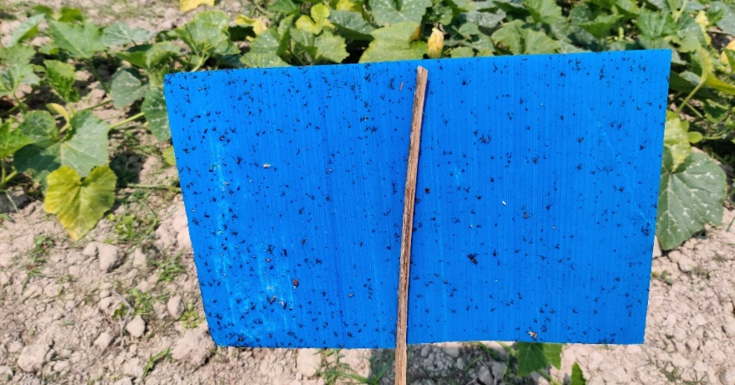
Sticky traps
Technologies introduced & promoted by WorldVeg
Yellow and blue
Different insect pests attracted to different colors
e.g., whitefly to yellow
Thrips to blue
Traps on to adhesive surface
Blue sticky trap
Yellow sticky trap

Slide 19
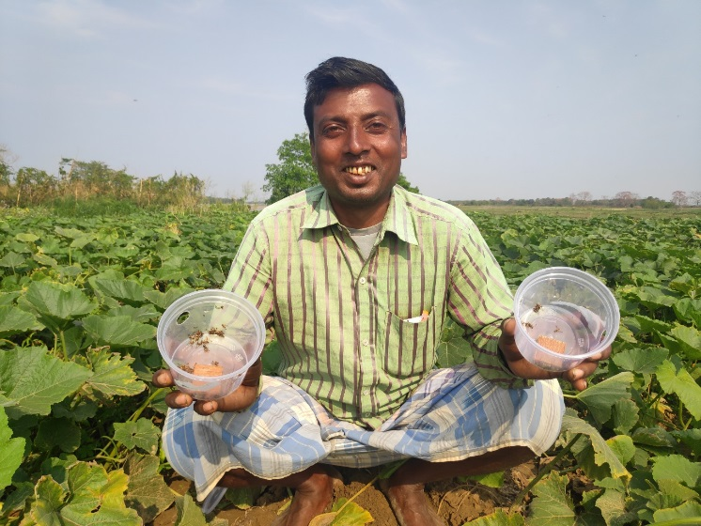
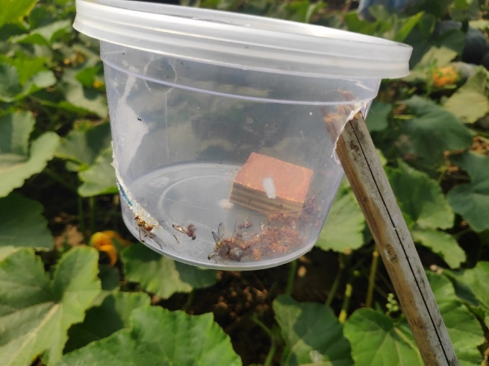
Pheromone traps
Technologies introduced & promoted by WorldVeg
Attract target insects using species-specific lures and traps them
Fruit and shoot borer lures in brinjal
Spodo lures for Spodoptera in cabbage and cauliflower
Lures for fruitfly in pumpkin
Heli lures for Helicoverpa in tomato, black gram, lentil and pea

Slide 20
Trap crops
Technologies introduced & promoted by WorldVeg
Crop-specific plant species
Attract insect pests
Keep them away from main crop
Pesticide application on trap crop if needed
Keep main crop safe from pesticide residues
Mustard in cabbage and cauliflower
African marigold in pumpkin, tomato, black gram, lentil and pea

Slide 21
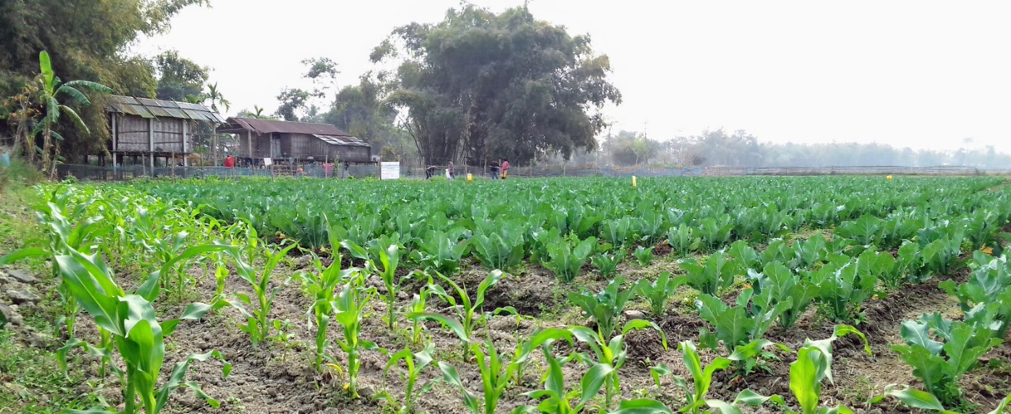
Border crops
Technologies introduced & promoted by WorldVeg
Quick-growing, tall, dense plants
Planted along field boundary
Physical deterrent to entry of insect pests
Maize for all crops
Maize as a border crop in pumpkin (top) & cauliflower (below)

Slide 22
Technologies introduced & promoted by WorldVeg
Safer alternatives to conventional pesticides
Reduced rates of agro-chemicals
Neem oil
Salts of fatty acids (e.g., Lastraw®)
Foliar applications of Beauveria and Metarhizium
In demonstrations
Reduced quantities of fertilizers
Reduced budget for conventional pesticides
To create awareness
Facilitate use of IPM components

Slide 23
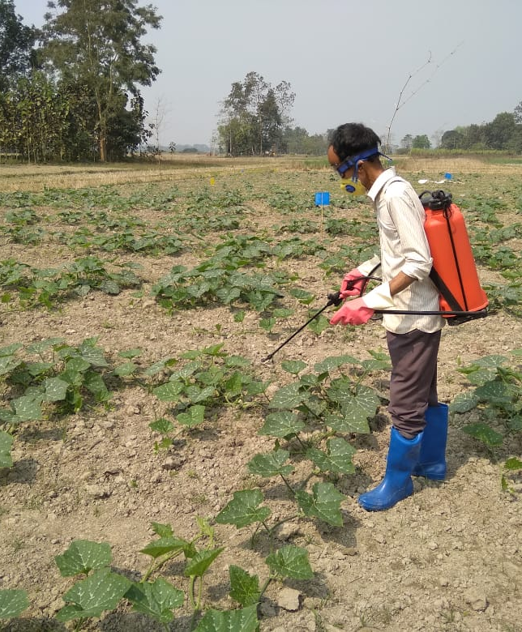
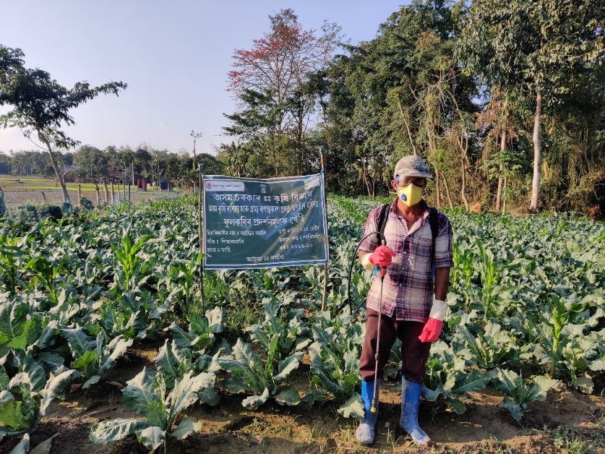
Personal protection equipment for farmers
Technologies introduced & promoted by WorldVeg
Awareness on use of safety gear
During pesticide handling and application
Reduce health risks to farmers
Gloves
Nose masks
Safety goggles [eyewear]
Gum boots

Slide 24
Economic analysis of the demonstration (Cost: Benefit)
Crops | Demonstration cost |  | Assessment on 2019-20 demos (Rs)
 | (Veg: 0.15 ha & Pulse: 0.25ha)
 | Demo (Rs.) | For 1 ha (Rs.) | Demo area (ha) | Average yield per ha (t/ha) | Market price per ton (Rs.) | Total income per ha (Rs.) | Cost: Benefit
Brinjal | 12,284 | 81,893 | 16.2 | 29 | 15,000 | 435000 | 5.3
Cabbage | 13,240 | 88,266 | 16.8 | 28 | 13,000 | 364000 | 4.1
Cauliflower | 13,080 | 87,200 | 14.4 | 25 | 15,000 | 375000 | 4.3
Pumpkin | 16,326 | 1,08,840 | 16.8 | 25 | 18,000 | 450000 | 4.1
Tomato | 12,060 | 80,400 | 18.9 | 32 | 13,000 | 416000 | 5.2
Black gram | 7,353 | 29,412 | 40 | 0.85 | 80,000 | 68,000 | 2.31
Lentil | 7,518 | 30,072 | 25 | 1.50 | 80,000 | 120,000 | 4.00
Pea | 8,360 | 33,440 | 25 | 5.00 | 55,000 | 275,000 | 8.22

Slide 25
Technical training on climate resilient and IPM technologies in vegetable and pulses
Year | Target group | Training topic | No. of training | Total participants | Male | Female
2018-19 | Farmers | Package of Practices on five vegetables and pulses | 66 | 1814 | 1444 | 370
2019-20 | ATMA officials | Improved Production Guides(IPGs) of vegetables & pulses | 17 | 281 | 232 | 49
 | Farmers | 1st Phase Training on IPGs | 111 | 3244 | 2658 | 586
 | Farmers | 2nd phase traing on IPGs | 31 | 737 | 546 | 191
Total |  |  | 225 | 6076 | 4880 | 1196

Slide 26
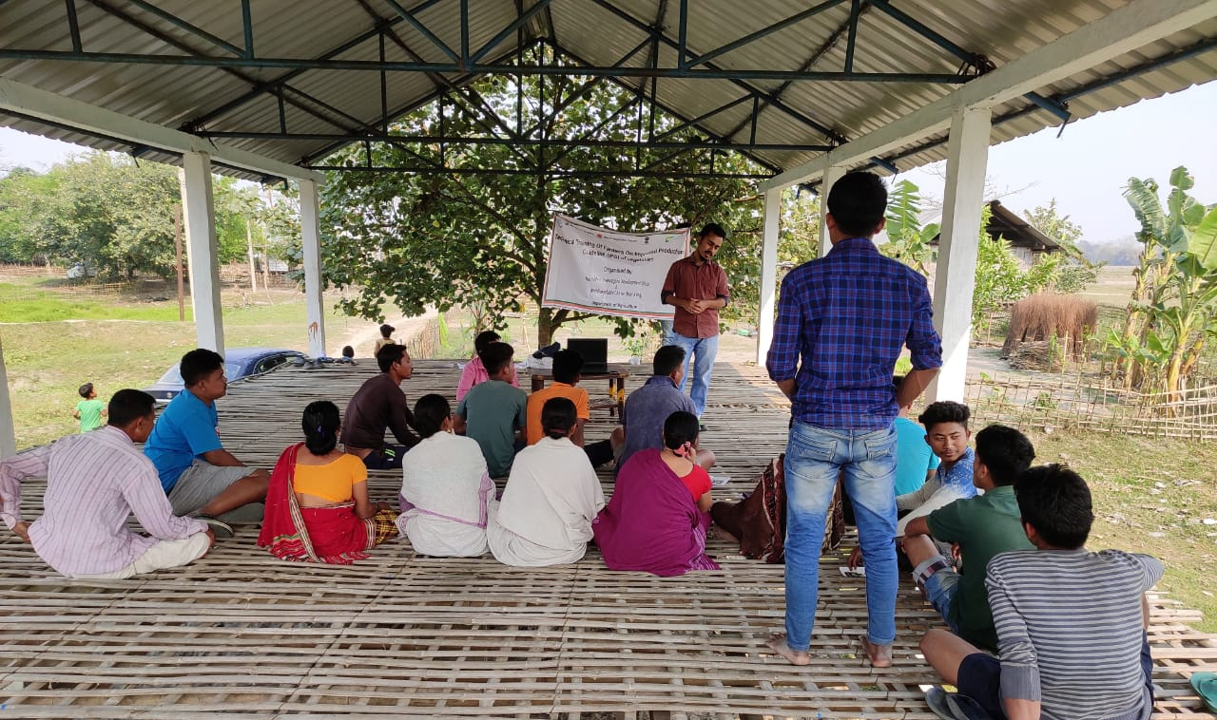
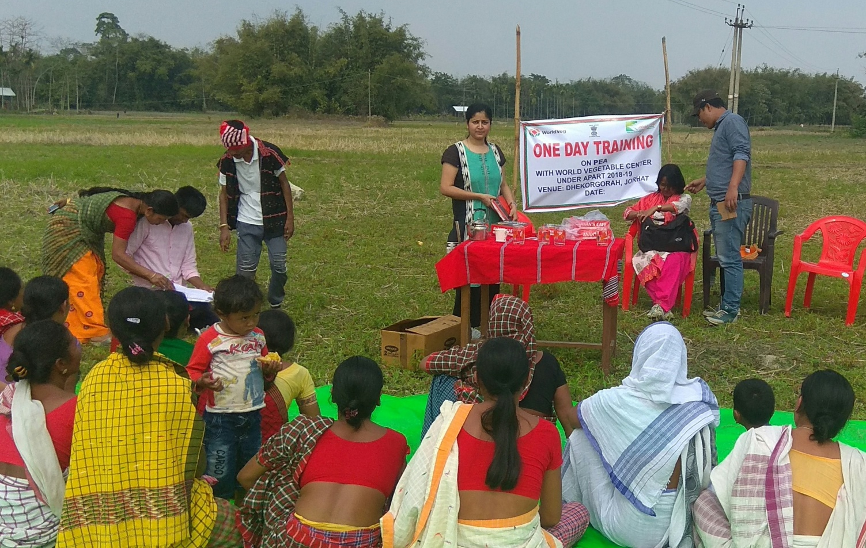
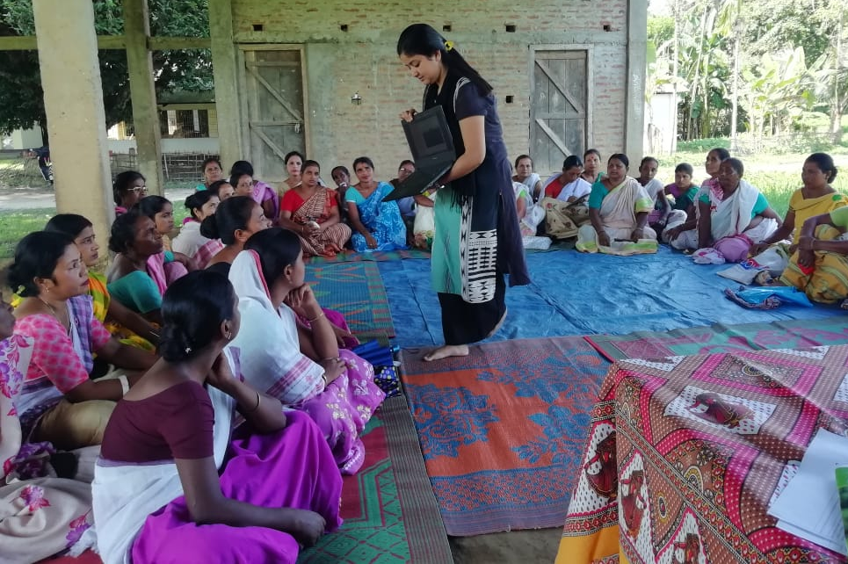
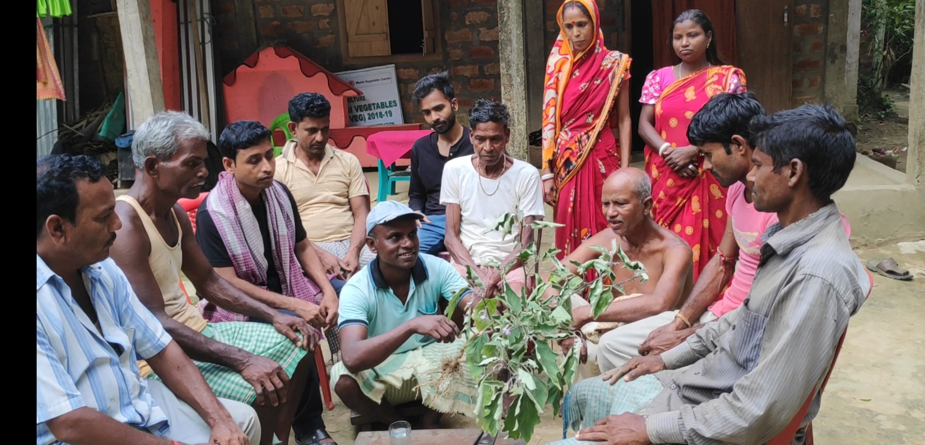
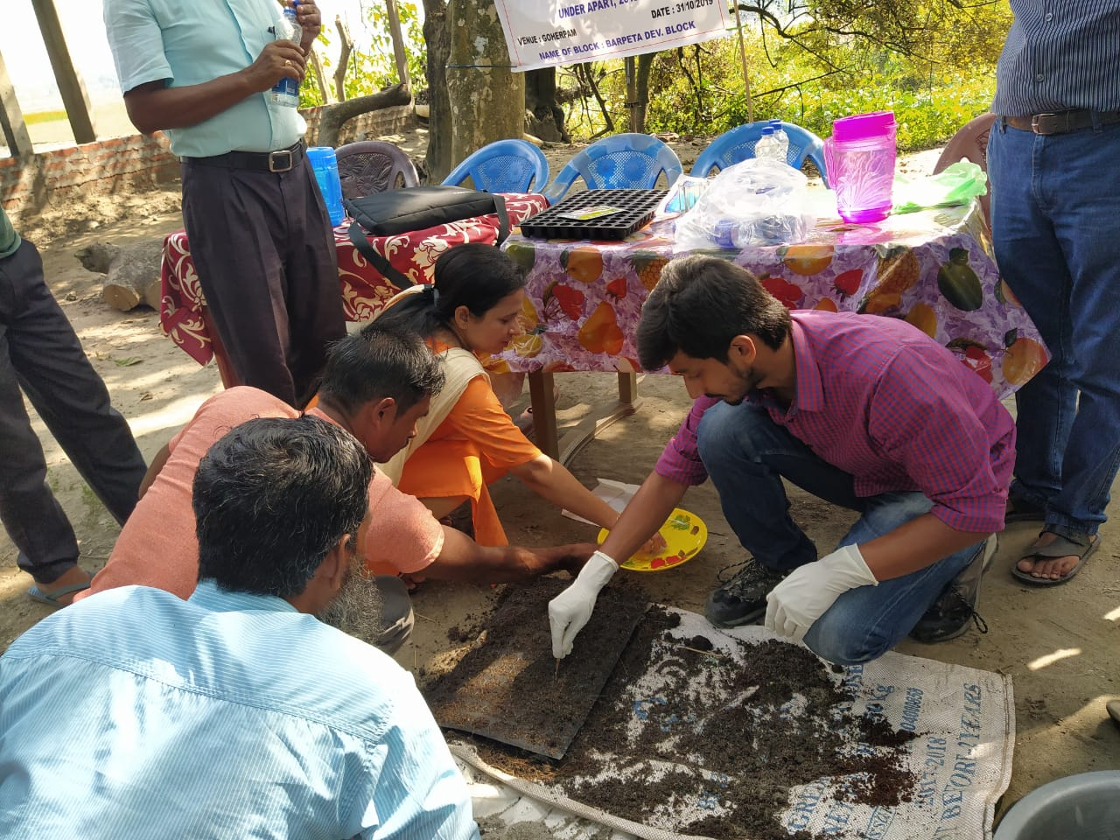
Technical training to farmers at different stages by WorldVeg team

Slide 27
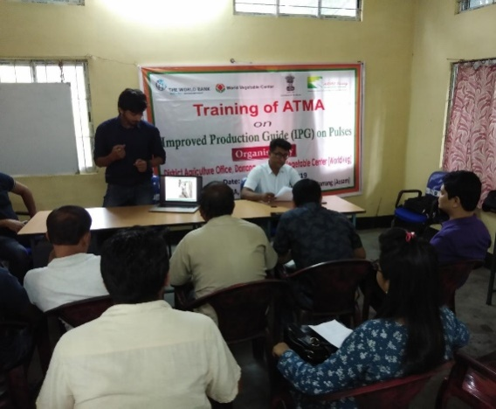
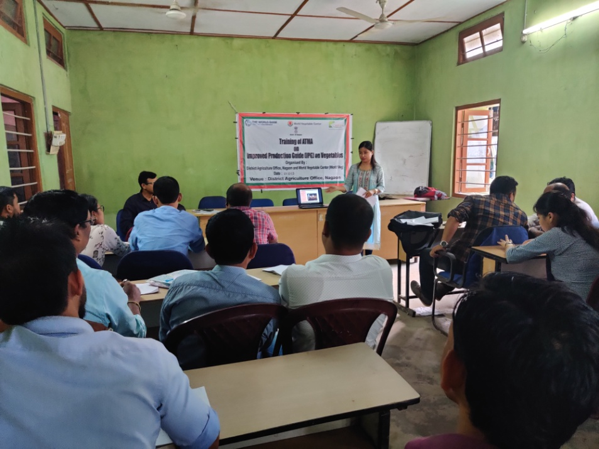
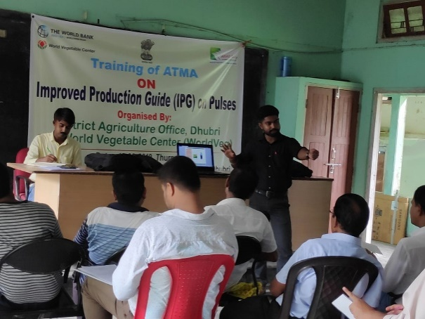
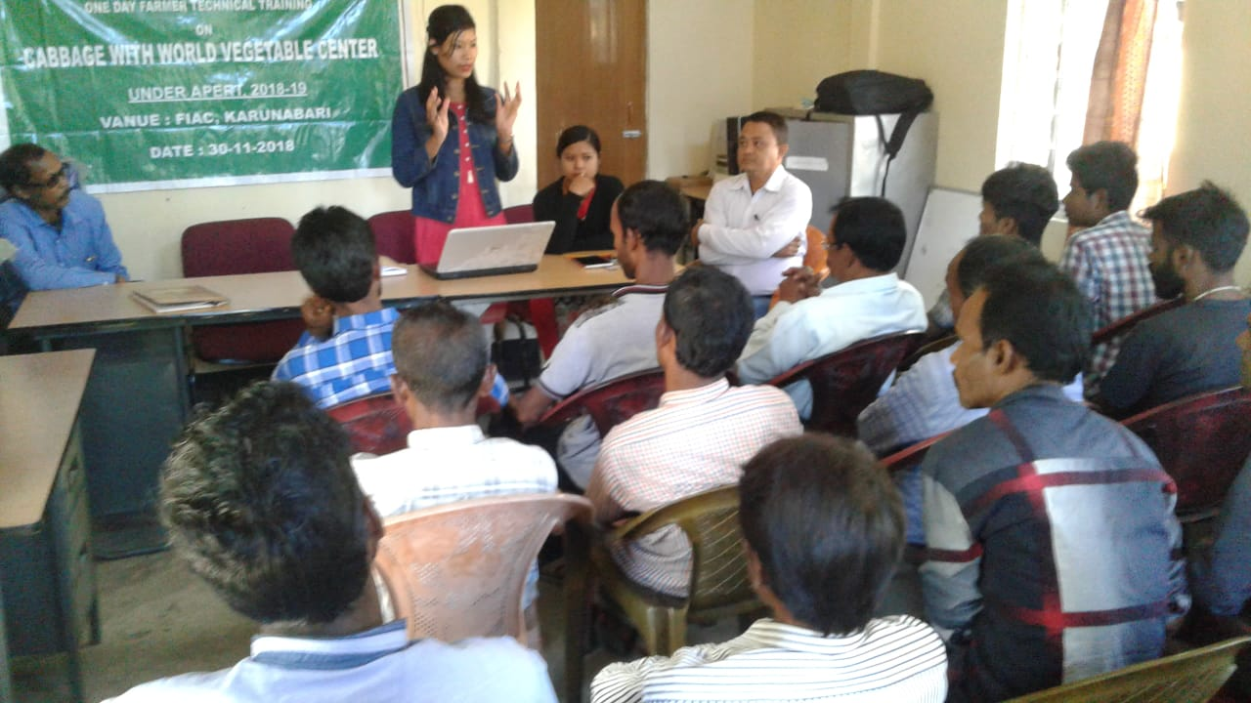
Technical training to district team by WorldVeg at different districts

Slide 28
Workshop conducted in 2019-2020 as a part of AWP
Workshops with AAU
Identification and prioritization of best performing varieties of vegetables and pulses:
The objective of these workshops was to discuss, in a forum of farmers (29), traders (2), scientists (34) and implementing partners (32), suitable vegetable and pulse crop varieties to be used in demonstration plot in each of the 15 APART districts. Selected varieties were popular and desired varieties in each district
2 workshops were conducted at:
Guwahati on 9th July 2019 with a total of 47 numbers of participants
Jorhat on 11th July 2019 with a total of 40 numbers of participants
Two virtual workshops:
Validation of IPM package of vegetables and pulses on 22nd June 2020
Drafting of crop manuals on vegetables and pulses on 23rd June 2020

Slide 29
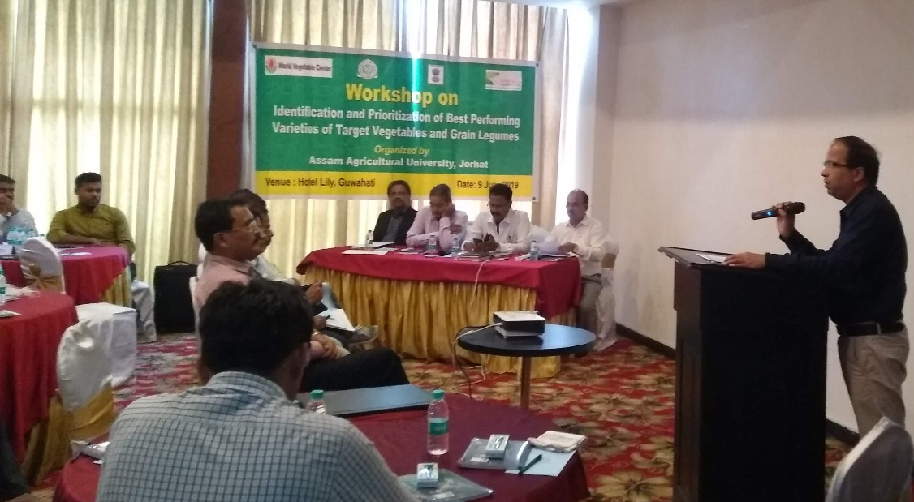
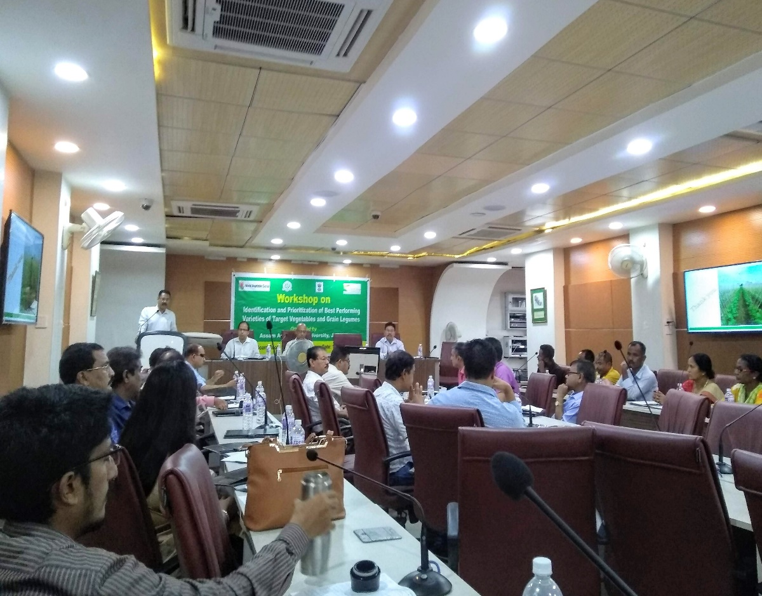
Identification and prioritization of best performing varieties of vegetables and pulses crops for 2019-2020 WorldVeg demonstration
Crop | Variety used during 2019-20
Brinjal | Navkiran, Pusa Purple Long, VNR-212, Sungro 33, Local Black, BSS 793, Bharat 436
Cabbage | Wonderball, Rareball, BC-76, Green Express, Pragati Plus
Cauliflower | White Excel, Madhuri, Megha, Mahi, Aanchal, NS-95, Cashmere, Snow heart
Pumpkin | Arjuna, Madhu
Workshop at Guwahati
Crop | Variety used during 2019-20
Tomato | INDAM 1006, Hard Rock, US 440, Rocky, Trishul, Anup
Black gram | IPU-02-43
Lentil | WBL 77
Pea | Kashi Nandini
Workshop at Jorhat

Slide 30
Workshop conducted in 2019-2020 as a part of AWP
Workshops with DOH&FP
Rapid Assessment of Training needs
The objective of this workshop was to collect and assess the requirements and expectations of stakeholders from the Project. District nodal officers of APART, ATMA officials, District Horticulture Coordinators and progressive farmers attended the workshop
2 workshops conducted at:
Guwahati on 5th August 2019 with a total of 54 participants from 8 districts (Cachar, Goalpara, Kamrup, Barpeta, Kokrajhar, Nalbari, Darrang, Dhubri)
Sonitpur on 7th August 2019 with a total of 88 participants from 7 districts (Morigaon, Lakhimpur, Nagaon, Jorhat, Sivasagar, Sonitpur, Golaghat)
A report was prepared based on the outcome of this workshop, which was shared with ARIASS and DOH&FP

Slide 31
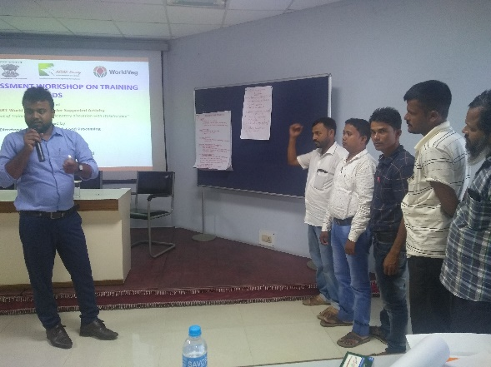
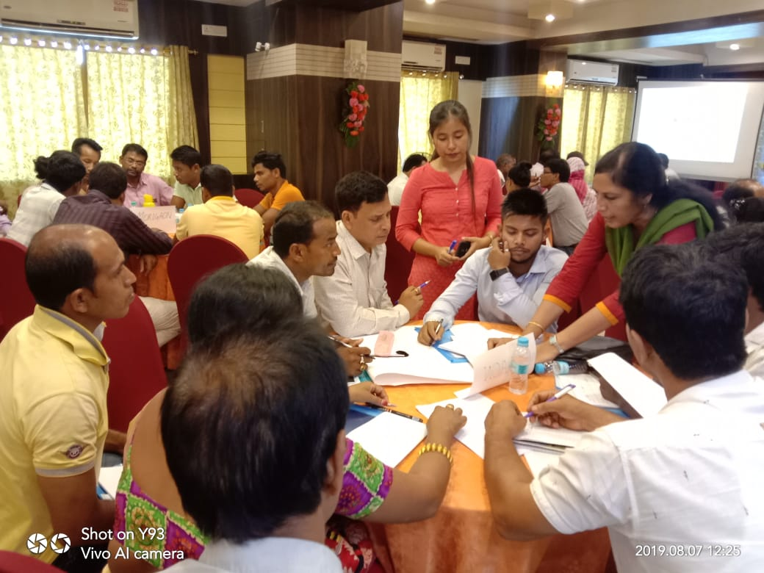
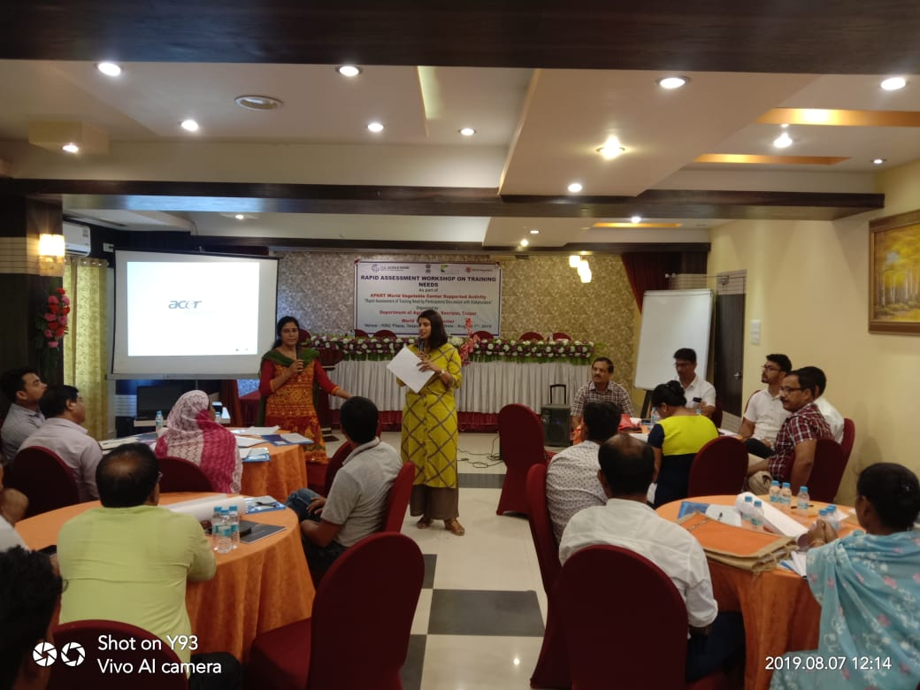
Rapid Assessment of Training Needs- 2019-2020
Team Cachar
Team Goalpara
Group discussion and presentation by team during the workshop at Guwahati
Team Nagaon
WorldVeg team addressing the participants
Group discussion and presentation by team during the workshop at Sonitpur

Slide 32
Workshop conducted in 2019-2020 as a part of AWP
Workshops with DOH&FP
Training of Trainers (ToT)
The objective of ToT is to train DHCs and ATMA master trainers on WorldVeg strategies and approaches to the 2019-20 demonstrations. Multiple sessions on various vegetable and pulse production topics were covered
2 workshops of three days each were conducted at:
Jorhat from 21st August to 23rd August 2019 with a total of 35 participants
Guwahati from 26th August to 28th August 2019 with a total of 43 participants

Slide 33
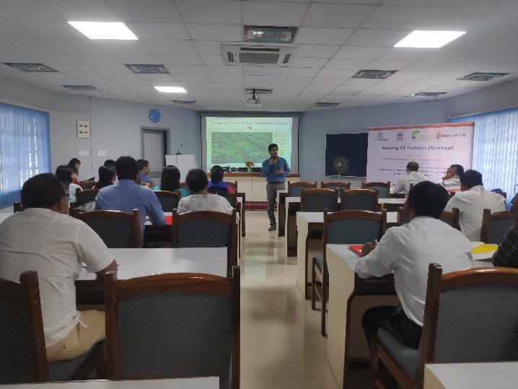
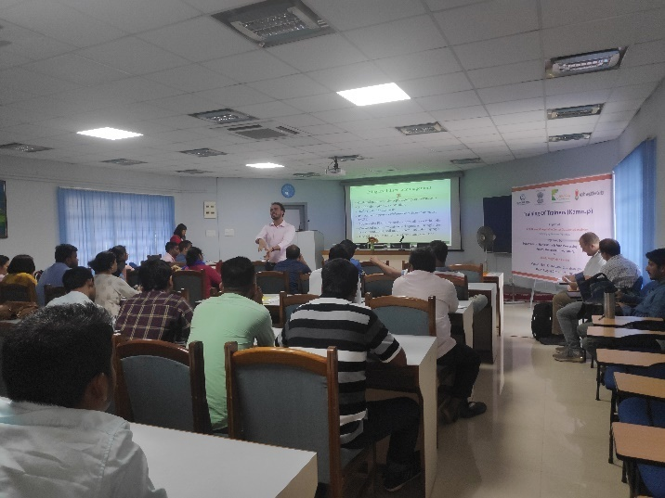
Training of trainers (2019-2020)
3 days Training of Trainers (ToT) at Jorhat
3 days Training of Trainers (ToT) at Guwahati

Slide 34
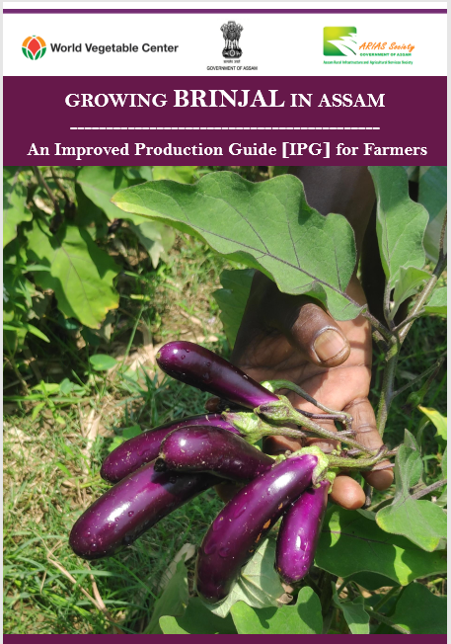
Crop manuals & Improved Production Guides (IPGs)
Training materials prepared by WorldVeg team
For 8 crops
Detailed instructions + tips
Crop production aspects + WorldVeg interventions
Nursery through harvest
Easy-to-use, comprehensive
Farmers + extension agents

Slide 35
Training materials prepared by WorldVeg team
Farmers’ friendly crop manuals and IPGs on 8 crops are shared with ARIASS and AAU and DoH&FP. WorldVeg shared the English versions of the crop manuals and IPGs to implementing partners for translation to local languages and distribution at district and farmers’ level

Slide 36
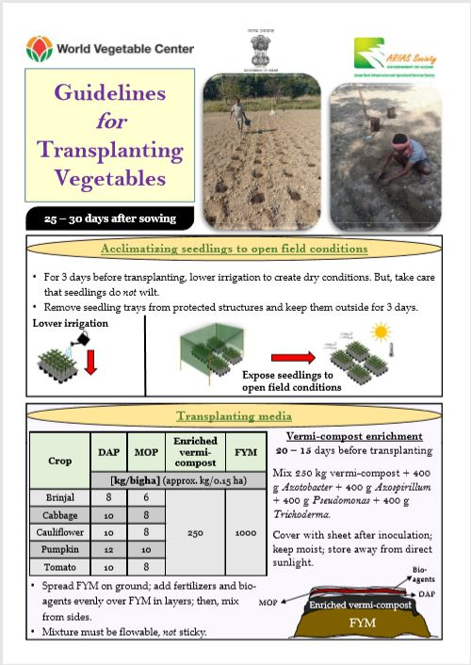
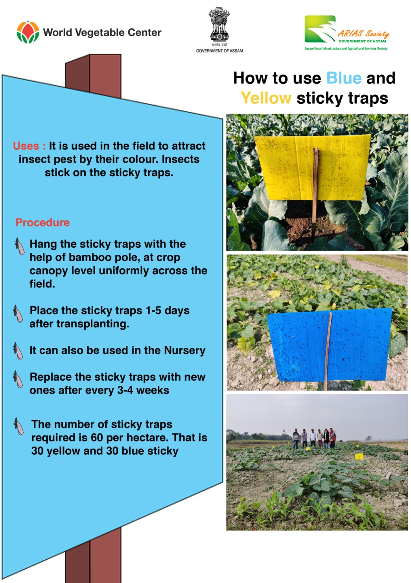
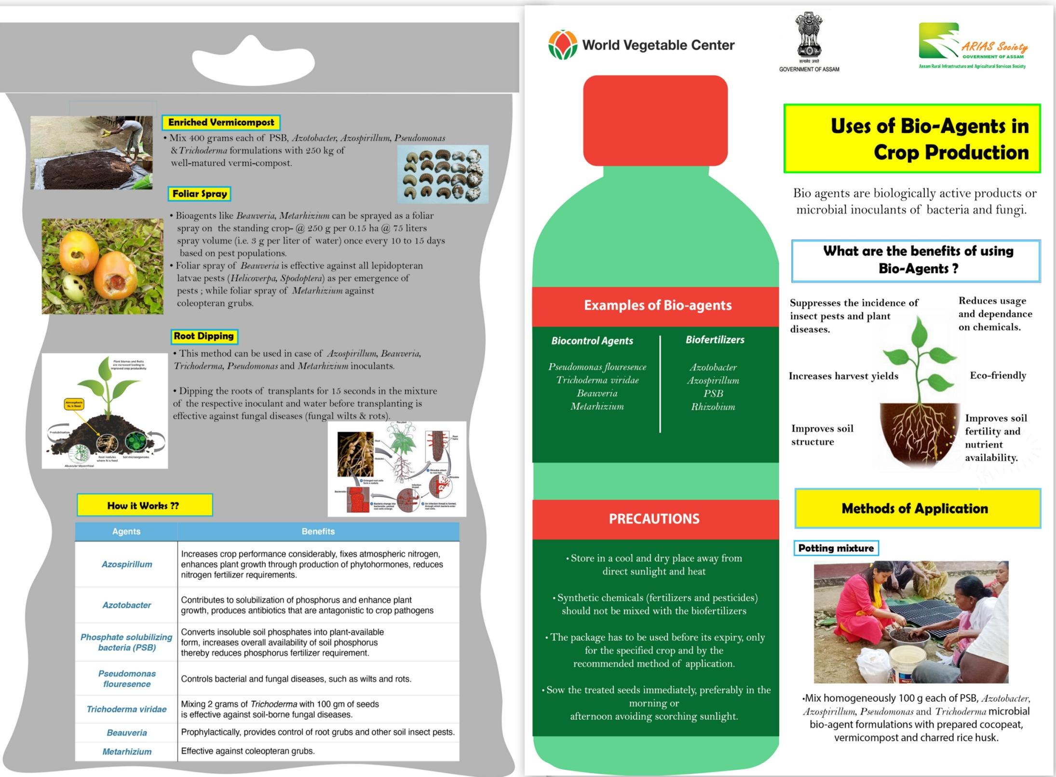
Leaflets
Training materials prepared by WorldVeg team
On specific topics
2-page hand-outs
Leaflets prepared under APART by WorldVeg are shared with implementing partners for translation and distribution.

Slide 37
Field activity videos
Training videos prepared by WorldVeg team
Three videos for technical training both in English and Assamese prepared and shared with implementing partners
How to prepare potting mixture and sowing in seedling trays
How to prepare transplanting media
Field preparation for transplanting
Farmers testimonial video with English subtitle

Slide 38
Activities planned under AWP 2020-21

Slide 39
Part B: Promoting the adoption of climate resilient good agricultural practices B1: Climate resilient production demonstrations
Activities planned under AWP 2020-21: DoH&FP
Crops | Number of demonstration | Remark
Brinjal | 162 | Input distribution, technical training and sowing of seeds in seedling trays has been initiated. Few demonstrations are planned to conduct in the late season (Feb, 2020)
Cabbage | 168 | Early season cabbage and cauliflower demonstration are conducted in six districts with an aim to get good market price
Cauliflower | 144
Pumpkin | 168 | The demonstration initiated in Nov. 2020 after rice harvest. Technical training of farmers are on going at village level
Tomato | 189 | The demonstration initiated in Nov. 2020 after rice harvest. Technical training of farmers are on going at village level
Total | 831 | 20% of the demonstration will be followed by rice or other crop to facilitate cropping sequence

Slide 40
Production of WorldVeg OP seeds of tomato and pumpkin under AWP 2020-21- a new activity with DoH&FP
Production of seeds of WorldVeg open pollinated (OP) lines of tomato and pumpkin through seed village will be carried out in pilot basis with an objective that farmers can be benefited from the introduction of open pollinated vegetable varieties with characteristics similar to hybrid varieties and overcome the associated problems of hybrid varieties such as:
Hybrid seeds are very expensive compared to open pollinated seed
Farmers have to buy fresh hybrid seeds for every planting season
Fake hybrid seeds are on the increase
A strategy paper has been prepared by WorldVeg and shared with DoH&FP
Selection of OP line for seed production:
Tomato: AVTO 1424
Pumpkin: AVPU 1391
Seeds have been dispatched from WorldVeg-South Asia
District selected for production of OP seeds:
Tomato: Pabhoi Greens, Biswanath under DoA Sonitpur and KVK, Khumtai, Golaghat
Pumpkin: DAO, Jorhat and KVK Nalbari

Slide 41
Thank you

