Slide 1
Enterprise Development through Vegetable Seedling Nurseries under APART
A brief update of the activities carried out in 2019-20

Slide 2
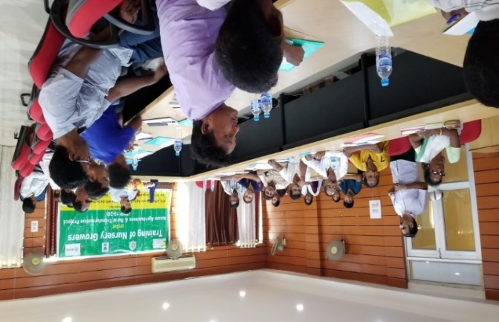
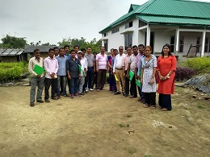
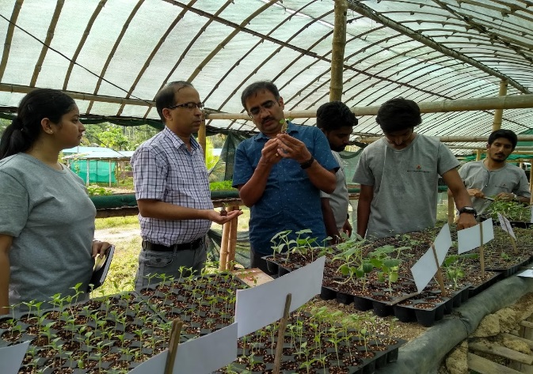
Part A: Improving the quality and availability of planting inputs A2: Enterprise Development through Vegetable Seedling Nurseries
The nursery entrepreneurs was selected by Directorate of Horticulture &Food Processing (DoH&FP) for the year 2019-2020 and a three days in house training was organized by Assam Agricultural University (AAU) at Jorhat
Dr Ravishankar Manickam, Scientist- Vegetable Grafting, WorldVeg, Taiwan, participated as Resource person in the training
A group of 18 vegetable growers were selected and graded during the training program by AAU and DoH&FP and finally 8 nursery entrepreneurs were selected for establishment of vegetable nursery under APART
Dr. Ravi participated as Resource person in technical training organized by AAU
Field visit of Nursery entrepreneurs to Sunderban nursery at Jorhat
Hands on training on grafting of vegetables by Dr. Ravi at Jorhat

Slide 3
Part A: Improving the quality and availability of planting inputs A2: Enterprise Development through Vegetable Seedling Nurseries
Status of selected nursery entrepreneurs for 2019-2020
Training | Districts involved | Male participants | Female participants | Total participants | Total selected participants
Training on vegetable nursery establishment at Jorhat | Jorhat, Morigaon, Golaghat, Nagaon, Darrang, Sonitpur, Lakhimpur, Barpeta, Goalpara, Nalbari | 16 | 2 | 18 | 8
Refresher training to the selected nursery entrepreneurs | Golaghat, Nagaon, Darrang, Sonitpur, Lakhimpur, Barpeta, Goalpara, Nalbari | 8 | 0 | 8 | 8
The WorldVeg team along with district team assisted the selected nursery entrepreneurs to establish vegetable nursery and raise healthy vegetable seedlings. The nursery establishment work has started from Sept. 2020.
The technical inputs provided apart from imparting technical training to nursery entrepreneurs:
Specification of vegetable nursery structure
Assessment of the selected nursery entrepreneurs
Strategic approach on “ Handholding for establishment of nursery”
Training manual on establishment of vegetable nursery and its management
Business plan for the vegetable nursery entrepreneurs

Slide 4
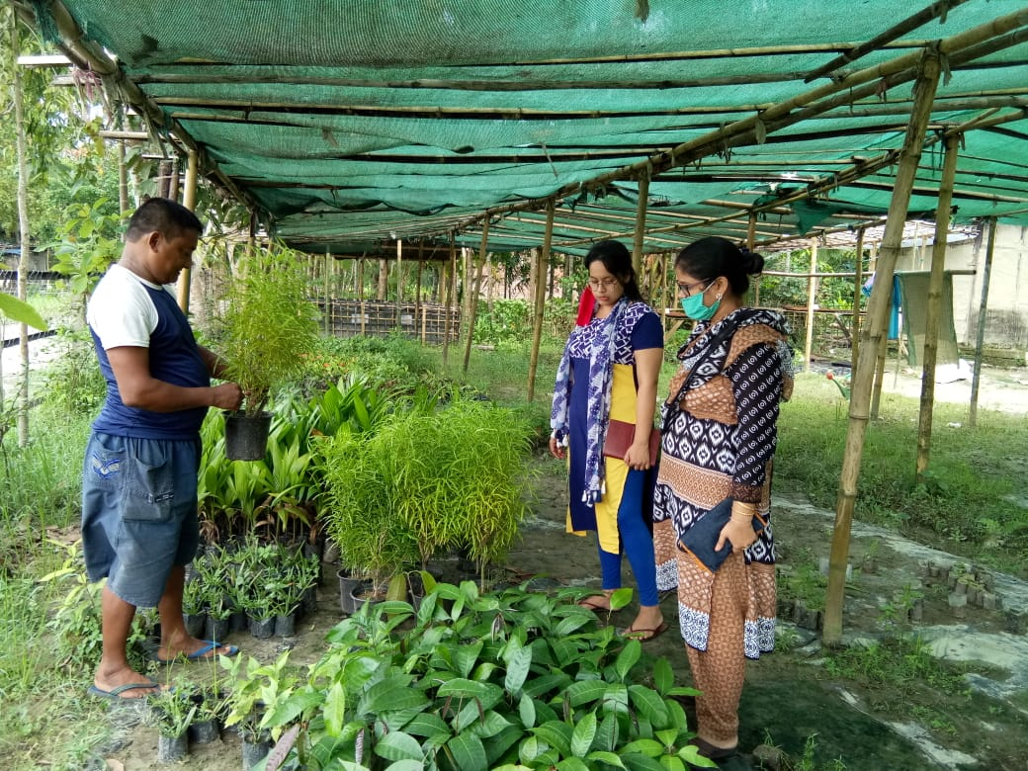
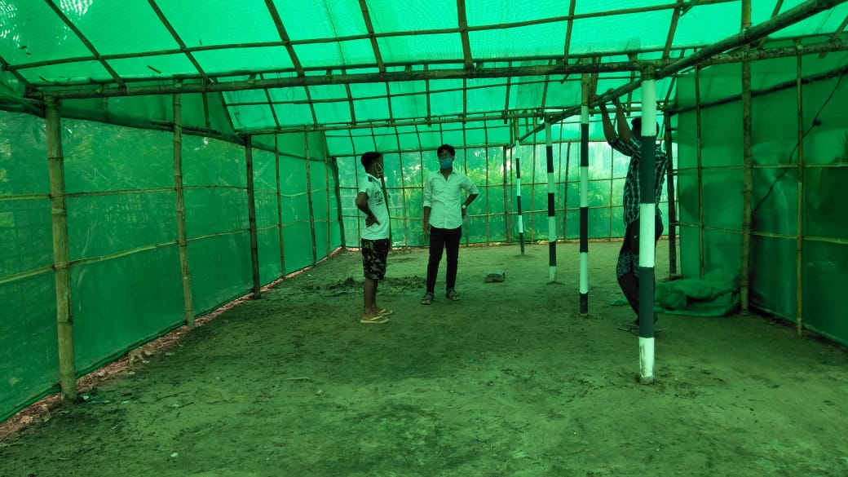
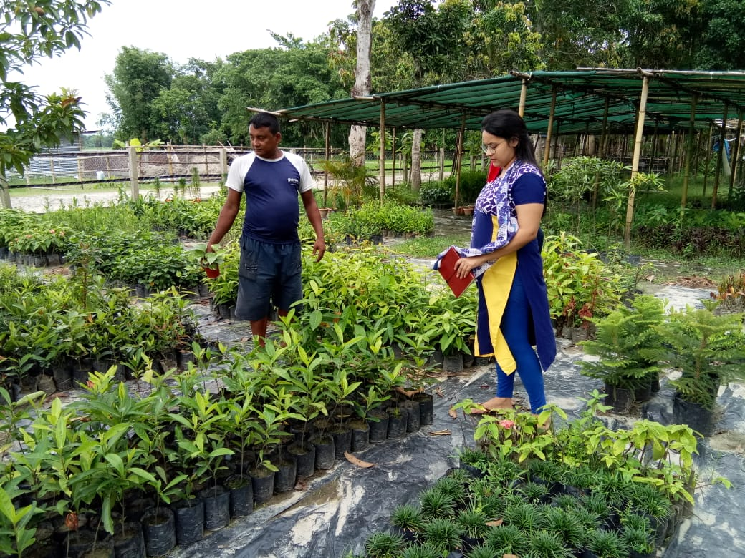
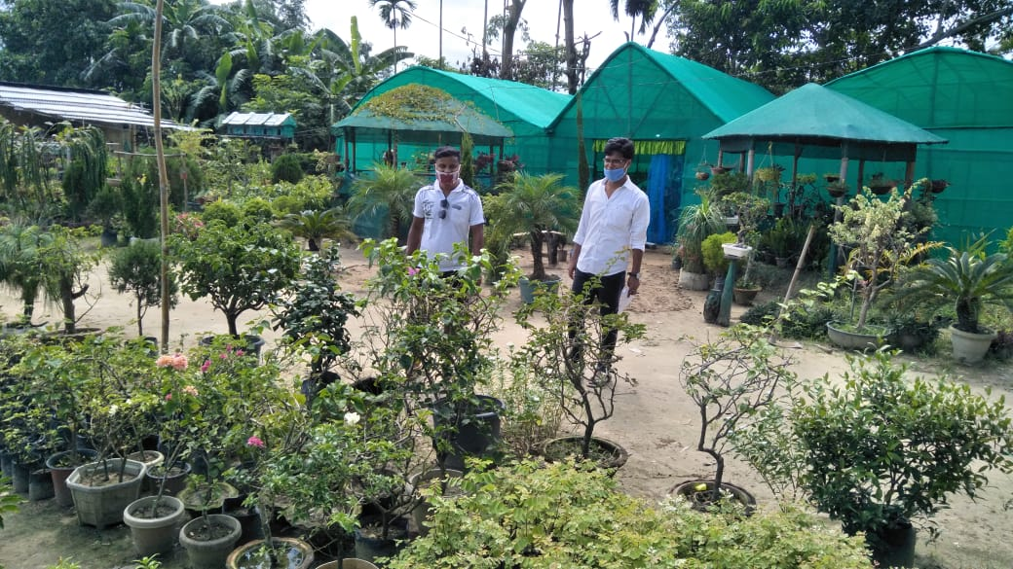
WorldVeg team at the nurseries of vegetable entrepreneurs

Slide 5
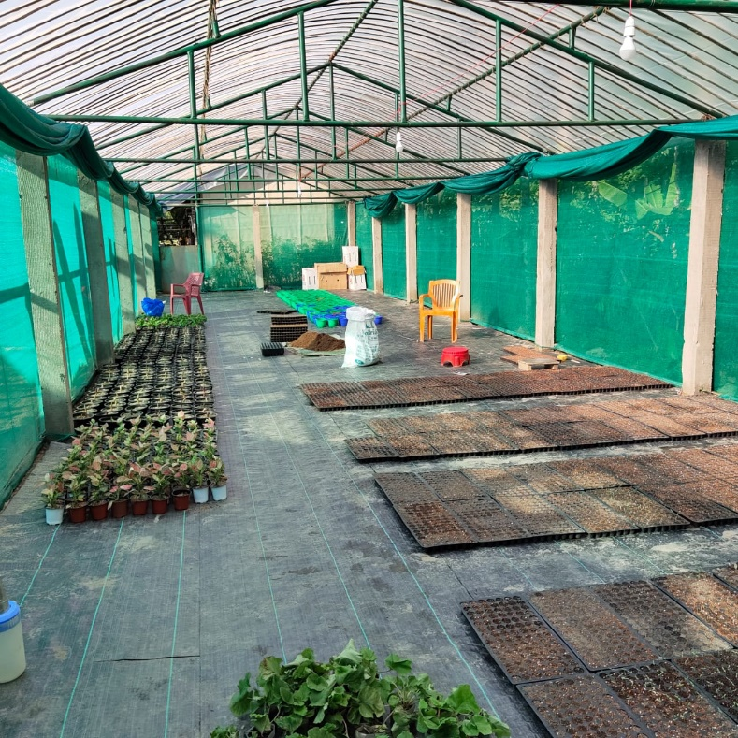
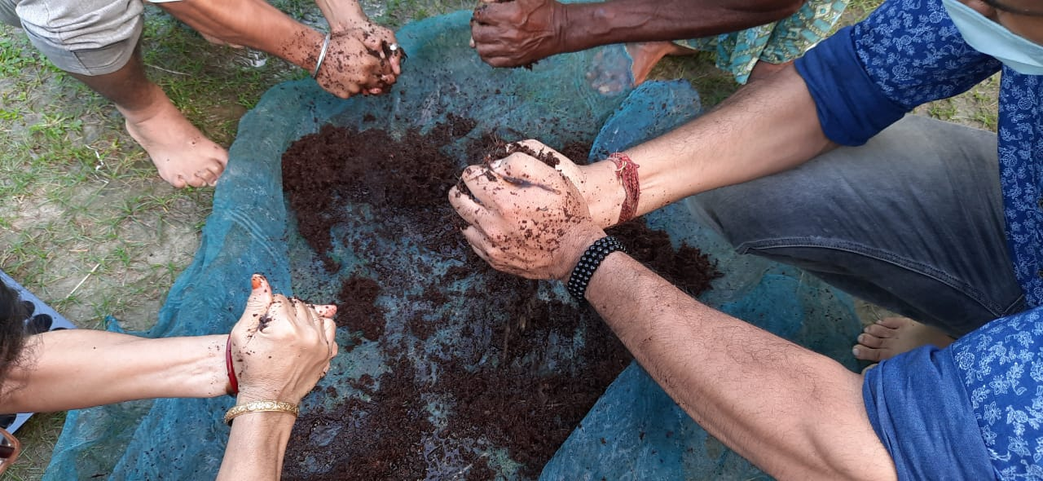
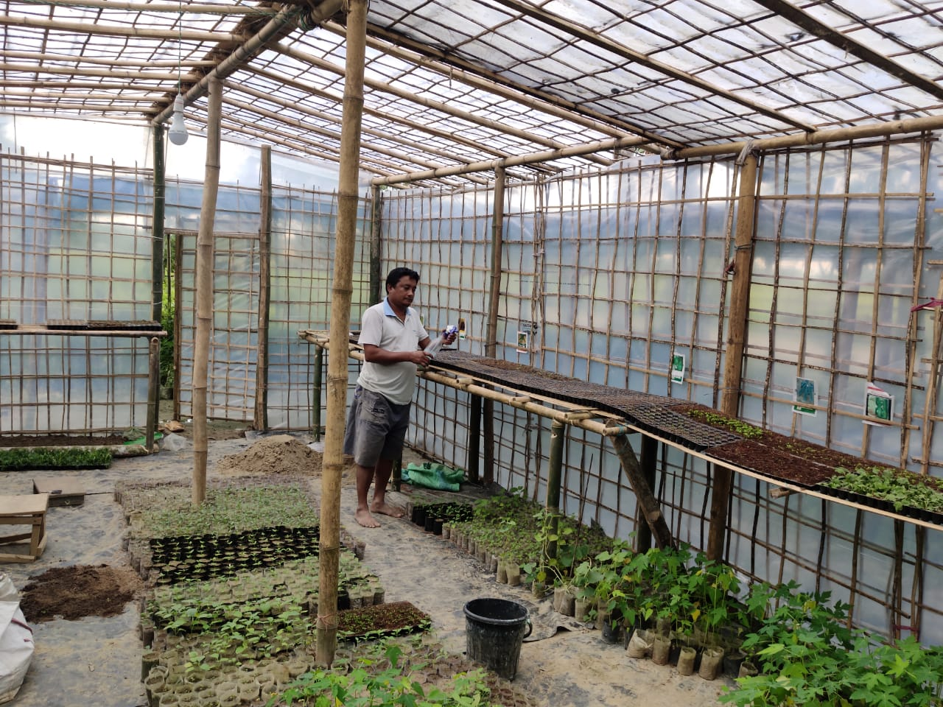
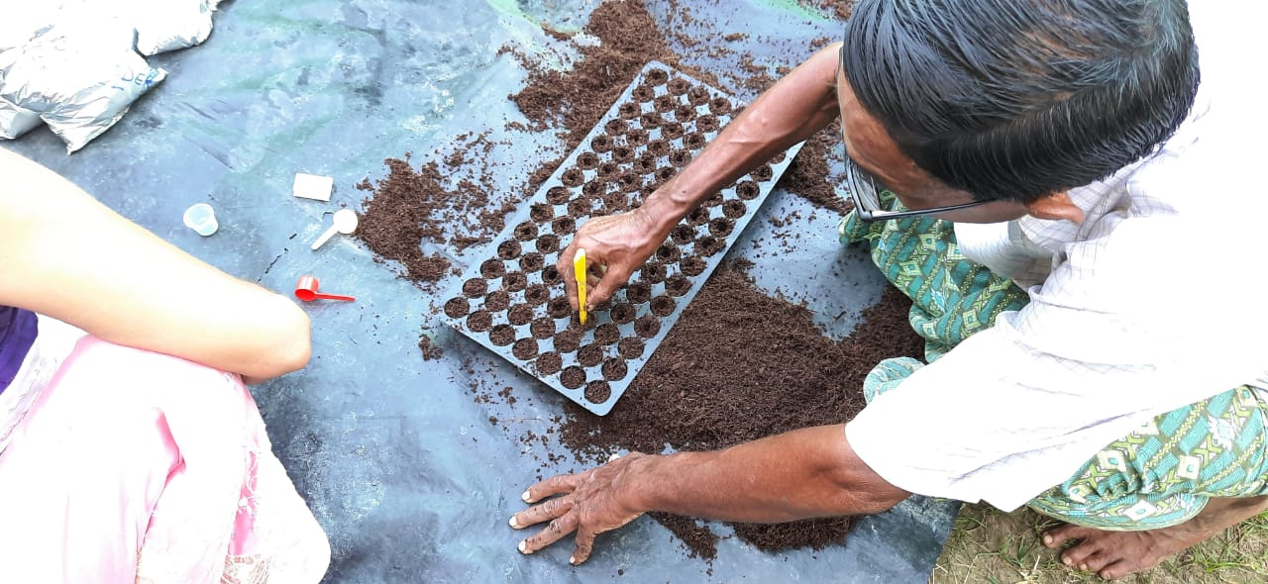
Some ongoing activities and training at the nursery of vegetable entrepreneur

