Slide 1
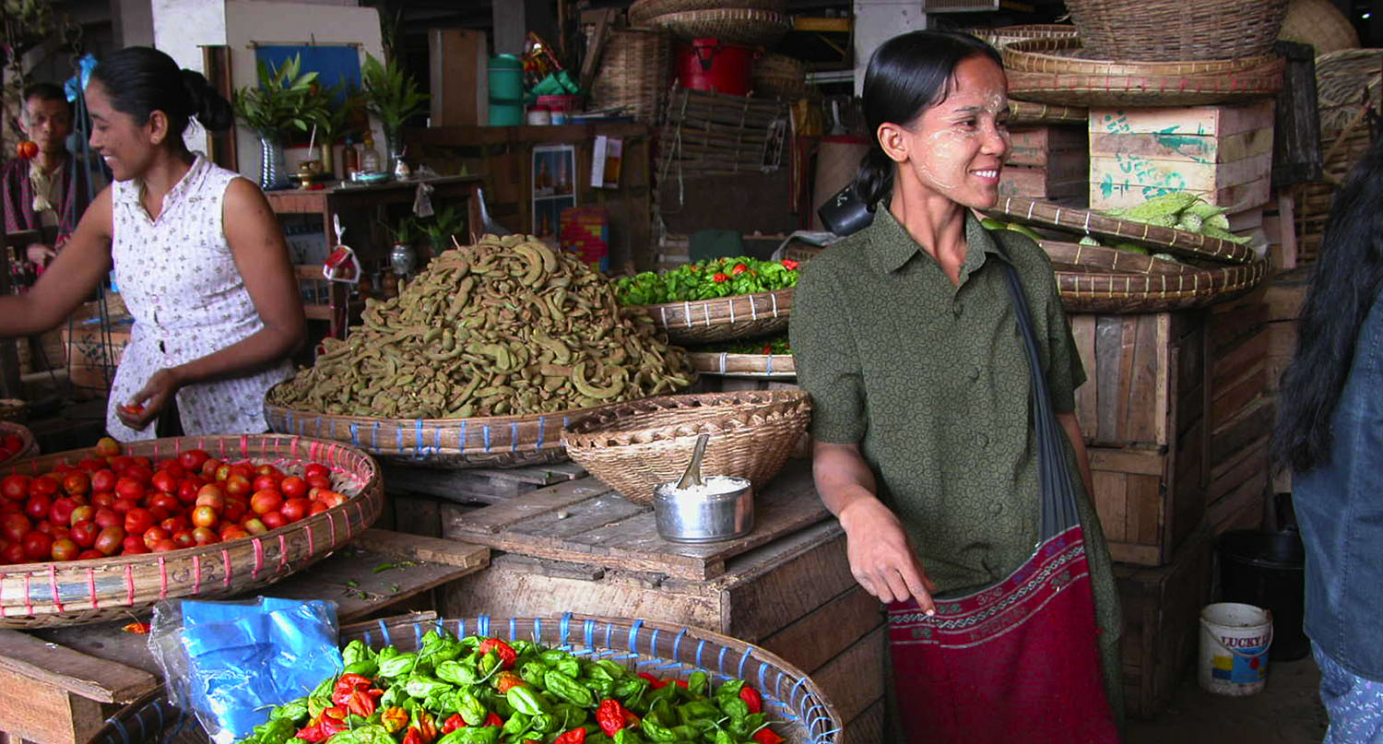

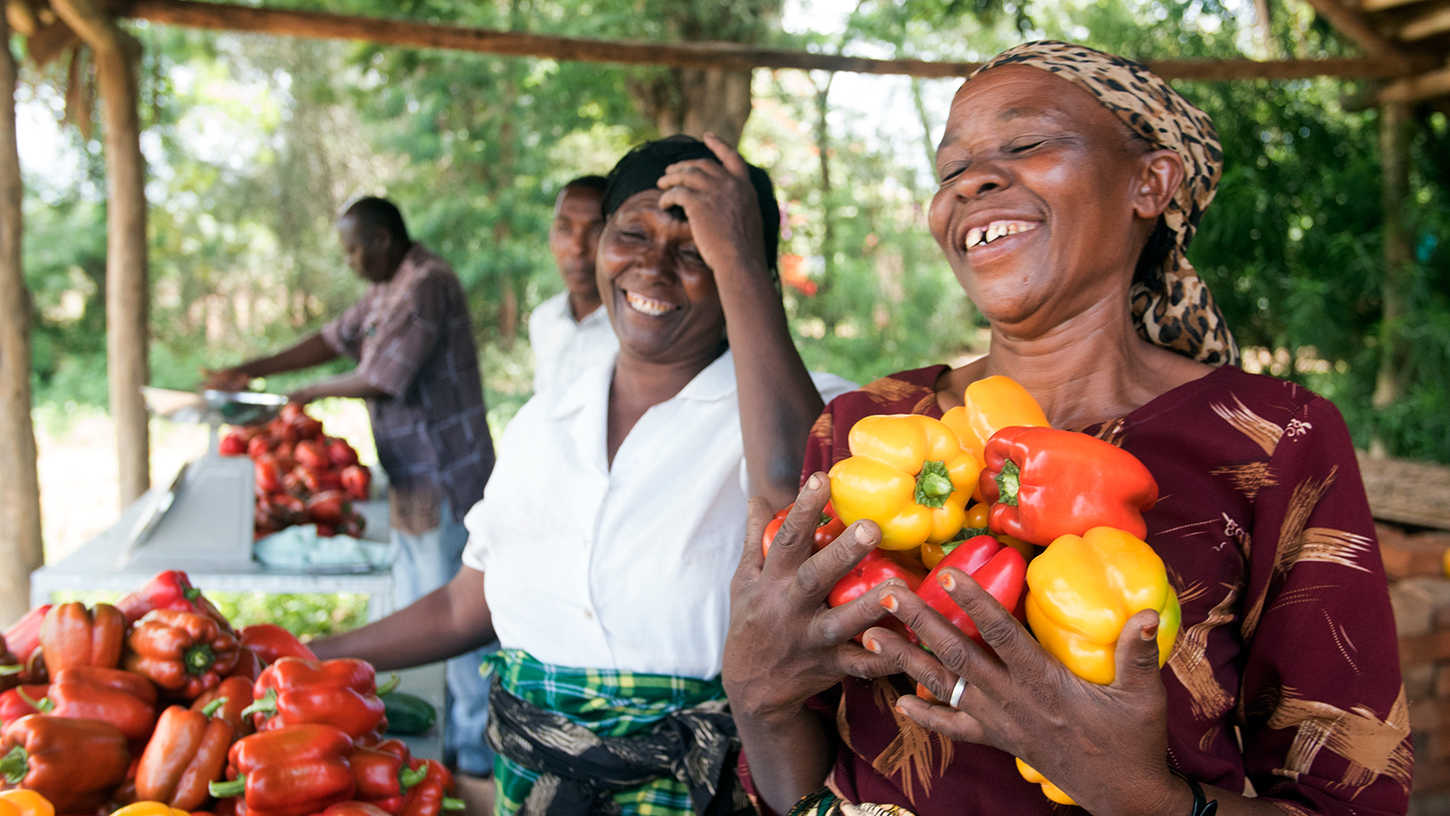
VEGETABLES!
Health, Resilience, Diversity
Notes:
Welcome to the World Vegetable Center. I’m here to tell you a little bit about what the Center does.
And by the end of this presentation, when you think of vegetables, I hope you will also think of these three words: HEALTH, EQUITABLE, and PROSPERITY.

Slide 2
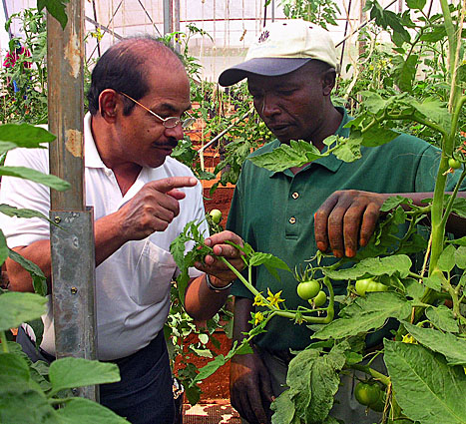
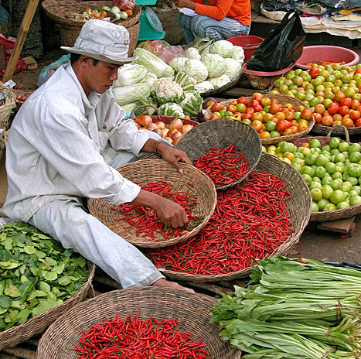
Some background…
MISSION
Conduct and share innovative vegetable research to alleviate malnutrition, enhance livelihoods, and build resilient food systems in the developing world
Founded in 1971 as the
Asian Vegetable Research and Development Center with a regional research focus on Asia
Nonprofit
Our research outputs are global public goods
Today the World Vegetable Center has an expanding global role with a growing network of regional offices
Notes:
We’ve been at our work for nearly four decades. We began as the ASIAN VEGETABLE RESEARCH and DEVELOPMENT CENTER, with a focus on tropical Asia.
Over time our geographical focus has shifted...but one thing that has remained the same is that we are NONPROFIT – our research outputs are global public goods and freely available for others to use.
This is our mission: Basically, we help farmers GROW MORE VEGETABLES and GROW THEM SAFELY, because vegetables are high-value crops that generate good income for farmers …. AND, WE WANT PEOPLE TO EAT MORE VEGETABLES, because vegetables have important nutrients we can’t get from any other source.

Slide 3
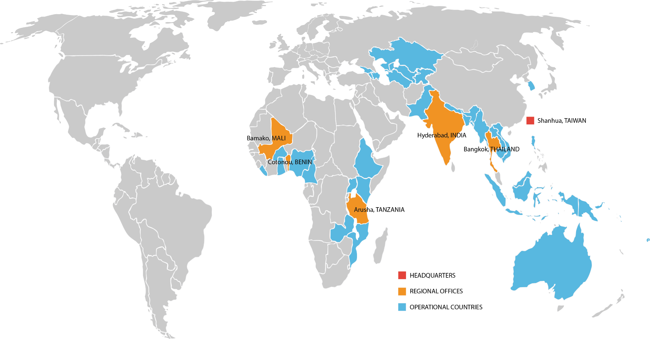
WORLD VEGETABLE CENTER
Notes:
This map shows where we now work around the globe. We have regional offices in
In Southeast Asia, Bangkok Thailand, where we have been since the early 1990s, and from there work in Indonesia, Vietnam, Myanmar and other countries in the region
We have three regional offices in Africa: One in Tanzania, one Mali, and one in Benin, working in sub-Saharan Africa from east to west
Our South Asia / Central Asia office opened in 2006; our base there is in Hyderabad, and we work in Pakistan, Nepal, Bhutan, and Bangladesh.

Slide 4
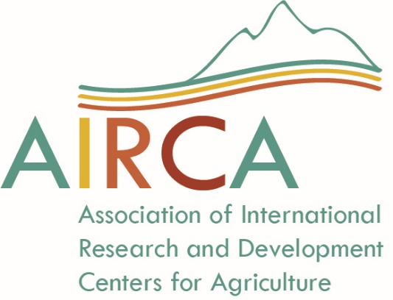
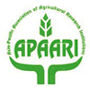
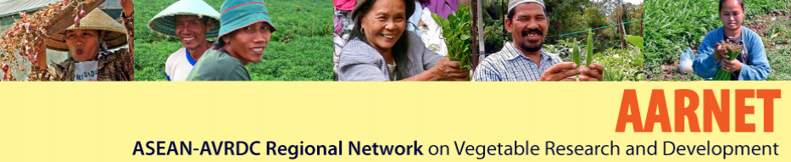


Networks are the link
Asia-Pacific Association of Agricultural Research Institutions
Central Asia and the Caucasus Regional Network for Vegetable Systems Research and Development
International Mungbean Improvement Network
Notes:
Networks are the link to our success….here are a few we work with in Asia. CLICK. You may recognize this one!

Slide 5
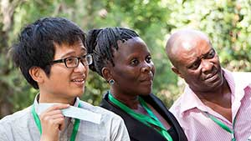
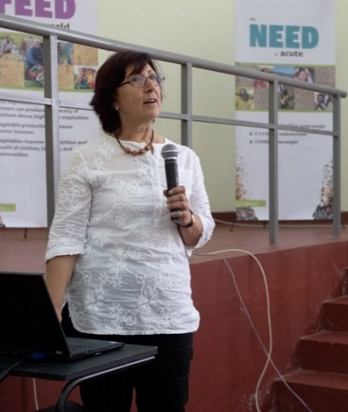
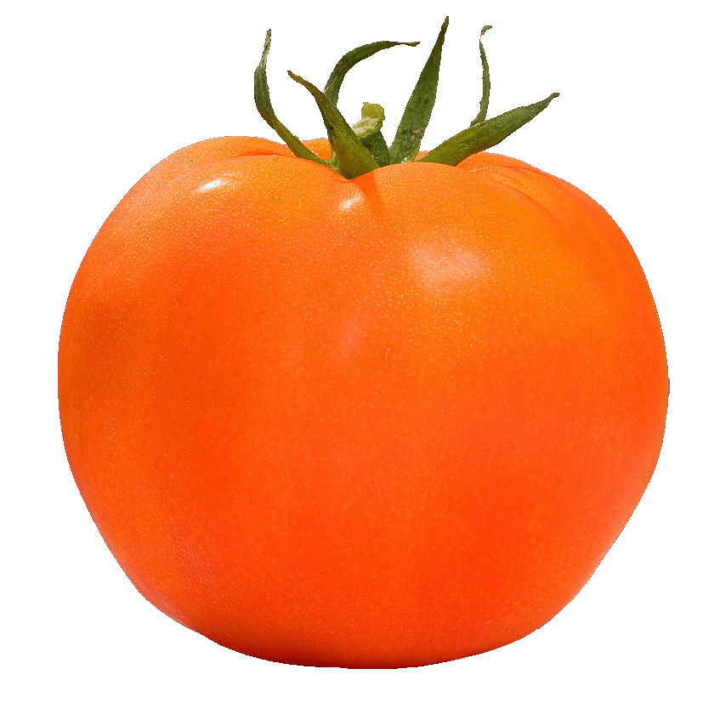
By the numbers…
~400 employees from 34 countries
67 professional staff with 28% women
USD 21 million annual budget
Notes:
The Center has about 350 employees from all around the world, with more than 60 professional staff.
Our annual budget is about USD 20 million. That funding comes from different countries, including our host country Taiwan, UK, USA, Australia, Germany, Thailand, Philippines, Korea and Japan. We work on specific projects that are funded by foundations
such as the Sir Ratan Tata Trust in India, and the Volkswagen Foundation in Germany. We also carry out some research that is supported by the private sector.

Slide 6
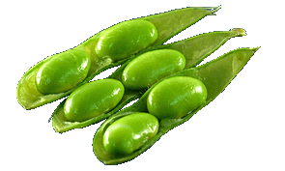
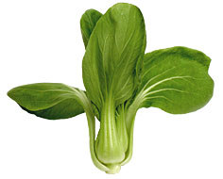
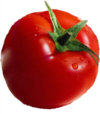
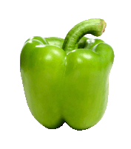
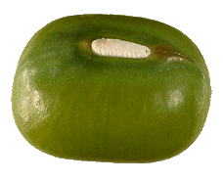
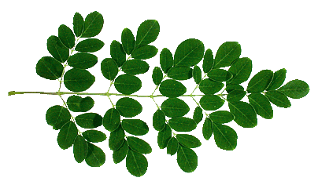
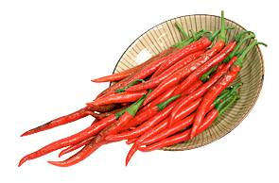
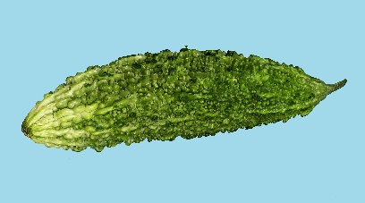
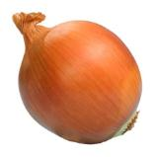
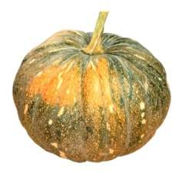
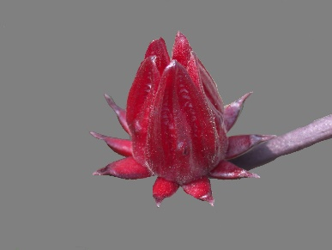
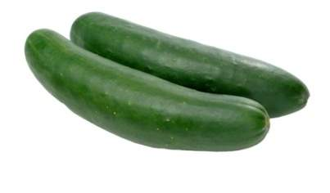
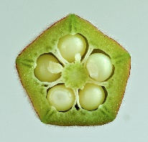
Our crop portfolio
  Legumes:
    Mungbean
    Vegetable
    soybean
  Cucurbits:
    Cucumber
    Pumpkin
    Bitter gourd
  Solanaceae:
    Tomato
    Pepper
  Bulb Alliums:
    Onion
  Traditional vegetables
Notes:
These are the crops the Center works with at this time. This portfolio changes periodically, depending on the needs of different regions.
I’d like to call your attention to Traditional Vegetables…these are plant species from specific locations that are eaten by people in local communities…some people call them vegetables, other people call them weeds -- I’ll tell you why they are important a little later.

Slide 7
Research to promote DIVERSITY
CROPS
  Growing several types of vegetables reduces farmers’ risk
CROPPING SYSTEMS
  More resilient in response to changing environment
DIETS
  A diverse diet provides a range of essential nutrients
  ECONOMIES
    Diverse agricultural economies offer opportunities to prosper all along the value chain, from primary production to processing and marketing
Notes:
There is strength in diversity.
Diversity in the field leads to diversity on the plate = improved nutrition

Slide 8
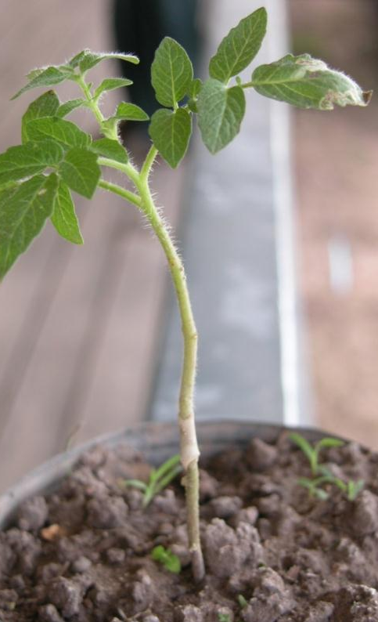
R & D Flagships
Seeds that Perform
Collect, conserve, characterize and use genetic diversity to improve vegetable crops.
Safe and Sustainable Value Chains
Build robust vegetable production / marketing systems with improved seed, good agricultural / postharvest practices.
Healthy Diets
Increase vegetable consumption / emphasize nutrition and health through behavior change communication, good agricultural and sanitation practices.
Enabling Impact
Develop scaling strategies for the Center’s technologies and interventions; conduct impact evaluation and policy research.
Notes:
8
The World Vegetable Center conducts research AND development activities.
That makes us unique; few other agricultural research institutes have development in their portfolios.
The Center’s work is structured under four flagships...and covers the agricultural spectrum: from seed to table, farm to fork. Each flagship works on innovations, and then develops products based on those innovations. Multidisciplinary.

Slide 9
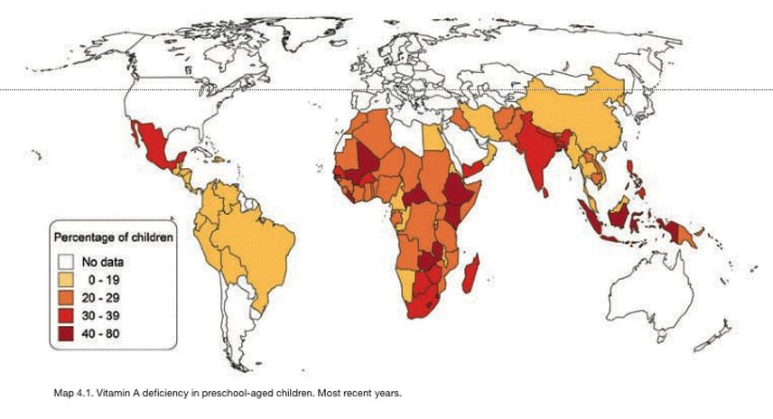
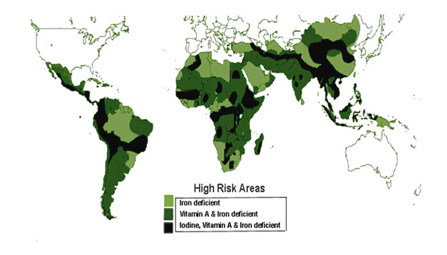
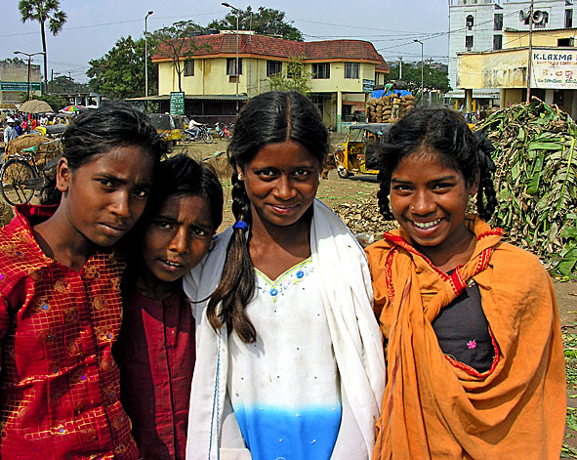
Each Year
2.7 million deaths due
to insufficient intake of micronutrients
“Hidden Hunger”: Micronutrient deficiencies
Each Year
Malnutrition causes nearly half (45%) of deaths in children under five: 3.1 million children each year.
Each Day
400 mothers die in childbirth due to iron deficiency
1400 children will go blind due to vitamin A deficiency
Each Year
6.6 million children under five die in developing countries due to malnutrition and hunger-related diseases
Source: WHO, Micronutrient Deficiencies, 2014
Vitamin A deficiency
Source: USAID; WHO, Micronutrient Deficiencies, 2015
Notes:
Why do we do this work? The Center aims to alleviate HIDDEN HUNGER, or micronutrient deficiencies in the diet. This lack of vitamins, minerals and other compounds necessary for good health – is a serious problem in the developing world.
A lack of vitamin A, for instance, is a major cause of preventable blindness in children, and weakens the immune system. The deficiency is especially acute in India and sub-Saharan Africa.

Slide 10
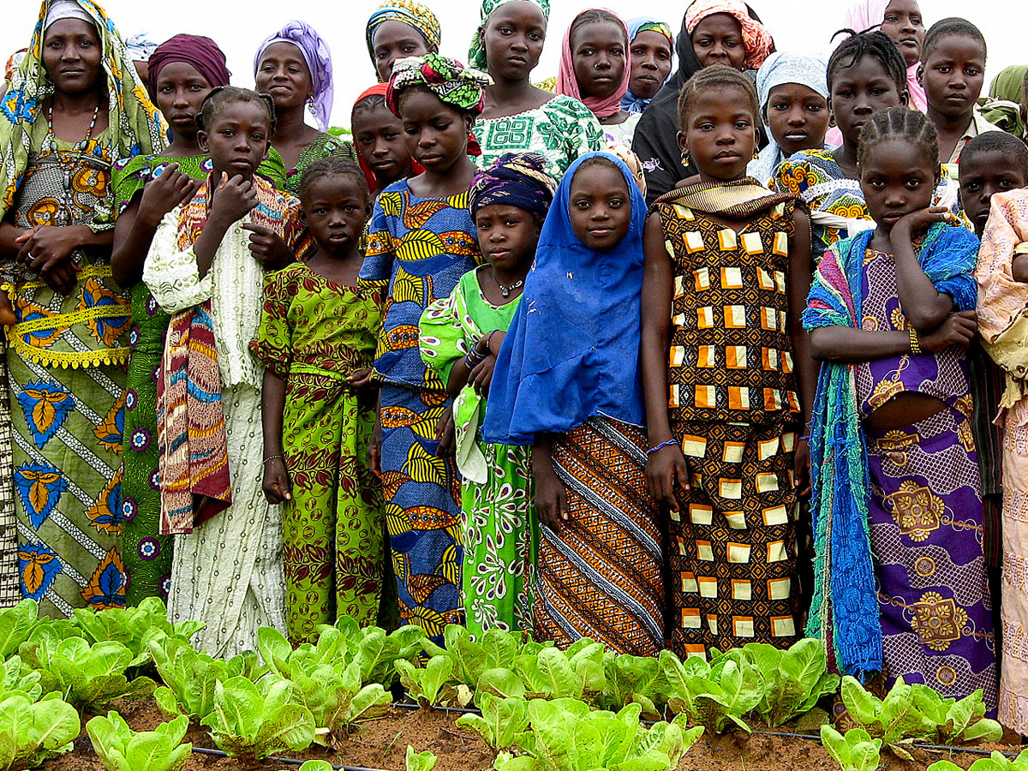



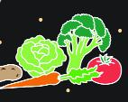
Imbalanced diets: Lack of micronutrients
Deficiency in
= HUNGER
= HUNGE
≥ 795 million
underweight
calories & protein
Deficiency in
= MICRONUTRIENT
DEFICIENCY
vitamins & minerals
2 billion
malnourished
Excess
calories
= IMBALANCED CONSUMPTION
≥ 1.9 billion
overweight
Source: WHO; IFAD; WFP, 2015
Notes:
10
But an interesting thing is happening worldwide – there are more people that are OVERWEIGHT than there are people who are HUNGRY. And there are many more people who are malnourished because their diets are imbalanced.
This imbalance in diets is leading to increased rates of obesity, diabetes, heart disease, other chronic diseases.
In a developing country, people might lack the money to purchase a diversity of food; but in developed countries, as people become more affluent, they tend to eat more processed foods, high in fat and calories.
No matter where it occurs, the lack of diversity in diets leads to the same result: poor health.
Rates of diabetes are rising fastest in developing countries
IFAD/FAO/WFP (2014) ‘The State of Food Insecurity in the World 2014, In. Rome, Italy: FAO. Worldwide obesity has more than doubled since 1980.

Slide 11
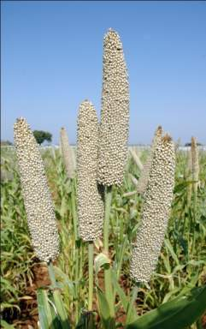

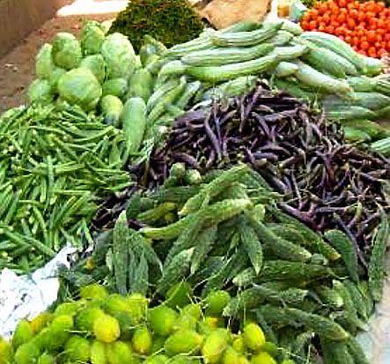
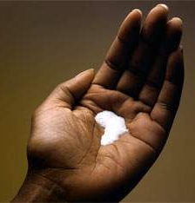
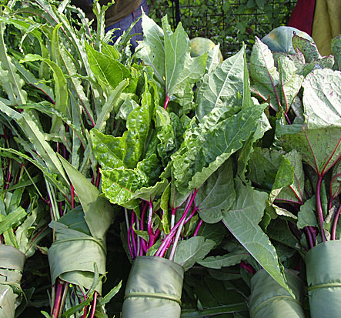

Fortification – or more diverse diets?
Iron and Zinc Biofortification
Iodization
Vitamin Supplementation
Notes:
There are several ways to address the lack of nutrients in the diet. For instance, taking vitamin supplements, or by breeding crops with higher nutrient content.
But the cheapest and easiest way to take in nutrients is by consuming a more diverse diet rich in vegetables. Our goal is not just food security – making sure people have enough to eat – but NUTRITION SECURITY – ensuring what they eat contributes the necessary vitamins and minerals for people to grow and thirve.
Slippery cabbage – has one of the highest levels of folate, a nutrient required by pregnant women. Very popular in the Solomon Islands...

Slide 12
High quality, nutritious: ‘Golden’ tomatoes
“Golden tomatoes”
  High quality
  Nutritious
  Good marketability
  Resistance to multiple diseases
One single improved tomato can provide a person’s full daily vitamin A requirements
Contain 3 to 6 times more
vitamin A
than standard types
Notes:
How can the World Vegetable Center help improve diets with vegetables? By making vegetables even more nutritious. The Center’s vegetable breeders aim to enhance the micronutrient content of vegetables.
Our “Golden tomatoes” are a good example
-- One single golden tomato can provide a person’s full daily vitamin A requirements
Vegetables are our best source of these important micronutrients. In most countries, developing or developed, vegetable consumption is much lower than it should be for good health. Recommendations are now about 400 g of fruit and vegetables per day, but few countries are at that level.
But the way in which vegetables are produced can be just as important for health….

Slide 13
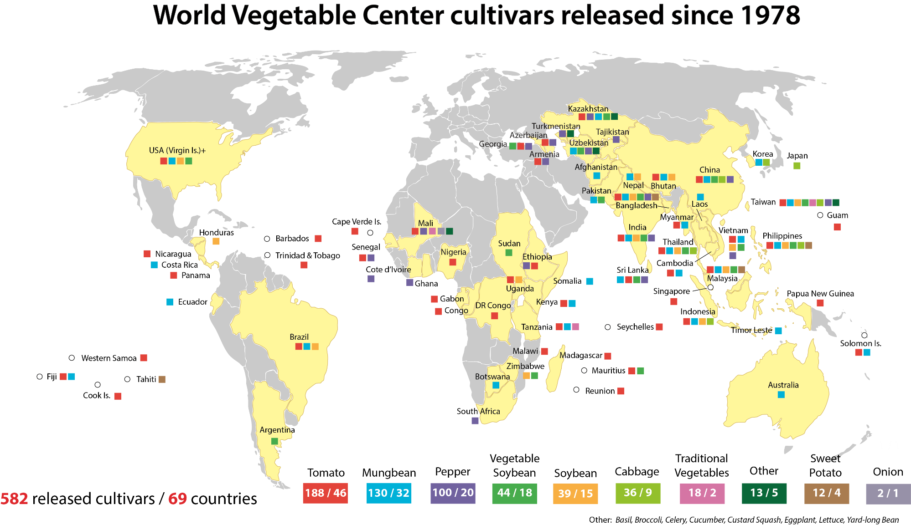
World Vegetable Center cultivars released since 1978
582 improved vegetable cultivars released in 69 countries
April 2017
Notes:
Over time the Center’s breeding work has had a big impact worldwide…hundreds of cultivars improved for production, nutrition and other characteristics have been released globally.
IMPORTANT: These are open-pollinated cultivars – so farmers can save their own seed.

Slide 14
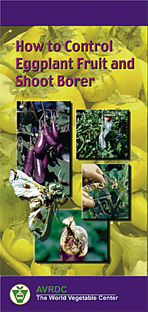
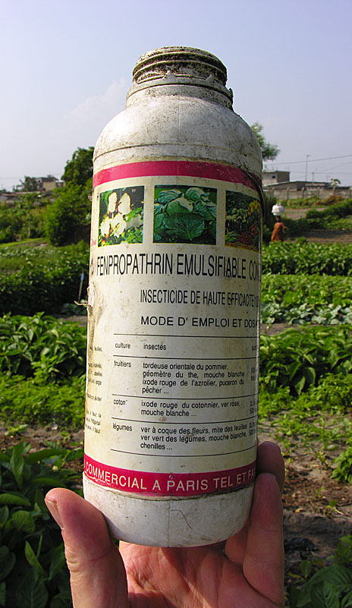
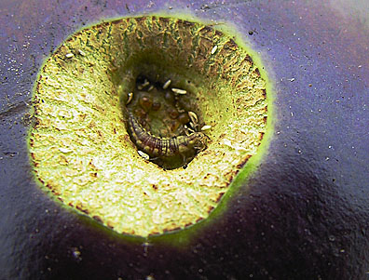
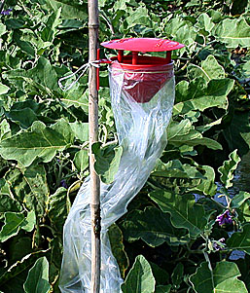
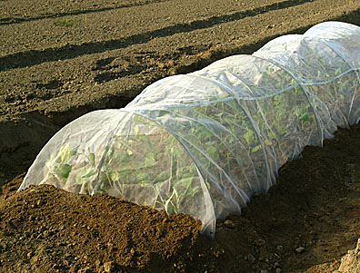
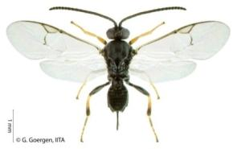
Produce vegetables safely!
Misuse of pesticides common throughout Asia and East Africa (e.g. eggplant: spray 140 and more times during 6 month cropping period)
Integrated pest management (IPM)
reduces pesticide use
Notes:
WorldVeg develops technology packages to help farmers grow vegetables SAFELY
Pesticide misuse is a serious problem in South Asia and Africa…in some places, eggplant farmers spray pesticides several times a week.
Integrated pest management methods, such as using a combination of pheromone traps, net shelters, and better cultivation practices, biocontrols like this parasitoid wasp, can significantly reduce the amount of pesticides farmers use.
In all our work, the Center promotes good agricultural practices.
Excessive use of cheap pesticides by farmers who lack protective equipment and knowledge about appropriate application methods is a growing global problem…it affects the health of farmers and consumers. Pesticide use is poorly regulated, and in parts of the developing world, pesticide poisoning causes more deaths than infectious disease. (The Lancet, Volume 360, Issue 9340, Pages 1163 - 1167, 12 October 2002)

Slide 15
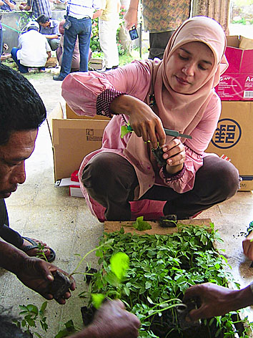
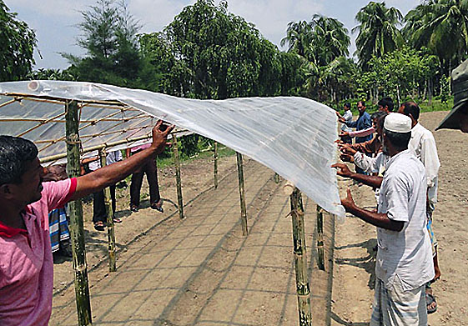
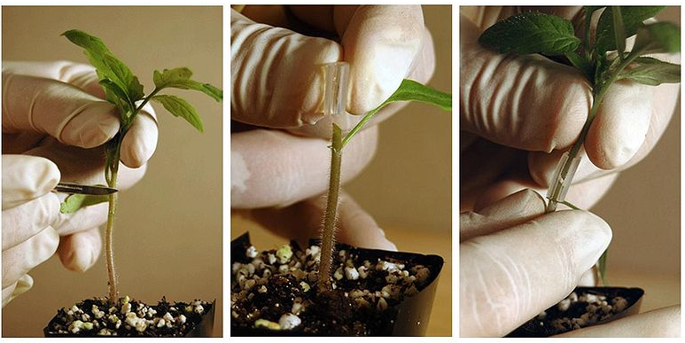
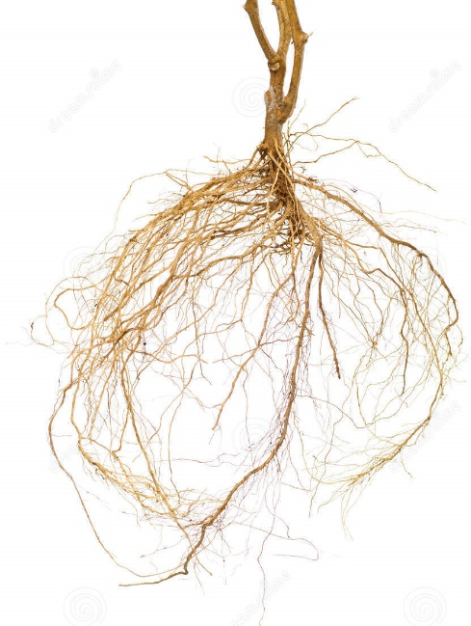
Field-tested innovations benefit small-scale farmers
INNOVATION: Grafting
Helps farmers overcome
flooding and soil-borne diseases
Simple rain shelters:
Protect high-value crops
PRODUCT: Resilient Rootstocks
Research into rootstocks with tolerance for wet or saline soils, resistance to bacterial wilt
Notes:
Center staff work with farmers to test and evaluate production innovations, such grafting and rain shelters.
More than 90% of Taiwan farmers have adopted the Center’s tomato and pepper grafting technology.

Slide 16
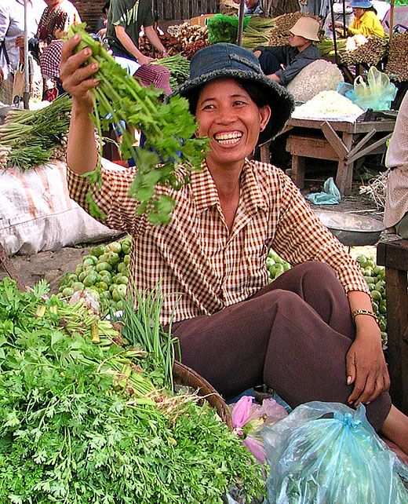
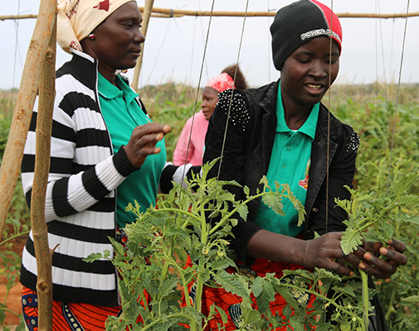
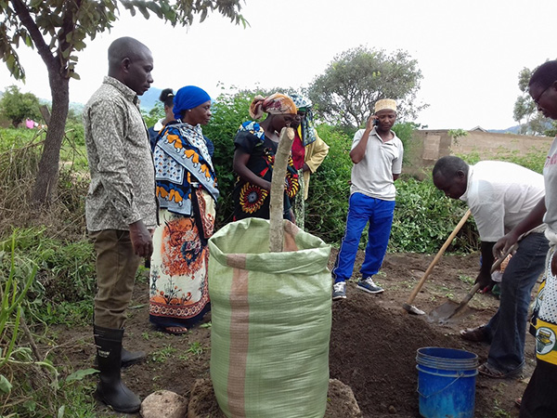
Vegetables: a path out of poverty
Smallholders often have a comparative advantage in producing vegetables
Vegetables generate higher farm income and more jobs than other crops, especially for women and young people
Vegetable value chains strengthen rural and urban economies
Notes:
Vegetables are good for health – and vegetable production is vital for a healthy agricultural economy.
Vegetables are high-value crops; they can generate good income for small-scale farmers. On small landholdings, producing vegetables can be more profitable than growing a staple crop like rice or maize.
Growing vegetables is labor-intensive, and it can be done year-round; this creates up to 5 times more jobs than other agricultural activities, especially for poor landless people.
Unlike grains, vegetables cannot be stored unless they are processed in some way – dried, pickled, made into sauce, etc. Vegetable processing businesses help develop and strengthen rural economies and infrastructure; offer economic opportunities for small-scale entrepreneurs.
URBAN AGRICULTURE – more than half of the world’s population lives in cities. With methods such as rooftop and vertical gardens, an opportunity to produce nutritious food close to where people live. Reduce need for long-distance transport.
It’s one thing to grow vegetables -- but getting them to market is another issue altogether...
Year-round vegetable production provides more secure employment options for poor landless people than cereal crops, where they may only be required at transplanting and harvest times.

Slide 17
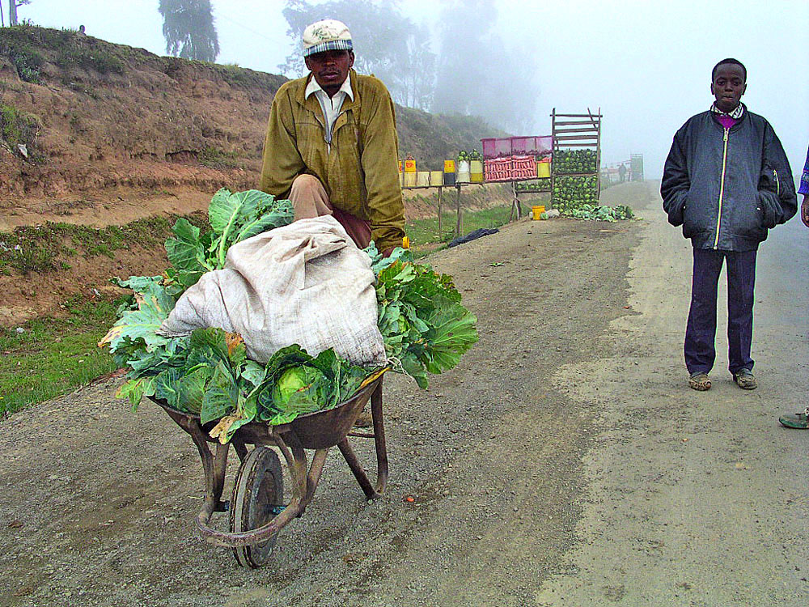
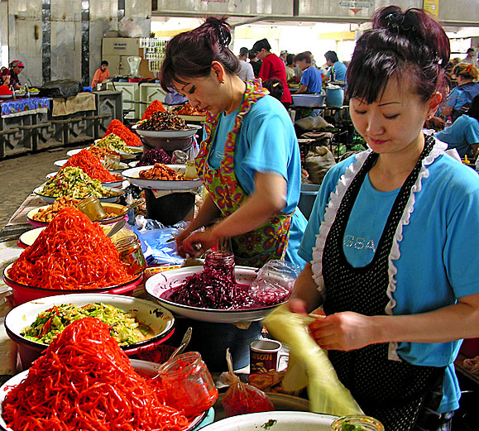

Lack of postharvest storage & processing:
Up to 40% of vegetable crops are lost from field to shelf
Notes:
Losses can be serious…due to poor infrastructure and handling methods.

Slide 18




Postharvest Training & Services Center
One-stop shop for equipment, advice, services, and ideas to improve postharvest handling of
fresh produce
Notes:
The Postharvest Training and Services Center at WorldVeg Eastern and Southern Africa in Arusha, Tanzania, provides harvesting equipment and materials at cost to farmers, and also offers packing and cold storage services, and training, too.
With the right tools and knowledge, farmers can bring more of the harvest to market in good condition – and realize more profit for their hard work.

Slide 19




* public
The world’s largest* collection of vegetable germplasm:
WorldVeg Genetic Resources and Seed Unit Genebank
Notes:
This is where all our raw material is stored – the WorldVeg genebank. The genebank was expanded in 2010, doubling the storage area with new refrigeration units. And Taiwan has been a very generous supporter of our genebank facility.

Slide 20


Germplasm accessions conserved – 5/2017
Principal crops Other crops Total
No. of accessions 56,071 4,138 60,209
No. of genera 173
No. of species 440
Countries of origin 151
Notes:
The Center conserves more than 60,000 accessions of vegetable germplasm from around the world in our genebanks at headquarters and in Africa. Most of it is in the form of seed.
That includes the world’s largest collection of tomato and pepper germplasm, and second largest collection of eggplant.
Why do we need such a large collection? We use this crop diversity:
-- for higher yields, and more stable yields under conditions of stress – drought, flooding, salinization
-- better resistance to pests and disease
-- better nutritional quality
-- improving high-value features such as color and texture, which are important for local market preferences.
With 400-plus species, we can find a vegetable to suit almost any growing condition.

Slide 21




Order seed: avrdc.org
Global reach: 52 countries received seed from the WorldVeg genebank in 2015 - 2016
Notes:
Although we have a lot of seed, we are not a seed company! What we do is distribute seed samples to researchers, universities, farmers, and private sector companies around the world. They use them for their own purposes: An NGO might take the seed multiply it, and share it with their beneficiaries. A private sector company might take one of our breeding lines, use it to develop a hybrid, and then sell the seed to farmers.
The Center’s research tends to focus on open-pollinated lines, so that farmers can save their own seed from season to season.
We distribute about 6,000 - 10,000 seed samples EACH YEAR

Slide 22


Climate-smart agriculture
High yielding tomato variety
Wild tomato relatives - source of drought tolerance, pest and disease resistance
Notes:
Why do we need all this seed? I think you know! Flooding, drought, heat, and other kinds of environmental stress are serious issues facing farmers as climates patterns change around the world. From accessions in the genebank, our breeders select characteristics and qualities to breed into improved varieties…on the right is a wild tomato (S. chilense), able to withstand severe drought…breeders select those genes from these hardy species to breed into better production varieties.
Food security begins...with crop diversity.

Slide 23



Food security: 15 crops...or 2,000 crops?!
Notes:
The world’s food supply relies on a very small number of crops...about 15 to 20 staples. But there are about 7000 edible plants, and about 2000 of those are vegetables.
Traditional vegetables tend to be very high in nutrients and are important sources of food in times of scarcity for some of the poorest people. With improved seed, these species can generate income for smallholder farmers.

Slide 24










Traditional treasures: diet diversity
Moringa
African eggplant
Spider plant
Nightshade
Ethiopian kale
Cowpea
Rice Paddy Herb
Amaranth
Notes:
Here are some five of the most popular traditional vegetables in Africa...the demand for these “traditional” vegetables is increasing in urban markets. The Center has been working to improve seed production and distribution of these species, to ensure farmers can get seed when then need it.
Spider plant is one crop we’ll be doing more research on – it’s a C4 plant, has good tolerance for drought and heat – important as the climate changes.

Slide 25





Micronutrient content of common and traditional vegetables
Traditional vegetables: Rich in nutrients
 | Ranges | Cabbage | Moringa | Amaranth | Aibika | Sweet potato leaf
β-Carotene,mg | 0.0 - 22 | 0.00 | 15.28 | 9.23 | 5.11 | 6.82
Vit C, mg | 1.1 - 353 | 22 | 459 | 113 | 82 | 81
Vit E, mg | 0.0 - 71 | 0.05 | 25.25 | 3.44 | 4.51 | 4.69
Iron, mg | 0.2 – 26 | 0.30 | 10.09 | 5.54 | 1.40 | 1.88
Folates, μg | 2.8 – 175 | ND | 93 | 78 | 177 | 39
Antioxidant activity, TE | 0.6 - 82,000 | 496 | 2858 | 394 | 560 | 870
Source: WorldVeg Nutrition Lab
Notes:
Why are traditional vegetables important? Many are very high in nutrients, more so than common popular vegetables. Well-adapted, easy to grow.
More research needed on indigenous vegetables.

Slide 26




Vegetable production is knowledge intensive
Building capacity for resilience
Notes:
Capacity building is vital to the success of all the Center does; it ensures continuity of our programs. We have a saying: Vegetable production is knowledge intensive…farmers have to know a great deal about soil and climate, which varieties will grow best in their areas, how to use the most effective methods to grow specific varieties, how to protect their crops and safely fight pests and disease, how to carry out the harvest…the list goes on…training helps .
International Training Course – held for more than 30 years in East and Southeast Asia Office. Participants come from all over the world to learn about germplasm collection, production, and marketing. The Center regularly conducts courses with our national partners and NGOs to train farmers in production and evaluation methods.
VINESA Training young people to become agripreneurs – to see agriculture as a profitable career --
Learning and sharing information is vital to progress for farmers and researchers alike.

Slide 27




Healthy diets begin with knowledge
Notes:
Center has initiatives to introduce students to vegetable growing through school garden projects. We also have a Nutrition Unit here that conducts nutritional analyses of crops and develops improved recipes to ensure people prepare vegetables to get the maximum benefit from the nutrients.
VEGETABLES GO TO SCHOOL : new school garden initiative for Bhutan, Nepal, Tanzania, Burkina Faso, Indonesia, Philippines Pilot school garden project in Philippines: 8000+ schools reached by 2008; in 2012, the government introduced this program to ALL public schools in the Philippines.
Oh My Gulay! Public awareness campaign inspired by a visit of Philippines legislators to AVRDC.

Slide 28




Healthy Home Garden Kits
To public and private agencies upon request
Each kit includes seed of high yielding & nutritious vegetables
Enough seed (2-50 g) of each crop to plant a home garden and sustain a healthy diet for a family of 4 for a year
Notes:
The Center has conducted research on home gardens for 40 years. HOME GARDENS:
-- provide a ready, low or no-cost supply of fresh, nutritious vegetables for the family
-- create home based employment, especially for women (processing, preserving, etc.)
-- generate income for the household through the sale of surplus vegetables
The Center’s Healthy Home Garden Kits can supply vegetables year-round. They come with seed specially selected for the local agroclimate and local preferences. These have been distributed in India, Cambodia, Tanzania, Uganda, Kenya and many other countries.

Slide 29









Linking private and public sectors
Notes:
The Center is a connector, bringing together the needs of public with the aims of the private sector. The public needs good quality seed; the private sector uses our breeding lines to develop the varieties the market wants.

Slide 30



Participatory variety trials from Africa to Asia
Farmers evaluate accessions for yield, color, size, and other characters. Promising lines undergo on-farm and multilocation trials for awareness, adoption and release.
Notes:
The Center works with farmers and national agriculture ministries to select lines of global and traditional species…they know what the local market wants. For instance, through farmer evaluations, we know customers in Mali prefer red-leaved roselle, while those in Senegal prefer green-leaved roselle. This kind of information helps farmers become more responsive to the market, enabling them to generate more household income.

Slide 31

Key points
Vegetables are essential for HEALTH
Research builds on GENETIC DIVERSITY
Vegetable production is an engine for ECONOMIC GROWTH and HIGHER INCOMES
Notes:
Leave you with a few points to remember:
-- Vegetables are vital for good nutrition…our work here is focused on increasing the nutritional quality and production characteristics of vegetables and ensuring people have access and opportunities to improve their diets with vegetables…
-- We collect and use a broad base of vegetable germplasm to develop productive, resilient, reliable vegetable lines
-- Vegetable production is one of the best ways to provide jobs and better incomes for rural and urban dwellers in developing countries.

Slide 32







Thank you!
World Vegetable Center
Notes:
Thank you!
If you have any questions, I’ll do my best to answer.

Slide 33
Projects with USAID
Cereal-based Systems of West Africa: Vegetables and associated best management practices in cereal-based crop production systems to improve income and diets of rural and urban households in Northern Ghana & Southern Mali | 2012 – 2016
Deploying Improved Vegetable Technologies to Overcome Malnutrition and Poverty in Mali | 2014 – 2017
Enhancing partnership among Africa RISING, NAFAKA and TUBORESHE CHAKULA programs for fast-tracking delivery and scaling of agricultural technologies in Tanzania | 2014 – 2016
Africa RISING: Enhancing vegetable value chains in rice-based and sole crop production systems to improve farm household income and consumer access to safer vegetables in Morogoro, Tanzania | 2014 – 2016
Promoting science and innovation in agriculture in Pakistan – Agricultural Innovation Program | 2013 – 2017
AVRDC Postharvest Program | 2012 – 2017
Deploying vegetable seed kits to tackle malnutrition in Cambodia, in Kenya, Uganda, Tanzania and Liberia | 2014 – 2017
Notes:
Australian Centre for International Agricultural Research -- about 3 million

Slide 34
EXTRA SLIDES…

Slide 35
Projects with ACIAR
Increasing productivity of allium and solanaceous vegetable crops in Indonesia and sub-tropical Australia (IMPROVED VARIETIES)
Improving livelihoods with innovative cropping systems on the East India plateau (MUNGBEAN)
Strengthening integrated crop management research in the Pacific Islands in support of sustainable intensification of high-value crop production (IMPROVED VARIETIES AND PRODUCTION SKILLS)
Promoting traditional vegetable production and consumption for improved livelihoods in Papua New Guinea and Northern Australia (SEED AND TRADITIONAL VEGETABLES)
Improving income and nutrition in Eastern and Southern Africa by enhancing vegetable-based farming and food systems in peri-urban corridors (YOUTH EMPLOYMENT IN HORTICULTURE)
Notes:
Australian Centre for International Agricultural Research -- about 3 million

Slide 36


Working With the Private Sector
Working with the private sector:
75% of seed companies in Asia use improved lines from AVRDC
Notes:
AVRDC breeding lines are used throughout the world…We’re involved with several seed associations on different continents, such as the Asia Pacific Seed Association, the West African Seed Alliance, and the African Seed Trade Association, to share germplasm and research.

Slide 37

Source: IFPRI, 2014
Notes:
That is a reflection of the distribution of hunger globally...concentrated in sub-Saharan Africa and South Asia.

Slide 38




Major national impacts: Tanzania
Increasing productivity due to new lines / varieties from AVRDC – The World Vegetable Center and national partners
+ 40%
Notes:
Sometimes called “the Red Revolution” – two tomato lines developed by AVRDC increased tomato production by 40%
in TanzaNIA…with a thicker skin the tomatoes can withstand shipping on rough roads, and TanzaNIA is now exporting tomatoes to neighboring countries. New varieties (‘Tengeru 2010’ and ‘Duluti’) were recently introduced with better heat-tolerance and improved resistance to disease.

Slide 39





Disaster Relief Seed Kits
Notes:
The Center also provides Disaster Relief Seed Kits: 2004 tsunami in Sumatra & Sri Lanka, Typhoon Morakot in Taiwan, 2010 earthquake in Haiti
Recently, the Center handed over 10,000 seed kits to Thailand for victims of 2011 flooding...
Kits contain seed of locally adapted, nutritious, fast-growing vegetables planting instruction in local languages. Help survivors rebuild their lives.

Slide 40







Improved Postharvest Techniques: Vietnam, Tanzania
Low-cost processing and packaging methods for chili sauce, tomato paste, pickles and other products add value
and availability of vegetables throughout the year
Notes:
AVRDC develops simple postharvest technologies such as solar dryers and evaporative coolers to help farmers overcome some of the difficulties of getting produce to the market. We’ve done a lot of work in Southeast Asia to help farmers find better ways to pack, transport and process tomatoes and chili peppers.
Value-added production like a sauce-making facility in Vietnam, ensure that more of the harvest will be consumed, more income will go to farmers and processors, and more jobs created in food processing. Grower, got involved in processing, he now employs about 100 people.

Slide 41






Advanced molecular marker breeding approaches
Molecular markers for tomato yellow leaf curl virus disease
Resistant
H H H H S R R H H R S H R H R R H
Susceptible
Notes:
Our researchers use molecular technology to enhance conventional breeding practices. With a technique called marker-assisted selection, breeders can screen a large number of plants in a population for traits of interest, such as resistance to a particular pest or disease, or fruit size, color, and so forth. The selected plants are then used for breeding programs. The information helps speed up the breeding process, which allows AVRDC to more quickly introduce new lines with the desired traits.
About 70 viruses cause tomato yellow leaf curl virus disease, a devastating disease in the tropics. Our breeders use strategies to develop stable resistance with multiple TY genes – called gene pyramiding.
Transgenic – no. We have transgenic greenhouses, conduct occasional research, but release no lines.

Slide 42




Slide 43

Chronic diseases: Why diet matters
Source: IDF Diabetes Atlas, 2014
Notes:
Need for more nutritious diets: Prevalence (%) estimates of diabetes (20-79 years), 2030. China is at about 8%, India is about 8%. Noncommunicable diseases on the UN agenda. Many are preventable
Diet can help control chronic diseases like diabetes.

Slide 44


Bitter gourd: High value
Momordica charantia can help millions in the developing world who suffer from metabolic disorders such as type-2 diabetes.
To be successful on a global scale, this indigenous crop requires attention from breeders and production system specialists.
Notes:
Bitter gourd is a promising indigenous vegetable. Compounds in bitter gourd may help lower blood glucose. AVRDC is now evaluating bitter gourd germplasm as the first step in improving this important species. With funding from the German Ministry for Economic Cooperation and Development, the AVRDC nutrition unit is collaborating with National Taiwan University, Justus-Liebig University Giessen in Germany, and institutions in India and Tanzania to research bitter gourd’s biochemical effects and antidiabetic properties.

Slide 45

Recipes: Good taste, good health
Notes:
Recipes help people learn how to prepare tasty dishes with maximum nutritional benefit….AVRDC ‘s nutrition group conducts nutritional analyses of vegetables and develops new recipes

Slide 46

AIRCA: An independent consortium
Association of International Research and Development Centers for Agriculture
^{World Vegetable Center}
^{CABI}
Tropical Agriculture Research and Higher Education Center (CATIE)
^{Crops for the Future (CFF)}
International Center for Biosaline Agriculture (ICBA)
International Center for Integrated Mountain Development (ICIMOD)
Africa Insect Science for Food and Health (icipe)
International Network for Bamboo and Rattan (INBAR)
^{IFDC}
Notes:
AVRDC is one of the founding members of AIRCA – the Association of International Research and Development Centers for Agriculture. This consortium of like-minded groups aims to address cross-sector issues at landscape scale.

Slide 47



