Slide 1
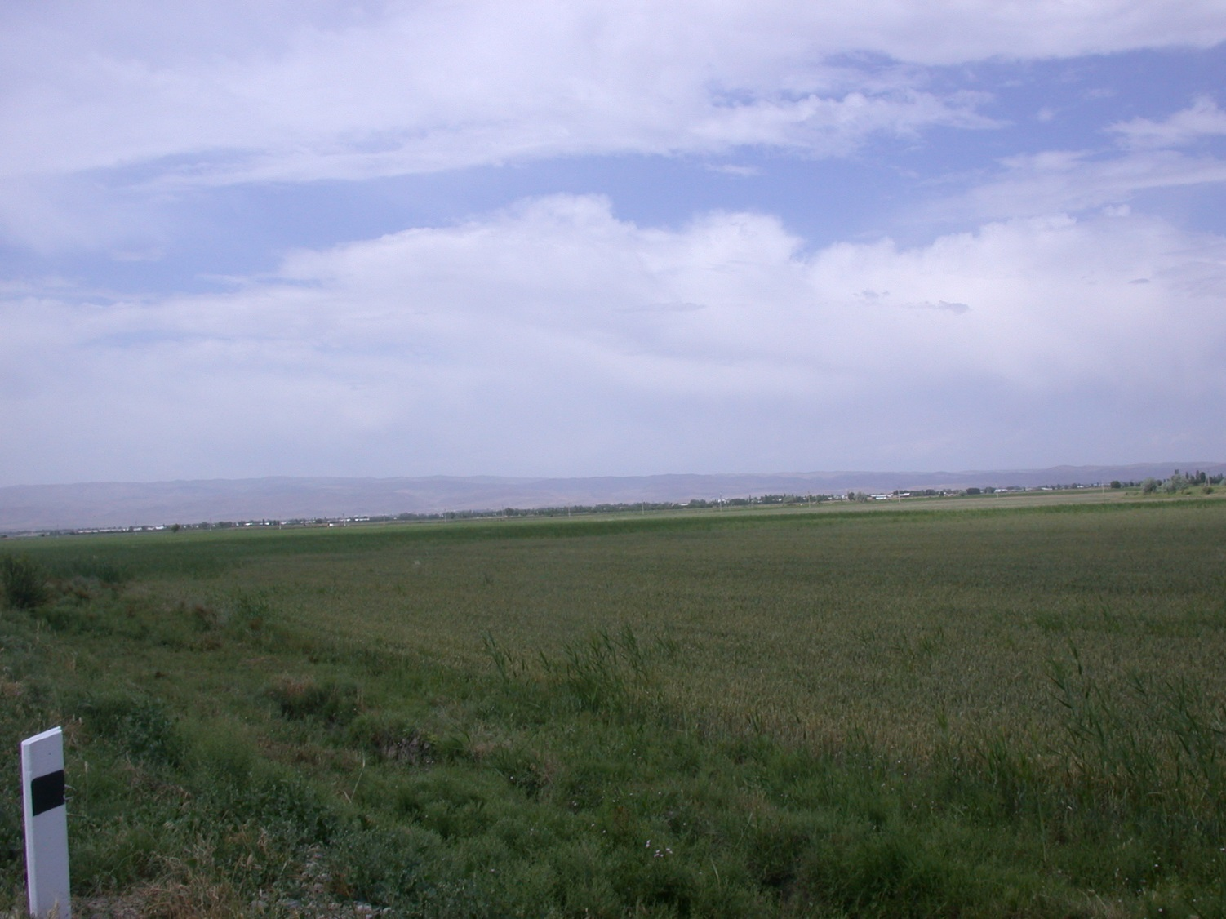
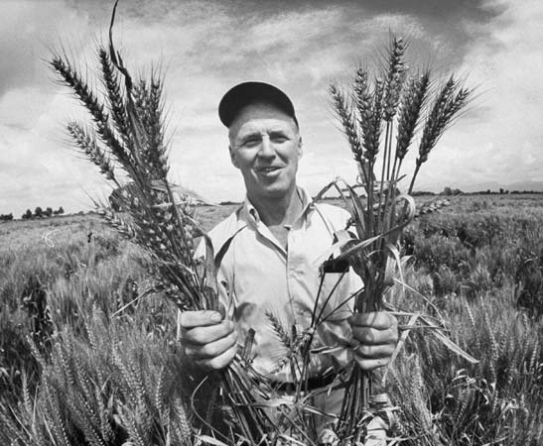
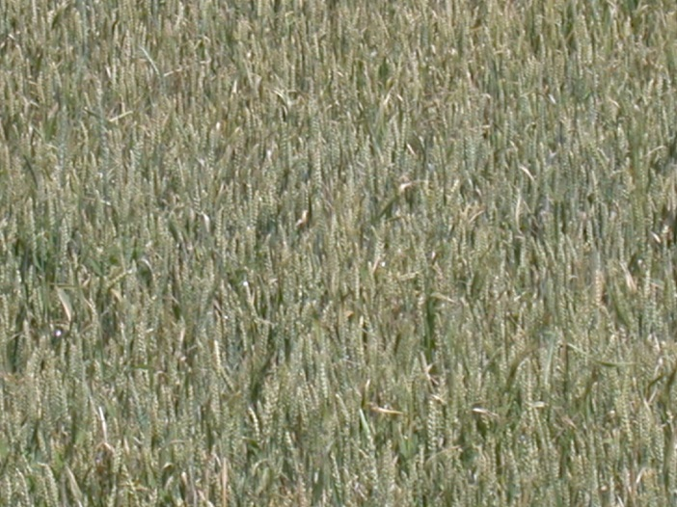

Slide 2
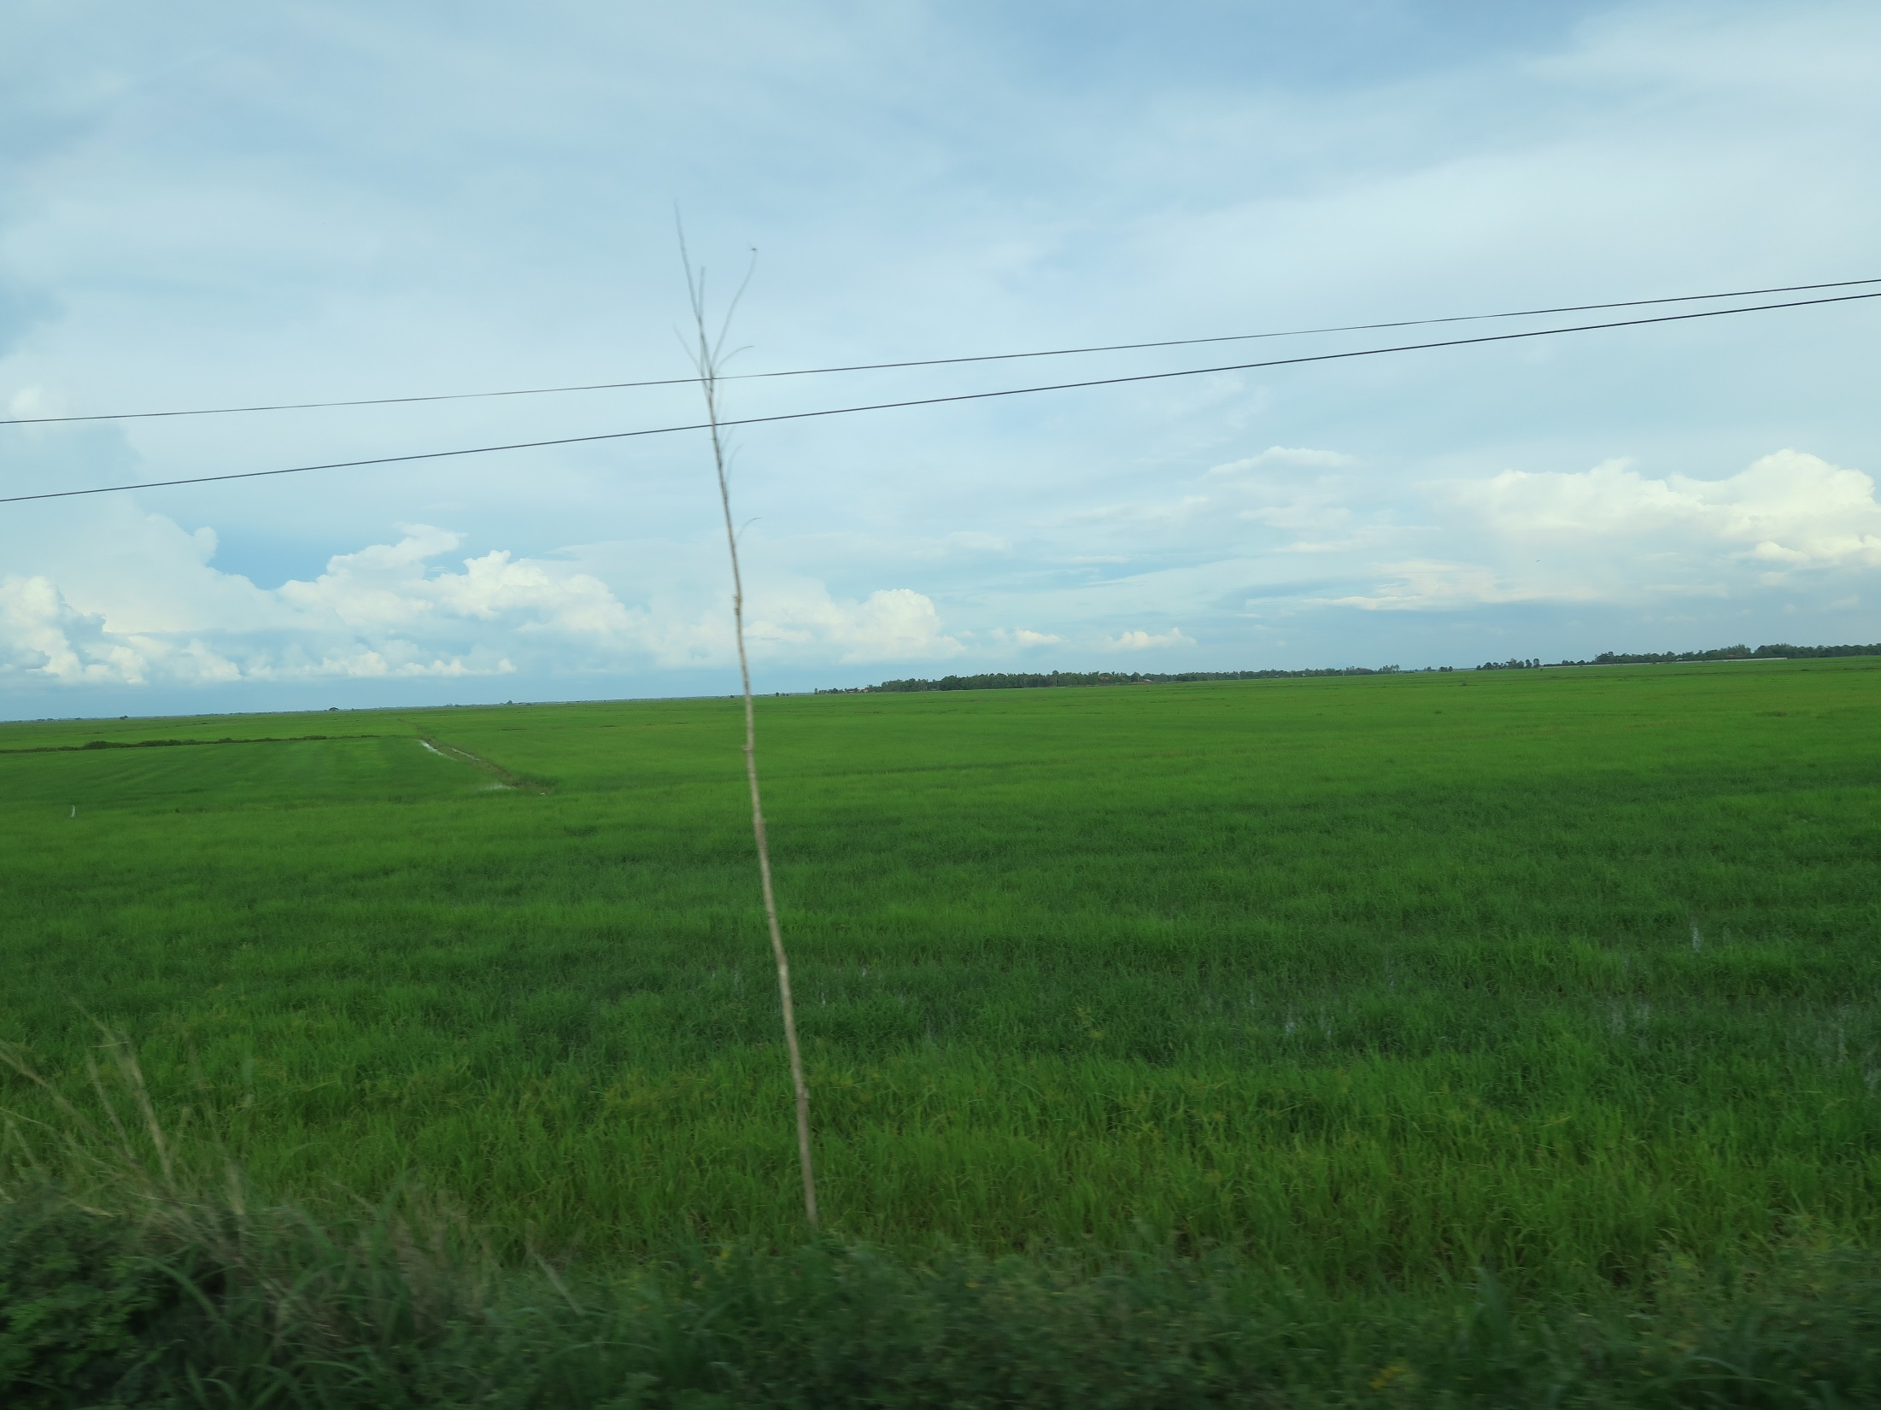
“Green Revolution”

Slide 3
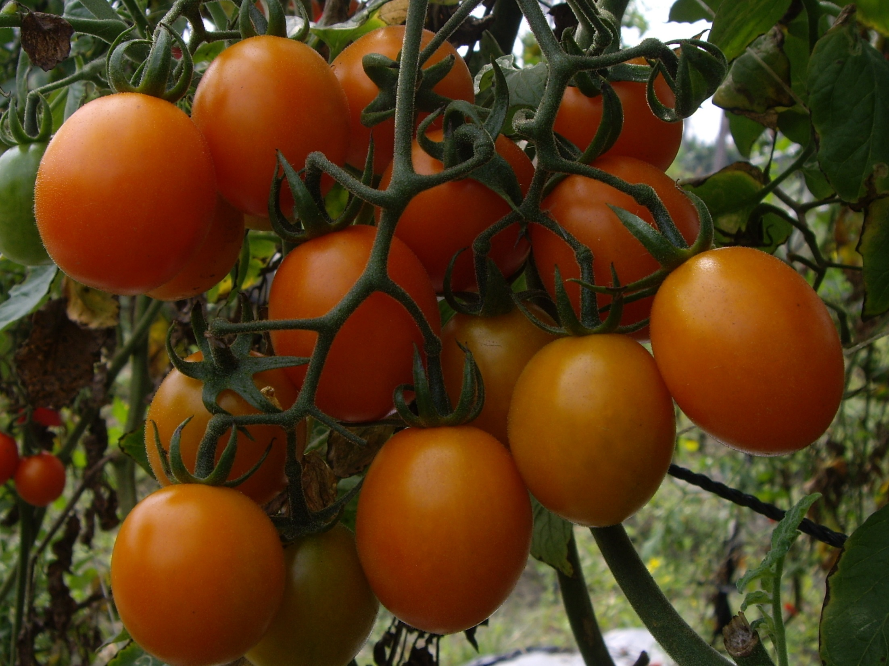

Slide 4
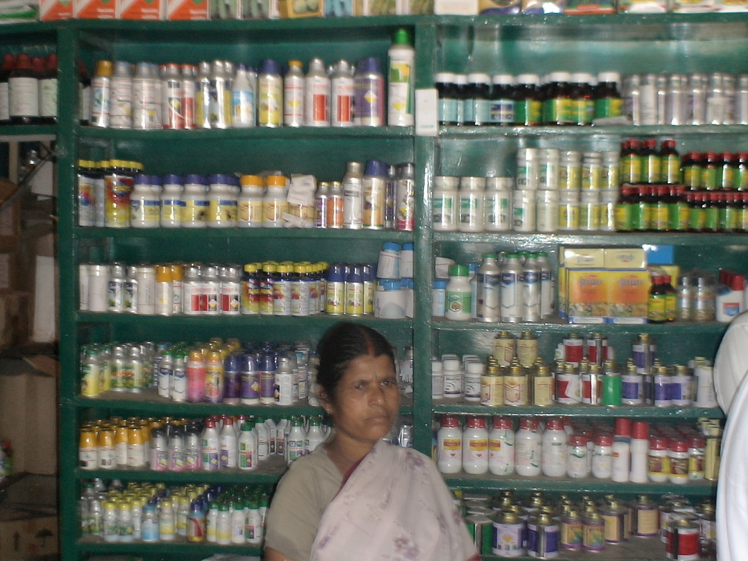
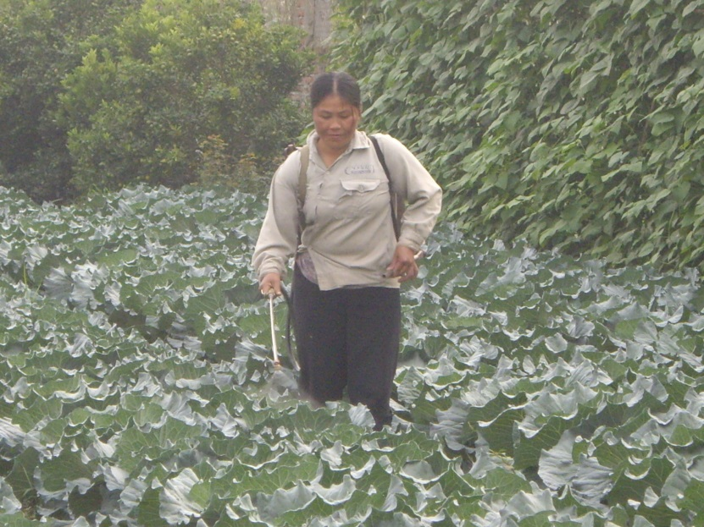
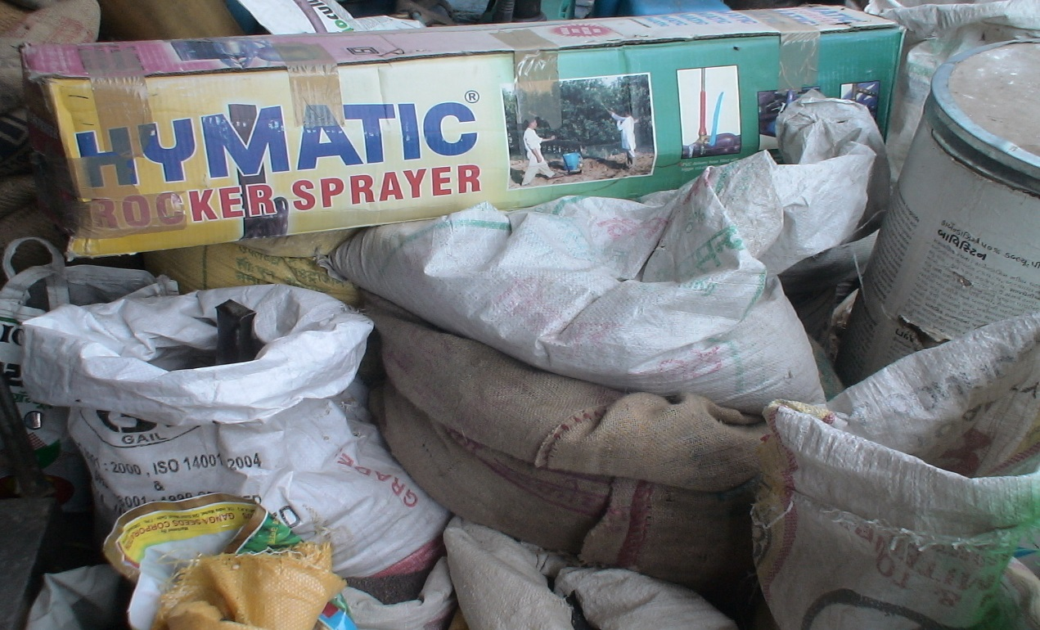
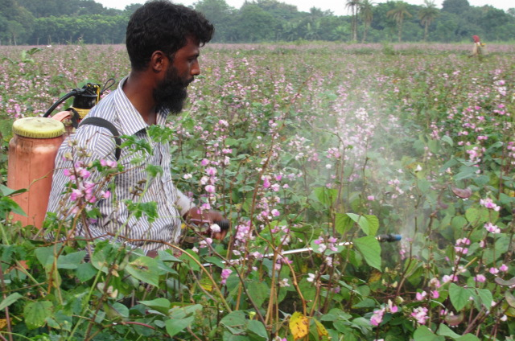

Slide 5
Flagship 2: - Safe & Sustainable Value Chains
Srinivasan Ramasamy (SRINI)
Lead Entomologist &
Flagship 2 Program Leader
World Vegetable Center
Shanhua, Tainan 74151, Taiwan
E: srini.ramasamy@worldveg.org

Slide 6

Safe & Sustainable Value Chains
Innovation Clusters
Peri-urban production systems
Off-season production systems
Intensifying systems
Cereal – Legume System

Slide 7
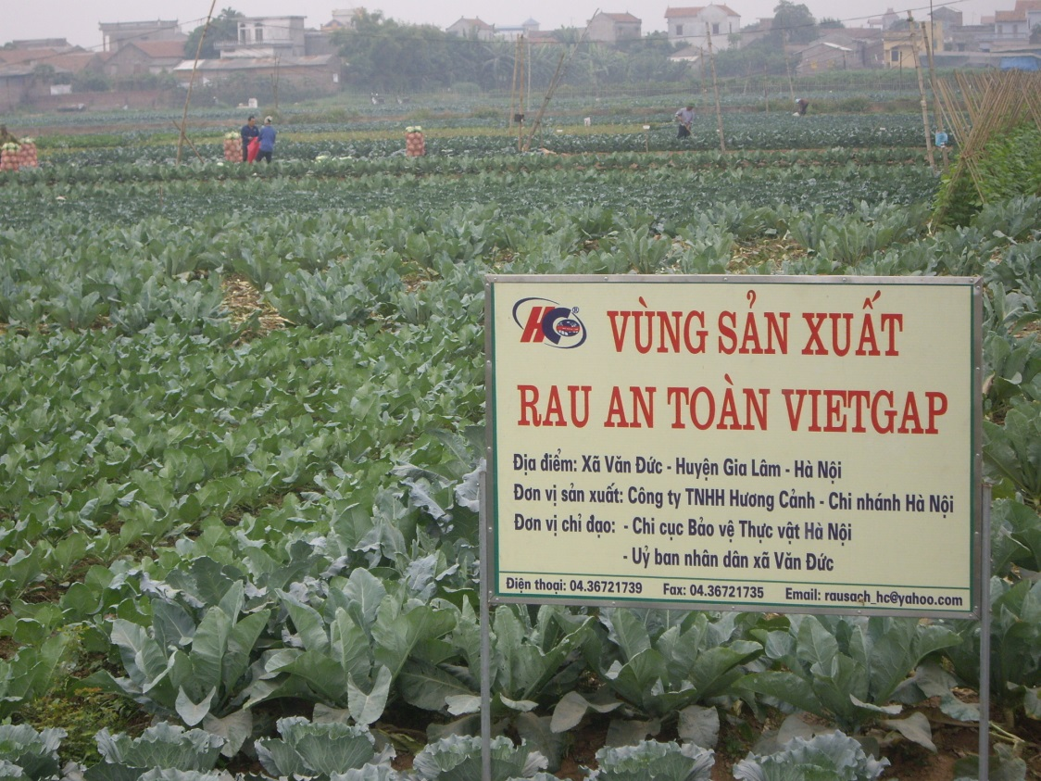
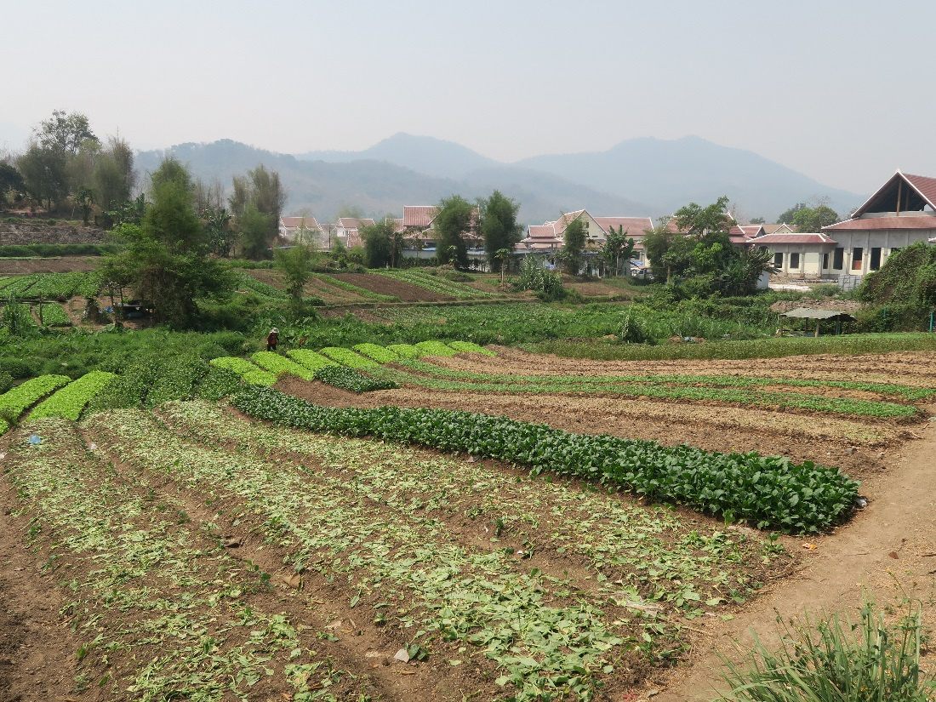
Peri-urban production systems

Slide 8
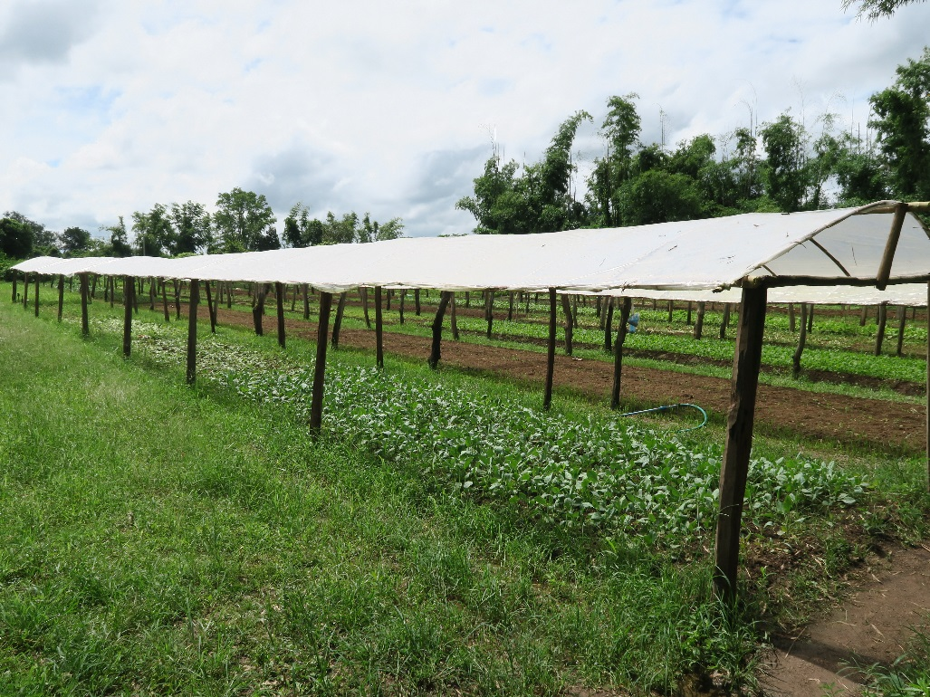
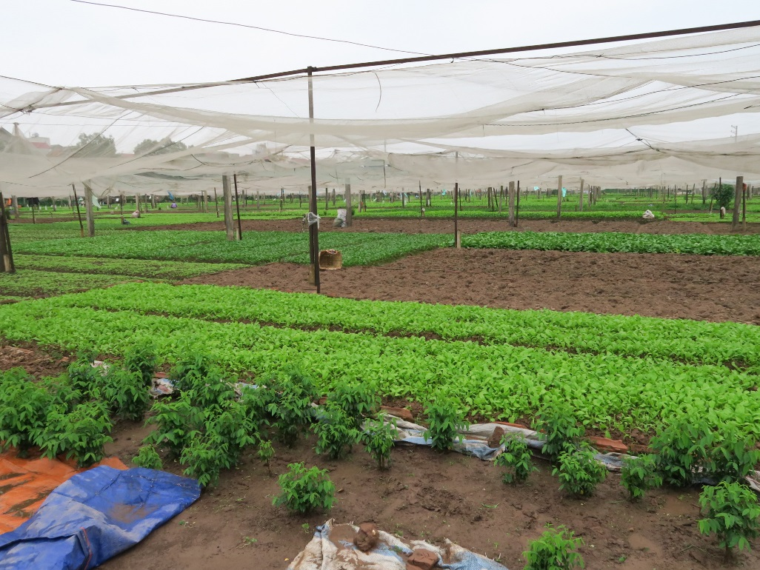
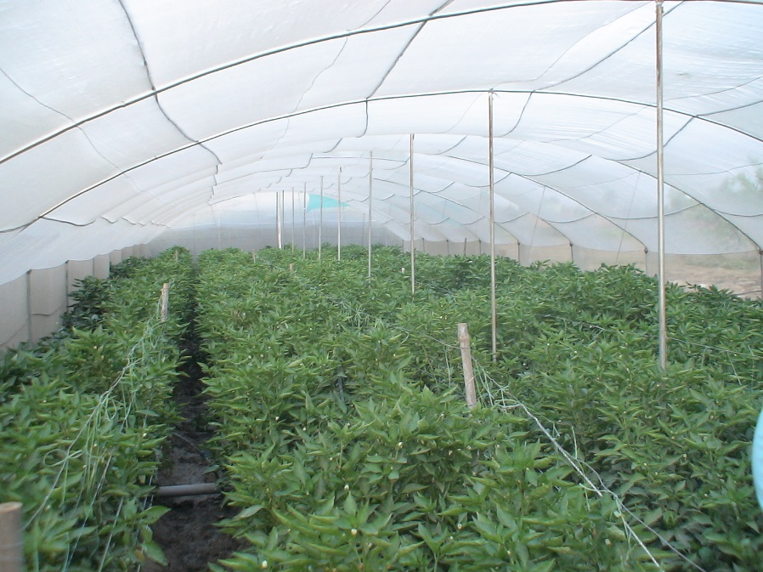
Off-season production systems

Slide 9
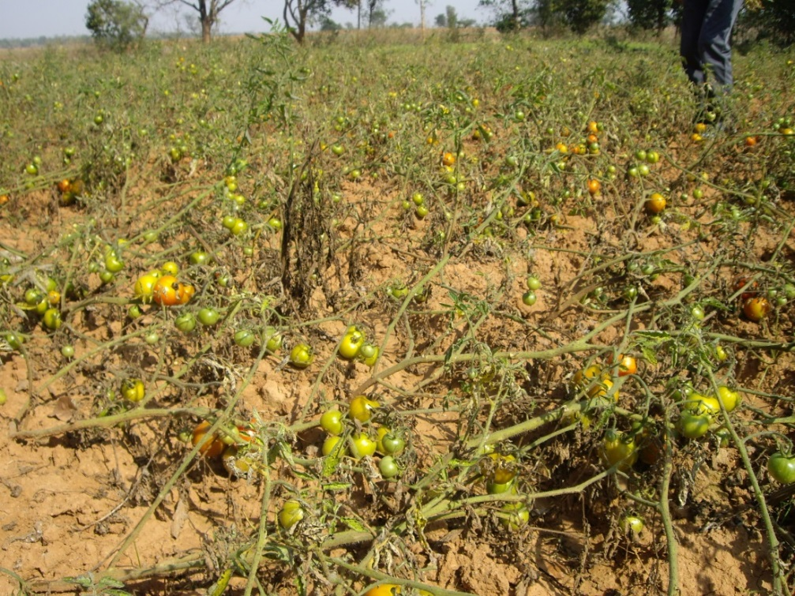
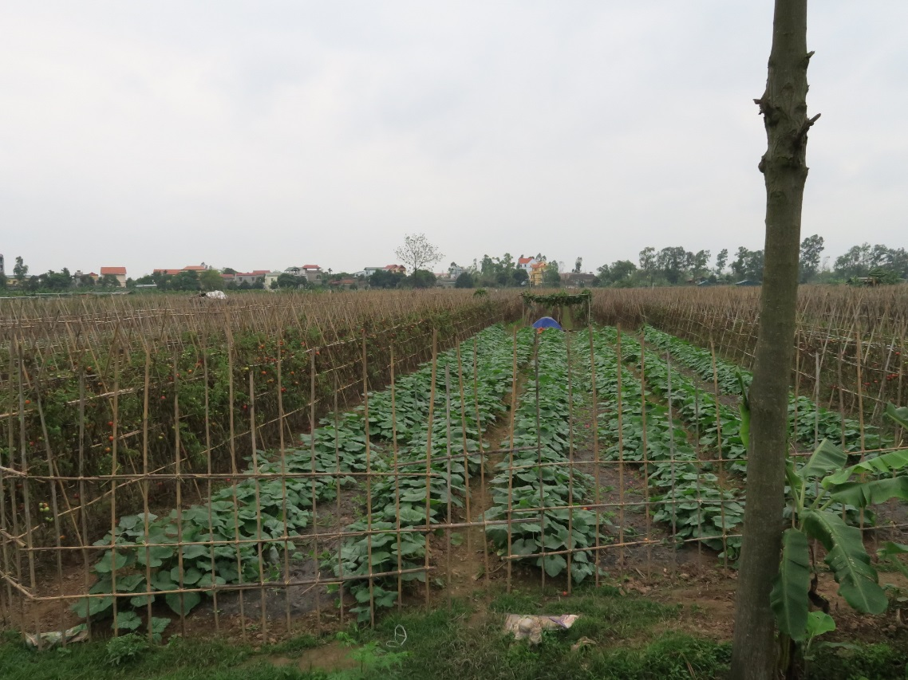
Intensifying systems

Slide 10
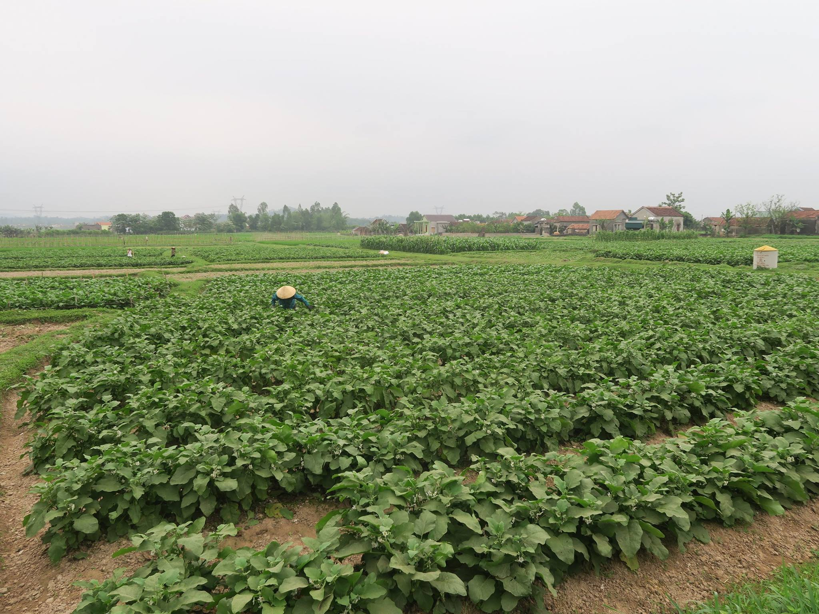
Intensifying systems

Slide 11
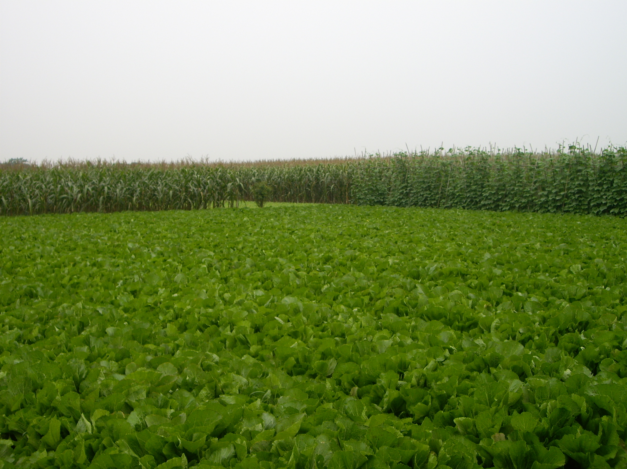
Cereal – Legume systems

Slide 12
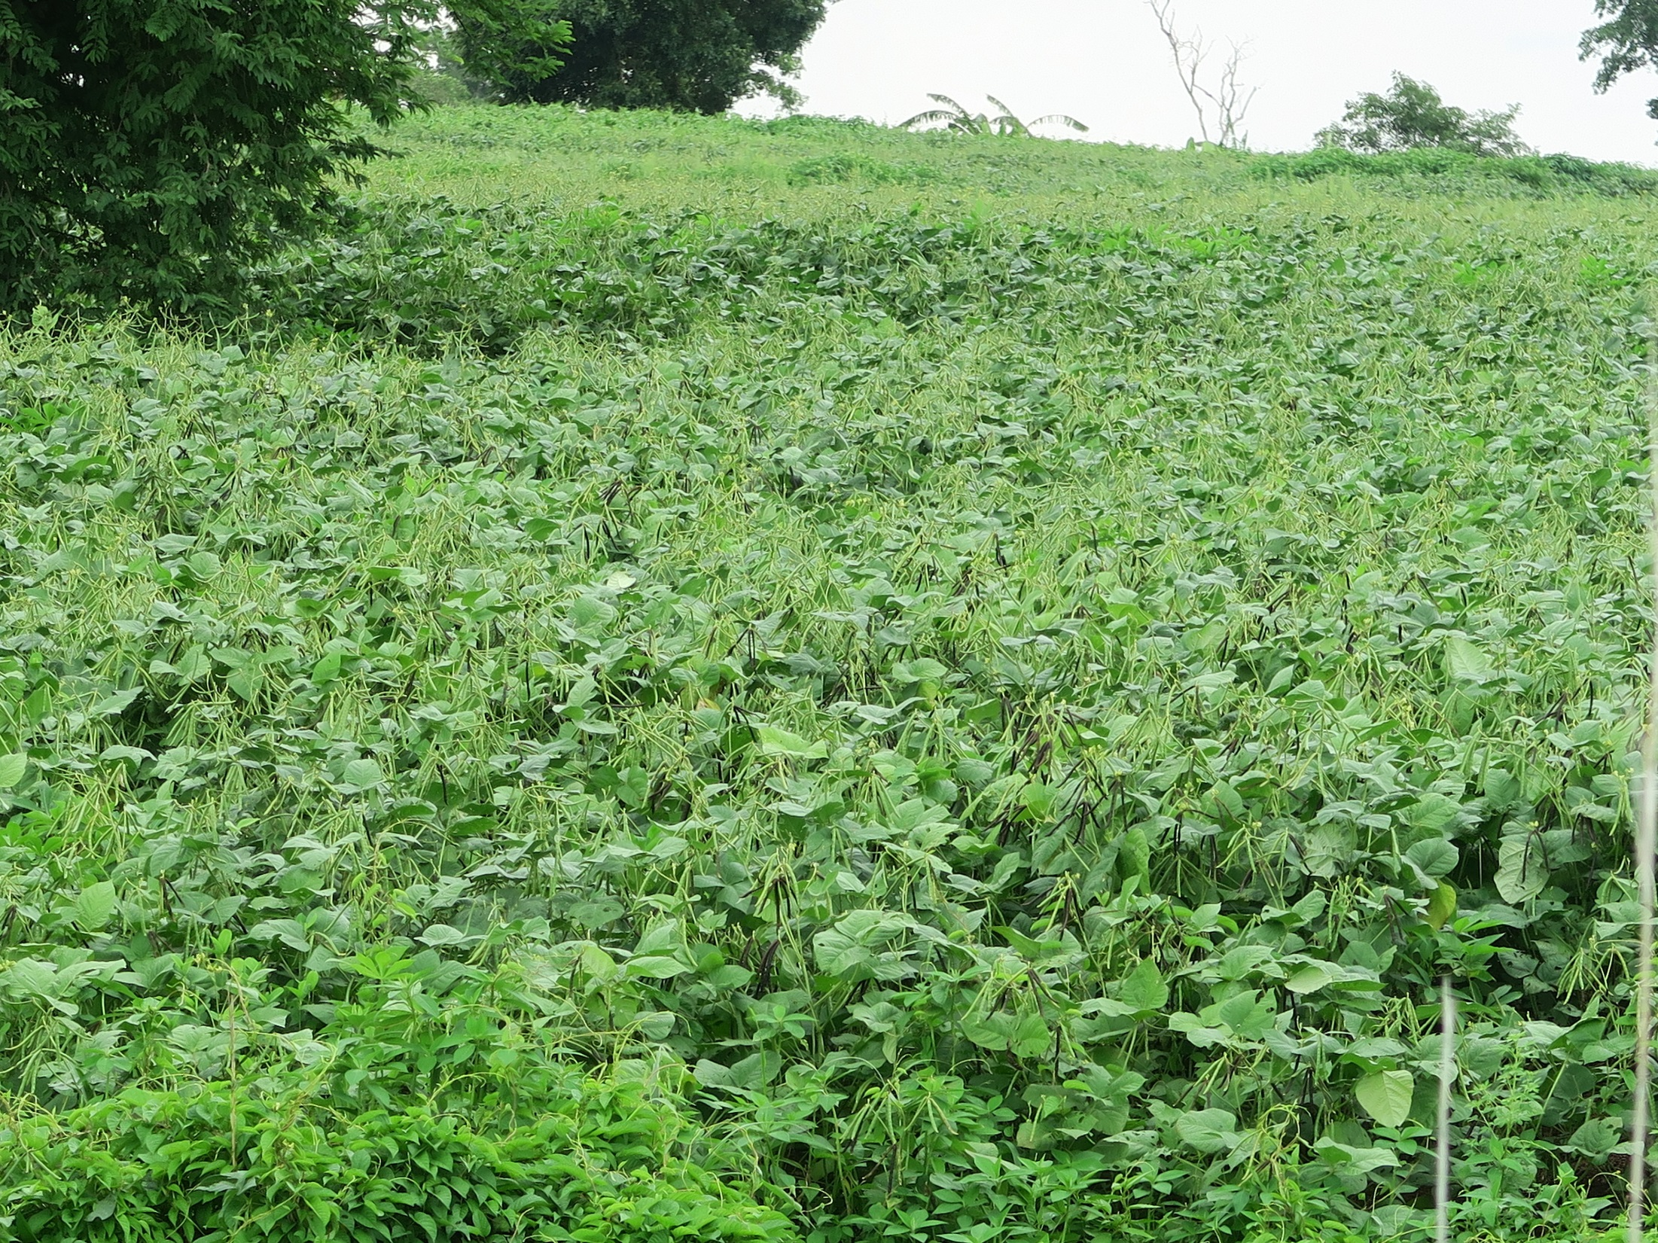
Cereal – Legume systems

Slide 13
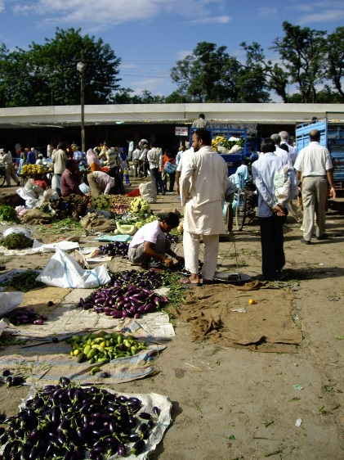
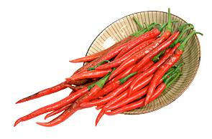
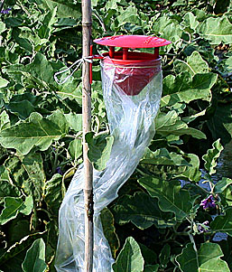
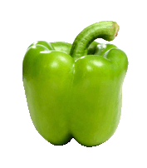
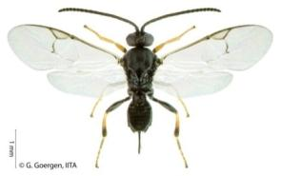
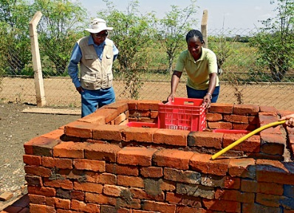

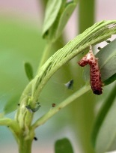
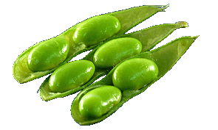
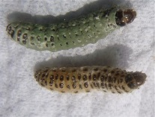
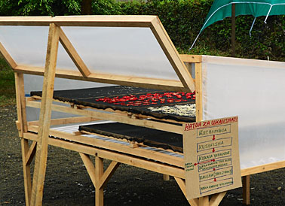
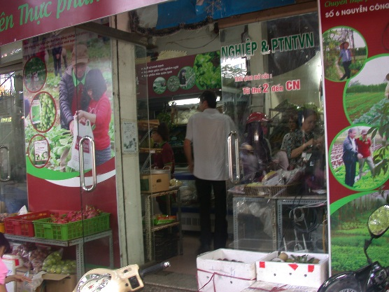
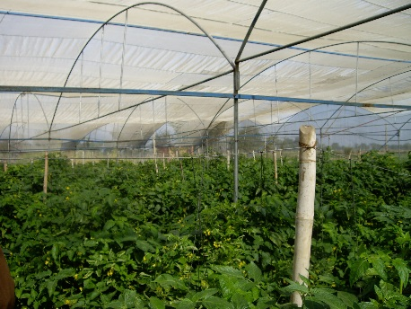
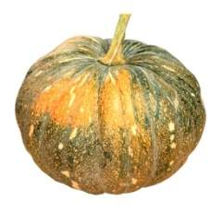
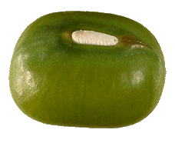
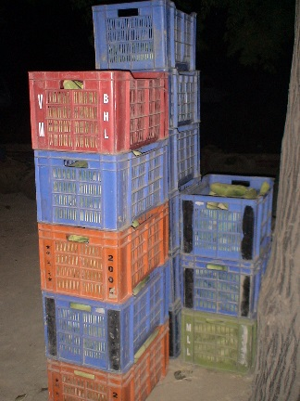
Improved varieties
Improved & Safer Production practices
Post-harvest & Processing
Marketing

Slide 14
Prioritization
Innovation Cluster | East and Southeast Asia
Packages for Peri-urban vegetable value chain | **
Options for off-season vegetable production | ***
Intensifying systems | ***
Cereal-legumes system | **

Slide 15
Innovation Cluster | Varietal basket | Options for GAP | Options for Harvest & PH | Enabling environment
Packages for urban & peri-urban vegetable value chain | Basket of varieties | IPM for safe vegetable production, Water management Protected cultivation Soil Health | Packhouse management | Traceability Market information system (MIS), Veg-business hubs Policy (standards, regulatory framework)
Options for off-season vegetable production | Clear breeding products for specific abiotic challenges (Heat, flood….) | Grafting, Protected cultivation IPM, | Harvest management,Packaging & Storage | Collective actions MIS
Intensifying systems | Specific breeding products (Biotic, Abiotic tolerance / resistance) | Grafting, Protected cultivation IPM, Soil fertility management | Processing, Med-longterm storage, grading/ packing/ transport | MIS, Regulatory framework for Quality inputs, Processing industries, Collective actions (Contract farmers)
Cereal-legume system | Specific breeding products (Biotic, Abiotic, short duration, synchronized maturity) | Soil health, IPM Happy seeder | Mechanized harvesting Storage | MIS, Collective actions, Seed production options, PPP for mechanization

Slide 16
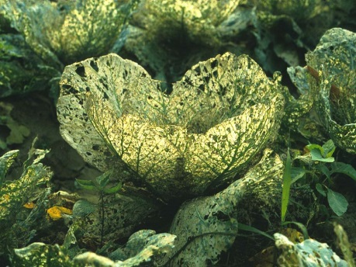
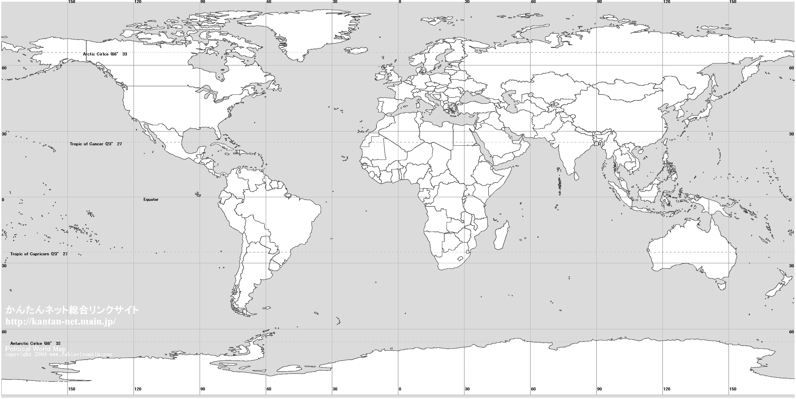
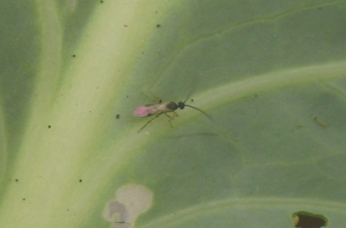
Diamondback moth biological control in Southeast Asia
1989-96

Slide 17
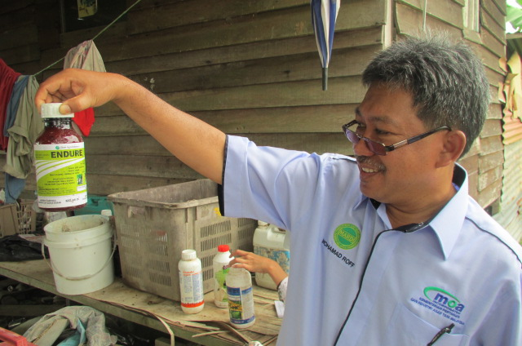
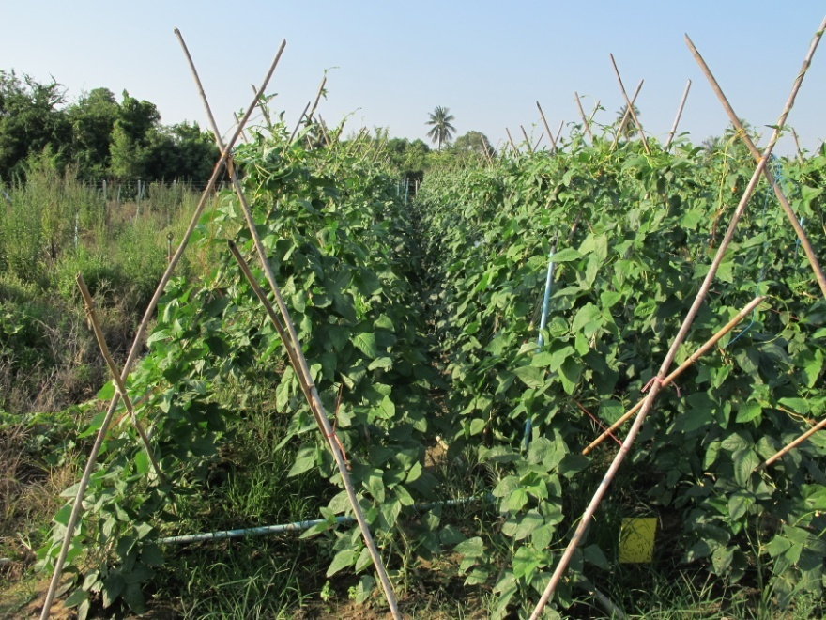
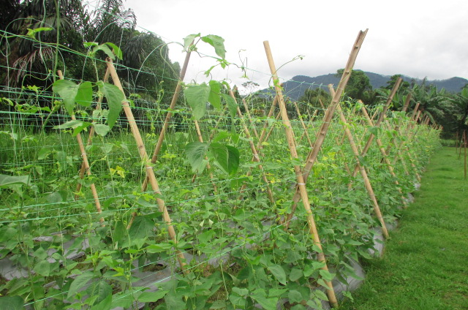
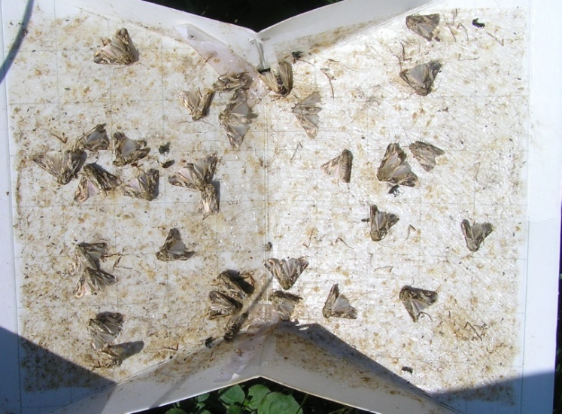
Other notable projects in SE Asia
IPM
  Chili & other vegetables (e.g., Indonesia)
  Vegetable Legumes (Lao PDR, Malaysia, Thailand, Vietnam)
  Management of virus diseases (Indonesia, Thailand, Vietnam)

Slide 18
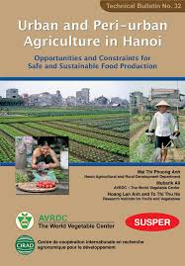
Other notable projects in SE Asia
Peri-urban vegetable production (e.g., Philippines)
Off-season vegetable production (Cambodia, Lao PDR & Vietnam)
Post-harvest (Cambodia, Lao PDR & Vietnam)

Slide 19
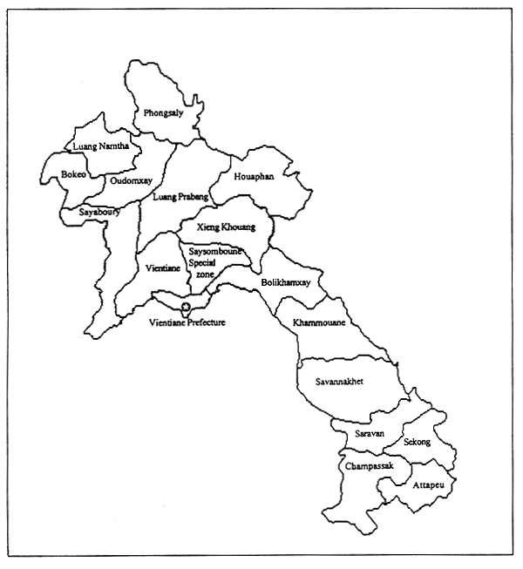
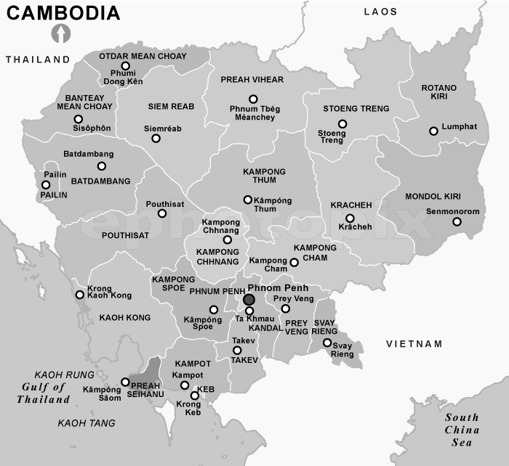
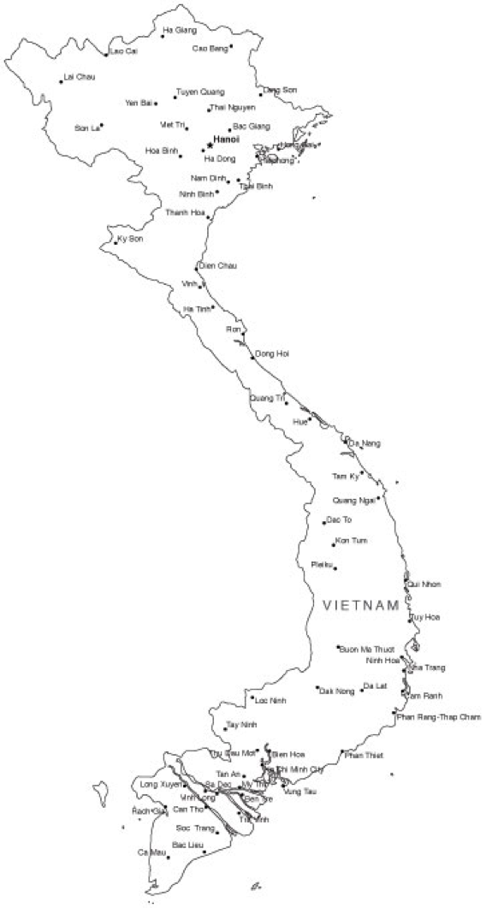
Ongoing projects in SE Asia

Slide 21
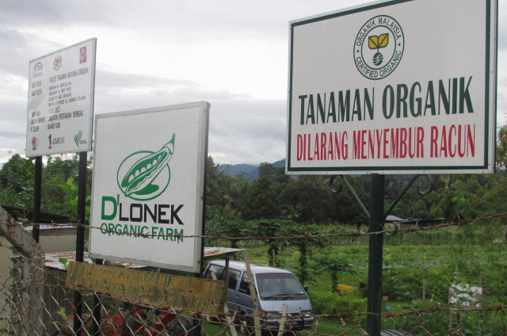
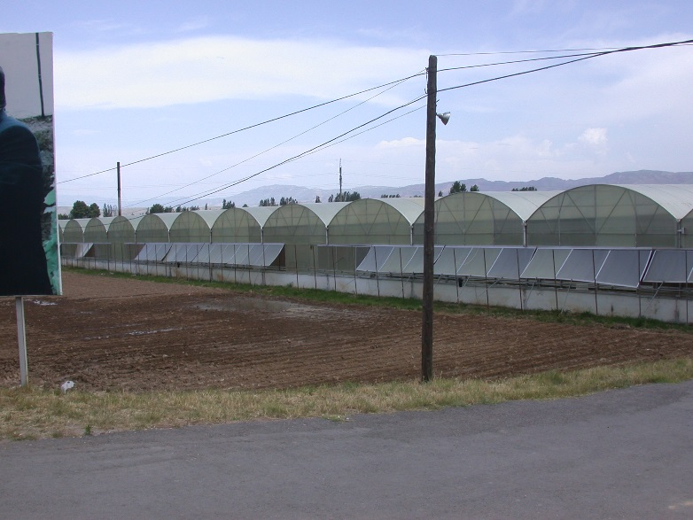
Future outlook for FS2 in SE Asia
Contribute to GAP
Policy advocacy on commercialization of IPM technologies
Public – Private Partnership (input & output markets, post-harvest & processing)

Slide 22
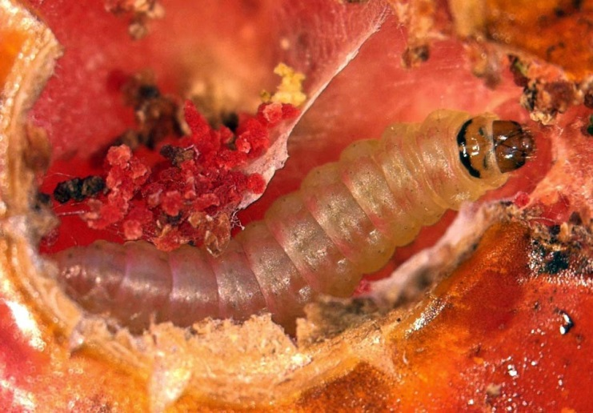
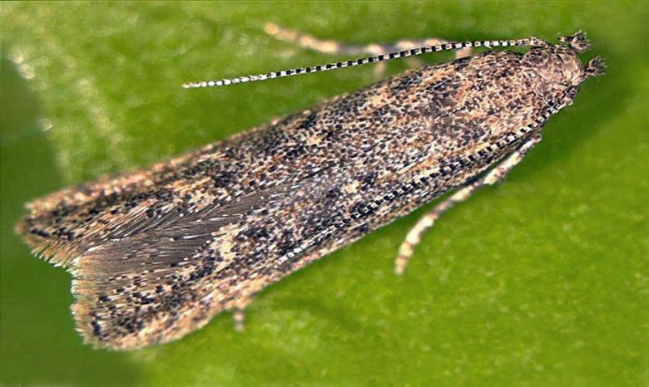
Tuta absoluta
South American tomato leaf miner
Damages both leaves and fruits
Moth
Lepidoptera: Gelechiidae
©Marja van der Straten/NVWA Plant Protection Service/Bugwood - CC BY-NC 3.0 US

Slide 23
Economic impact of T. absoluta
100% yield loss, if left uncontrolled
Significant increase in the use of chemical pesticides
Disruption of IPM programs targeting other pests of tomato
Trade bans
Soaring tomato prices (e.g., 375% within a month in Tanzania)

Slide 24
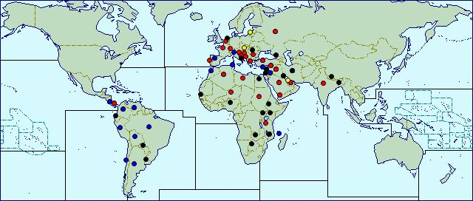
Distribution of T. absoluta
Widespread
Confined, subject to quarantine
Present, no further details
Occasional or few reports
Localized
(CABI, as of February 01, 2017)

Slide 25

CLIMEX climatic suitability indices for T. absoluta in the world
EI = (0–5) location is not suitable
EI = (5–20) moderate level of suitability
EI = (20–50) high risk of establishment and
EI > 50 very high likelihood of long-term survival
Tonnang et al. 2015. PLoS ONE 10(8): e0135283. doi:10.1371/journal.pone.0135283
http://127.0.0.1:8081/plosone/article?id=info:doi/10.1371/journal.pone.0135283

