Slide 1

2017-2020 Operational Plan
David Johnson
12th Steering Committee Meeting of the ASEAN-AVRDC Regional Network for Vegetable Research and Development (AARNET)
World Vegetable Center, Shanhua, Tainan, Taiwan
23-25 May 2017

Slide 2
Why are we here?
“Alleviating poverty and malnutrition in the developing world through increased production and consumption of nutritious, health-promoting vegetables”

Slide 3
From research to impact at scale
1. Discovery research
2. Proof of concept / piloting
3. Impact at scale
Development Partners
Research
Partners

Slide 4
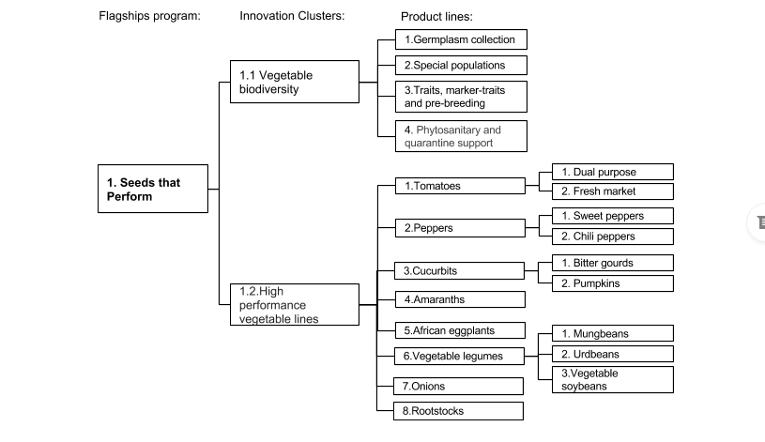
Flagship - Seeds that Perform

Slide 5
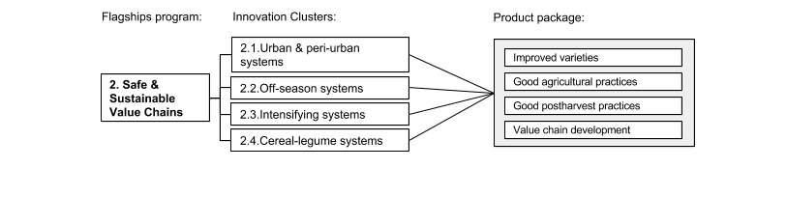
Flagship - Safe & Sustainable Value Chains

Slide 6
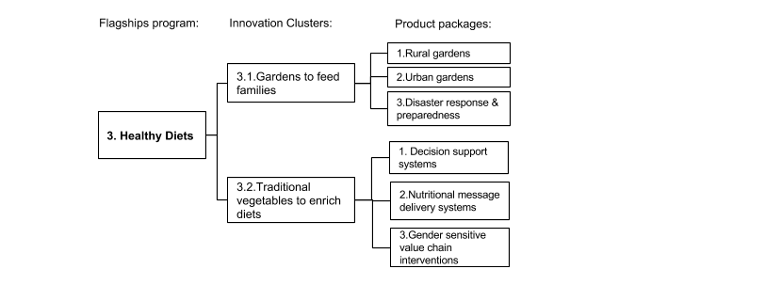
Flagship - Healthy Diets

Slide 7
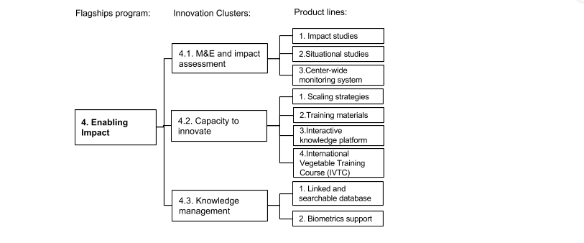
Flagship - Enabling Impact

Slide 8
AARNET Committee Meeting
23-25 May 2017
World Vegetable Center, Tainan, Taiwan
Flagship Program –
Healthy Diets
Ray-Yu Yang
Nutritionist
Flagship Program Leader
World Vegetable Center

Slide 9
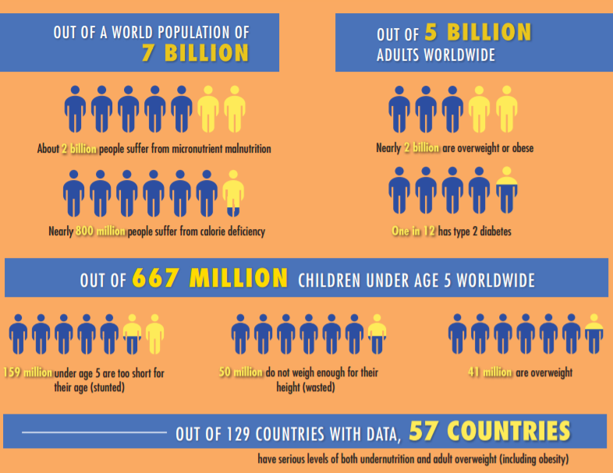
Global nutrition status
2 billion:
micronutrient malnutrition
2 billion:
overweight & obesity
800 million:
calorie deficiency
1/12: type 2 diabetes
159 million:
children<5 stunted
41 million:
Children<5 overweight
50 million:
Children<5 wasted
Source: IFPRI 2016, Global Nutrition Report – from promise to impact

Slide 10
Causes of malnutrition, particularly for nutritional deficiencies
Dietary intake
Low birth weight and maternal nutritional status.
Breastfeeding practices
Complementary feeding practices
Disease; unhealthy environments; water, sanitation, and hygiene; and access to health care
Poverty, food security, population density, and land ownership
Gender inequality and women’s status
Civil and political unrest
Governance

Slide 11
Dietary recommendations
Achieve energy balance and a healthy weight
Limit energy intake from total fats and shift fat consumption away from saturated fats to unsaturated fats and towards the elimination of trans-fatty acids
Increase consumption of fruits and vegetables, and legumes, whole grains and nuts
Limit the intake of free sugars
Limit salt (sodium) consumption from all sources and ensure that salt is iodized
Source: WHO, Global Strategy on Diet, Physical Activity and Health
http://www.who.int/dietphysicalactivity/goals/en/

Slide 12
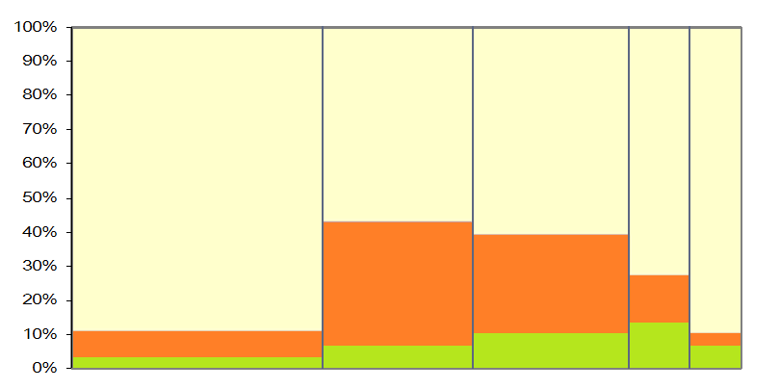
Share of vegetable availability (g/person/day) in Asia
(min. 200 g/person/day)
Eastern Asia 38% | Western Asia 23% | Central Asia 23% | S Asia 9% | SE Asia 8%
715 g/day
423 g/day
422 g/day
171
g/day
144
g/day
87%
56%
59%
71%
88%
Other
36%
29%
14%
7%
4%
Tomato
5%
8%
12%
15%
8%
Onion
Source: Yang et al., 2013, data source: FAOSTAT 2012
Notes:
12

Slide 13
Flagship Program – Healthy Diets
Objectives
  Alleviate malnutrition by improving dietary quality from greater consumption of diverse and nutritious vegetables and enhancing healthy eating behaviors
Approaches
  Multi-sectoral collaborations among agriculture, nutrition, health and education
  Nutrition-sensitive interventions from seed to table

Slide 14
Flagship Program-Healthy Diets
Innovation cluster 1: Gardens, nutrition and health
  1.1: Rural household garden
  1.2: Urban garden
  1.3: Disaster response and preparedness
Innovation cluster 2: Traditional vegetables to enrich diets
  2.1: Assessing traditional vegetables’ potential
  2.2: Stimulating demands for healthy diets
  2.3: Gender and nutrition sensitive value chain interventions

Slide 15
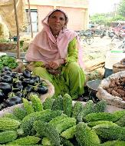
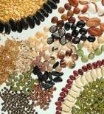
Nutrition-sensitive interventions from seed to table
Dietary & nutrition assessments
Seeds
Field
Homestead Production
Plate
Human
Market
Household-based interventions and assessments:
Nutrition and WASH integrated home garden programs
Scaling and support system for sustainability
Community-based interventions and assessments:
Nutrition/health behavior change communications
Nutrition messages integrated public/private extension services
Filed and laboratory based assessment:
Assessing phytonutrient content/ benefits of traditional and diverse vegetables
Nutritional and quality evaluation for germplasm, breeding, postharvest programs
School based interventions and assessments: Nutrition and WASH integrated school garden programs, and linking school meals and local food system
WASH: water, sanitation and hygiene

Slide 16
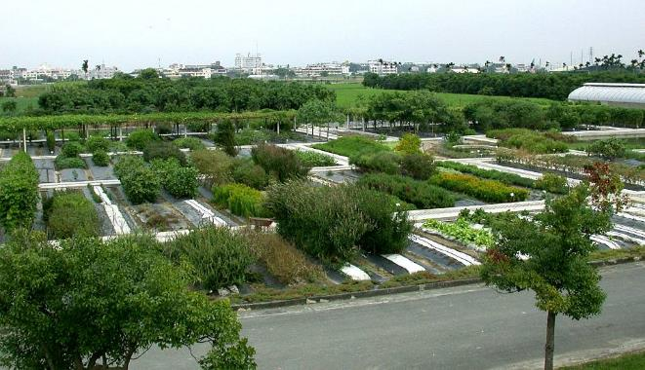
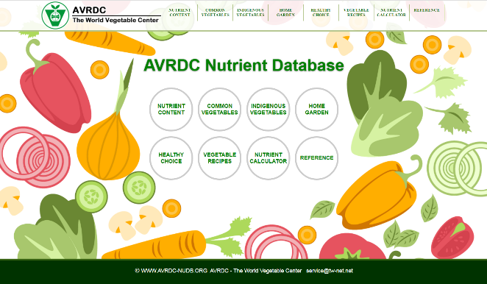
WorldVeg Nutrient Database
Common and traditional vegetables
  100 family, 150 species, 350 types of vegetables
Data:
  Macronutrients:
    Protein, n-3, 6 fatty acids
  Micronutrients:
    Vitamins and minerals
  Bioactive phytochemicals
    Flavonoids, carotenoids and others
  Anti-nutrients
    Oxalates, phenolics and others

Slide 17
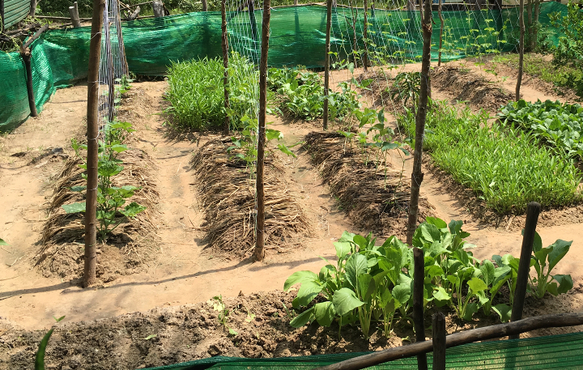


Scaling Seed Kits Through Household Gardens
Notes:
This presentation firstly summarises the World Vegetable Center’s approach to the development of home gardens currently funded through the Feed the Future initiative. Secondly I will delve more deeply into key development concepts plus elucidate on the “theory of change” underlying the suite of home garden projects around the world managed by World Vegetable Center.
Thirdly I will touch on our scaling approaches we promote across all the projects, and fourthly provide you with an update and examination of the activities in the Cambodian household garden scaling project.
{click}

Slide 18
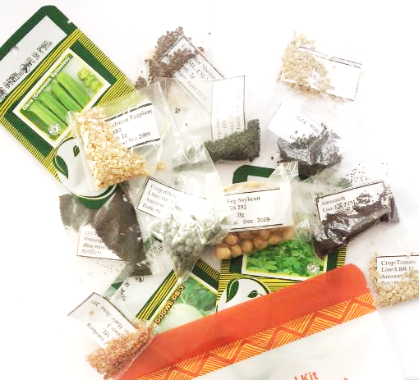
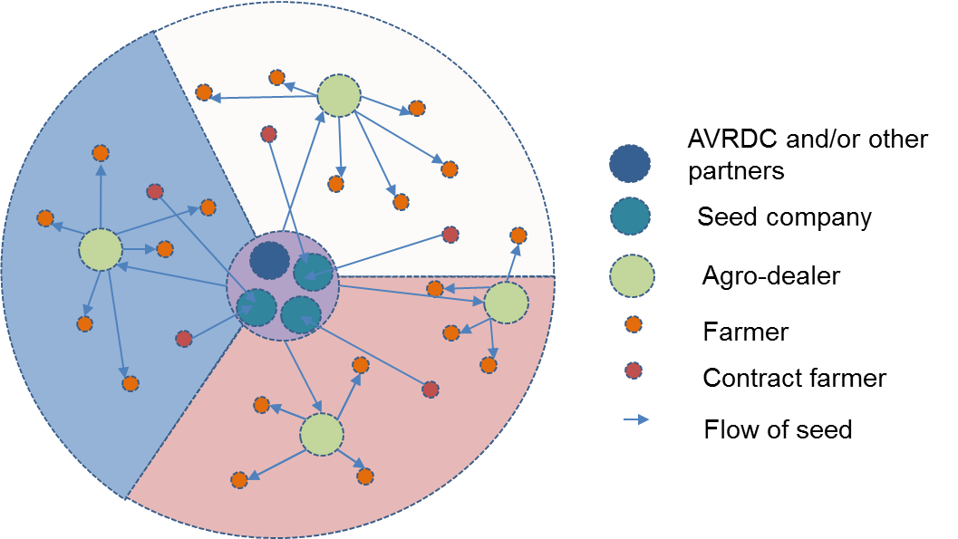
Distribution of seed kits (push factor)
Selection of varieties are based on farmers’ practices, evaluation, and environmental suitability
More than 50,000 households are targeted
23,000 households adopting within 2 years
Seed kit business model with multiple seed complies
Curtesy: Ralph Roothaert

Slide 19
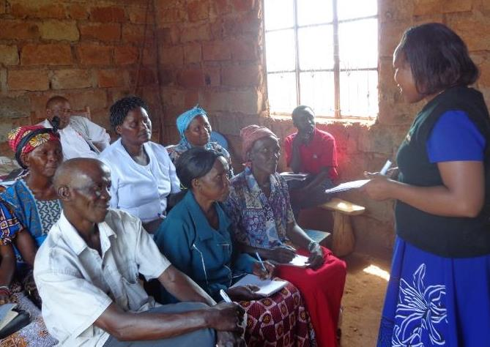
Sensitization (pull factor)
Sensitization
Cooking shows
There is still a big gender divide when it comes to learning opportunities.
Introduce new foods, preserve more nutrients, convince family members by tasting.
Curtesy: Ralph Roothaert

Slide 20
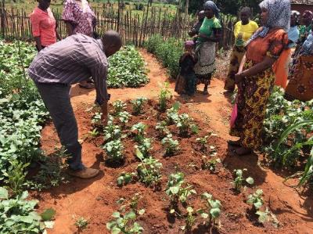
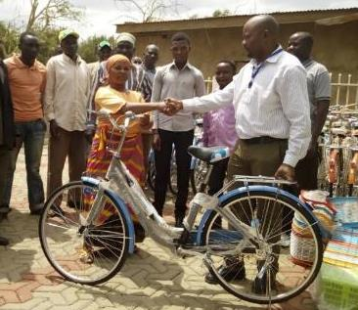
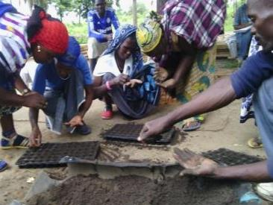
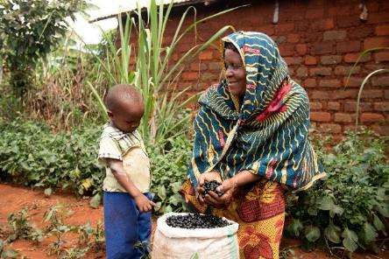
Training approaches (push factor)
2-3 hub demo-gardens are established in every village
Bicycles to facilitate movements of Community Based Trainers
Hub-spoke demonstration gardens
Community based trainers
Bicycles
Training topics:
Production
Pests and diseases
Water management
Nutrition and hygiene
Marketing
Nursery techniques using seed trays and sterilized soil
Saving seed of OPVs
Curtesy: Ralph Roothaert

Slide 21
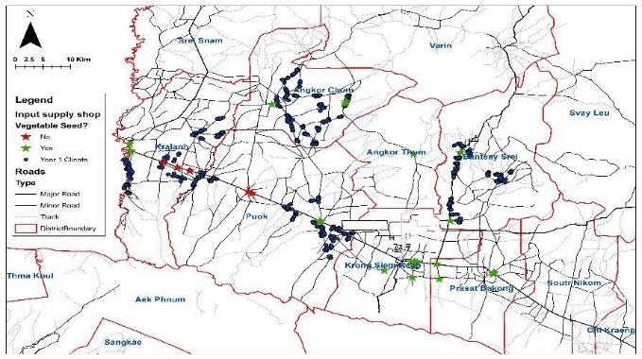
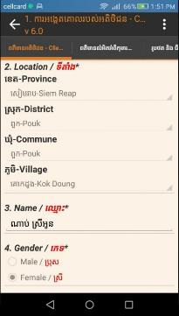
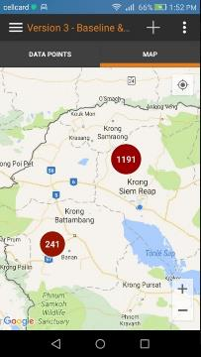
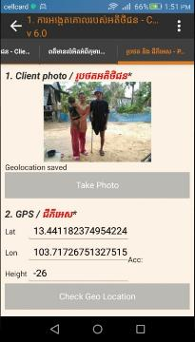

Application of ICT (information communication technologies)
Data collection with mobile device
Application of Geographical Information System (GIS) in monitoring seed supply and use
Curtesy: Stuart Brown
Notes:
The project has embarked on a GIS analysis of input supply stores in the districts in which we currently operate. A survey using Akvo Flow was commissioned to understand the existing network of input supply shops to assess their proximity to current clients.
This map shows the location of clients for year 1 in Siem Reap in relation to input supply shops that sell vegetable seed and those that do not. This map has identified that some clients can readily access vegetable seeds and yet many cannot within their immediate locations.
{click}
The project is taking a commercial approach to seed availability on the premise that the commercial sector is in the best position to provide a sustainable supply of quality seed to clients. However this particular map tells only part of the story. We have identified East West Seed as being one of the more professional outfits when it comes to small home garden vegetable varieties through their development of value packs which are focused on smaller packets of relevant high nutrition varieties. Lets see what happens when we identify where East West Seeds are available in the districts we are focussing on in Year 1 for Siem Reap.
{click}

Slide 22
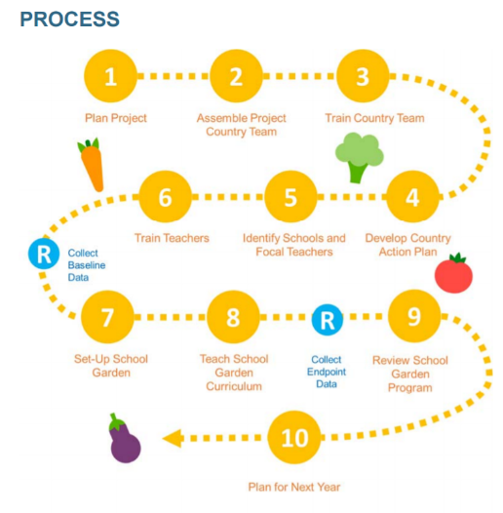

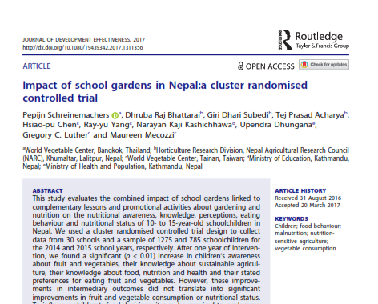
Vegetables Go to School
A multidisciplinary school garden project piloting the use of multi-intervention school garden programs in Bhutan, Burkina Faso, Indonesia and Nepal
Project Phase I aims to generate evidence using randomized control trials (RCT) and measured the program’s nutritional impact on schoolchildren in developing countries.

Slide 23



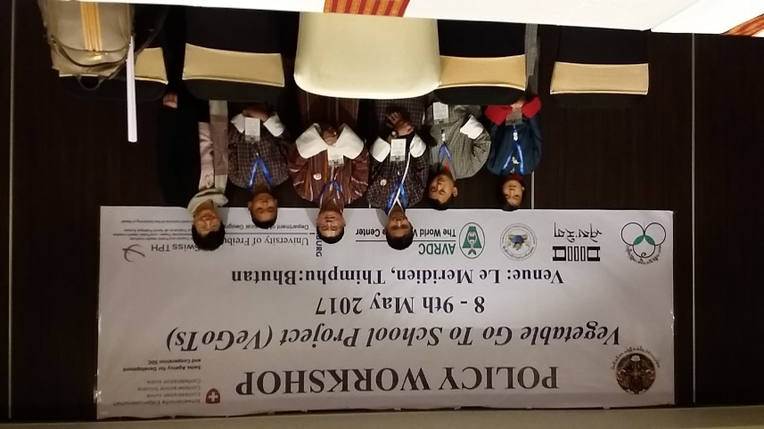

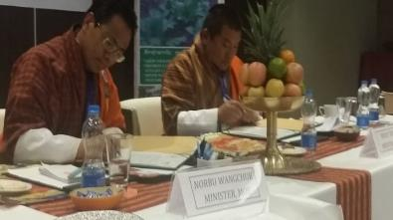
Vegetables Go to School
Project Phase II aims to identify policy roadmap and advocate investment in school garden programs for food security and nutrition in the developing countries
Policy Workshop in Nepal, 2017.05.05, Kathmandu
Policy workshop and signing ceremony in Bhutan, 2017.05.08

Slide 24
FLAGSHIP PROGRAM 4
Enabling Impact
Prepared by
Pepijn schreinemachers
For
12th Steering Committee Meeting of the ASEAN-AVRDC Regional Network for Vegetable Research and Development (AARNET)
World Vegetable Center, Shanhua, Tainan, Taiwan
23-25 May 2017

Slide 25
Rationale
The new Strategy (2017-2025) and Operational Plan aim to create an organization that is more strongly oriented toward creating impact.
This Flagship Program supports the other programs in achieving this.

Slide 26
Innovation Clusters & Product lines
Flagship
Innovation clusters
Product lines
Impact studies
4.1 M&E and Impact Assessment
Situational studies
Center-wide monitoring system
Scaling strategies
4. Enabling Impact
4.2 Capacity to Innovate
Training materials
Interactive knowledge platform
Linked and searchable database
4.3 Knowledge Management
Biometrics support
Notes:
The flagship is organized into 3 Innovation Clusters and 8 product lines.

Slide 27
Impact Studies
Pepijn Schreinemachers
(coordinating scientist)
Question asked: What changes in poor people’s livelihoods can be attributed to technologies or interventions introduced by WorldVeg and its partners?
Example: An ongoing impact evaluation in Cambodia tries to quantify the change in people’s diets as a results of home garden training (Flagship Program – Healthy Diets).

Slide 28
Ongoing adoption & impact studies
Flagship Program | West Africa | East and Southern Africa | South and Central Asia | Southeast Asia
1. Seeds that Perform | - | - | Mungbean adoption Pakistan, Bangladesh | Mungbean adoption Myanmar
2. Safe and Sustainable Production Systems | Onion production Cameroon | Vegetables & youth Tanzania, Ethiopia, Malawi, Mozambique | IPM Bangladesh Pack house Bangladesh | -
3. Healthy Diets | School gardens Burkina Faso Home gardens Mali | Home gardens Tanzania, Kenya, Uganda | School gardens Nepal, Bhutan Home garden Bangladesh | School gardens Indonesia Home gardens Cambodia
Notes:
There are 20 ongoing impact & adoption studies that cover nearly all combinations of regions and flagships.

Slide 29
Center-wide monitoring system
Bharath Krishnan
(responsible scientist)
Question asked: How do we know if we are on track in meeting our short- and long-term goals?
Example: We are developing to a new system to monitor progress on deliverables (defined in our operational plan) and link these to individual scientists, projects, regions, countries, crops, etc.

Slide 30
Scaling strategies
Gregory C. Luther
(coordinating scientist)
Question asked: What scaling methods are most effective to ensure that as many farmers as possible can benefit from our technologies?
Example: WorldVeg is forming consortia with seed companies to help ensure that our breeding programs are responsive to market demand and that our breeding lines are widely used by seed producers.

Slide 31
Linked and searchable database
Maureen Mecozzi
Question asked: What knowledge management system will allow us to store our research data, research protocols and publications in such way that it can easily be retrieved and reused?
Example: We have currently selected three systems that could meet our needs; TIND was identified as the most promising one.

Slide 32
Conclusion
Enabling Impact is a new Flagship Program that we think can play a major role within the Center.
It allows the Center to learn as an organization through evaluation studies, effective tracking systems, evidence-based scaling strategies and better knowledge management.
Its research agenda is expected to see continuous reflection and adjustment.

Slide 33
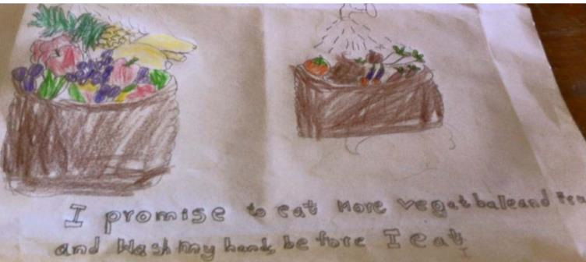
Thank you!

