Slide 1
Vegetable Production and strategies of AARNET Countries: Thailand
Grisana Linwattana, Ph.D.
12th Steering committee meeting of the ASEAN-AVRDC regional network for vegetable research and development (AARNET)
at WorldVeg-Taiwan,
May 23, 2017

Slide 2
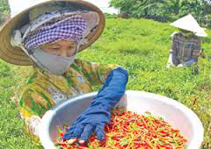
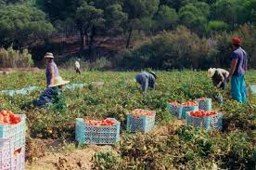
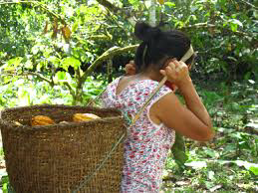
General Information of Thailand
Area Cultivation
- Total land area 51 m. ha - Area cultivation 23.94 m. ha (149 m. rai) or 40.87% of the total
- major crop
- Rice 12.30 m. ha (50.74%)
with production 23.3 m. tons
- Field crop 5.8 m. ha (21.55%)
with production 54 m. tons

Slide 3
Market situation (2016)
Top ten of principal agric. export
Rubber & products (1st) : 155,753.08 m.baht
Rice & products (2rd) : 154,433.92 m.baht
Cassava & products (3rd) : 103,128.77 m.baht
Chicken & products (4th): 71,680.22 m.baht
Fruits & products (5^{h}) : 54,627.25 m.baht
veget. & products (11th) : 6 7,502.21 m.baht
ที่มา : ศูนย์เทคโนโลยีสารสนเทศและการสื่อสาร สำนักงานปลัดกระทรวงพาณิชย์ โดยความร่วมมือจากกรมศุลกากร
http://www.ops3.moc.go.th/export/recode_export_rank/#

Slide 4
Income & debt
Debt
Income:
Households Baht/Year
Agri-income 5,583,082 - 100,060
None Agri-income 4,423,170 - 78,827
mean 157,722
In Agri.
Range (Baht)
Household
Percent
<
>

Slide 5
Vegetables and product value export

Slide 6
Courtesy of Nakorn Limpakooptathaworn, Thai City Farm Project

Slide 7
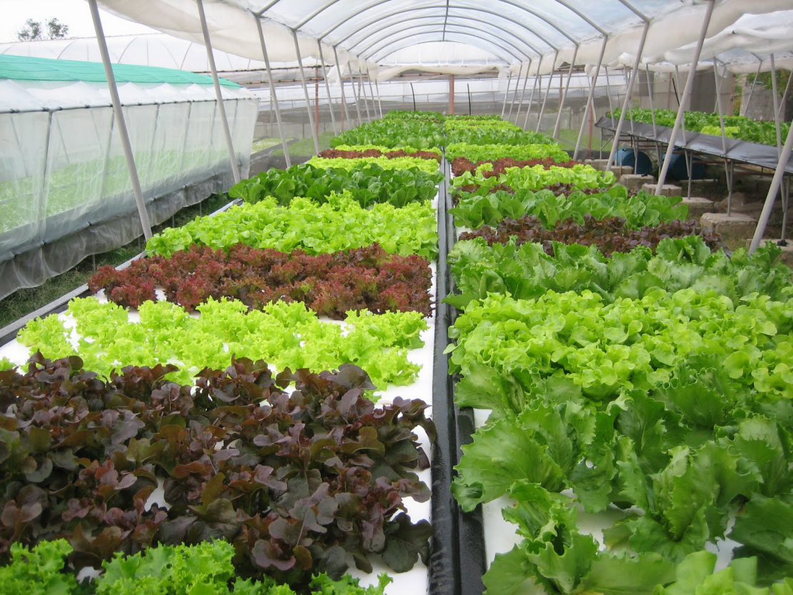
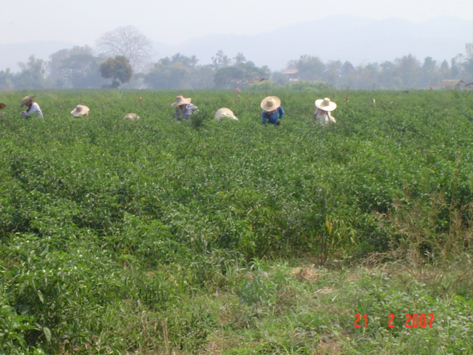
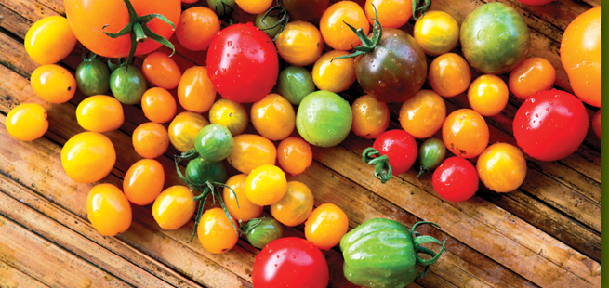
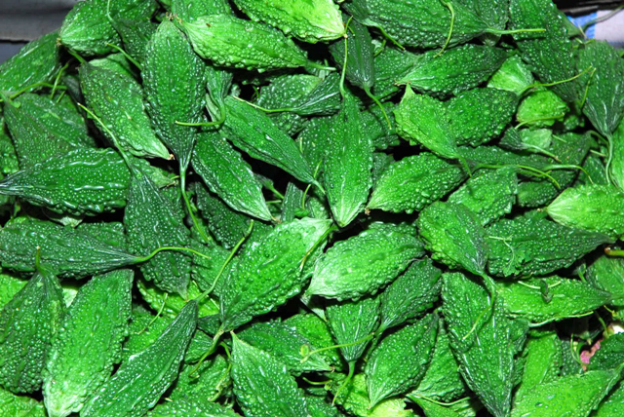
Vegetables Production

Slide 8
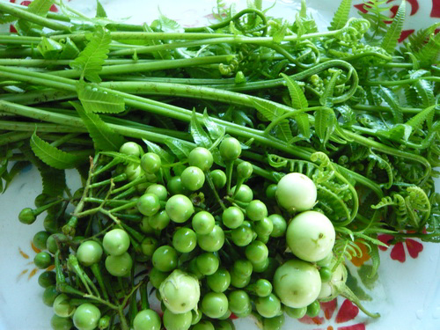
Crop Production Situation
vegetable production in
tropical regions faces a lot of problems
- Insect pests
- Diseases
- Low standard
- High residues Exceed the MRL
High Agr. Input but low income return

Slide 9
Kind of vegetables in Thailand
Leafy vegetable: edible amaranth . oriental celery . garland chrysanthemum (Shingiku) . Japanese Greens . herbs . vhinese kale (kai lam) . komatsuna . lettuce . malabar spinach . oriental mustard . bunching onion . yu choy (edible rape) . oriental spinach . hon-tsai-tai . - Chinese cabbage: . white petiole small cabbage . green petiole small cabbage . white Large Pak Choy . heading NAPA Cabbage . Semiheading Chinese cabbage
Herbs: Chinese leek (Chinese chives) . Thai basil . coriander (Chinese parsley) . mint . perilla (Japanese Shi-So) . watercress
Fruit/gourd vegetable: oriental cucumber . oriental eggplant . bitter gourd (bitter melon) . winter melon (wax gourd) . calabash (OPO) . mao qwa (hairy gourd) . Snake Gourd . Edible Luffa . Oriental Melon . Pickling Melon . Oriental Sweet pepper . hot pepper . oriental squash . tomato . watermelon
Root vegetable: edible burdock (gobo) . carrot . oriental radish (daikon) . turnip
Flower vegetable: broccoli . cauliflower . flower Chinese cabbage . Chinese leek flower . white choy sum . green choy sum
Others: baby corn . kohlrabi . Okra . sesame

Slide 10
Showing vegetable acreage of different types, damage, harvest and yield (2012).
Vegetables | Planted Area | Damage | Harvest | Yield | Yield/rai
 | (rai /) | (rai) | (rai) | (Metric Ton) | (Kg/rai)
Vegetable and products | 2,360,751.25 | 55,571.00 | 1,579,392.25 | 3,395,134.09 | 2,149.65
Chili | 493,324.50 | 8,699.00 | 220,734.00 | 353,992.46 | 1,840.04
Sweet Corn | 263,900.00 | 6,515.00 | 180,362.00 | 299,082.53 | 1,658.23
Baby Corn | 181,302.00 | 609 | 167,217.00 | 222,994.42 | 1,333.56
Water Mellon | 146,113.50 | 9,915.00 | 71,525.00 | 169,401.91 | 2,368.43
Shallot | 130,833.00 | 1,573.00 | 92,650.00 | 253,576.30 | 2,736.93
Mush room | 107,027.00 | 0 | 104,884.00 | 567.57 | 5.41
Cabbage | 83,996.00 | 51 | 71,681.00 | 936,474.07 | 13,064.47
Garlic | 72,965.50 | 455 | 40,887.00 | 63,847.99 | 1,561.57
Yearlong Bean | 71,915.50 | 2,747.00 | 67,239.50 | 82,310.65 | 1,224.14
Egg Plant | 68,202.00 | 805 | 37,756.00 | 44,234.15 | 1,171.58
Others | 741,172.25 | 24,202.00 | 524,456.75 | 968,652.04 | -

Slide 11
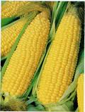
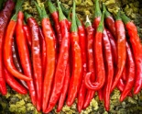
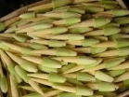
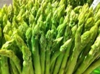
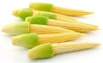
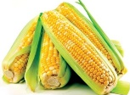
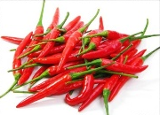
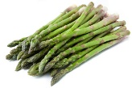
พื้นที่ปลูกพืชผักโดยทั่วไป
พื้นที่เก็บเกี่ยว (2556)
ข้าวโพดหวาน 209,143 ไร่
ข้าวโพดฝักอ่อน 198,011 ไร่
พริก 159,598 ไร่
หน่อไม้ฝรั่ง 14,267 ไร่
ปลูกเพื่อเน้นการส่งออก
ปลูกเพื่อเน้นบริโภคภายใน

Slide 12
Tomato

Slide 13
Garlic
Shallot
Plantation Areas
2007-2016
Onion
Potato

Slide 15
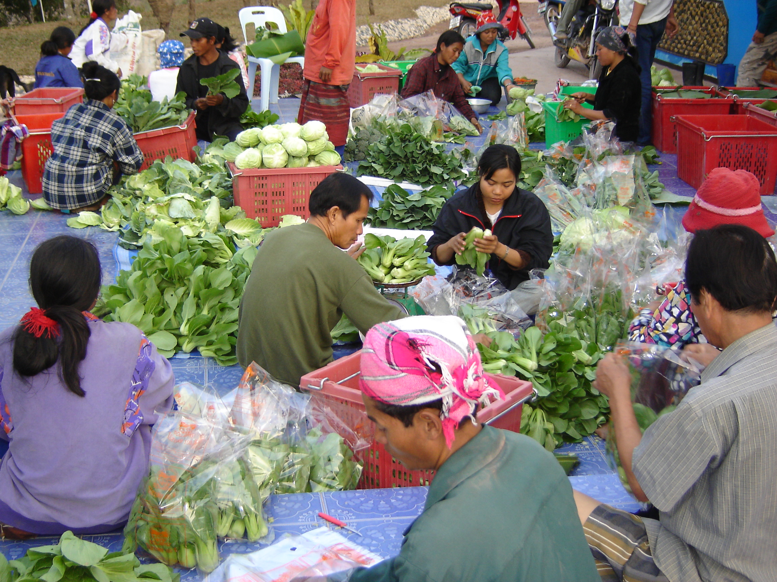
Strategy policy

Slide 16
Thailand’s 20-Year National Strategy & 4.0 Policy (1)
The 20-year national strategies :
Six primary strategies
(1) enhance and develop the potential of human capital;
(2) ensure justice and reduce social disparities;
(3) strengthen the economy and enhance competitiveness on a sustainable basis;
(4) promote green growth for sustainable development;
(5) bring about national stability for national development toward prosperity and sustainability;
(6) enhance the efficiency of public sector management and promote good governance.
2

Slide 17
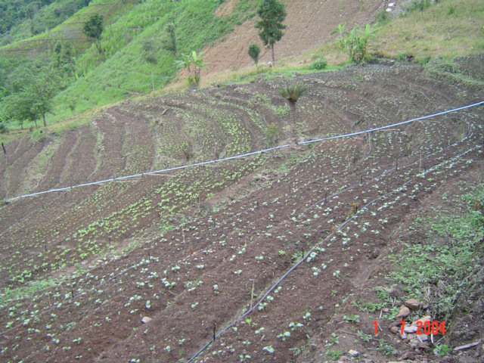
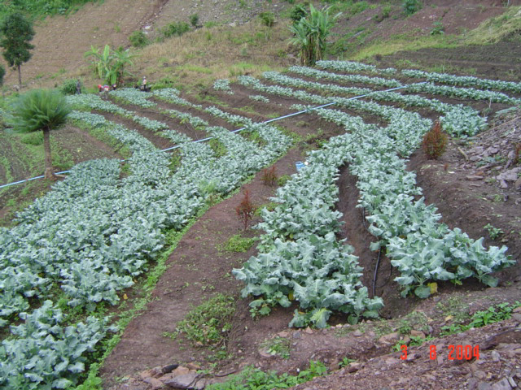
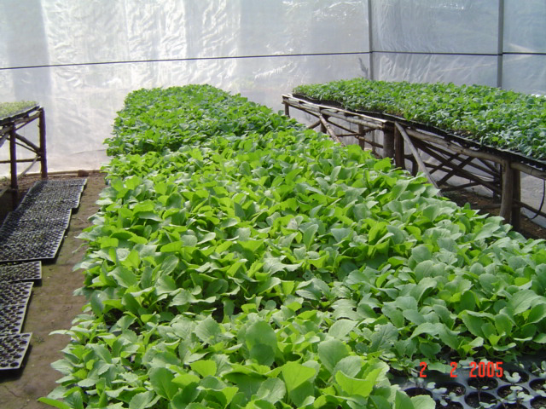
Thailand’s 20-Year National Strategy & 4.0 Policy (2)
The 20-year national strategies : (cont’)
Four supporting strategies
(1) infrastructure development and the logistics system; (2) science and technology, research, and innovation; (3) urban, regional, and economic zone development; (4) international cooperation for development.
3

Slide 18
Thailand’s 20-Year National Strategy & 4.0 Policy (3)
Thailand 4.0 policy :
Reforming existing five industries (automotive, electronics, affluent medical and wellness tourism, agriculture and biotechnology, and food),
Promoting five new industries, in which Thailand has the potential to succeed (robotics, aviation and logistics, biofuels and biochemicals, the digital industry, and the medical hub).
4

Slide 19
Ministry of Agriculture and Cooperatives
“Stability, Prosperity and Sustainability”
National
"To provide farmers with good quality of life, people with safe food for consumption, with income generation for their agri-activities”
Ministry of Agriculture and Cooperatives
1
1.“Reduce Production Costs and Enhance Competitiveness of Agricultural Production”
2
3
4
5
6
Agricultural Zoning
Cluster Farm
Organic Farming
Agricultural
Learning Centers
Agricultural Products’ Bank
Cost Reduction
Increase Productivity
Market
5
Management

Slide 20
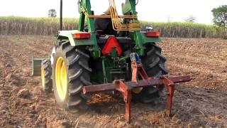
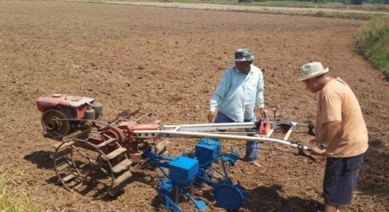
1. Cost Reduction & Enhancing Competitiveness
Lower production costs/ Optimize Productivity per unit
Production standards/ Meet market demand
Enhance Competitiveness / Farmers’ income increase
7

Slide 21
2. Agricultural Zoning by Agri-Map
“Promote agricultural production for suitable commodities in
potential areas, balance between demand and
supply, reduce the production costs, and increase
the production efficiency”
Promote production of agricultural products in potential areas
Adjust production of agricultural products that is not suitable to the areas
9

Slide 22
Agricultural Map for Adaptive Management
Marketing Plan
Logistics
Seeds
Production inputs
Water resources/management
Cropping pattern
Cropping requirement
etc.
Resources
Balance
Production
Market
demand
10

Slide 23
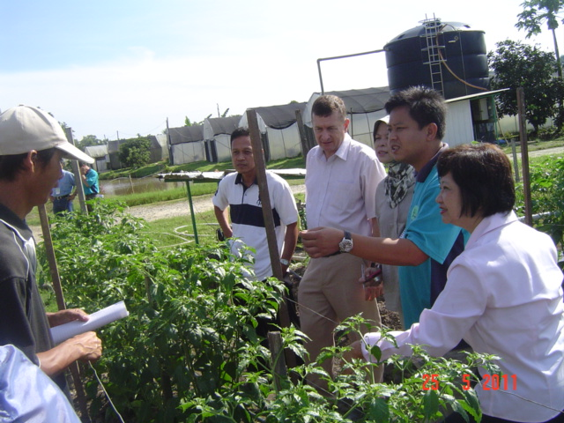
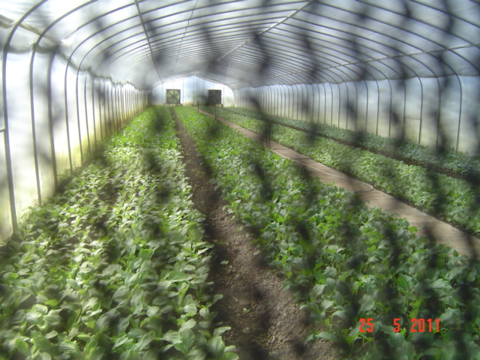
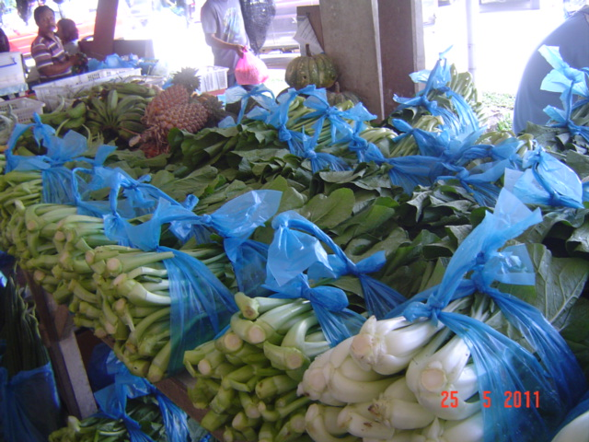
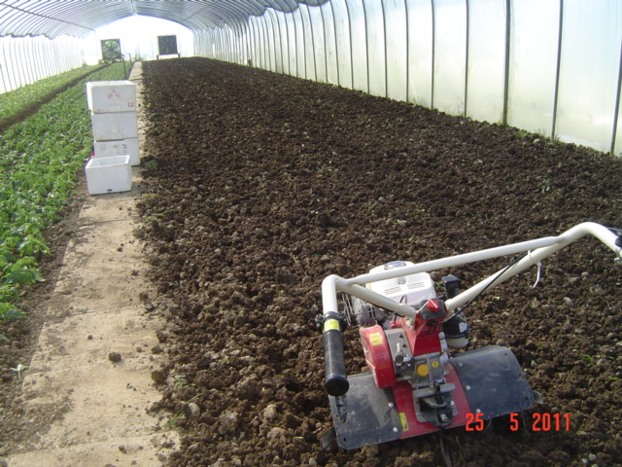
3. Cluster Agricultural Farms/Mega Farms
“Area – based production, Integrated management among relevant agencies, effective farm and supply – chain management”
11

Slide 24
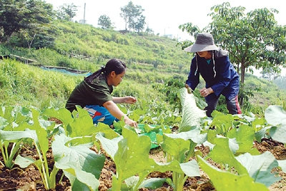
4. Organic Farming
“Increase organic farming areas at least 10 % each year”
1. Preparation
- Organic farming database
- Capacity building (public personnel, farmers sectors)
2. Promoting Organic Farming
- organic farming city
- Management efficiency for farmers and agricultural cooperatives
3. Standard Certification
- Organic farming standards
- Production Standard Certification
4. Value-added production (processing)
5. Knowledge and awareness institution
Yasothon Model
12

Slide 25
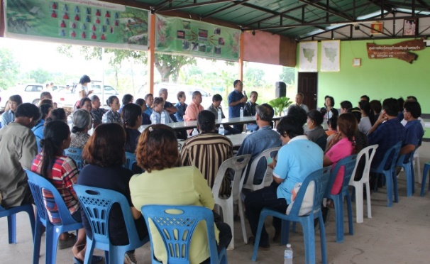
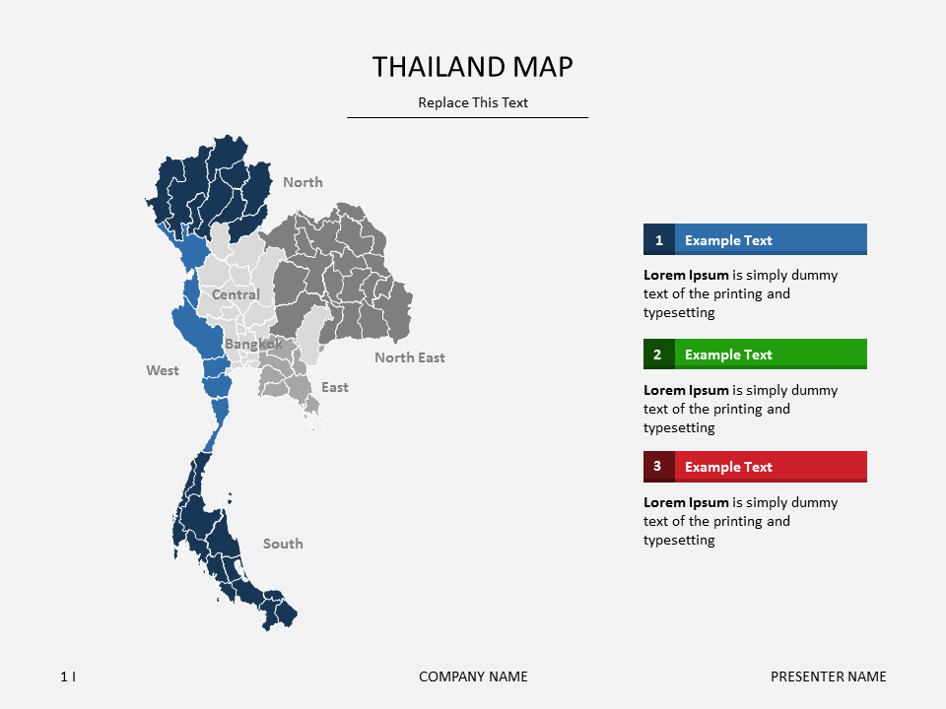
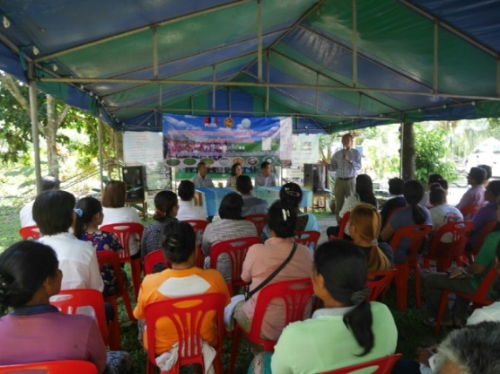
5. Agricultural Learning Centers
Centers for technology transfer/ services / information: 882 LCs (in 882 districts)
Integrated management mechanism among relevant agencies for agricultural solutions and development (882)
13

Slide 26
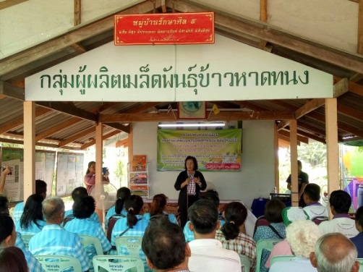
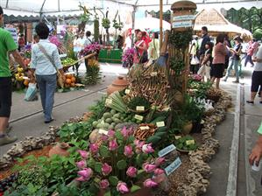
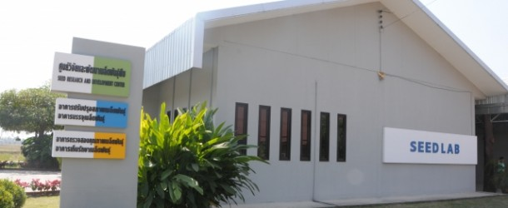
6. Agricultural Products Bank
“Create farmers’ awareness in waste and cost reduction.
Pool of agricultural products ”
Bank of Organic Fertilizers
Bank of Cattle
Bank of Seeds
14

Slide 27
The A4 Paper Models
Better quality of life
More Income
Reducing Cost of Produn.
Push forward/
Mobilize
Six national policy (MOAC)
Smart farmer/Officer
Mission
Innovation/
Tech./
New theory
In Agri.
PPP

Slide 28
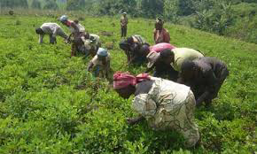
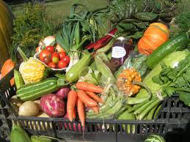
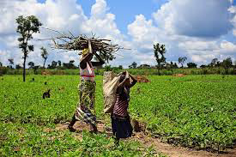
Vegetable strategy
Vision:
Leadership in varieties of vegetables produce and products in line with environmental friendly
GAP/Quality standards/Safe vegetables/Seed hub

Slide 29
Q-GAP
8. Record keeping
7. Harvest & post-harvest handling
6. Production process for quality produces
5. Product free from pest
4. Storage and transport
3. Chemical/ Pesticide application
2. Growing area
1. Water source

Slide 30
Strategy R&D for vegetables
1960 – 2000 for increasing (high) yield/productivity
>2000 – 2010 for minimizing chemical residual
>2010 - for inc. standard/nutritional/health/organics/safe
Protected Tech./ Precision Agri./Organic Agri/ Safe Vegetables

Slide 31
Strategy R&D for vegetables
New technology/Innovation for increasing efficiency of vegetable production
Top down R&D
Breeding Programme
R&D for specific problem
From Public and Private

Slide 32
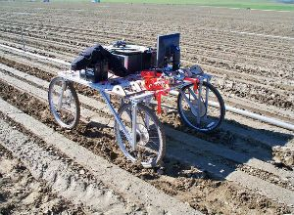
เทคนิคใหม่ๆ (New Techniques)
Drone :
-Spraying
-Image Phenotyping
Ext. devices
GPS
Smartphones
Early warning
etc.
Robot Sensor:
-การพ่นสารเคมี
-การใช้ภาพถ่าย แปลผลในการควบคุมการเกิดโรค
เจ้าผักกาด หุ่นยนต์มือสังหารวัชพืช
ปัจจุบันหุ่นยนต์ผักกาดต้นแบบตัวนี้ถูกลากโดยรถแทรกเตอร์ ตัวหุ่นยนต์จะใช้กล้องมองหาพืช จากนั้นแยกแยะว่าที่เห็นเป็นผักกาดหรือวัชพืช โดยการใช้ระบบตรวจจำวัตถุ (object recognition) เทียบสิ่งที่มองเห็นกับฐานข้อมูลที่เคยเก็บไว้ สุดท้ายคือการกำจัดวัชพืชซึ่งทำได้หลายวิธี คือ ตัดทิ้ง ใส่ยาฆ่าวัชพืชเล็กน้อยลงไปเฉพาะจุด หรือใส่ปุ๋ยลงไปบริเวณวัชพืช ซึ่งความเข้มข้นปุ๋ยที่ใส่มากเพียงพอที่จะทำให้วัชพืชตายในขณะที่เพิ่มอาหารให้ผักกาดไปในตัว กระบวนการทั้งหมดนี้ทำในขณะที่หุ่นยนต์ถูกลากอยู่ ดังนั้นการตัดหรือฉีดสารเคมีจะต้องคำนวณตำแหน่งชดเชยการเคลื่อนที่ไว้ด้วย ซึ่งในระบบปัจจุบันสามารถทำได้แม่นยำถึง 98% ที่ความเร็วในการวิ่ง 4.8 กิโลเมตรต่อชั่วโมง
https://www.thairobotics.com/2012/10/01/lettuce-bot-weed-terminator/

Slide 33
Areas of interest Precision Agriculture technology-DOA
Area of interest / Challenge PA technology for DOA | Possible Applications
Proximal sensing | Measurement/specific mapping
Global Navigation Satellite System : GNSS) | Controlled Traffic Farming (CTF)
Variable Rate Technology (VRT) | Various cultural managements
Remote Sensing: RS | Characterization/crop risk analysis
UAV (Drone) | Increase efficiency spraying/pest control/phenotyping
GIS – modeling integration | for natural resource management/ Land/Crop suitability rating/consolidated/mega farm (แปลงใหญ่)
Sampling Location | efficiency of fertilizer application
Biomass Monitoring | for fertilizer/nitrogen management
Farm Management Information Systems | Decision making for input
Machine Vision Systems | Grading/phenotyping
Greenhouse Technology | Climate control/productivity/standard operating procedure
37

Slide 34
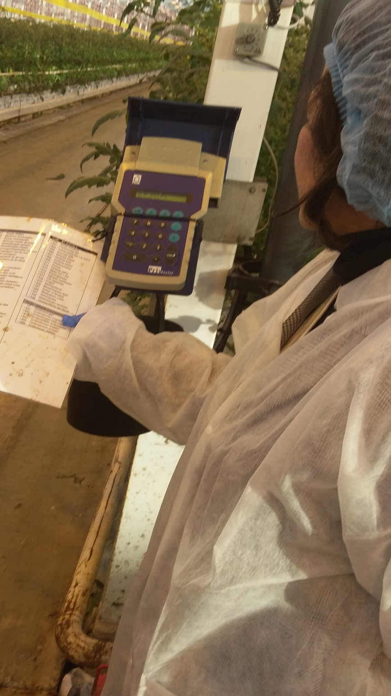
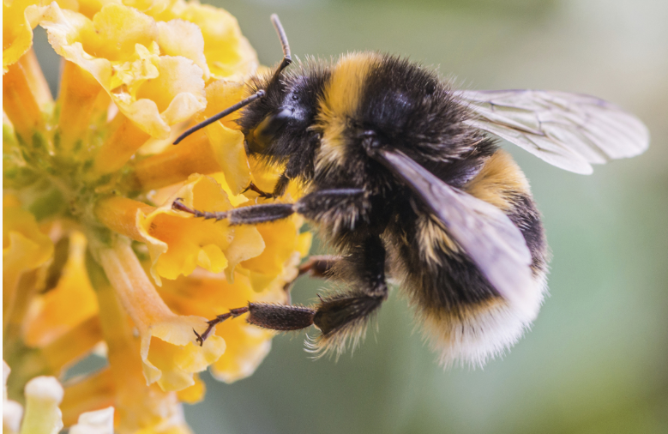
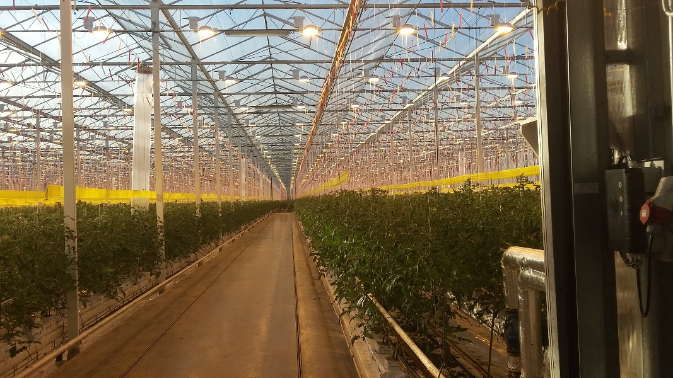
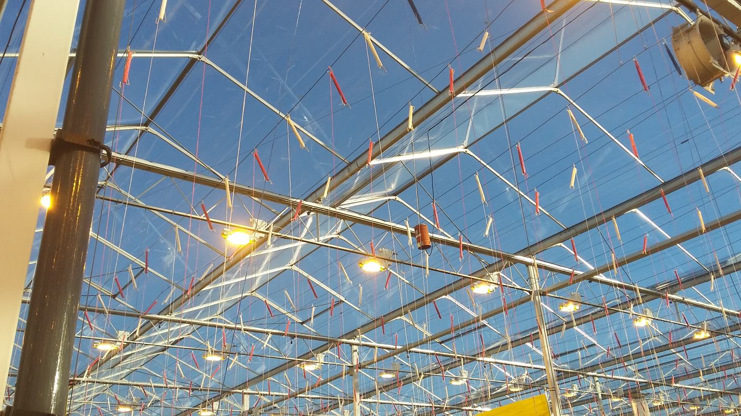
Precision Tomato Production (in NL) - increasing photosynthesis - co2 at leaf boundary layer - fertigation (crop requirt.) - light inty. -temperature 18-30 ⁰c - rh - vigorous rootstock - pollination (bubble bee)
Our Expectation
Attaining as potential
yield as 80-100 kg./sqm.
https://www.google.co.th/?gws_rd=cr&ei=e3LFWNTbC8TKvgSJg6pY#q=bumble+bee&*

Slide 35
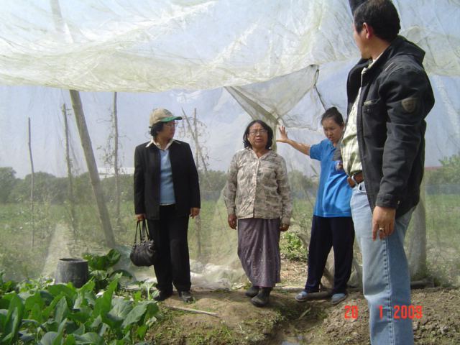
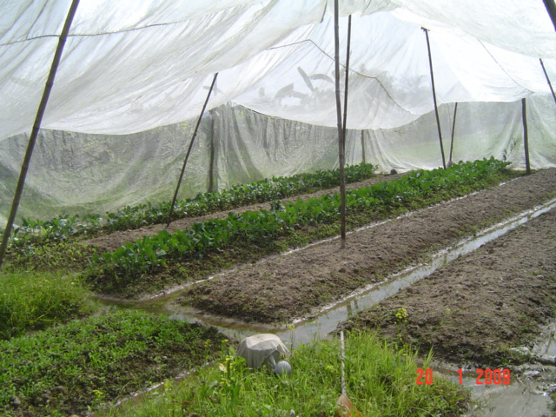

Slide 37
Conclusion
Production are depending mainly on
Market/Economic demand (Export and Domestic consumption)
Environmental Stress
Disease and Insect constrain
Governmental Policy
(Less in Innovation and Technology)
Contrast b/w Strategy and Current situation

Slide 38
THANK YOU!!
for your attention

