Slide 1
Transforming Vegetable Farming in Singapore
12th AARNET Steering Committee Meeting,23-25 May 2017, WorldVeg HQ, Tainan, Taiwan

Slide 2
Background
Singapore is a city state (land area 710 sq km) with population of 5 million
Agriculture contributes less than 0.1% of its GDP
Imports more than 90% of its food from diversified sources (170 countries worldwide)
Local farms produce a small proportion of fresh food (leafy veg, eggs & fish), helps to buffer against sudden supply disruptions.

Slide 3
Snapshot of Singapore Agriculture Sector
Agrotechnology Parks are agricultural estates designated for farming
Close to 500 ha of land are allocated to over 300 farms
- 72 food farms on 210 ha land
(eggs, food fish, vegetables, other food)
118 coastal fish farms on 400 ha of coastal water

Slide 4
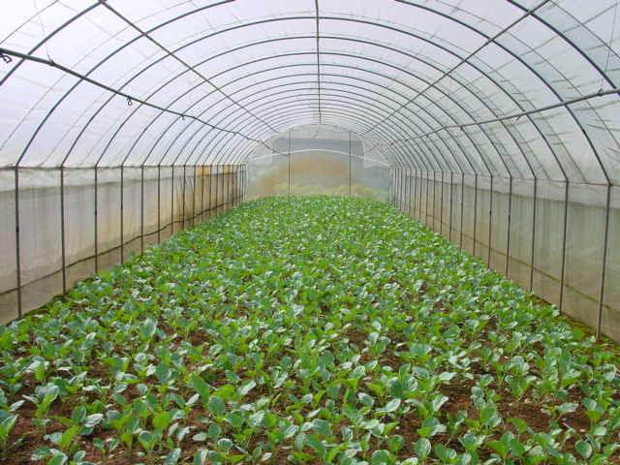
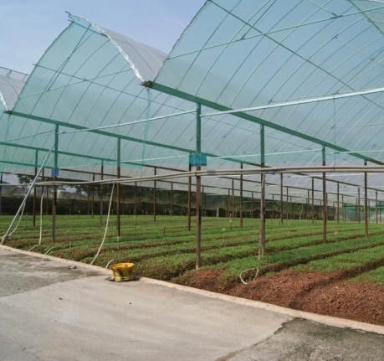
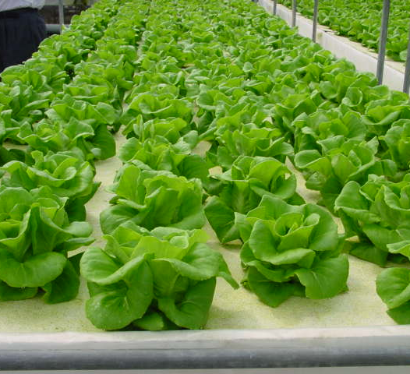
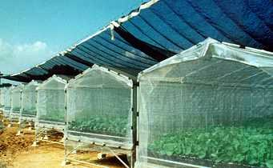
Vegetable Farms
Number: 56
Area: 113.9 ha
Average size: ~2 ha
Conventional, soil-based.
Notes:
Different cultivation systems used in Singapore:
Tunnel houses
Open field under netting for pest exclusion
Greenhouses with higher roofs
Hydroponics
Majority of production is soil based

Slide 5
Vegetable Production in 2016
 | Amount (tonnes) | Value (S$million)
Leafy vegetables | 11,335 | $21.0
Bean sprouts | 10,686 | $9.3
Others | 437 | $3.7
Total | 22,458 | $34.0
Productivity (tonnes/ha/year)
Average farm | 130
Top farm | ~ 200

Slide 6
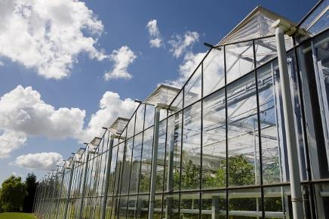
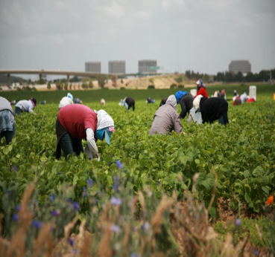
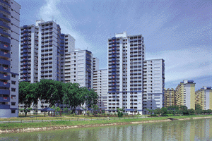
Challenges
High production cost
Land rental
Manpower cost
Resource constraints
Labour shortage
Limited agri-inputs
Land scarcity
Competing land use → less land for farming
Climate change
Extreme weather conditions
Longest Dry Spell (2014)
Plankton Bloom
Fishkill Incident (Feb 2014)

Slide 7
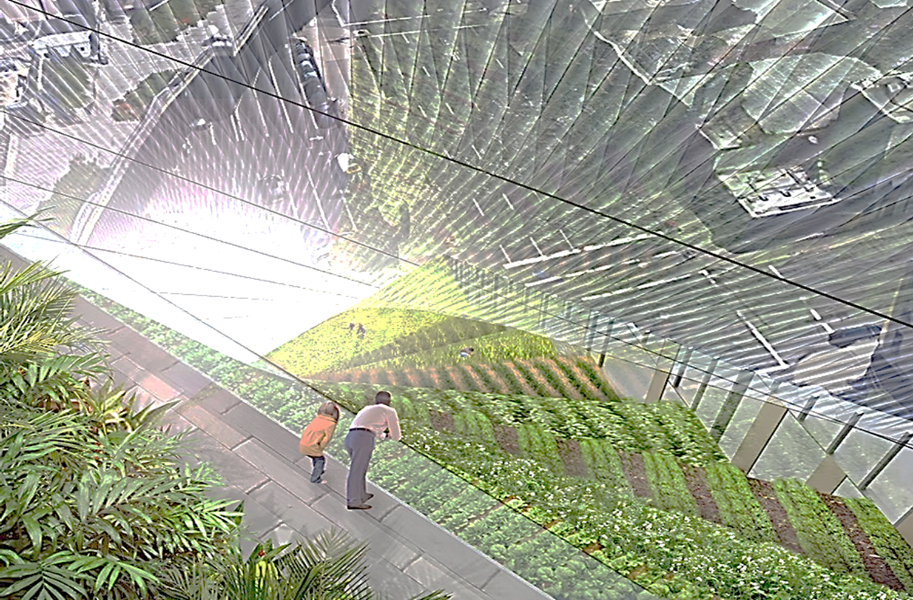
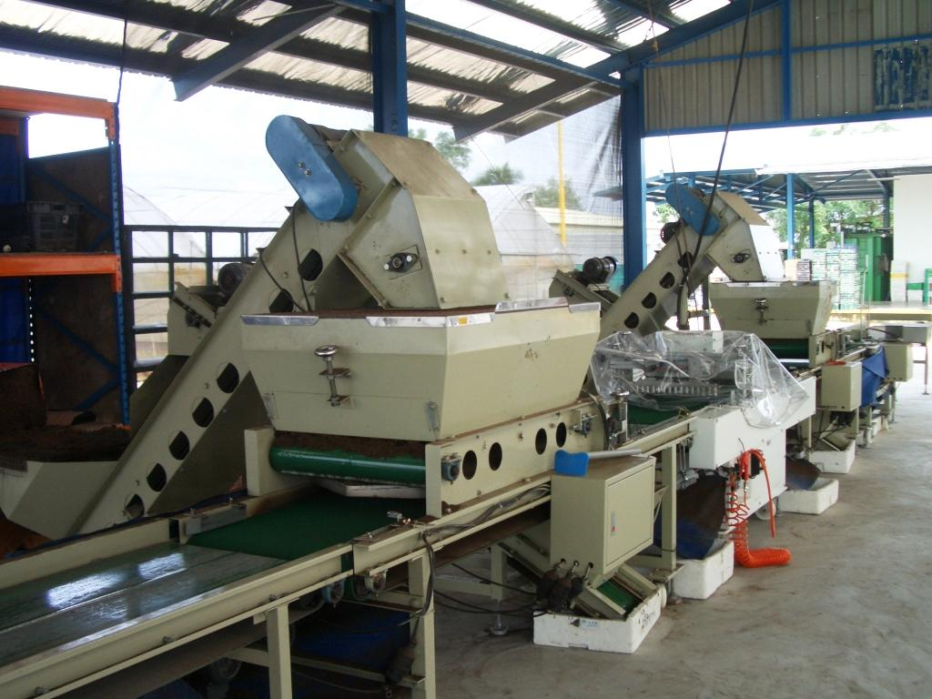
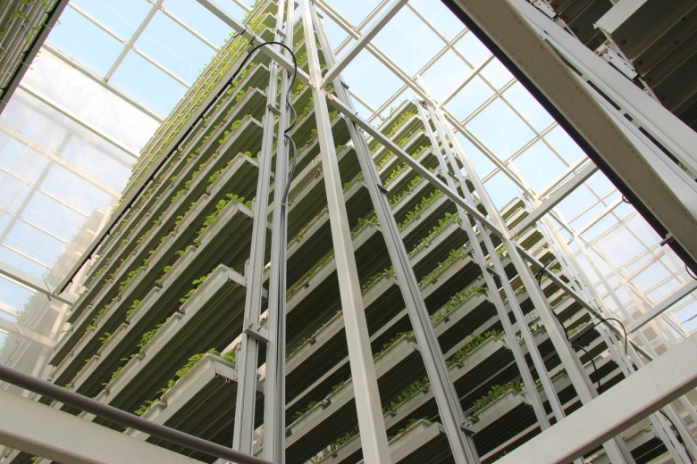
Farm Transformation in Singapore
AVA VISION
Safe food, healthy animals and plants for Singapore; trusted and respected globally
MISSION
Ensure a resilient supply of safe food
Farm Transformation
Food security
Climate resilience
Transformation Guidelines
Maximize land use
Increase productivity
Reduce need for manpower
Reduce use of energy & water
Commercially competitive

Slide 8
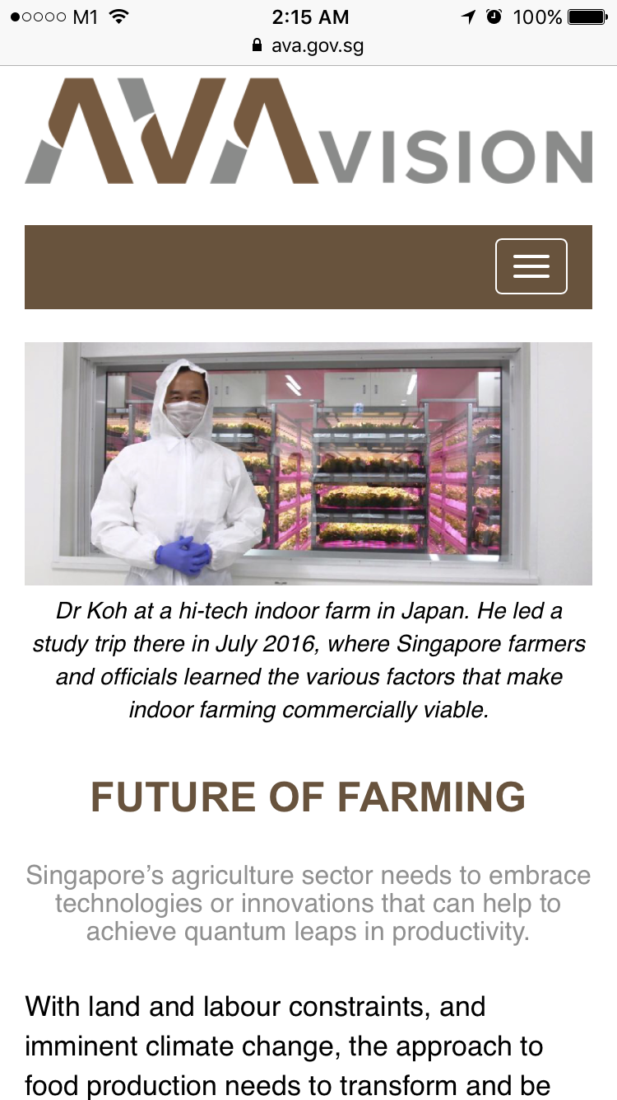
Turning Challenges to Opportunities
We have the opportunity to carve a niche in urban solutions by becoming a living lab for food production technologies
Impetus for Farm Transformation
“We envision that farms of the future… will be highly intensive and productive, and operate on minimal manpower.”
Dr Koh Poh Koon
Minister of State,
MND & MTI

Slide 9
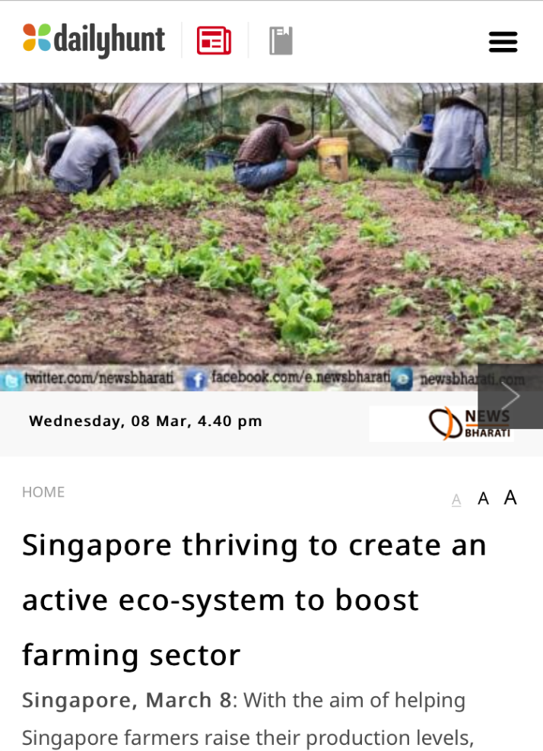
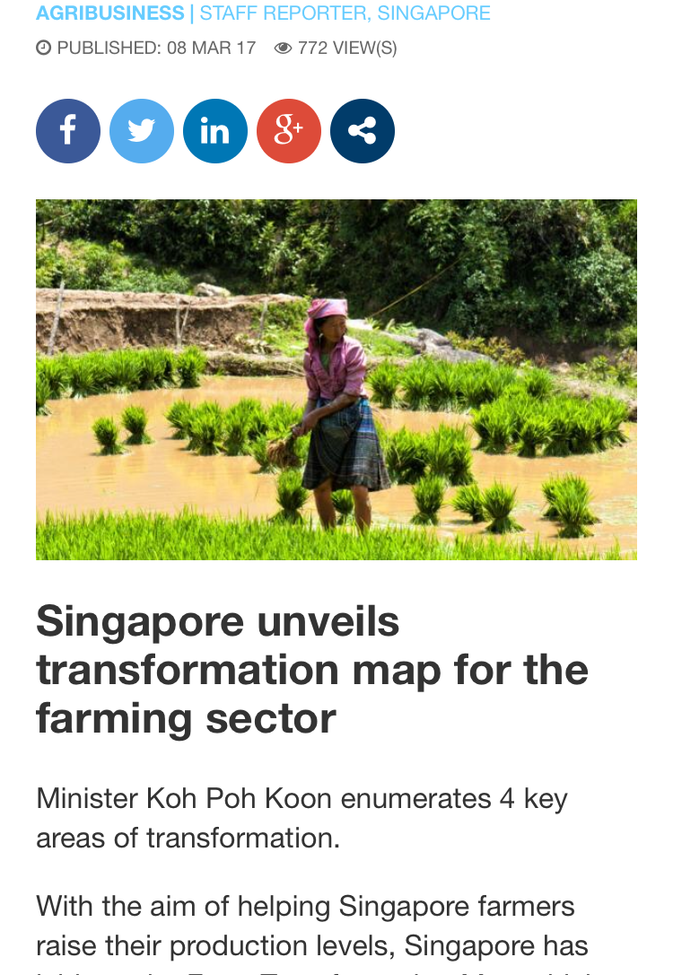
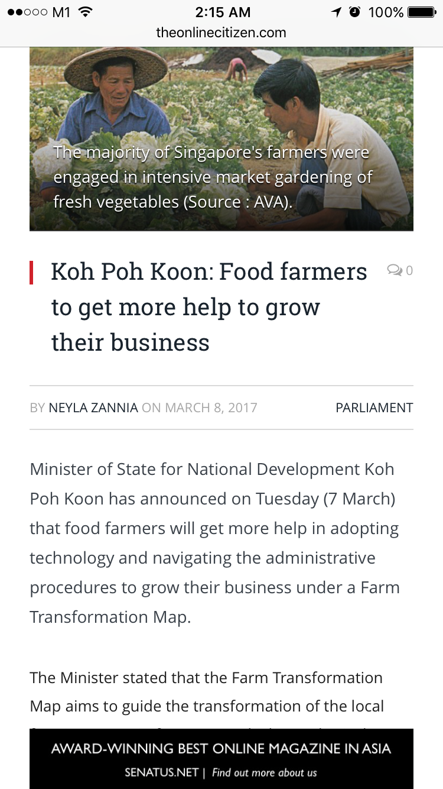
Online news feed after the announcement of Farm Transformation Map, 7 Mar 2017

Slide 10
Leveraging Technologies for
More Productive Farms

Slide 11
Innovation is key Technologies for…
Space creating system
Automation & System Integration
Inputs optimisation
Climate Change
Vertical & multi-tiered systems
Indoor systems
System for unconventional spaces i.e. container farming
Automation & robotics
Sensors & IOT
Closed-loop system
A More Food Secured SG
Urban Food Production
A more food secured SG
Improved genetics
Energy & water efficiency
Water and Nutrient used efficiency
Impact and adaptation measures for farms
Control environment agriculture (CEA)

Slide 12
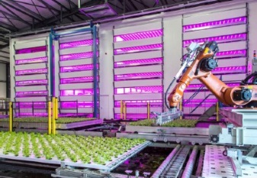
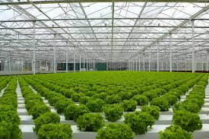
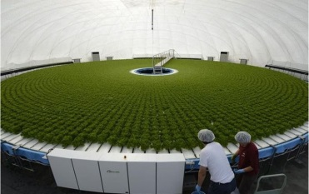
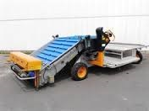
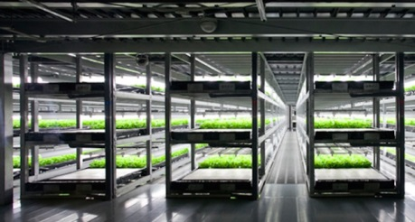
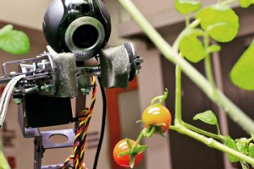
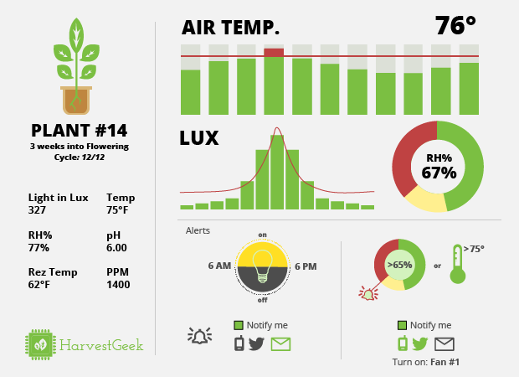
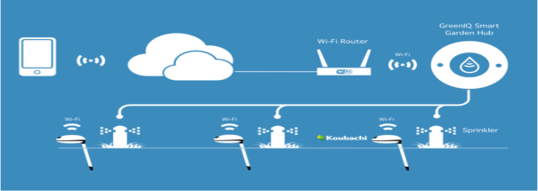
Potential technologies for the next quantum leap for farming in SG
Automation
Greenhouse & hydroponics
Automation
Vertical Indoor farming
Improved varieties
Mechanisation
Smart Sensing
Data analytics
Internet of Things

Slide 13
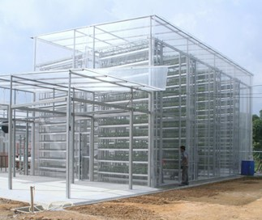
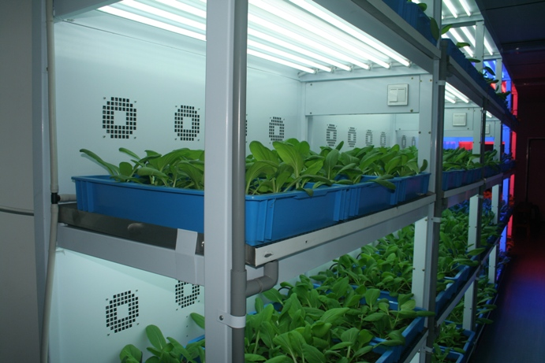
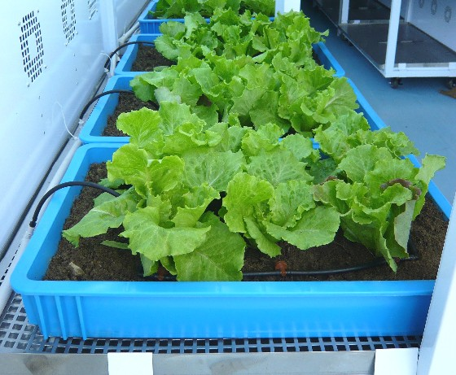
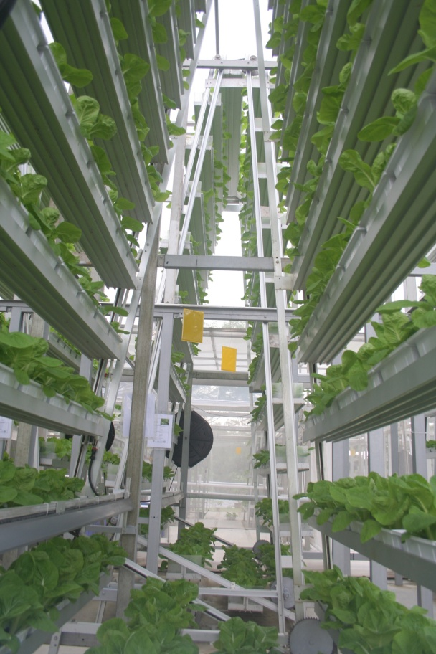
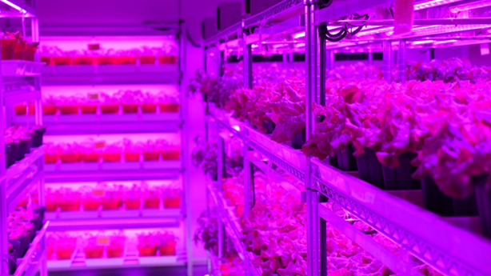
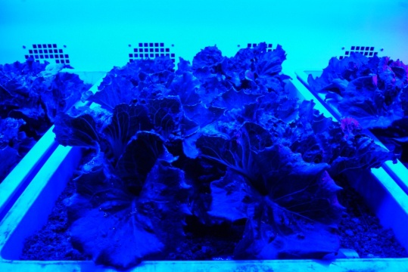
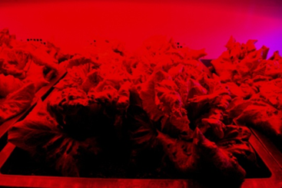
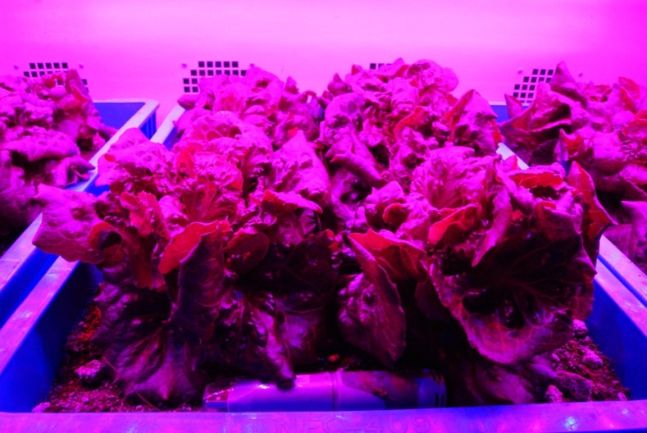
LAND INTENSIFICATION
Outdoor
Indoor
Vertical Farming
Notes:
Outdoor commercial vertical farm – SkyGreens
- 9 m tall rotating system
5 times more productive compared to growing on flat ground
Officially opened in October 2012
Indoor farms – ?? currently
- Produce crops under controlled environmental conditions
- Currently restricted to production of high value and specialty crops due to higher production costs

Slide 14
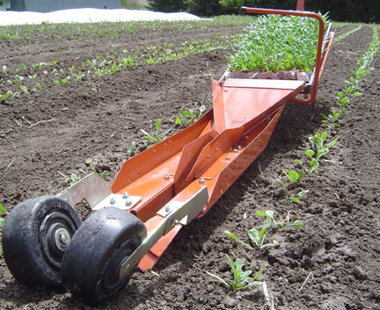
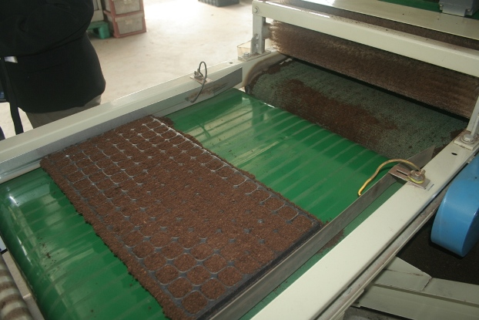
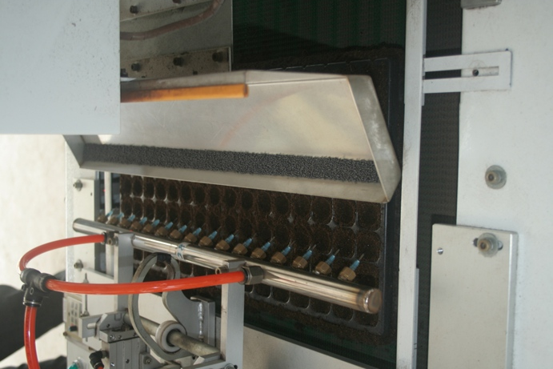
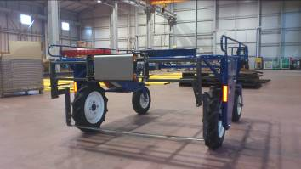
MECHANISATION & AUTOMATION
Source: http://www.smallfarmworks.com/
Transplanter
Media filling & seeding machine
Source: Koyo Engineering
Harvester

Slide 15
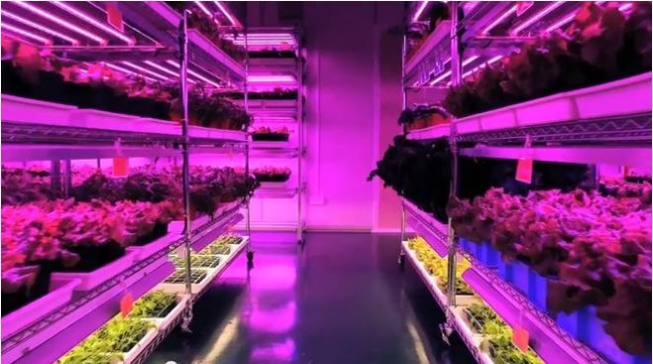
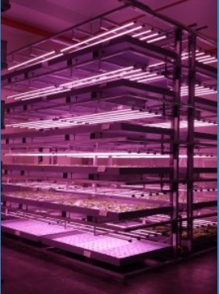
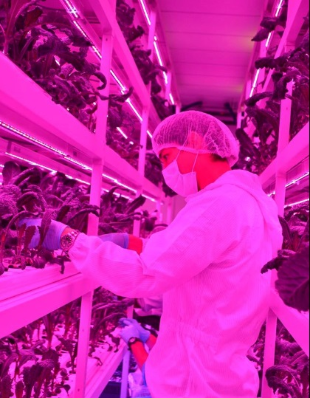
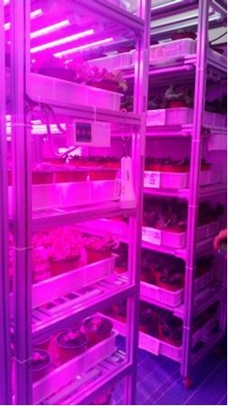
Indoor vegetable farms
Current status
To date, 12 indoor farms
Limitation:
appropriate space to test-bed
farming system
business model
Gov support:
AVA facilitate applications, interagency coordination
Agriculture productivity Fund (APF)
Panasonic
ENF Farm
Sustenir Agriculture
Farm Delight
Notes:
Panasonic - uses existing space in their warehouse in Tuas. Started out with 120sqm in 2014 and expanded to ~1,200sqm in 2015 – which is supposed to produce 81 tons a year.
Sustenir, ENF and Farm Delight rented factory units from industrial buildings -not well established, still developing technology, and business model.
All multi-tier, using artificial lighting (LED or flurorescent). Panasonic and Farm Delight are soil-based. Sustenir & ENF - hydroponics

Slide 16
Indoor Farming/Plant factory
Stable supply of green vegetables both in quality and quantity
Minimise environmental risks such as the climate, disease and insect pests.
Intensify food production
Attract young agri-specialists and replacing aging farming population
Less food miles and smaller carbon foot print. More environmentally friendly.
Notes:
Advantages/Benefit to farm indoor

Slide 17
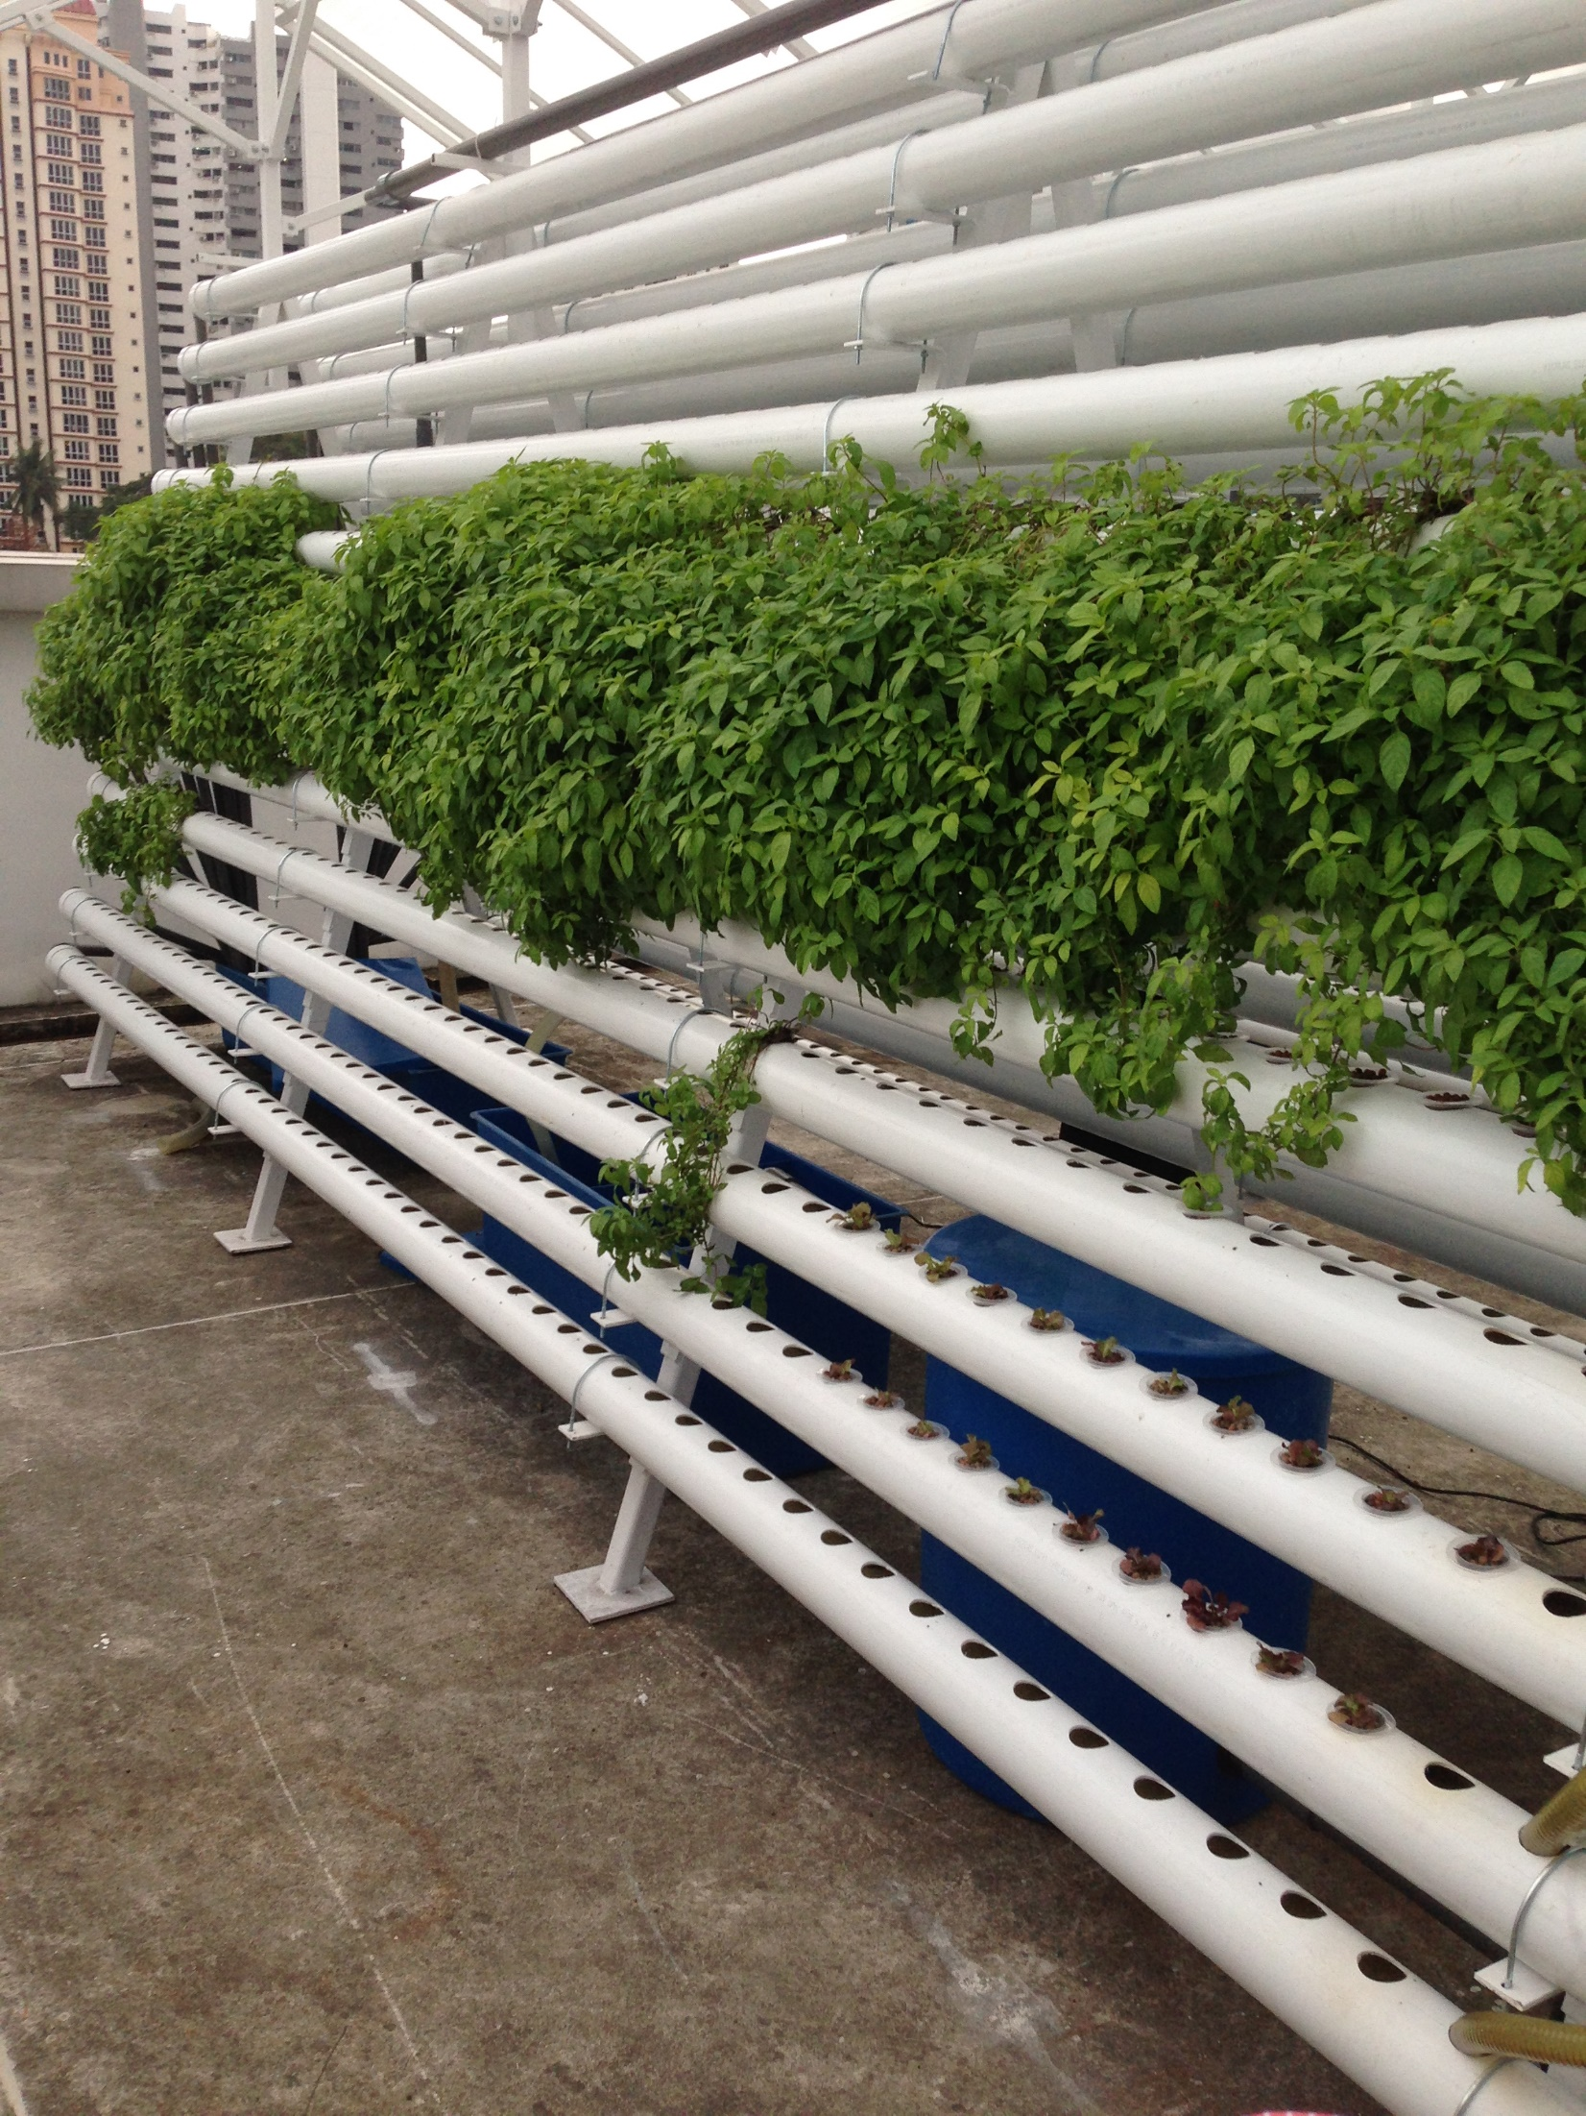
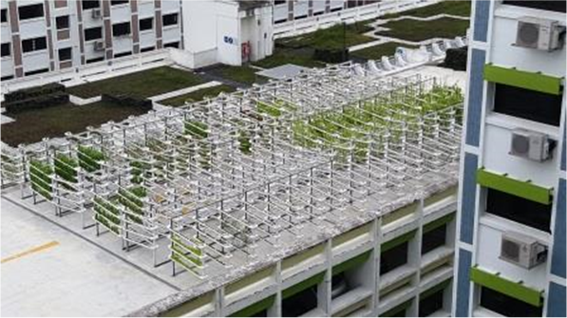
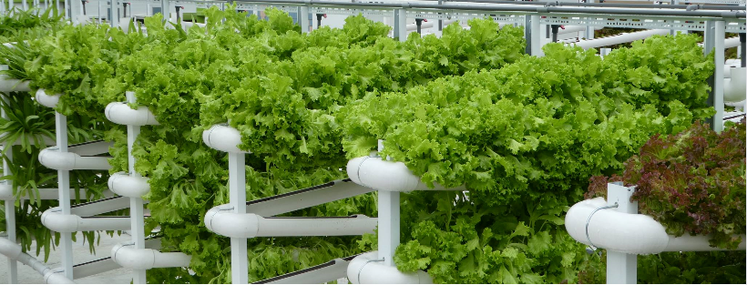
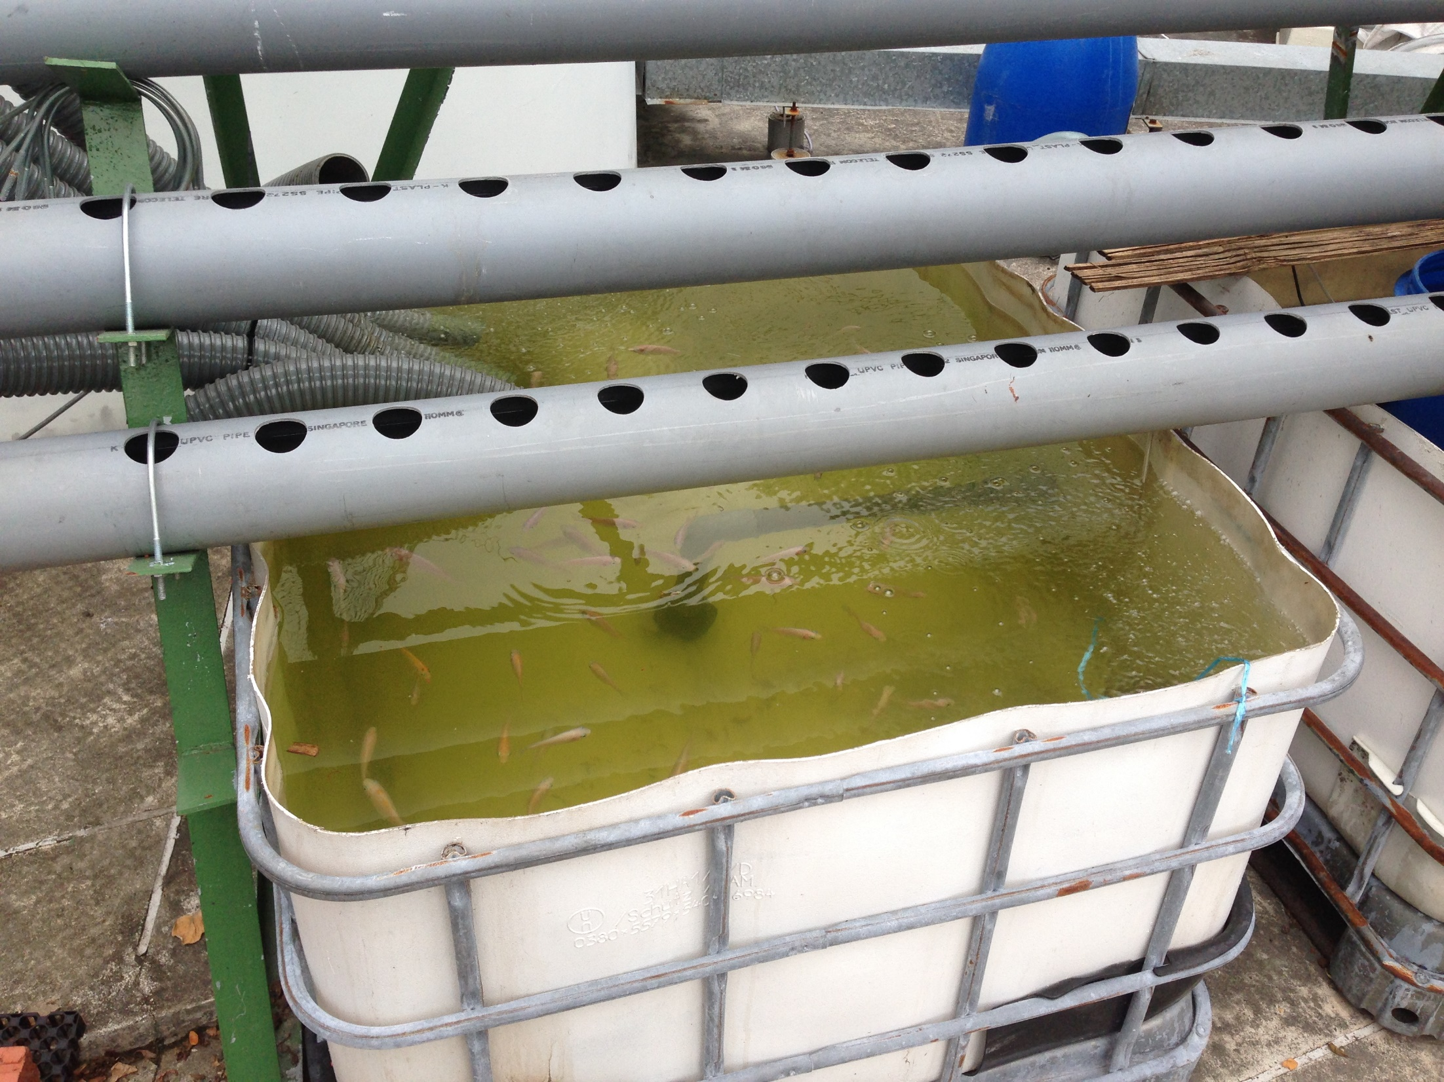
Rooftop farms
Open Cultivation
Multi-tier system
Hydroponics water culture
Natural sunlight

Slide 18
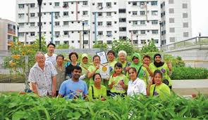
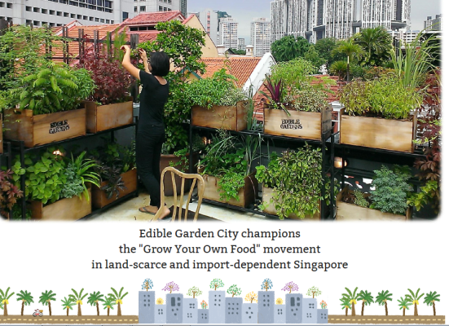
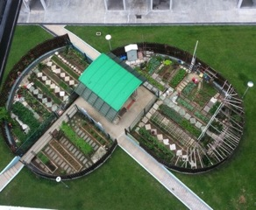
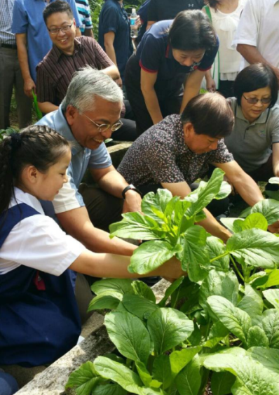
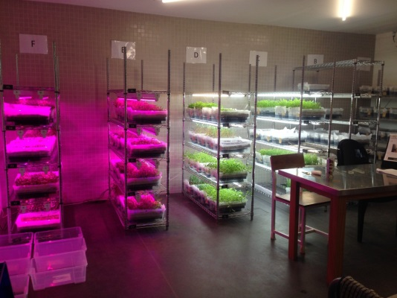
Social enterprises
Community gardens
Rooftop/indoor
Educational
Empty plot/rooftop
Low tech
Bonding, interest, health
E.g. Edible Gardens
Notes:
Edible Gardens is a registered social enterprise, primarily doing foodscape projects (both indoor and rooftop), working with SG-Enable, and training courses for public.

Slide 19
THANK YOU

