Slide 1
Vegetable production and strategies of aarnet countries: malaysia
aarnet meeting 23-25 May 2017
Dr Pauziah Muda
& Vegetable Programme Team
MALAYSIAN AGRICULTURAL RESEARCH AND DEVELOPMENT INSTITUTE (MARDI)
http://www.mardi.gov.my

Slide 2
Malaysian Vegetable Industry
Vegetable production increased 41% in 5 years period (2011 – 2015)
The production was 1,373,086 MT from 68,927 ha, valued RM3,054,967,000 (2015)
Local demand of Vegetables increasing every year
Per capital consumption increasing every year; 55.3 (2011) to 58.5 kg/year (2014)
aarnet meeting 23-25 May 2017

Slide 3
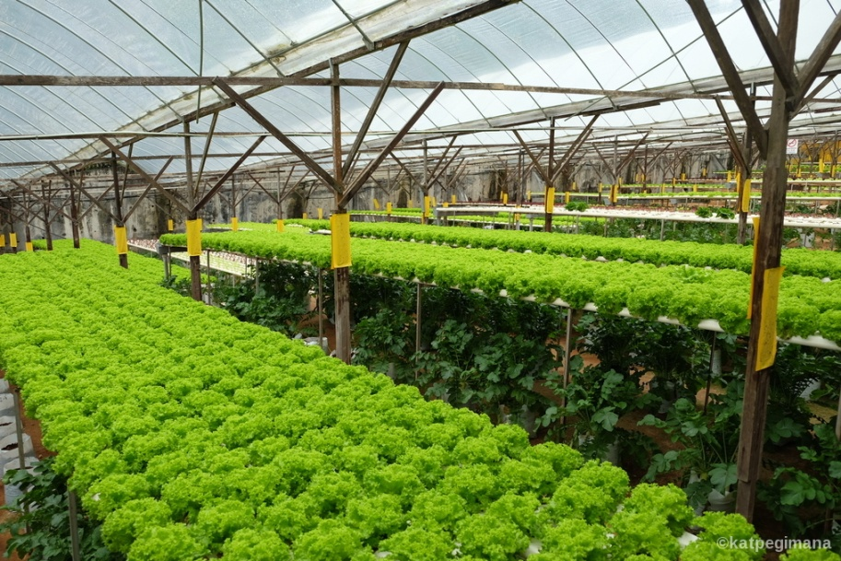
Malaysian Vegetable Industry
Export value RM1,097,134,000 (2015)
Import value RM4,480,709,000 (2015)
Vegetable production in Malaysia comprises of the tropical and temperate types
There are more than 25 types of vegetables grown in Malaysia
Temperate vegetables cultivated at the high land area, Cameron Highland (~1,800m altitude, 8-25°C)
aarnet meeting 23-25 May 2017

Slide 4
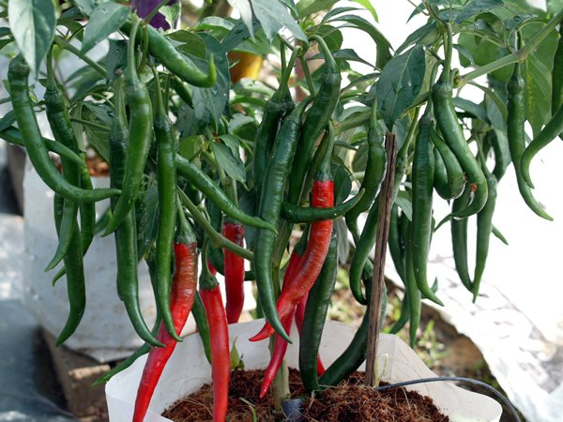
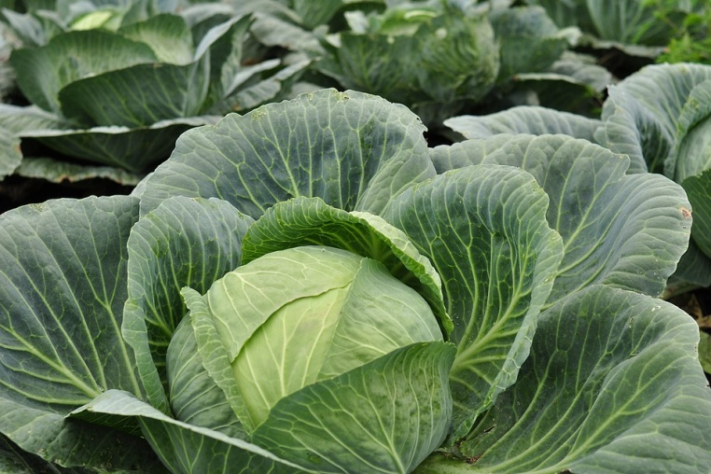
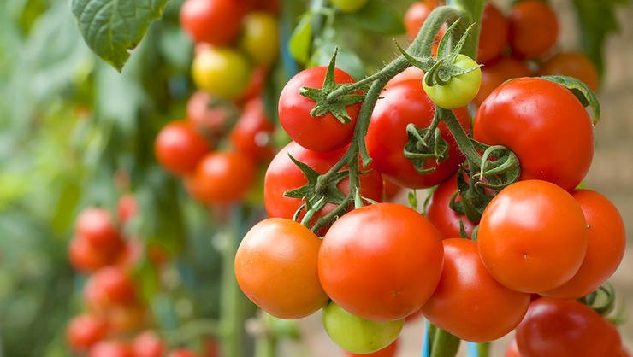
Malaysian Vegetable Industry
Chilli, tomato and cabbage are among the most important and highly demand locally
Local consumption per capital (DOA, 2015)
Chilli 2.5 kg/yr
Tomato 3.6 kg/yr
Cabbage 10.1 kg/yr
Production areas of these vegetables increasing every year
The supply is still insufficient thus allowing increasing import of these vegetables annually
Import value (2013): Chilli RM136.16 mill , Tomato RM58.92 mill, Cabbage RM122 mill
aarnet meeting 23-25 May 2017

Slide 5
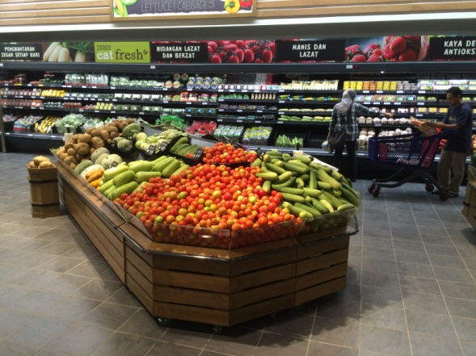
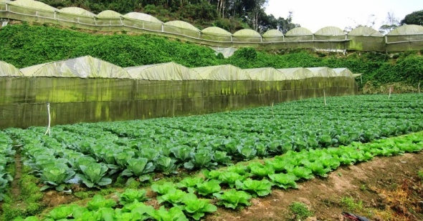
CHALLENGES IN MALAYSIAN VEGETABLE INDUSTRY
Local demand of Vegetables expected to be increased at 4.5% yearly i.e. from 1.6 to 2.4 million MT (2010-2020)
Per capital consumption to be increased at 2.6% yearly (55 kg to 70 kg)
Insufficient of production to cater for local demand
Issues in vegetable production: small scale production, high cost of production – import seeds, competition with low cost production countries
Transformation into Competitive and Sustainable Industry. Thus to focus on increase productivity, expansion of commercial cultivation areas, reduce post harvest losses and strengthen market.
aarnet meeting 23-25 May 2017

Slide 6
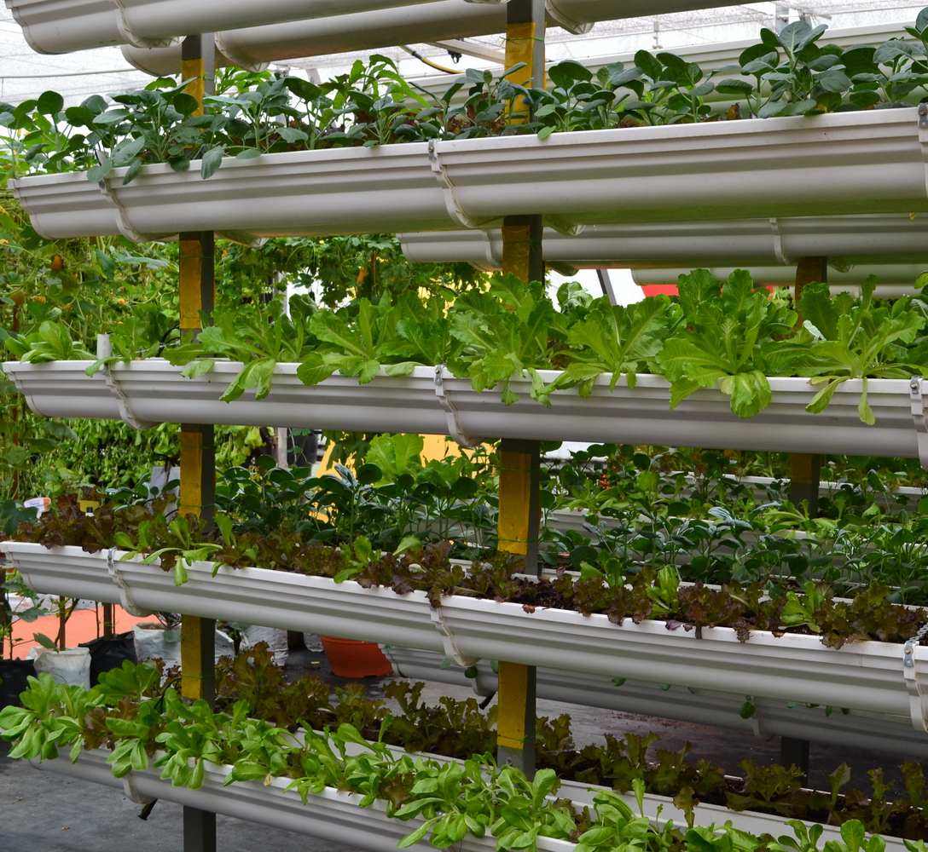
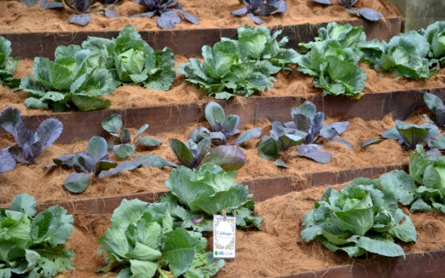
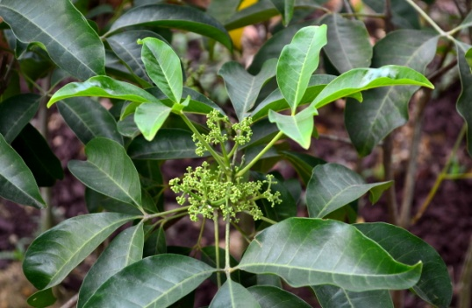
R&D VEGETABLE IN MARDI: Aims
1
Increase production through development of variety with high quality and nutritious value, and development of an efficient production system towards environmental friendly and sustainable approaches.
2
Focus Crop:
High Value Vegetables for low land cultivation
Traditional/ Local Vegetables: bioprospeksi and domestication
aarnet meeting 23-25 May 2017

Slide 7
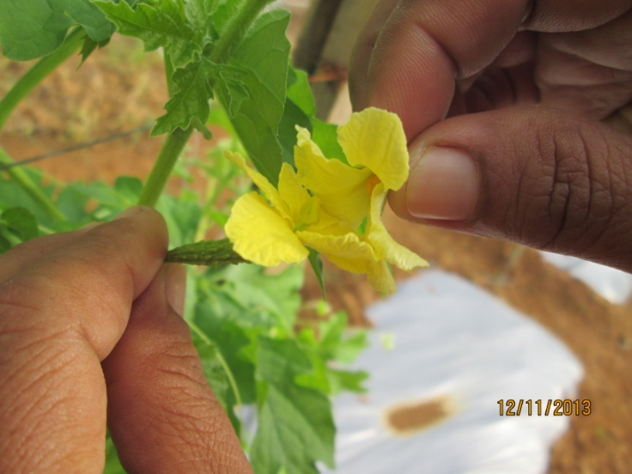
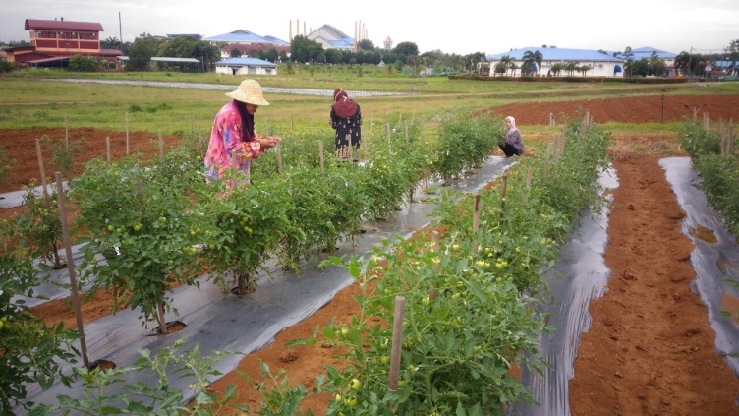
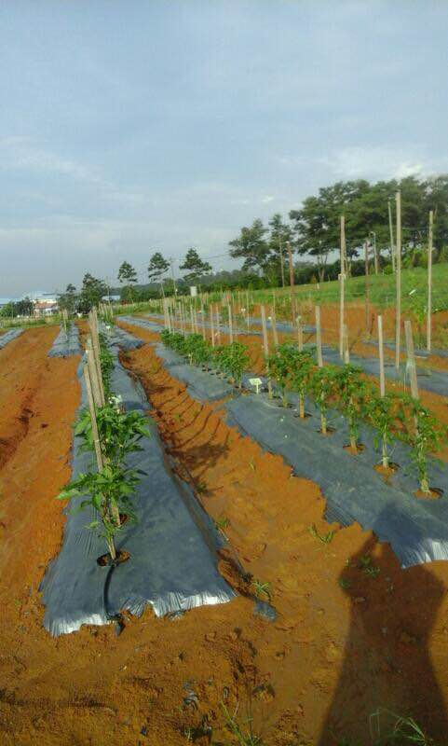
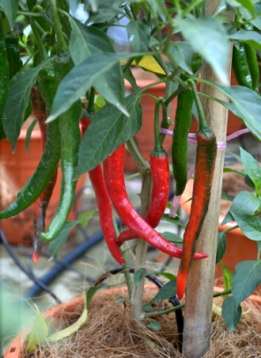
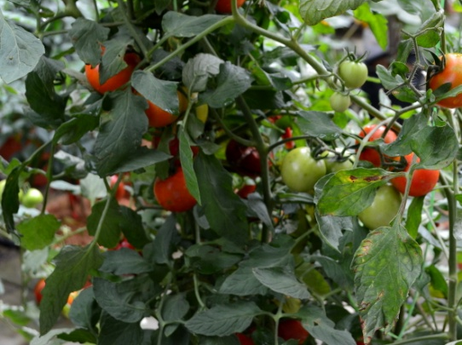
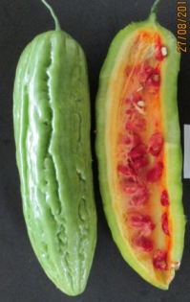
BREEDING & SELECTIONS
Trait aimed:
Heat-tolerance, high yield, disease resistance, long shelf-life
Use wider genetic materials
Crop emphasised:
Chilli
Tomato
Bitter gourd
aarnet meeting 23-25 May 2017

Slide 8
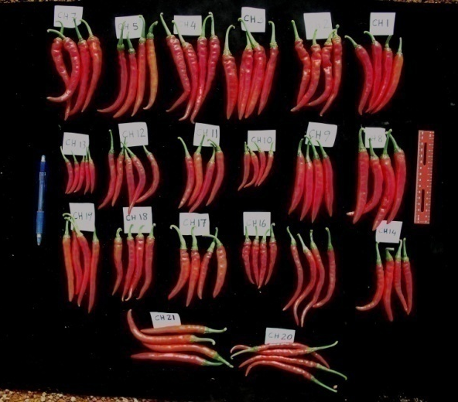
VARIETAL DEVELOPMENT OF CHILLI
(Capsicum annum)
Projects :
Development of chilli variety resistance to anthracnose
GENETIC CONTROL OF CUCUMBER MOSAIC VIRUS RESISTANCE IN CHILLI (Capsicum annuum L.)
Chilli hybrid development using CMS materials: Genetic study of cytoplasmic male sterile (CMS) trait in chilli (Capsicum annuum L.)
1
2
3
High yield
Disease resistance
Anthracnose
Virus
Cytoplasmic Male Sterility (CMS)
Traits aimed:
aarnet meeting 23-25 May 2017

Slide 9
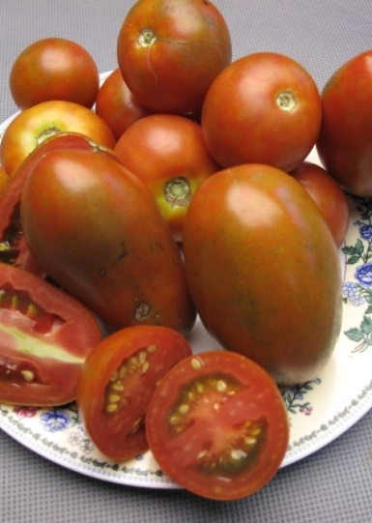
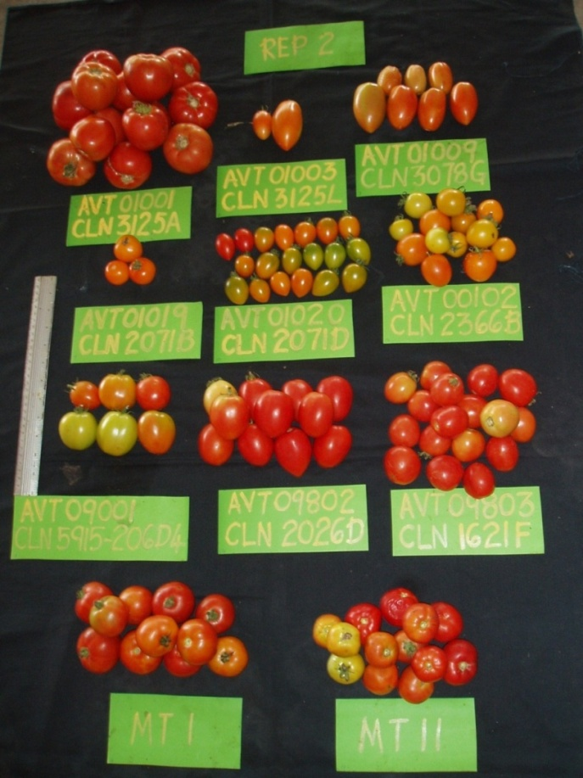
Development of Tomato for lowland cultivation
Projects :
Local tomato, MTI & MTII as base
MTI - resistant to bacterial wilt, fruit of small size, orange red flesh
MTII - tolerant to bacterial wilt, fruit of bigger size, orange red flesh
1
2
3
Heat-tolerant
Bacterial -wilt resistance
High yield
Good color
Long shelf life
Traits aimed:
aarnet meeting 23-25 May 2017

Slide 10
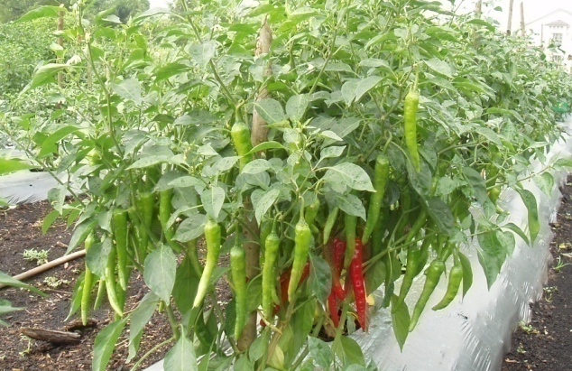
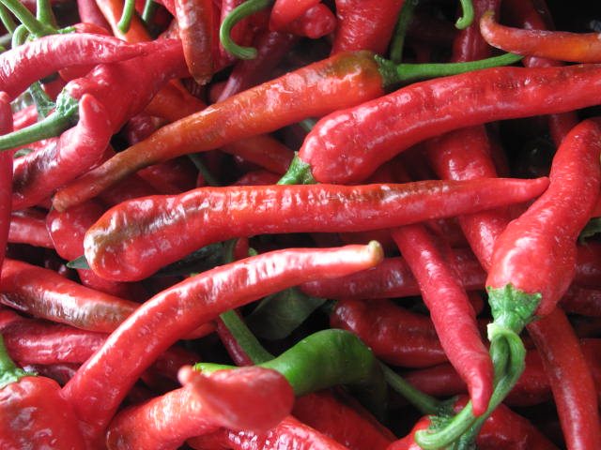
NEW breed:
CILIMARDI L5
Heavy and synchronize fruiting
Fruit saiz: 16.0 -19.0 g
Fruit length: 13.0 – 18.0 cm
Fruit dimeter: 2.0 – 3.0 cm
Yield > 2.0 kg pe plant; ~ 20-30 tonnes/ha
Use as fresh and fresh processing
As fresh processing:
Good natural color
Good color retention for making sos
Capsaicin content perfect for processing
Good flavour
Characteristics:
aarnet meeting 23-25 May 2017

Slide 11
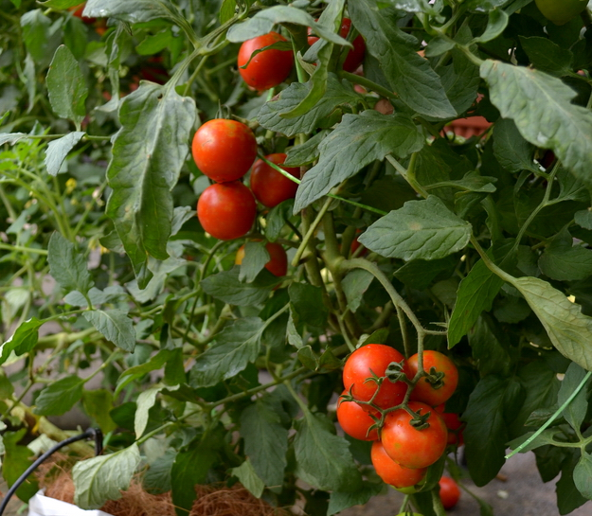
NEW breed:
Tomato line 32 FOR LOW-LAND CULTIVATION
Characteristics:
Yield >1.8 kg/plant
~ yield >25 ton/ha (21,000 plants/ha)
Fruit size 25-30 g/fruit
High tolerance to bacterial wilt
Survival rate > 93%
Long shelf-life
aarnet meeting 23-25 May 2017

Slide 12
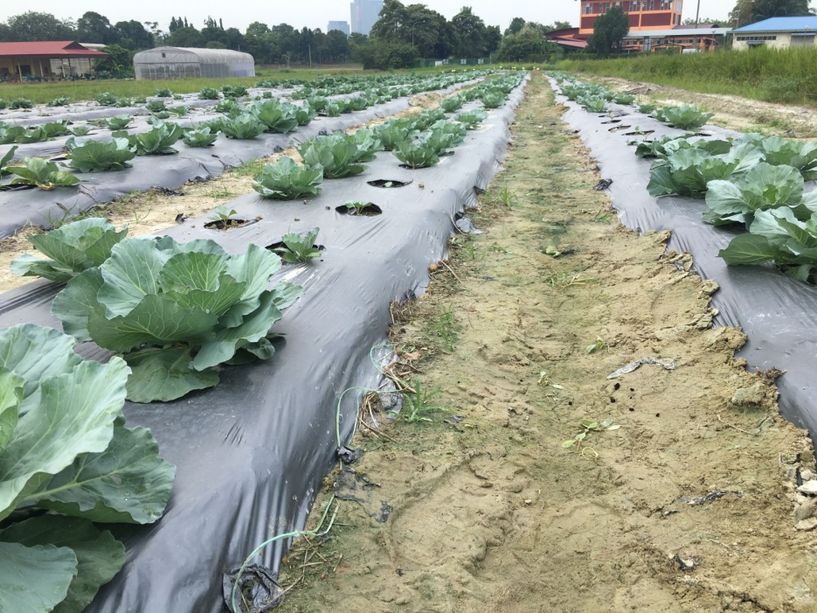
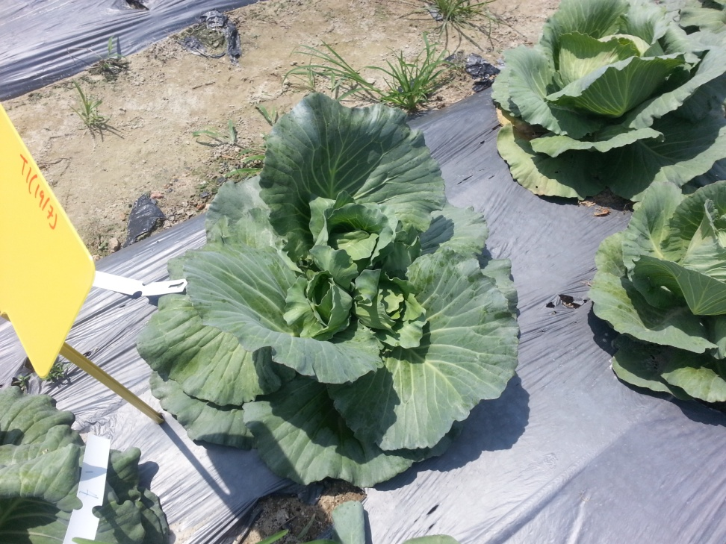
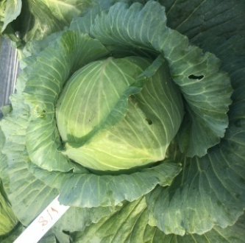
TECHNOLOGY OF LOWLAND CABBAGE CULTIVATION
(Brassica oleracea var. capitata)
Green Cabbage production
Cabbage Sprout production
An open area planting
Harvested 10.5 – 12 weeks after planting
Size of cabbage head:
1.5 kg
19.4 cm head diameter
30 MT/ha (22,220 plants /ha)
Good Agronomic cultural practices
Open field production
Induce sprouts by agronomic practices (topping) and fertilizer application
Sprouts rich in protective chemical defences
Higher premium price
aarnet meeting 23-25 May 2017

Slide 13
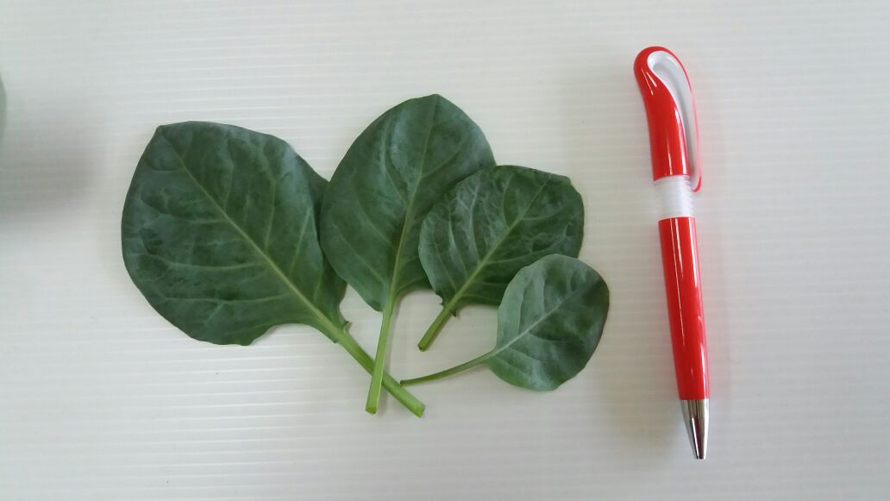
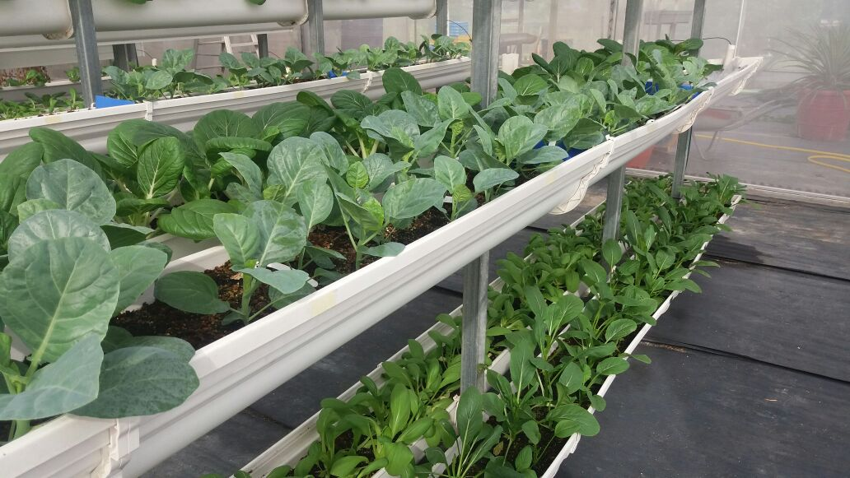
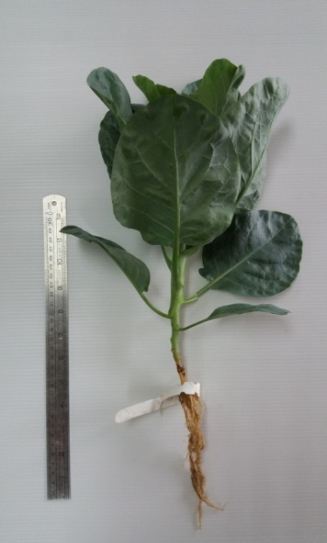
LEAF-HARVESTING TECHNIGUE
Tuaian Daun
Intensive production technique of leafy vegetable for maximum yield
Leaves and tender shoots to be harvested several times
Value added leafy vegetable
Vegetable with premium price
In multi-layer self watering system
Tuaian matang
Tuaian muda
aarnet meeting 23-25 May 2017

Slide 14
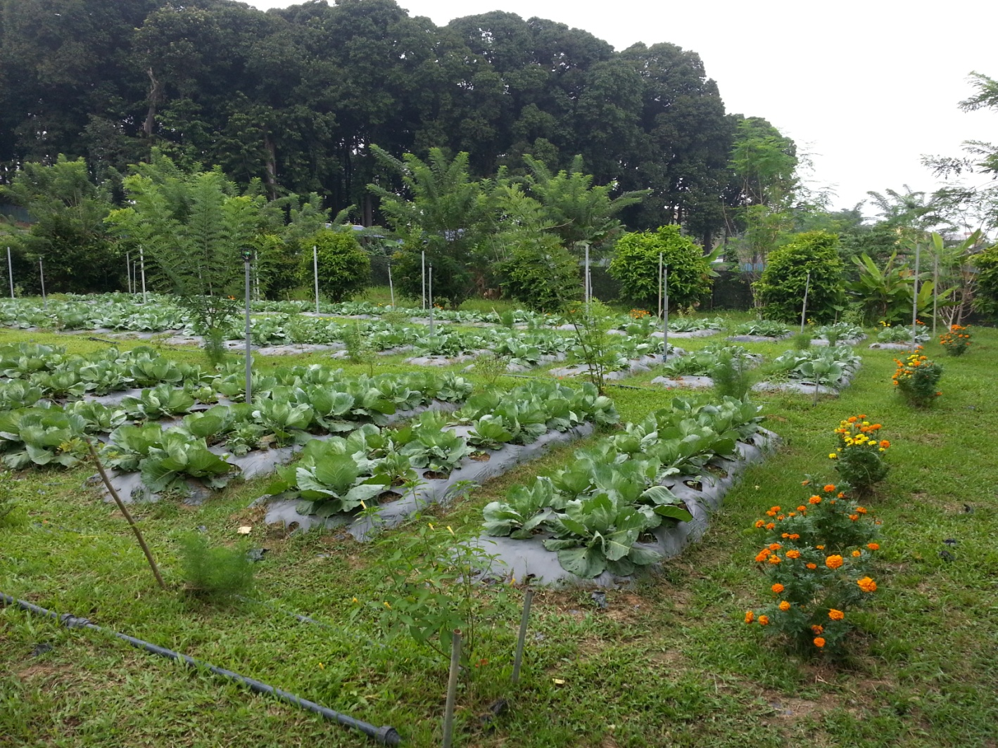
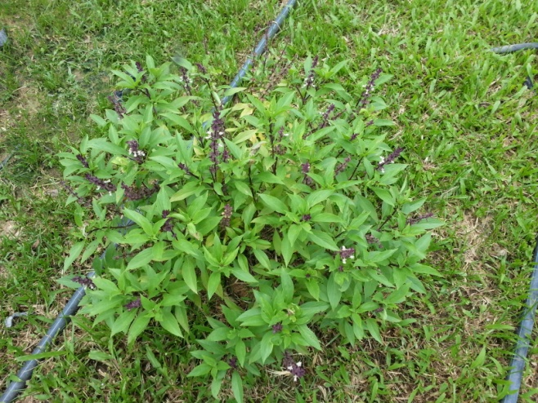
ORGANIC PRODUCTION SYSTEM : CABBAGE FOR LOWLAND
Biological control using bio-pesticides
Eco-engineering approach: Use plants to attract beneficial insects and reduce the infestation of pest
Cabbage head Yield average ≈ 1.3 kg.
aarnet meeting 23-25 May 2017

Slide 15
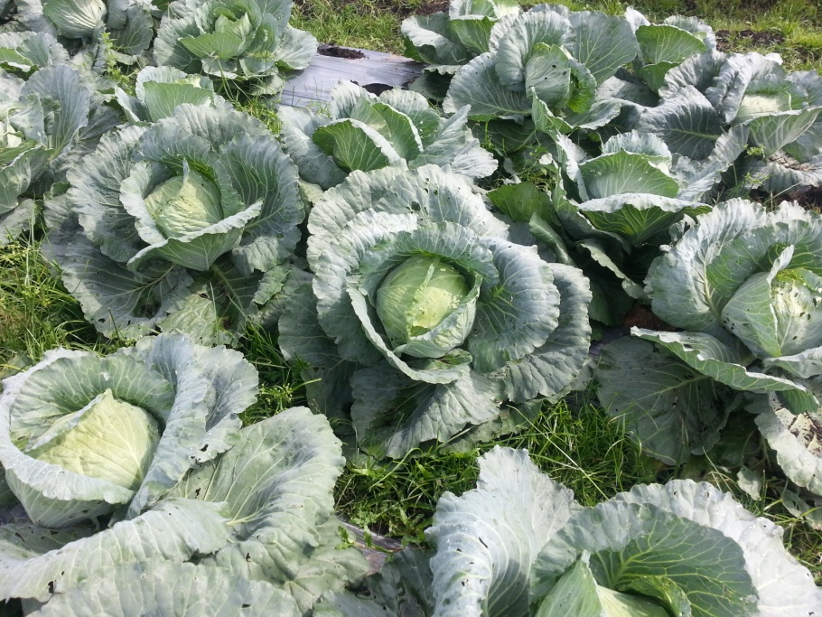
Fertilizer Study
Organo-Mineral fertilizer trial on sandy soil (Bachok)
Organo-Mineral (OM) fertilizer for low-land cabbage on problematic soils – peat and bris.
Yield increased by 17% .
NPK compound-commercial
Organo-Mineral fertilizer
aarnet meeting 23-25 May 2017

Slide 16
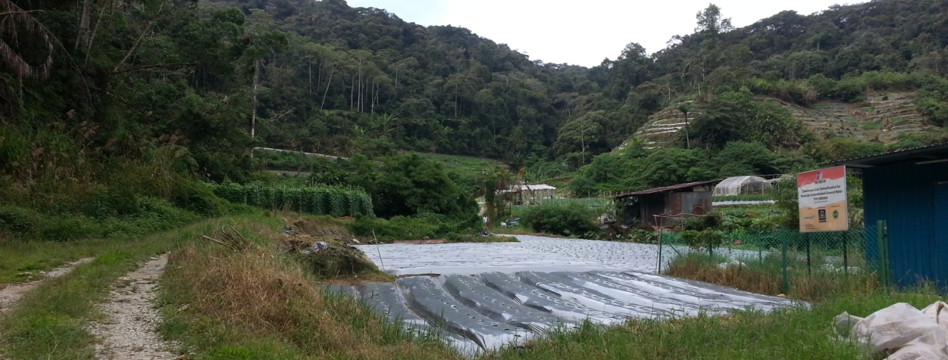
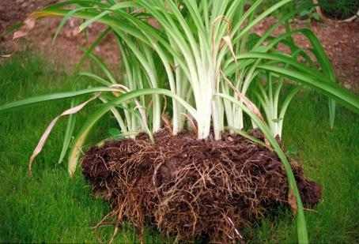
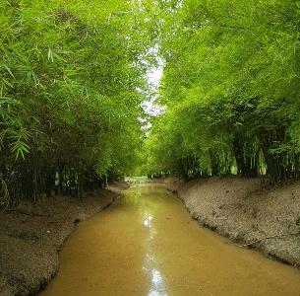
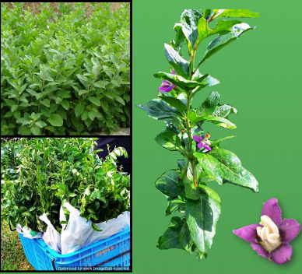
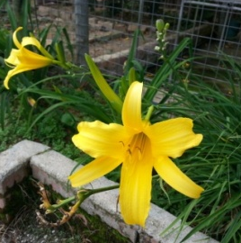
TECHNOLOGY ON SLOPE LAND MANAGEMENT FOR VEGETABLE PLOT – CAMERON HIGHLAND
3 Edible plants identified for slope management
At Lembah Berembun, Cameron Highland
Kimcham (Hemrocallis minor)
Buluh madu
(Gigantochloa albociliata)
Kaukei (Lycium chinense)
aarnet meeting 23-25 May 2017

Slide 17
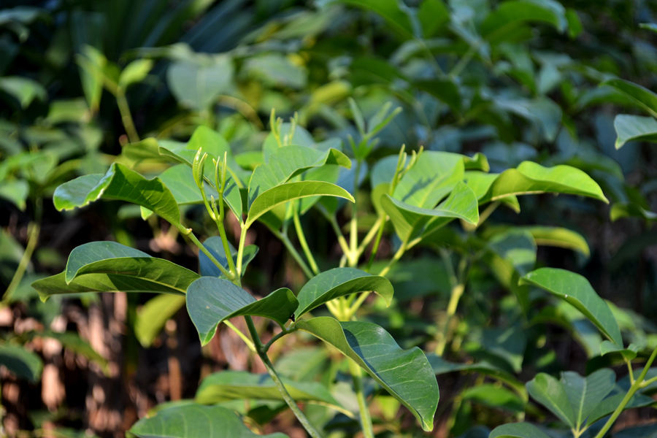
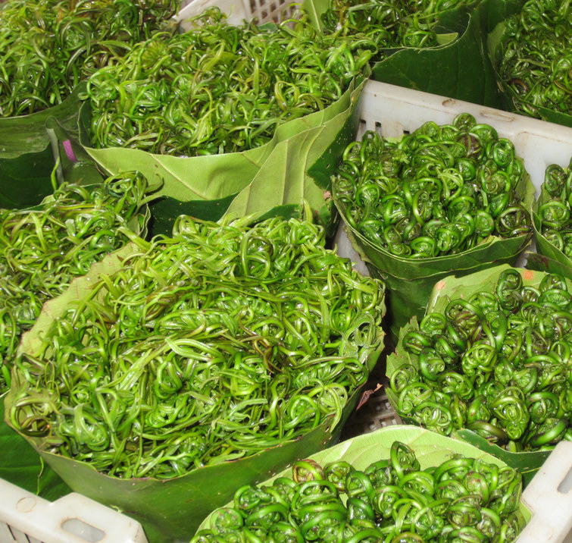
DOMESTICATION OF TRADISIONAL VEGETABLES
aarnet meeting 23-25 May 2017

Slide 18
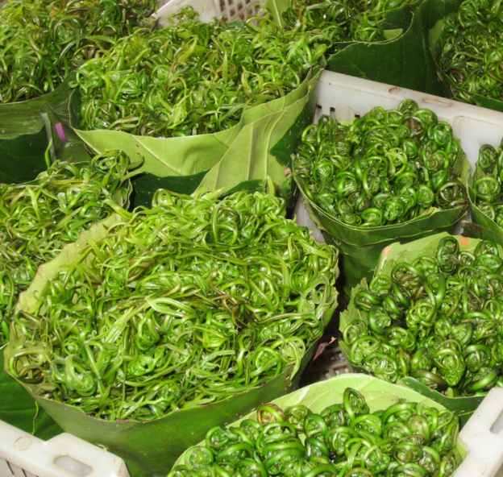
LOCAL TRADISIONAL VEGETABLES
Variety of indigenous spp in Malaysia which are grown naturally can be exploited to be cultivated at commercial scale
Demand increasing as consumer awareness of their importance in diet due to high nutritious value
Grown as a back yard or collected from wild in natural conditions thus the productivity, yield and quality is low
Propagation not efficient and difficult for certain types
Improvement of the cultivation technology for domestication for large scale production
Among the potential spp. :
Stenochlaena palustris (Paku Midin)
Melicope ptelefolia (Tenggek Burung)
aarnet meeting 23-25 May 2017

Slide 19
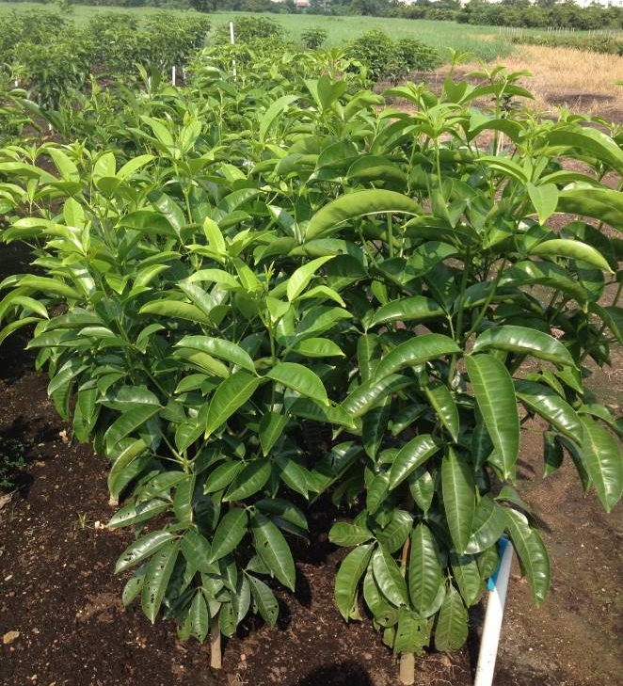
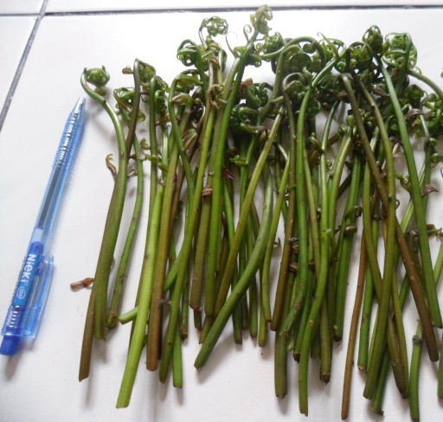
Melicope ptelefolia (Tenggek Burung)
Stenochlaena palustris (Paku Midin)
Has antioxidant and nitric oxide inhibitory activities
Traditionally used to revitalize the body and prevent hypertension
As traditional medicine to relieve fevers and improve complexion
High nutritional contents
Good source of phosphorus & potassium
High anthocynin and phenolics content of the edible young sterile frond
Potential as a functional food
aarnet meeting 23-25 May 2017

Slide 20
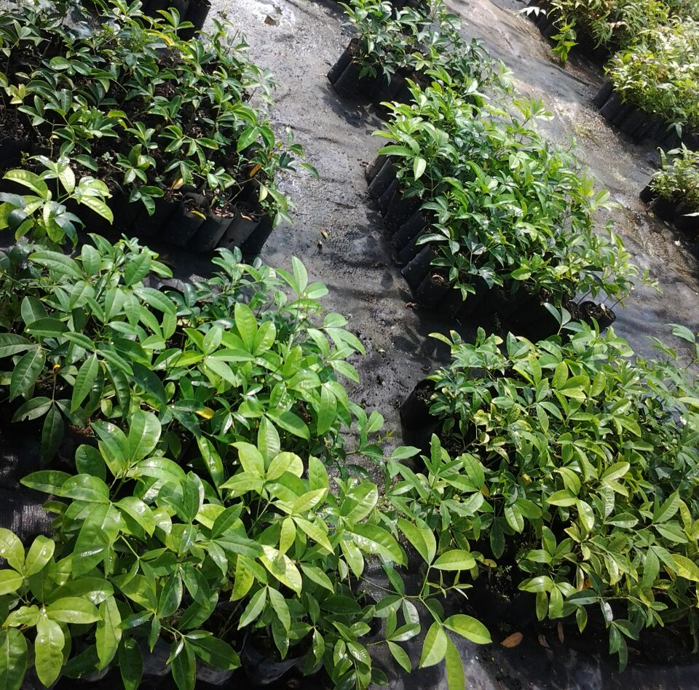
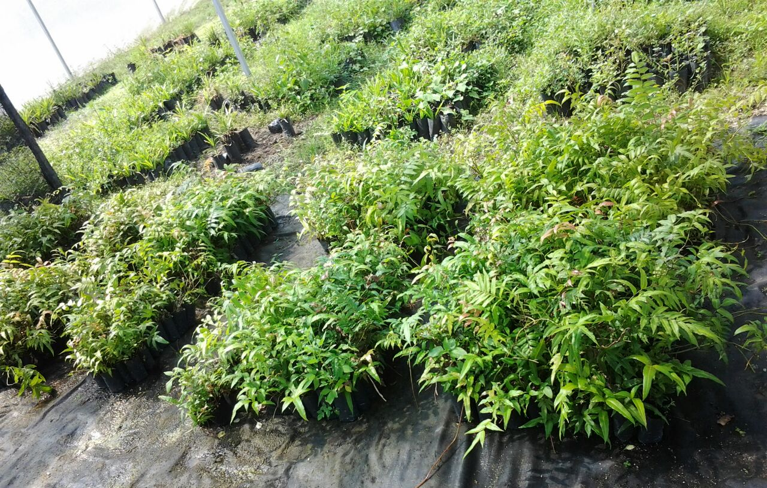
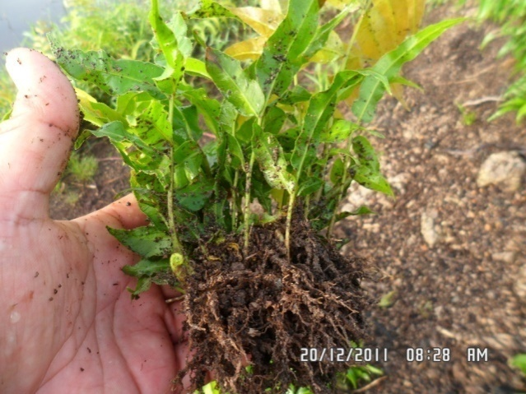
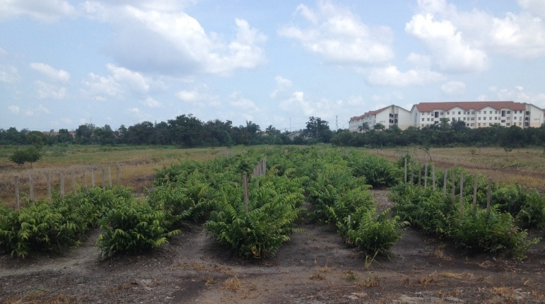
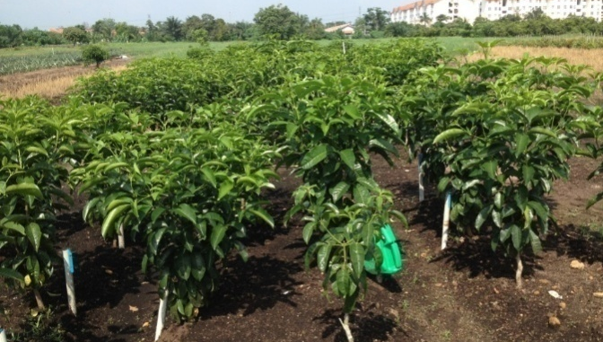
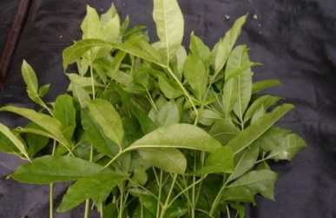
EFFICIEN PRODUCTION SYSTEM FOR MASS MULTIPLICATION OF Stenochlaena palustris & Melicope ptelefolia
aarnet meeting 23-25 May 2017

Slide 21
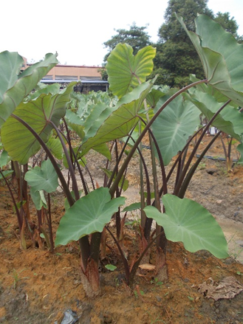
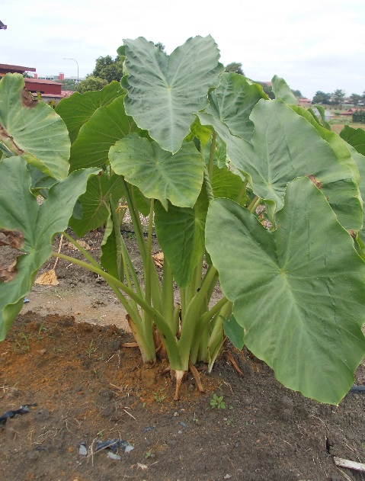
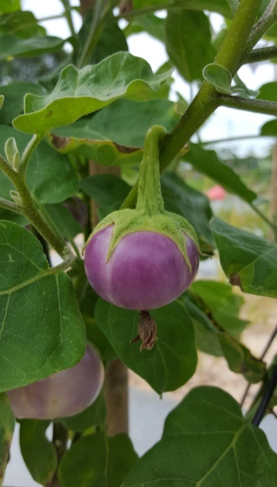
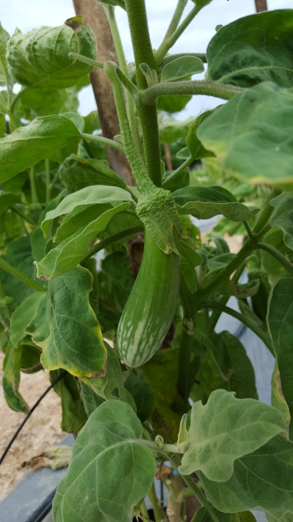
DOMESTICATION OF TRADISIONAL VEGETABLES: Solanum melongena (Terung) & Colocasia esculenta (Keladi)
Terung telunjuk #09
Terung rapuh ungu #77
Keladi Putih
Keladi Wangi
Target for high yield and early maturity
aarnet meeting 23-25 May 2017

Slide 22
POST HARVEST TECHNOLOGY
Melicope ptelefolia (Tenggek burung):
Low-land Cabbage
Optimum temperature | 6 – 8⁰C
Storage | 17 days
Packaging | PP 0.08mm
At ambient (25 C) last for 1 week
At 10 C good quality, last for 3 weeks
At 5 C good quality maintain till week 6
Using shrink wrap
Sweet Bamboo (Rebung madu):
Optimum temperature for storage at 80C can last for 2 weeks.
aarnet meeting 23-25 May 2017

Slide 23
Thank You

