Slide 1
THE 12th AARNET STEERING COMMITTEE MEETING
VEGETABLE PRODUCTION AND STRATEGIES
BRUNEI DARUSSALAM
23-25 MAY 2017
Shanhua, Tainan, Taiwan

Slide 2
DEPARTMENT OF AGRICULTURE AND AGRIFOOD
Ministry of Primary Resources and Tourism
VISION
Towards Improving Productions on Agriculture and Agrifood Based Industries through Increasing Productivity And High Technology Oriented For Export
MISSION
To Accelerate The Growth of Agriculture and Agrifood Based Industry through High-Technology and Export Oriented, Encouraging Progressive Involvement of Local and Foreign Direct Investment, while focusing on High-Yield Production inclusive of Primary and Processing Industry

Slide 3
VEGETABLE INDUSTRY 2016
Total Consumption : 24,745.3 mt
Tropical : 16,924.0 mt
Temperate : 7,821.4 mt
Est. Retail Value (B$) : $65.62 million
Per Capita Consumption : 58.4 kg
Population : 423,561

Slide 4
Local Production 2016
Local Production : 13,952.2 mt
Retail value (B$) : 34.78 million
self-sufficiency : 56.4%
Tropical vegetable : 82.4%
production
No of Farmers : 533 Farmers
Area : 692.9 ha
Average Size of Farms : 2 ha

Slide 5
Importation
Import : 10,793.1 mt
CIF Value (B$) : 15.48 million
Est. Retail Value (B$) : 30.84 million
Percentage Import : 43.6%
Average Retail Price (B$) : 1.18-12.00 /kg
Average CIF Price (B$) Tropical 0.45-8.22 /kg Temperate 0.45-48.19/kg

Slide 6
Challenges
Small Domestic Market
High Cost of Production (cannot compete with lower price of import product)
Low Farm Productivity
Under utilized Awarded Agriculture Development area
Lack of start up capital
Insufficient Infrastructure (Drainage and Irrigation)
Low adaptation of High Tech Farming Technologies
Climate Change
Strategies
Adaptation of modern technology (High Yielding Varieties, High value crops and high tech farming systems)
Sustainable Vegetable production
Encourage foreign direct investor (FDI)

Slide 7
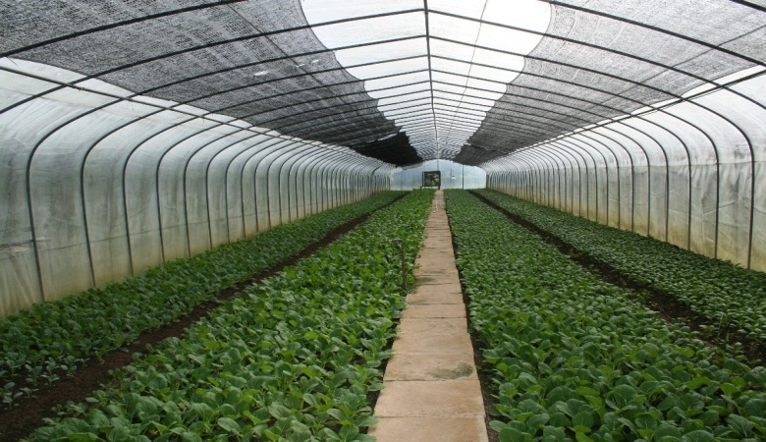
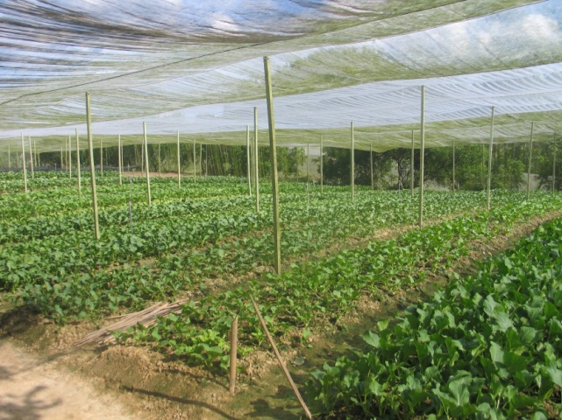
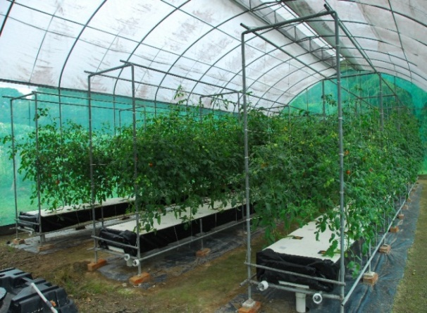
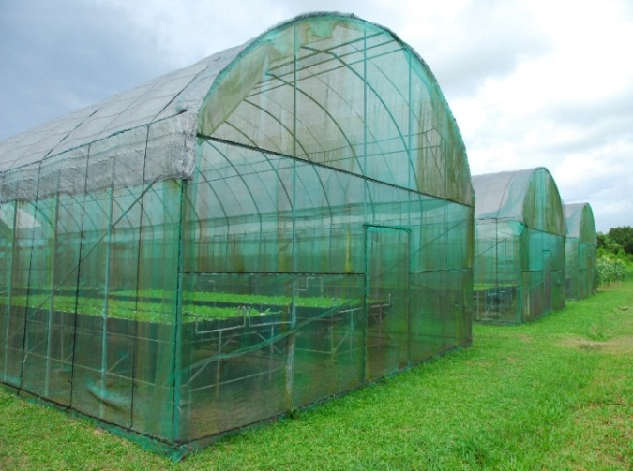
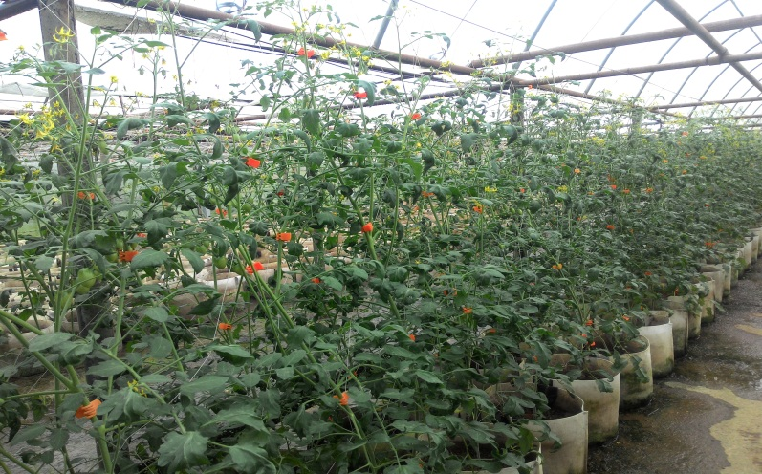
Method of Production

Slide 8
THANK
YOU
TERIMA
KASIH

