Slide 1
THE 12th MEETING OF THE ASEAN TECHNICAL WORKING GROUP ON AGRICULTURAL RESEARCH AND DEVELOPMENT (12th ATWGARD)
17-18 MAY 2017, Siem Reap, Cambodia
COUNTRY REPORT
BRUNEI DARUSSALAM

Slide 2
VISION
Towards Improving Productions on Agriculture and Agrifood Based Industries through Increasing Productivity And High Technology Oriented For Export

Slide 3
MISSION
To Accelerate The Growth of Agriculture and Agrifood Based Industry through High-Technology and Export Oriented, Encouraging Progressive Involvement of Local and Foreign Direct Investment, while focusing on High-Yield Production inclusive of Primary and Processing Industry

Slide 4
RESEARCH AND DEVELOPMENT DIVISION
To develop and transfer innovative technology towards increase in production of farmers, entrepreneurs and other agencies relevant to crop industry
H E A D O F
R E S E A R C H A N D
D E V E L O P M E N T
D I V I S I O N
PADDY RESEARCH UNIT
FRUIT RESEARCH UNIT
VEGETABLES RESEARCH UNIT
PLANT BIOTECHNOLOGY UNIT
CROP PROTECTION UNIT
To conduct and develop research of breeding new paddy varieties (both inbred and hybrid) to support innovative production of rice.
To conduct and develop technologies of fruit breeding technology including physiological, agronomic and post harvest aspects, and transfer of expertise to stakeholders to support diversification of local fruit production for both domestic and export markets.
To conduct and develop technologies of increasing productivity of high-value vegetables with innovative and cost-effective technologies for diversification of local vegetable production for both domestic and export markets.
To conduct and develop innovative tissue culture techniques to increase production of high value crops/mushroom spawns for both domestic and export markets.
To conduct and develop crop protection innovative technologies to provide farmers effective identification and management of pests and diseases of crops with emphasis on Integrated Pest Management to support increase in production of crop commodities.

Slide 5
RICE RESEARCH AND DEVELOPMENT
Development of High Yielding Variety
Status as of Mei 2017
6 new crosses 20 lines of F1 Generation 10 lines of F2 Generation 23 lines of F3 – F6 Generation 10 lines under Advanced Observational Nursery 10 lines under Preliminary Yield Trial
Notes:
Sebanyak 6 jenis kacukan telah dilakukan pada musim utama 2016/2017.
F1 Generation
Sebanyak 20 baka yang telah berhasil dikacukkan dari musim lepas telah ditanam dan akan dituai dengan cara bulk harvest sekurang-kurangnya 10 pokok.
Pemilihan Pukal Generasi F₂ – Segregating Population
Sebanyak 10 baka telah ditanam dan pokok akan dipilih dengan cara bulk harvest-1 hill
Pemilihan “ear row” F₃ ke F₆
Sebanyak 221 pokok telah dipilih daripada kombinasi 23 jenis kacukan padi dan telah ditanam pada musim utama 2016/2017. Pada masa ini padi dalam peringkat masak dan pemilihan baka akan dilakukan apabila padi hampir masak.
Kajian Pemilihan baka yang berpotensi untuk ke peringkat percubaan hasil
Sebanyak 10 baka telah ditanam di Greenhouse bagi kajian pemerhatian dari segi hasil dan ketahanan terhadap penyakit dan musuh serangga. Pada masani padi dalam peringkat masak dan pemilihan baka dan pengambilan sampel untuk peringkat percubaan hasil akan dilakukan.
Kajian Percubaan Hasil
Sebanyak 10 baka telah ditanam di ladang penyelidikan padi, Wasan bagi kajian hasil. Pada masa ini padi dalam peringkat masak.

Slide 6
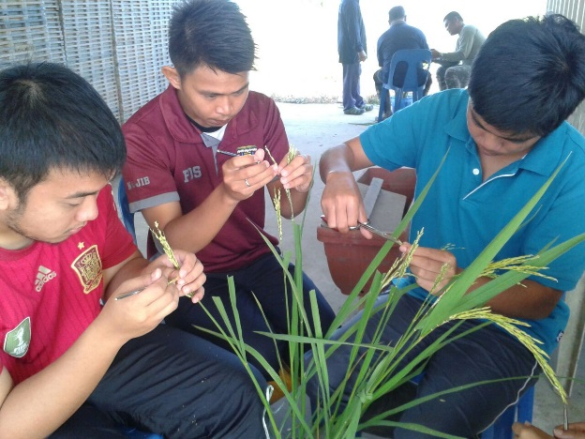
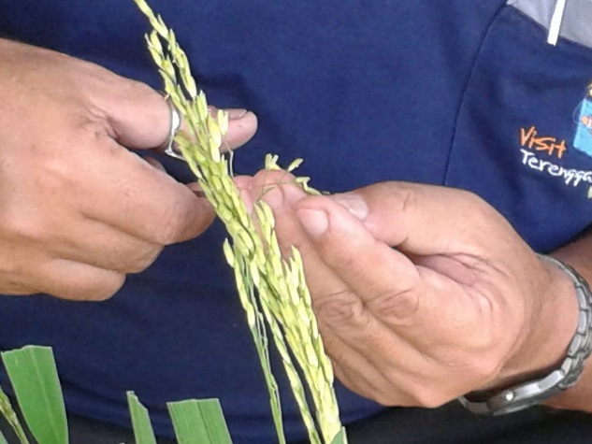
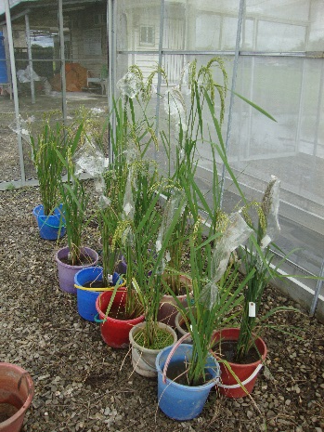
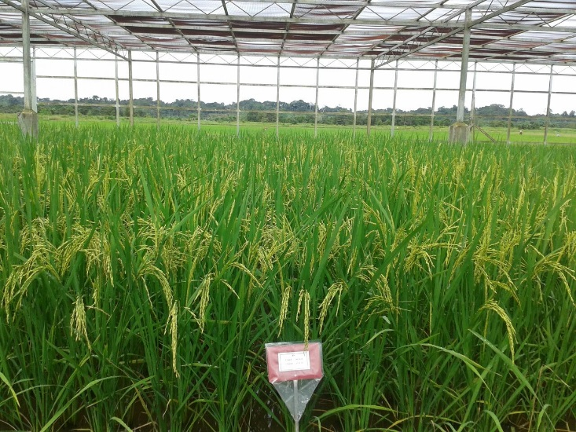
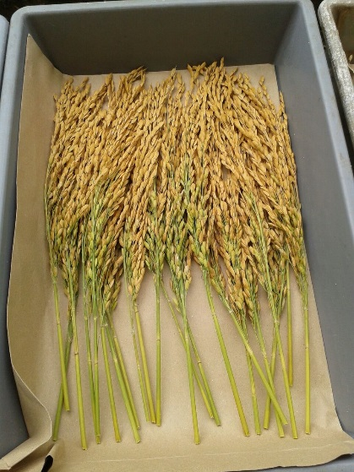
RICE RESEARCH AND DEVELOPMENT
Development of High Yielding Variety

Slide 7
RICE RESEARCH AND DEVELOPMENT
Evaluation of potential varieties / Multi location trial
Activity | Type of varieties | No. of varieties | Area
Multi-location Trial | Inbred | 3 | Brunei Muara, Belait and Temburong
Varietal Trial | Hybrid varieties from Pt. Biogene Indonesia | 3 | Brunei Muara
 | Hybrid varieties from Yuan Longping High-Tech Agriculture Co. Ltd | 6 | Brunei Muara (Wasan and Batong)

Slide 8
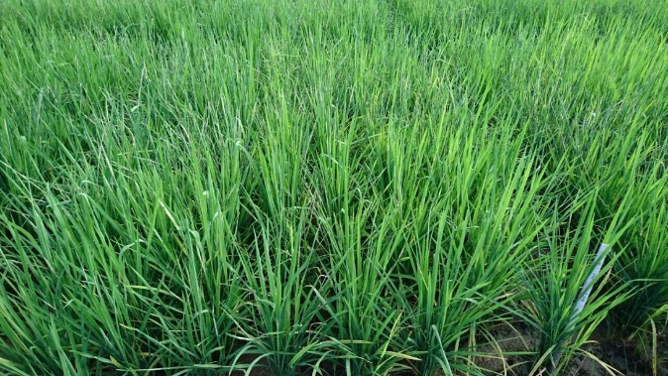
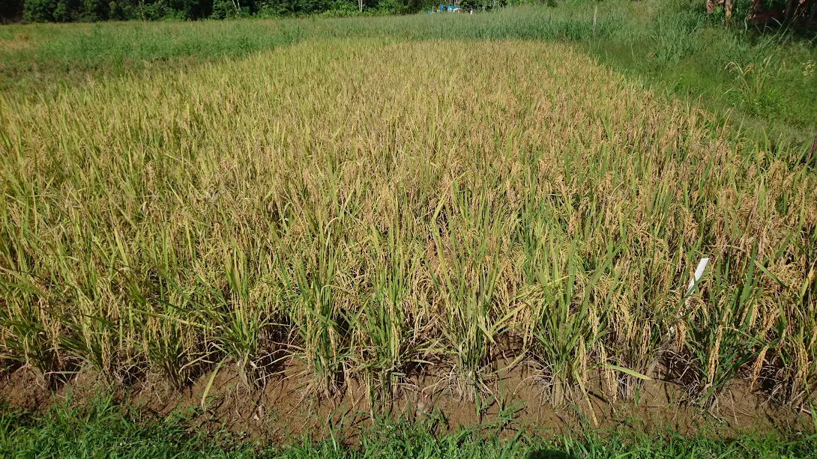
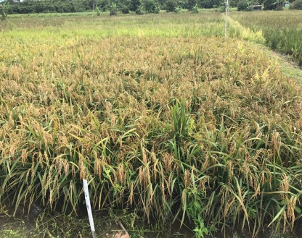
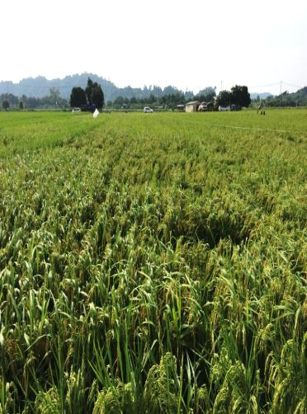
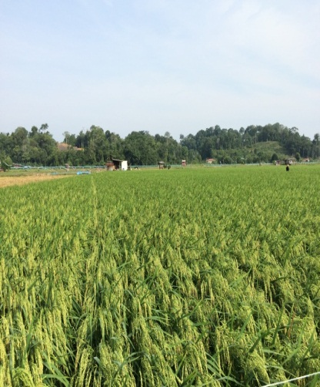
RICE RESEARCH AND DEVELOPMENT
Evaluation of potential varieties / Multi location trial

Slide 9
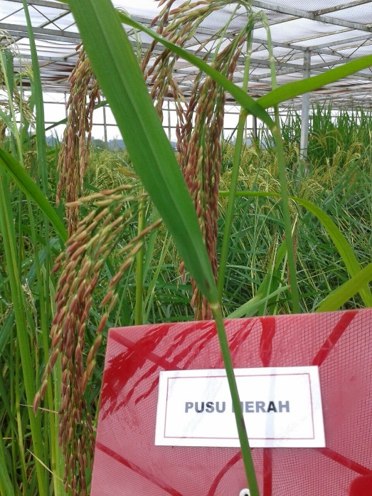
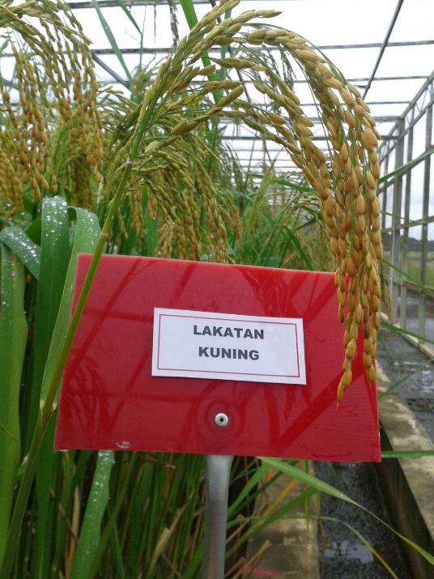
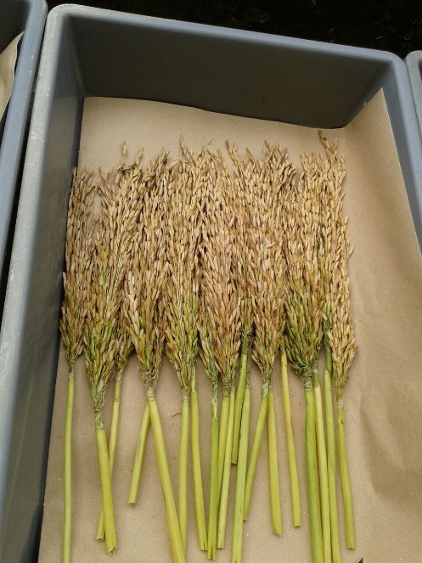
RICE RESEARCH AND DEVELOPMENT
Germplasm Collection
44 Local Varieties

Slide 10
RICE RESEARCH AND DEVELOPMENT
Seed Production Program

Slide 11
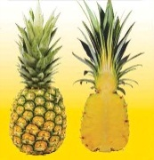
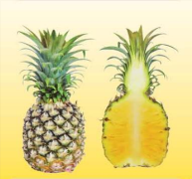
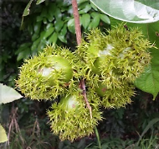
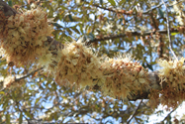
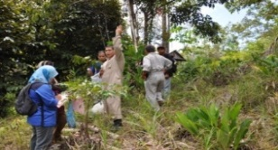
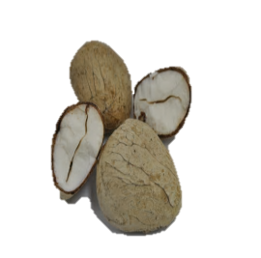
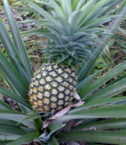
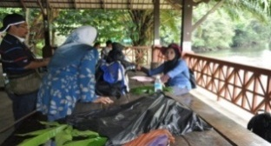
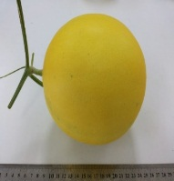
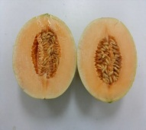
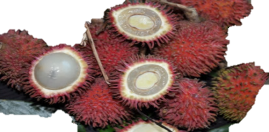
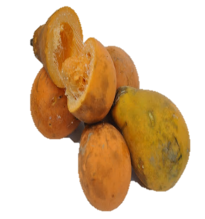
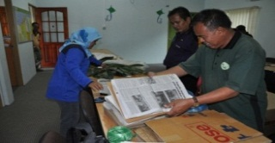
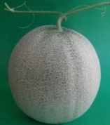
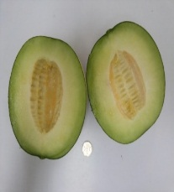
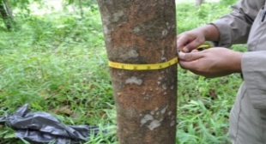
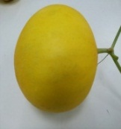
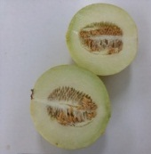
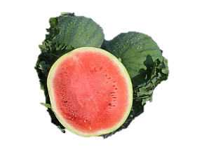
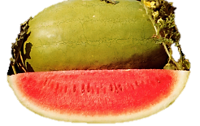
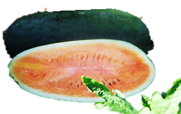
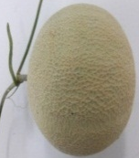
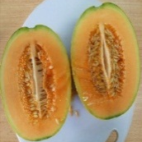
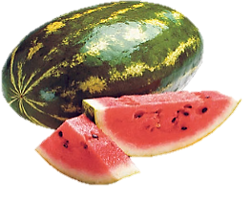
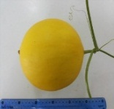
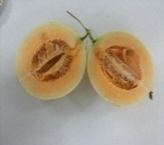
RESEARCH ON FRUIT
Germplasm Collection Indigenious Fruit and Development of Indigenious Fruit Information System Datasbase (IFIS) (http://www.ifis.gov.bn)
Varietal Trial on
Phenology Trial
on Local Durian
Pineapples
(10 Varieties)
Melon
(6 Varieties)
(Fertigation System Under Protected Cultivation)
Watermelon
(5 Varieties)
As of 2016, the total of local fruits’ families collected are as follows:
Perdayan Station Arboretum, Temburong:
- Total family: 19
-Total species collected: 70
- Total plant:1969
Herbarium collection:
- Total family: 30
- Total species collected: 135
Birau Agriculture Research Station Arboretum:
- Total family: 17
- Total species collected: 67
- Total plant : 2466
Timeline from Flowering To Maturity (123-166days)

Slide 12
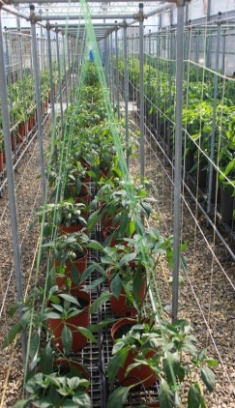
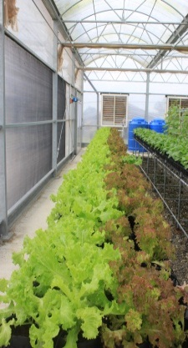
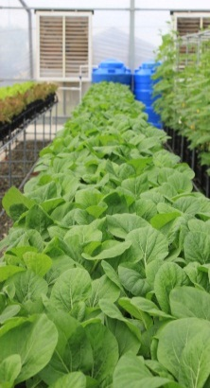
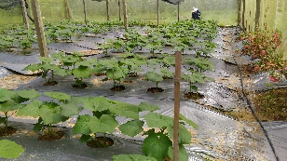
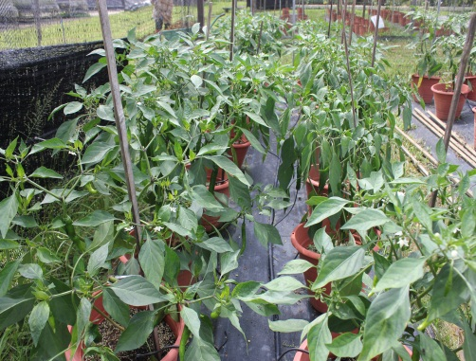
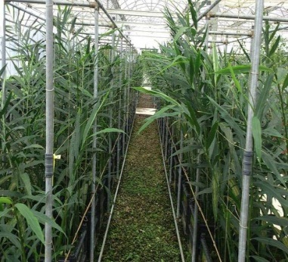
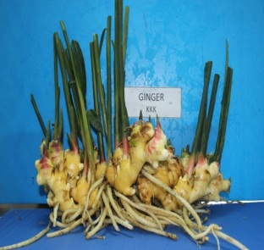
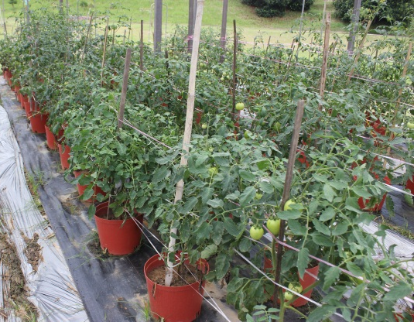
RESEARCH ON VEGETABLES AND FIELD CROP
To Evaluate and Introduce Promising Varieties To Local Farmers
Varietal Trial Using Open Fertigation System
Varietal Using Fertigation system Under Protected House With Cooling Pad.
Varietal Trial on Okra Under Netted Structure
Chilli
Lettuce
Pak Choy
Chilli
Cultivation of Varieties of Sweet Potatoes, Ipomoea batatas L. Under Protected House (Netted Structure)
Observation Trial on Ginger, Zingiber officinale.
Yield Per Plant: 1.74Kg
Yield Per m² : 7Kg (4 plants)
Day of Harvesting : 258 days
Tomato

Slide 13
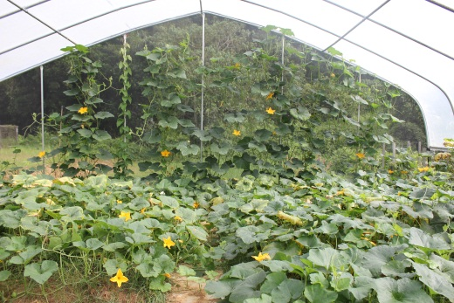
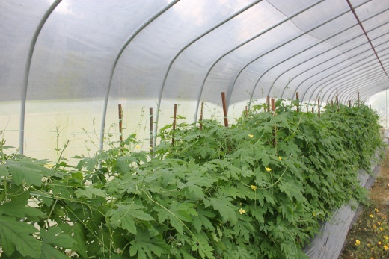
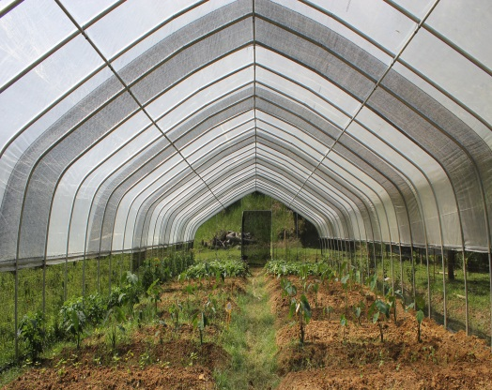
RESEARCH ON VEGETABLES AND FIELD CROP
Observation Trial On Performance and Growth of Crops Under Polytunnel
Pumpkin
Bitter Gourd
Taro
Asparagus
Sweet Potato

Slide 14
RESEARCH ON CROP PROTECTION
Mass-rearing of lady beetle
Snail extract fertilizer
Objective : To study the possibility of the mass-rearing of lady beetle as biological control.
Objective : To study the effectiveness of snail extract as fertilizer of paddy.
Joint research study between Crop Protection Unit and Soil Science Unit.
Snail shells separated from meat
Insect cages where mass-rearing is attempted
Process of fermenting snail meat using brown sugar
Extracts of snail meat and snail shell
Larva lady beetle feeding on aphid
Collection of lady beetle eggs
Notes:
Current Situation for Mass-Rearing of Lady Beetle
Limitation of food resource (not enough man-labour to do the task of collecting insects for Bettle’s food) ; switched to culture aphids by growing long beans without insect control the attempt was successful at the start but over time, as the population of aphids grow, the population of natural enemies of the aphids increased as well – we ended up with depressed source of food for the beetle. To overcome this, we tried to grow aphids on long beans in caged environment with the objective of letting the aphids grow without the intrusion of natural enemies, however, the long beans were not as healthy as we would like them to be and even the good ones were not able to accommodate aphids as much as the ones we planted in open environment.
Unsuitable lady beetle of choice -started the experiment with paddy biocontrol in mind. However, after witnessing very active feeding behaviour from a different species of lady beetle (one of the natural enemies that was feeding on aphids of long beans), we thought that perhaps we should have studied the more vigorous lady beetle instead. Near the end of the experiment, we did notice that the lady beetle population inside our ‘insect cage’ was dominated by the vigorous species, both in population and food competition.
Inexperience in hands-on technical aspect; therefore seeking training for mass-rearing project
Current Situation for Snail Extract Fertilizer
- Currently ongoing potted paddy experiment comparing effectiveness of using snail extract as fertilizer with conventional fertilizers

Slide 15
RESEARCH ON CROP PROTECTION
Citrus Rehabilitation
Objective : To conduct research works on the effectiveness of heat therapy (by using tent) in the control and management of Citrus Greening Disease in citrus plants (Variety:Limau Manis)
Side-lobed fruits from infected tree
Assembling the Citrus Heat Therapy Tent
Citrus Heat Therapy Tent left for at least 48 hours in the field
Treated citrus tree at fruiting stage; 6 Months after treatment
Notes:
The observation and maintenance of the treated trees are still on going (almost 6 months after treatment and at early fruiting stage at the moment) so as to conclude the effect of the treatment on the fruit quality and yield, although the method did not completely eliminate the inoculum, the heat may have at least reduced the bacteria and thus the symptoms may also be alleviated.

Slide 16
RESEARCH ON CROP PROTECTION
Blast Screening for paddy varieties for breeding activities
Objective: To screen and assess the resistance (against Blast disease) of various paddy varieties produced from breeding activities by Paddy Research Unit.
Inoculum plants surrounding in the research plot
Various padi varieties being screened for resistance against Blast
Notes:
The result of the trials was not conclusive due to various environmental factors in the field or research plots which affected the quality of the results. Result on the negative control or susceptible lines was inconsistent.
- Currently the field has been prepared to start another round of Blast Screening activities,to be assessed end of May 2017, the varieties to be tested are as follows: Bario/NSIC RC-156, PR 36732-B-81-4-3 /LAILA, NSIC RC-160, LAILA/ HS 8011, Tadukan (Positive Control/ Resistant Line) and Laila (Negative Control/ Susceptible Line)

Slide 17
RESEARCH ON BIOTECHNOLOGY
Citrus Shoot-tip Grafting
This project is in collaboration with Crop Protection Unit for the Citrus Rehabilitation Project.
Grafted Citrus Seedling
Citrus Shoot Tip
Citrus Rootstock
Micrografted Seedling
Under Microscope
Acclimatization of Micrografted Seedling
The research was first initiated in August 2015.
Three unsuccessful trials have been conducted in this research. Major constraints are getting suitable seeds for rootstocks tissue culture, high contamination rate and micrografting techniques. Seeds used are from Citrus citrange and Poncirus trifoliata imported from Australia. However, potential rootstocks have been identified that can be easily acquired locally i.e. Limau Kasturi Citrofortunella microcarpa and Citrus reshni.
Micrografting survival was 0% for all three trials.
Current status:
Limau Kasturi Citrofortunella microcarpa seeds acquired from BARC Herbal Garden are used as part of micrografting familiarization technique. Micrografting were carried on 111 seedlings however only 10 seedlings (9%) are successfully grafted and are now under observation in the Nursery.

Slide 18
RESEARCH ON BIOTECHNOLOGY
Orchid Hybrid
This project is in collaboration with Floriculture Unit in Rimba. Seeds produced from orchid crosses between local species & commercials ones are submitted to Tissue Culture Laboratory for germination in-vitro.
Immature Orchid Seedpod
Protocorm_Stage 1
Protcorm_Stage 2
Plantlets developing from Protocorms
True Orchid Plantlets
Current status:
Project still on –going. Plantlets derived from tissue culture are transferred to Nursery in Rimba for further physical observation.
Rooting Stage (6 months before Acclimatization process in the Nursery)

Slide 19
THANK
YOU
TERIMA
KASIH

